Slide 2
You and Your SECONDARY Students Can S.C.O.R.R.E!
Lindsay Williams
Professional Development Coordinator
K20 Center
Notes:
In this interactive, collaborative session, participants will explore and experience student-centered instructional strategies appropriate across PK-5 Elementary grade levels and content areas. These strategies are a vehicle to increase student-centered learning opportunities to increase rigor, relevance, and student engagement.

Slide 3
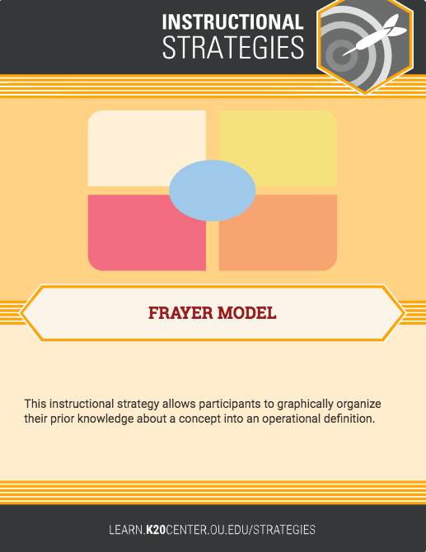
What do you already know about...
Student-Centered Learning
Rigor
Relevance
Engagement
Using the Frayer Model template, fill in the 4 sections (definition, characteristics, example, non-example) for the word in the center…
Notes:
Example from your class or something you’ve seen done that represents this.
How does a frayer model work in the grade levels that can’t write/spell well? Modify it and use it with numbers, the word wall, or encourage inventive spelling.

Slide 4
Objectives
Today we will...
Reflect, identify, and explain how instructional strategies can be used to promote and increase student-centered opportunities for rigor, relevance, and engagement.
Notes:
Today is all about increasing opportunities for student-centered teaching and learning, rigor, relevance, and engagement.

Slide 5
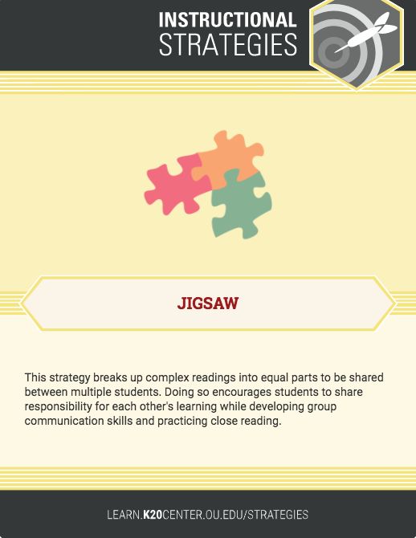
Categorical Highlighting
Using your component as a focus, read the research and highlight/circle verbs and student outcomes that identify your component.
Notes:
Make sure they know the reading is NOT going to explicitly say Rigor happens when... Relevance is… Engagement looks like… or Student-Centered is… The four elements are embedded throughout the reading. However, rigor is not surface level and it is not how much you have to teach that year, how many standards, or how many problems/questions you assign for homework. Rigor is learning concepts/topics deep, applying knowledge to contexts outside the classroom instruction/lesson, critically thinking, communicating, and constructing problems/questions/situations that use new knowledge.

Slide 6
What does research say about...
Student-Centered Learning
Rigor
Relevance
Engagement
Using the same Frayer Model template AND a different color pen, add evidence from the reading to each section (definition, characteristics, example, non-example)
Notes:
Characteristics should use verbs
Examples should include student outcomes
How does a frayer model work in the grade levels that can’t write/spell well? Modify it and use it with numbers, the word wall, or encourage inventive spelling.

Slide 7
Pair, Share, and Summarize!
(like colors only)
Write a summary statement about your element on the lines in the center circle.

Slide 8
Share Summary Statements
Notes:
**share first with table and then a few out with the whole group
Share out the summary statements you wrote on your frayer model. What does research tell us about SCORRE?

Slide 9
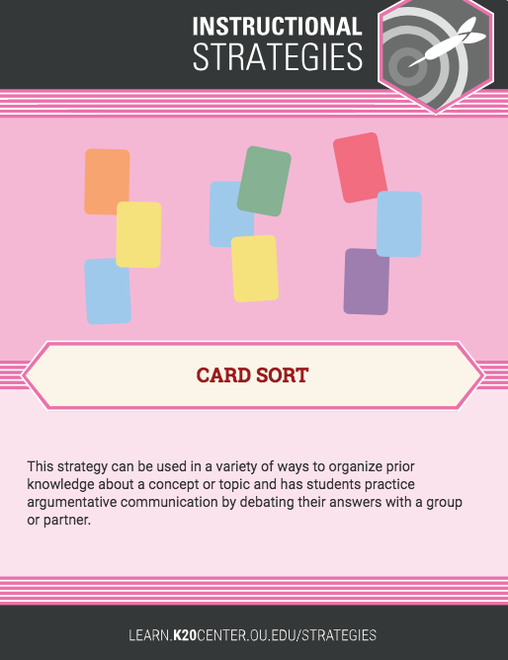
Card Sort
Pair Up!
In pairs, sort the card strips into the 4 elements:
  student-centered, rigorous, relevant, and engaging.
Be ready to justify why you sorted the way you did.
Mix Up!
Find someone with a
different color Frayer Model.
Notes:
Pairs and sort cards next slide will pair the pairs and then share out what you noticed

Slide 10
Pair the Pairs!
Work with another pair and justify card placement.
Notes:
IF POSSIBLE: Pairs should create groups of four that all have different frayer model colors.
Distribute Reflection Tool as a possible “answer” key

Slide 11
Triangle-Square-Circle
learn.k20center.ou.edu/strategies
Strategy
With your mixed color group, find 3 K20 LEARN strategies that you could use in your classroom to support S.C.O.R.R.E.
Use the 3 points
to record your 3 strategies.
Strategy
Strategy

Slide 12
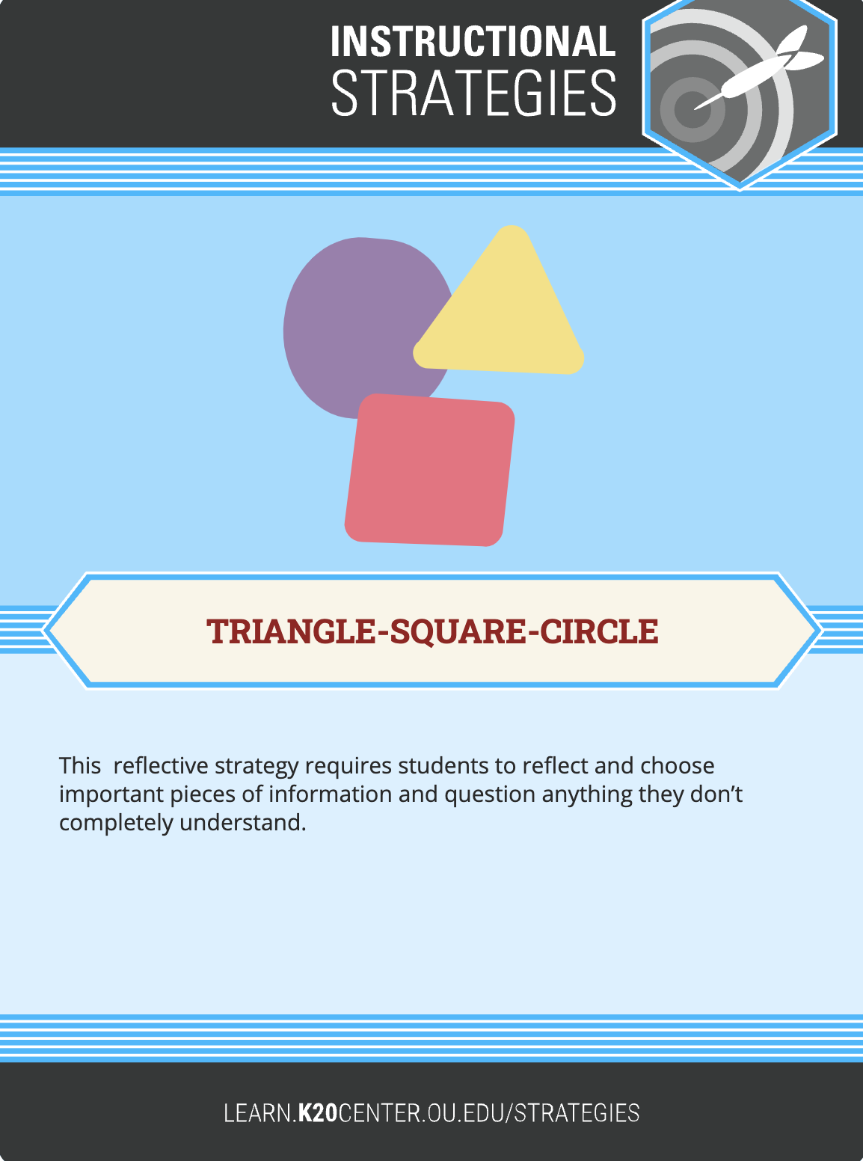
Triangle-Square-Circle
Write something that squared with your thinking inside the square.

Slide 13
Triangle-Square-Circle
Write something
you’re still considering inside the circle
(my brain is still circling…)

Slide 14

Follow us on social media

