Slide 1
Notes:
4 colors card stock

Slide 2
It’s Not the App.
It’s the Experience!
Creating Meaningful Learning Experiences with iPads

Slide 3
Essential Question
How can I create learning experiences for my students using the iPad?

Slide 4


Slide 5
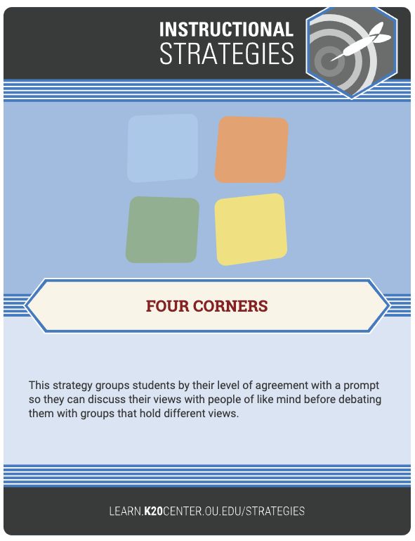
Four Corners with the “Four Cs”
Collaboration
Communication
Creativity
Critical Thinking
  Curation
Source: The National Education Association (n.d.). Preparing 21st Century Students for a Global Society: An Educator’s Guide to the “Four Cs.” National Education Association. Retrieved from http://www.nea.org/assets/docs/A-Guide-to-Four-Cs.pdf
Notes:
Presenter’s Note: For this activity, have participants ...
The National Education Association (n.d.). Preparing 21st Century Students for a Global Society: An Educator’s Guide to the “Four Cs.” National Education Association. Retrieved from http://www.nea.org/assets/docs/A-Guide-to-Four-Cs.pdf

Slide 6
Objectives
Identify a component of the Four Cs to actively promote in your classroom.
Apply your understanding of iPads and the available tools to create a learning experience for the classroom.

Slide 7


Slide 8
App Ideas
Collaboration | Communication | Creativity | Critical Thinking | Curation*
Flipgrid Google Docs Padlet Quizlet | Seesaw Synth Educreations Mentimeter | Adobe Spark Buncee Clips Kahoot! Canva | Code.org Tags by Breakout EDU iMovie | Wakelet

Slide 9

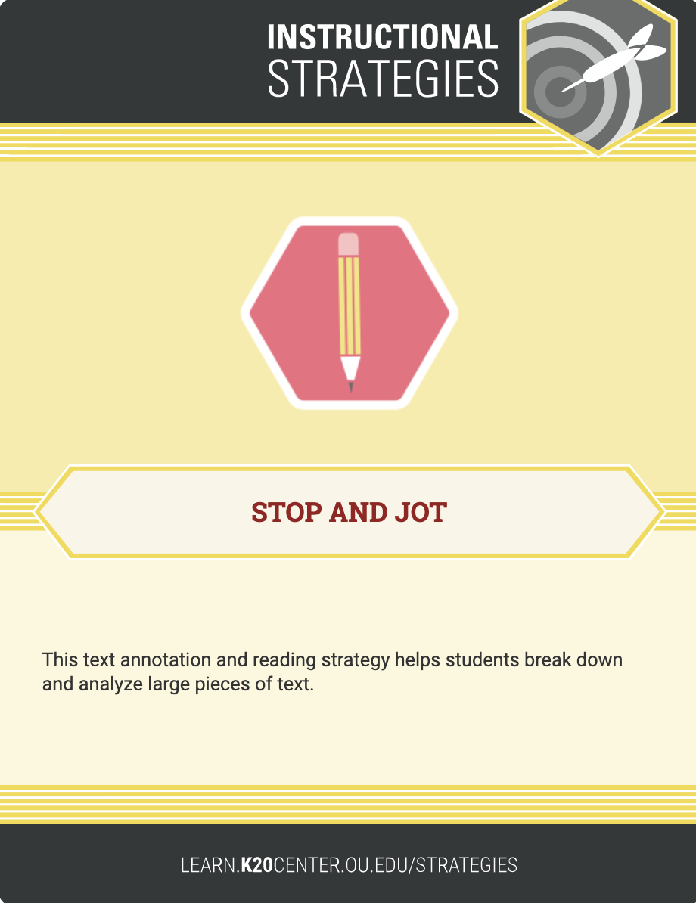
Stop and Jot
As you research apps, make a few notes on this Google Doc.
Notes:
Coogle Coc forced copy

Slide 10


Slide 11
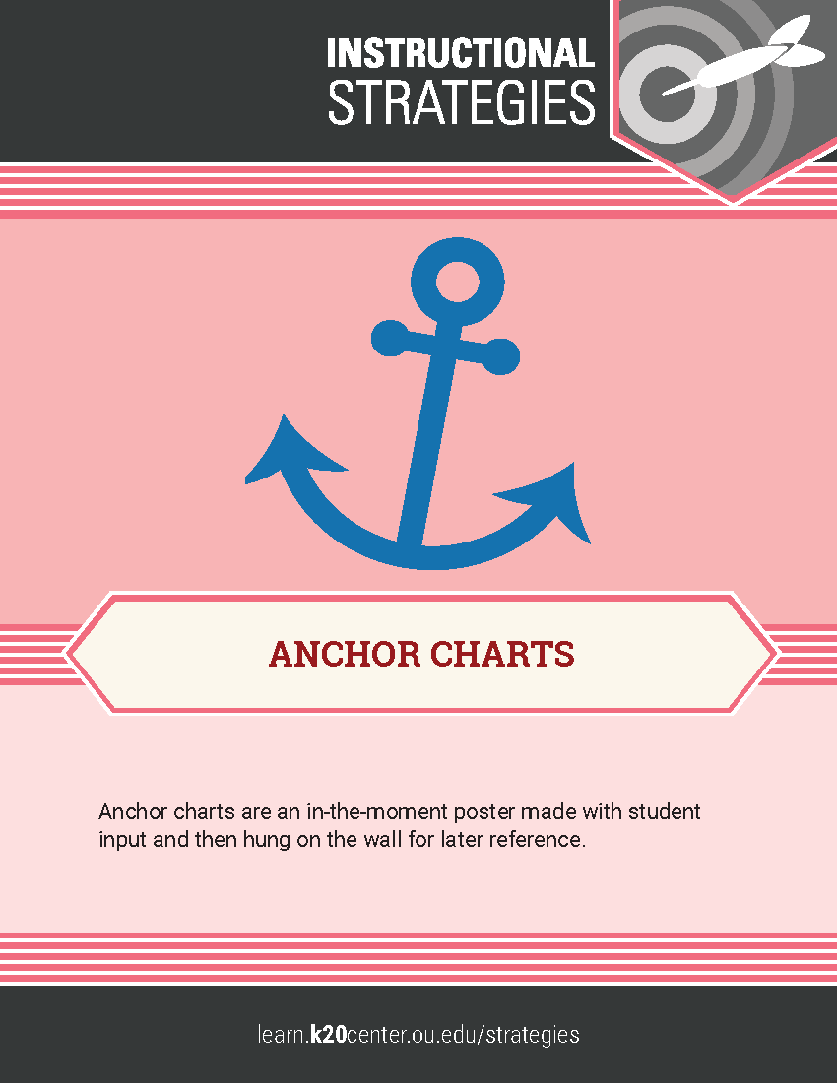
Constructing the Four Cs: Anchor Chart
With your partner, discuss your notes in the “How would this app address my Four C focus area?” column. What themes do you have in common?
Construct a list of characteristics that make an app useful for that C. Post the list to the 4C chart in Canva.
Does everyone agree with their assessments?

Slide 12


Slide 13

Task Card Work Time
Complete the Task Card by creating an activity to use in your classroom.
This 5E Lesson Organizer might help you.
Notes:
Task Card - This link will force participants to create their own copies.

Slide 14


Slide 15
Share & Reflect
Go to Flipgrid and answer the prompt.
Go to the shared spreadsheet of activities created by your teammates. Bookmark this sheet!
Review 2–3 activities. Think about how you might use the same ideas or topics.
Go back to Flipgrid and respond to 2–3 videos from your teammates.

Slide 16
Objectives Revisited
Identify a component of the Four Cs to actively promote in your classroom.
Apply your understanding of iPads and the available tools to create a learning experience for the classroom.

Slide 17
Strategies/Tools Revisited
Anchor Charts
Mentimeter
Four Corners
Stop and Jot
Canva
Task Card
Share/Reflect

Slide 18
Feedback
{insert Rapid Feedback QR code}

