Slide 2
Interactive Technology in Math and Science

Slide 3
Session Goals
Apply research-based practices to support the use of simulations and models in curriculum.
Explore the effects of interactive technology on student learning.
Notes:
(5 min) goals and objectives
Context
Some teachers see simulations and models as difficult or frivolous to incorporate into instruction, but there is a legitimate research supporting simulations as effective instructional tools in science. Likewise, they can be integrated fairly easily into lessons without significant extra planning on the part of the teacher.

Slide 4
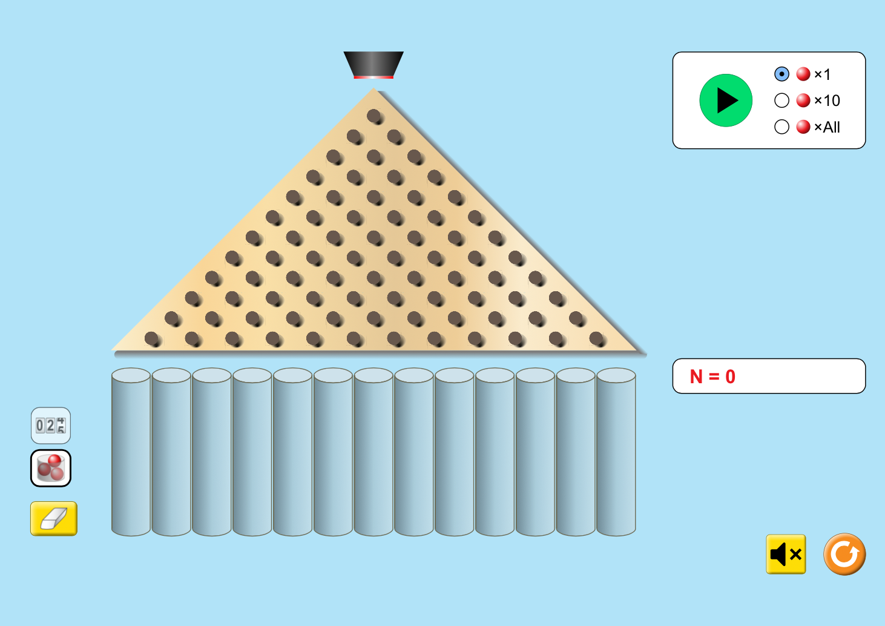
Interact With a Simulation
PhET Interactive Simulations - Plinko Probability
Visit:
bit.ly/plinkoprob
Notes:
Task:
Direct participants to simulation using the bit.ly.
Start with intro portion, have participants predict which bin they think one ball will land. Maybe even ask why.
Let one ball fall through. Talk through who was right/wrong and where they think ten balls will land mostly.
Let ten balls fall. Talk it through.
Switch to Lab mode. Have a participant (or two or three) to come up and select the options for the following challenges:
Have the most balls fall in the exact center bin (bonus for all the balls to fall in the same bin only!)
Have every ball fall on the right side bins only
Have every ball fall on the left side bins only
Run a trial as close to the ‘ideal’ as possible
After this, ask participants:
What variables did you consider when trying to achieve the challenge tasks?
Did running more trials help or harm your ability to make predictions?
From the perspective of a teacher, how successful would this activity be in your classroom?
*Pass out probability worksheets. From the perspective of a teacher, what did this activity give that this worksheet did not?
This last question and their answers are the transition opportunity to simulations and interactive technology is the gateway to a lot of things.

Slide 5
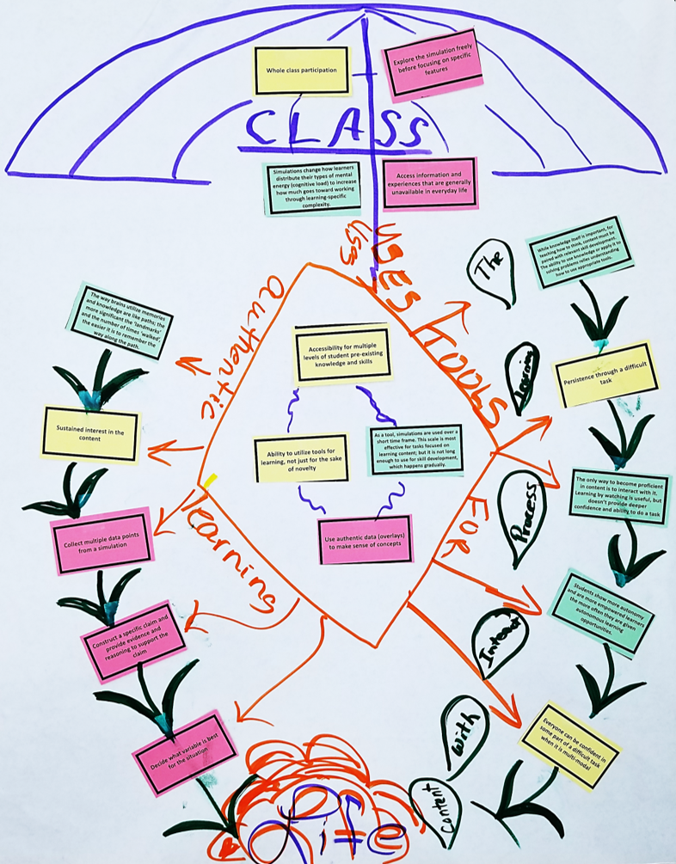
Fitting It All Together: Concept Map
Arrange the concept cards to show connections among ideas.
When you are happy with your arrangement, tape the cards to the poster.
Draw arrows among concepts and label them to show how they influence and interact with one another.
Notes:
(20 min) concept maps
Directions:
In task groups, have teachers create a concept map from the student, task, and research cards. They should tape them down on poster paper and draw arrows to indicate relationships among the cards.

Slide 6
Fitting It All Together: Gallery Walk
Visit the other concept maps around the room.
How do they compare to yours?
What do you notice?
What do you wonder?
Student Experience or Impact
Task Element
Research
Notes:
(10 min) Gallery Walk and debrief
Context:
This is an opportunity to deepen their understanding of the research that supports simulation use as it relates to students’ experiences and the specific tasks we engaged in.
Directions:
Identify which card color is which (student, task, research)
Have teachers do a gallery walk making note of what they notice and wonder in regard to: (1) the ways the three types of card are related in maps, and (2) how their own concept map compares to the others around the room.
If time is a concern, rather than a gallery walk, groups could look at only one other concept map or (at worst), teachers could notice and wonder about (1).
Have a brief share out time (one or more per concept map group, time permitting)

Slide 7
What does the research say?
Simulations < Immersive AR/VR < Video Games
The more immersive, the higher the achievement
Yields highest gains for struggling students
Best for content-based tasks
Reduces cognitive load unrelated to learning processes
Must be paired with quality instruction to be effective
Which idea from the Concept Card Map do you feel most comfortable with?
Which idea might be the most difficult to implement?
Notes:
(10 min)
Directions:
Discuss the major points of the research regarding simulations (“desktop VR”) and other VR formats on the continuum.
This is a good place to address any specific questions and concerns from the recap if they are relevant.

Slide 8
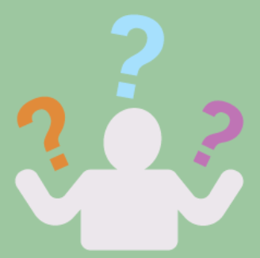
What? So What? Now What?
What obstacles could get in the way of using interactive technology or simulations in your classroom?
For example, classroom layout or student behavior.
Notes:
Context:
Directions:
Pass out What? So what? Now what? Handout. Pose the “What?” question and allow participants time to discuss in their groups. Solicit responses from the group.

Slide 9
What? So What? Now What?
So what are some practical solutions or procedures that you could put in place to address these obstacles?
Notes:
Context:
Directions:
Pass out What? So what? Now what? Handout. Pose the “What?” question and allow participants time to discuss in their groups. Solicit responses from the group.

Slide 10
What? So What? Now What?
Now what can you do with this information?
Develop an action plan for how you will use what you’ve learned today.
Notes:
Context:
Directions:
Pass out What? So what? Now what? Handout. Pose the “What?” question and allow participants time to discuss in their groups. Solicit responses from the group.

Slide 11


LEARN Strategy Reflection
Concept Maps
Gallery Walk/Carousel
What? So What? Now What?
Notes:
Pass out the instructional strategy note sheet.
Allow time for participants to reflect and complete their LEARN Strategy Reflection on the Instructional Strategy Notes handout.

Slide 12
Thank You!

