Slide 2


Slide 3

Bransford’s Model and Assessment Types

Slide 4
GEAR UP for the FUTURE Goals
Increase cohort academic performance and preparation for postsecondary education (PSE).
Increase high school graduation and PSE participation.
Increase student educational expectations and increase student and family knowledge of PSE options, preparation, and financing.

Slide 5
GEAR UP O+K=C Goals
Increase students’ engagement in learning.
Increase students’ academic preparation for PSE upon graduation.
Increase schools’ high school graduation and PSE enrollment rates.
Increase students’ and their families’ knowledge of PSE options, preparation, and financing.

Slide 6
GEAR UP for MY SUCCESS Goals
Increase cohort academic performance and preparation for PSE.
Increase high school graduation and PSE participation.
Increase student educational expectations and increase student and family knowledge of PSE options, preparation, and financing.

Slide 7
Essential Question
What is the role of assessment in the design of effective learning environments?

Slide 8
Lesson Objectives
Define assessment.
Determine the purposes of formative assessment in the classroom.
Explain the difference between assessment of learning, assessment for learning, and assessment as learning.

Slide 9
Whole-Group Definition of Assessment
Insert the whole-group definition created at the end of Day 1.
Notes:
Yesterday we created a group definition of assessment that includes summative, formative, diagnostic assessment. Let’s take a look at that definition again.

Slide 10

How Am I Feeling? What Am I Thinking?
On a sticky note, reflect on the first day of the Institute.
Draw a diagonal line through your note. Using a word, phrase, or image, answer the following questions on either side:
  How am I feeling?
  What am I thinking?

Slide 11

Cognitive Comics
Think back to a memorable classroom learning experience from your childhood that stuck with you.
Draw a picture of this learning experience.
Label the image with key details.
Provide a caption that describes what occurred during the learning experience.
Notes:
We want an memorable learning environment for our students, as we learned about yesterday - it worked really well and you learned something that stuck with you.

Slide 12
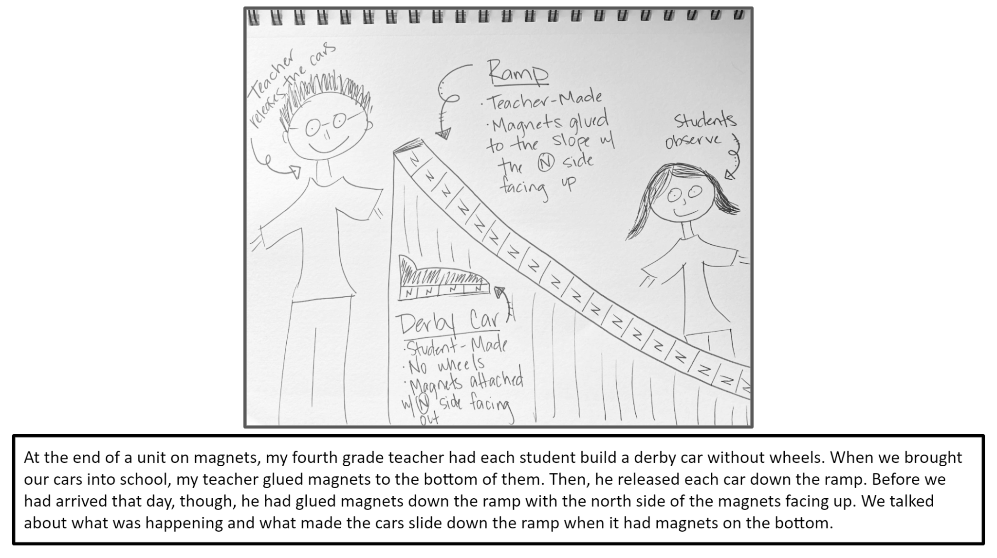
Here is a labeled image of a memorable learning experience.
And a caption describing what occurred during the learning experience.
Notes:
Share one of your memories verbally, and connect it to this one and say this is an example of what you might make

Slide 13
Cognitive Comics
Think back to a memorable classroom learning experience from your childhood that stuck with you.
Draw a picture of this learning experience.
Label the image with key details.
Provide a caption that describes what occurred during the learning experience.

Slide 14
Three Types of Assessment
In the classroom, there are three main reasons for doing assessment:
To report on if, and how effectively, learning has occurred (assessment of learning).
To aid learning and adjust instruction (assessment for learning).
To give students ownership of their learning so they know what they are able to do and plan their next learning steps (assessment as learning).
Notes:
We have looked at a definition of assessment but there are other ways to think about the purposes of assessment. One way to do this is to think of assessment purposes is by looking at how three simple prepositions can change the meaning of how we are approaching assessment in different situations.
Different types of assessment have certain things in common: gathering evidence, interpreting that evidence, and using the interpretation in some way. But how each of these things is carried out is determined by the purpose of the assessment.

Slide 15

Another Way to Think About Assessment
Assessment of Learning
Assessment for Learning
Assessment as Learning
Notes:
Read three short descriptions of each of these ideas and discuss how the preposition describes a different purpose for learning in each one.
Ex: A teacher gives her students a comprehensive final at the end of a unit on biodiversity. What makes “of” appropriate here? What type of assessment might this be? (summative, diagnostic, or formative)
Ex: A teacher asks his student to do an exit ticket describing the three things they learned and two things they still need to know more about. What makes “for” appropriate here? What type of assessment might this be? (summative, diagnostic, or formative)
Ex: A teacher asks students to peer edit paragraphs written by others and then discuss their edits. What makes “as” appropriate here? What type of assessment might this be? (summative, diagnostic, or formative)

Slide 16
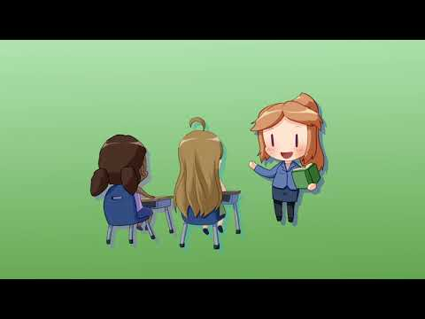
Notes:
Video link: https://youtu.be/OxPcSne3pEg

Slide 17

I Think, We Think
Read each scenario and think about which assessment type is being described:
  Assessment as Learning
  Assessment for Learning
  Assessment of Learning
Discuss the scenario with your group and come to a consensus on what you all think.

Slide 18
Assessment as Learning
Ms. Cobb’s students are studying the dangers of traditions by reading The Lottery by Shirley Jackson. Paired with the short story is an informational text describing how traditions work in society and how they sometimes persist despite putting people in danger. Ms. Cobb asks students to write a One-Pager petitioning for the removal or addition of a school tradition. Using the One-Pager strategy, students summarize their knowledge of the topic and provide evidence and reasoning for their argument. The One-Pagers are then peer-assessed and revised by the students.

Slide 19
Assessment for Learning
In Mr. Jacobs’ class, students begin using Google Earth to locate and identify landforms and features across the United States. Students work in pairs and use Google Docs as a tool to collaboratively record their findings. Rather than just grade their final documents, Mr. Jacobs views the history of each document and gives immediate feedback to students. He also looks for evidence of students’ understanding of the concepts underlying the activity. Next, students plan what they need to do to clarify the document according to their own understanding and based on how other readers might want to use the information.

Slide 20
Assessment of Learning
An algebra class begins reviewing domain and range in preparation for learning about asymptotes. Students use guided notes to learn about and formalize their understanding of graphing rational functions before they apply what they have learned. As they complete the day’s lesson, the teacher changes gears to assess what they have learned. She distributes a card-matching activity that includes equations of rational functions, graphs, and asymptotes. When students finish, she grades their card matches and finds many of the students can apply their knowledge to the matching activity.

Slide 21
Assessment for Learning
During a class discussion on the major political causes of WWII, the teacher recognizes that several students have confused the purpose of the Treaty of Versailles. Several others have confused the countries who came together to form the Axis of Powers. The teacher decides to change the sequence of the topics she was planning to teach. She develops some additional activities for students to review the events leading up to WWII, including those which ended WWI. After this, she asks students to create a meme summarizing these events in their own words.

Slide 22
Assessment as Learning
During science class, Ms. Moore makes use of a P-E-O (predict-explain-observe) probe. Students make predictions about an outcome before launching into their investigations. After explaining the reasons for their predictions to classmates, students are very engaged in investigating. As they investigate, they observe and collect data. Many of the students’ observations and data analyses do not match their predictions. Students then revisit their initial ideas and work to figure out a new explanation.

Slide 23
Cognitive Comics
Return to your comic and consider where each type of assessment occurred—or could occur—during the learning experience.
Use sticky notes to write a description of what the teacher and students do for each type of assessment:
  Assessment as Learning: Blue
  Assessment of Learning: Pink
  Assessment for Learning: Yellow

Slide 24
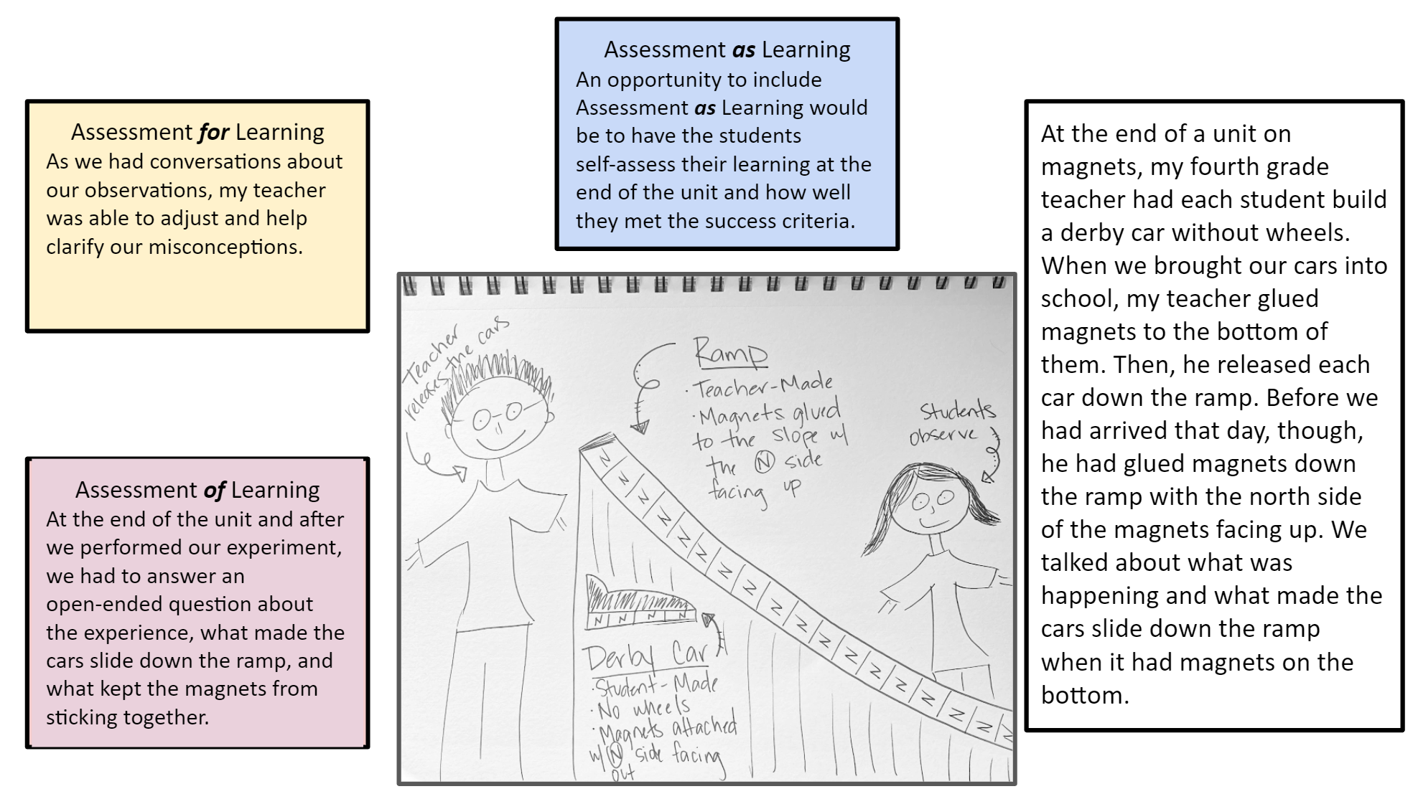

Slide 25
Cognitive Comics
Return to your comic and consider where each type of assessment occurred, or could occur during the learning experience.
Use sticky notes to write a description of what the teacher and students are doing for each type of assessment:
  Assessment as Learning: Blue
  Assessment of Learning: Pink
  Assessment for Learning: Yellow
Notes:
Provide them with an opportunity to share

Slide 26
Purposes of Formative Assessment
Insert the photo of the Anchor Chart list developed in the first session.
Notes:
Ask participants if some big ideas stand out from this list. What types of themes do we see in this based on what we have seen so far about the main purposes of formative assessment.

Slide 27
Main Purposes of Formative Assessment
Gather data to:
Inform ongoing and future instruction.
Provide feedback to students about their learning.

Slide 28
Note Catcher
Take a moment to reflect on the assessment strategies that we have participated in. Answer the following questions:
How was it used?
How can I use it?
Notes:
Break after taking notes

Slide 29

Concept Card Mapping
On your chart paper, spread out the cards.
Read through each of the cards labeled with the following:
  20 purposes of formative assessment
  Examples of formative assessment strategies
Determine which strategies relate to each of the purposes of formative assessment.
Keep in mind that multiple strategies may fit multiple purposes and vice versa.
Organize your cards into a concept map, and glue the cards in place.
Show the relationships between multiple cards by connecting them with lines.
Notes:
The main purpose of formative assessment is to inform instruction and to receive student feedback
Highlight the chart that they came up with on day 1 or star the main or most often used

Slide 30

Gallery Walk
Walk around the room and look at other groups’ Concept Card Maps.
If you have any questions or comments on other groups’ maps, write those comments on sticky notes and leave them on the chart paper.

Slide 31
Gallery Walk
What did you notice about the other Concept Card Maps around the room?
Where there any similarities?
Where there any major differences?
Did anyone leave a question on your chart paper that you would like to answer?

Slide 32

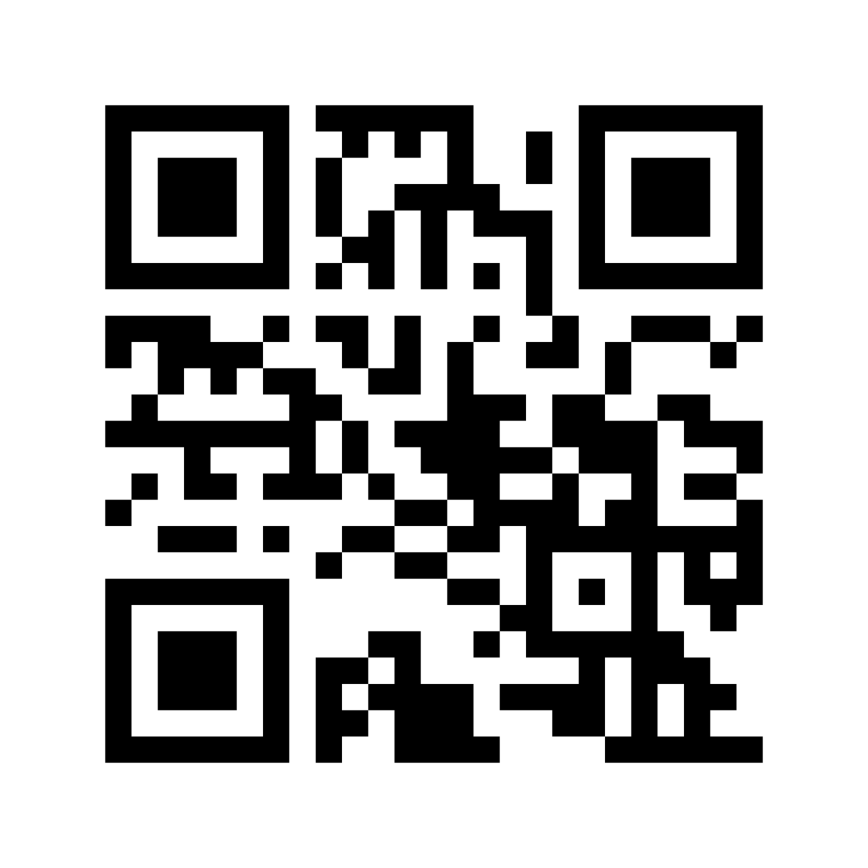
Six-Word Memoir
Summarize your learning in six words or less. Let your Six-Word Memoir reflect the purposes of formative assessment.
Notes:
Maybe something different here as a wrap-up.

Slide 33
Note Catcher
Take a moment to reflect on the assessment strategies that we have used. Answer the following questions:
How was it used?
How can I use it?

