Slide 2
Supporting Meaningful Student Discussion
As you come in, please respond to the following prompts on the color-coded stickies and place them on the chart paper on the side door.
This session will be a success if:
I do…
(yourself)
We do…
(the group)
You do…
(facilitator)
Notes:
5 min including intro
Participants fill out on sticky notes and put them on a posted chart paper as they come in. They should identify one thing they personally should do ("I do"), the group should do ("We do"), and the facilitator ("You do") should do to make the session successful.
(change colors to match what stickies are on hand)

Slide 3
Supporting Meaningful Student Discussion

Slide 4
Session Objectives
Learn approaches for supporting meaningful student discussion.
Engage with instructional strategies that address barriers to discussion.
Apply strategies to an upcoming classroom discussion.

Slide 5
This session will be a success if...
I do...
We do...
You do...
Notes:
5 min including intro
Participants should have filled out on sticky notes and put them on a posted chart paper as they came in (change colors to match what stickies are on hand)
Review the sticky notes that have been placed and explain that these are the session expectations the group has developed. Explain that norm-setting that asks students to identify their own behavior and needs creates buy-in and student comfort.

Slide 6
Partner Speaks: Facilitating Discussion
Describe to your partner your experience facilitating discussion.
What do discussions look like in your class?
What are some memorable conversations, successful or unsuccessful?
Be prepared to share out your partner’s experiences.
Notes:
5 min (2-3 min talk, 2-3 min share)
Have participants go back to their tables and pair up with a partner.
For social distancing purposes, if participants wish to spread out around the room to chat so conversations don’t overlap each other too much while they leave space between themselves.
Participants share out

Slide 7
Four Corners: Roadblocks for Discussion
Students are afraid to be wrong.
Students don’t talk with one another.
Student groups don’t stay on topic.
Students don’t share out or volunteer answers.
Notes:
Pick the roadblock most relevant to your own experience

Slide 8
Four Corners: Roadblocks for Discussion
As a group, discuss how these strategies could help overcome your roadblock.
Select one strategy to share with the group.
Notes:
10 min explore, 5 min share out
Give participants time to read over strategies and discuss
Encourage them to fill out the note catcher for any they find potentially useful for their own classrooms
Ask groups to share out and bring up their strategy on LEARN on the screen. If there are any corners without participants, highlight one or two of the strategies from that corner.
Afraid to be wrong
Fold the Line
Collective Brain Dump
My Favorite Mistake
Stand Up, Sit Down
No peer-to-peer talk
Chat Stations
4-2-1
I Think/We Think
Appointment Clocks
Off-task
Discourse Moves
Inverted Pyramid
Strike Out
Three Stray, One Stays
Lack of response
Fostering Student Participation
Establishing Norms
Standard Operating Procedure

Slide 9
Overcoming Roadblocks
Strategies that support classroom discussion...
Normalize making mistakes.
Build peer-to-peer relationships and classroom culture.
Reduce the stakes and lower the pressure on students.
Provide scaffolding to build skills and confidence.

Slide 10
Planning for Meaningful Discussion
The most effective student conversations are planned.
Two questions to consider before you ask them to talk:
Why are you having students engage in discussion?
What kind of conversation are you asking students to have?
Notes:
7 min total (through best practices)
Two elements of planning
Why you’re having the conversation
What are you asking students to do during conversation
Planning should involve knowing where you want the conversation to end up (why) and what you’re asking students to do in order to get there (how). Pre-thinking the conversation and the end goal to keep conversation flowing and helping teacher not getting held up mid-discussion.

Slide 11
Why Are We Having This Conversation?
Activating and Eliciting Student Ideas Solicit prior knowledge and initial ideas | Helping Students Make Sense of New Information Process info and begin developing explanations
Connecting Activities to Concepts Applying concepts to experiences, consensus building | Pressing for Evidence-Based Explanations Synthesizing info and developing thorough explanations
Notes:
There are other types of conversations, but these are the most salient

Slide 12
What kind of conversation is this?
Sharing, Expanding, and Clarifying Ideas | Validates student ideas, improves confidence, and promotes metacognition
Thinking With Each Other | Knowledge is communal, emphasizes student ideas and peer-to-peer talk
Listening Carefully to One Another | Validates student ideas and expertise, and encourages learning from each other
Deepening Reasoning | Values evidence-based understanding and applied knowledge
Notes:
Sharing, Expanding and Clarifying Ideas
Validates student ideas and improves confidence
Give students time to think
Ask students to say more
Thinking With Each Other
Knowledge is communal, emphasizes student-driven discussion
Ask students to build on each other
Explain someone else’s meaning
Listening Carefully to One Another
Validates student ideas and encourages learning from each other
Paraphrase ideas
Agree or disagree, and why?
Deepening Reasoning
Values evidence-based understanding and applied knowledge
Ask for evidence and reasoning
Provide challenges and counterexamples
Develop back pocket questions that support the types of intellectual work best suited to the conversation’s purpose.
Choose your talk moves based on both the purpose of conversation and student intellectual work

Slide 13
Best Practices for Facilitating Discussion
Collaboratively establish guidelines for respectful talk.
Accountability to each other
Equitable airtime
Respect
Expectation of participation
Normalize making mistakes and “being wrong.”
Provide frequent opportunities for structured talk.
Develop routines and commonly used strategies for talk.
Use talk moves that support specific types of conversation.
Encourage the use of content-specific language and vocabulary.

Slide 14
Planning for Discussion
Take some time to explore resources:
Instructional strategies on the LEARN website
Specific strategies from the Four Corners
Conversation planning resources
Select a strategy to try in an upcoming class, OR begin developing a plan for an upcoming discussion.
Notes:
10 min
Conversation planning documents from Ambitious Science Teaching, Discourse Moves, Talk Activities Flow Chart

Slide 15
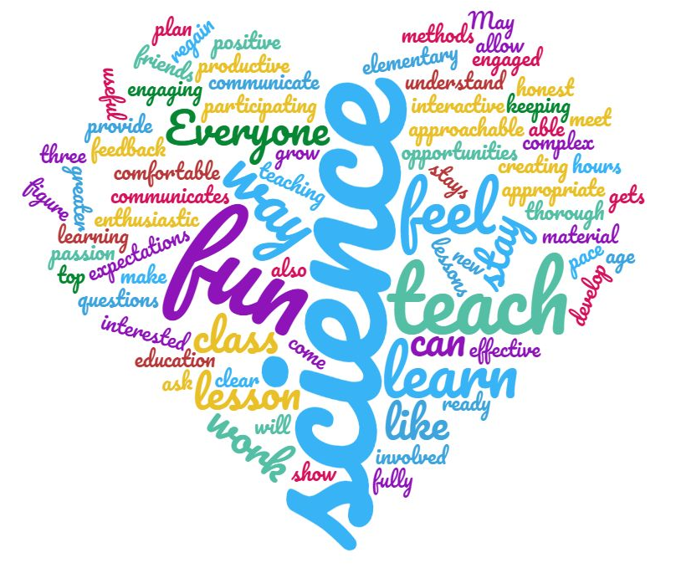
Collaborative Word Cloud
Come up with five or more keywords that represent your big takeaways.
Combine your list of words. Make note of how many times a word appears in your group’s list.
Create a word cloud using your group’s list.
Words that appear more often should be bigger in your cloud.
Notes:
8 min

Slide 16
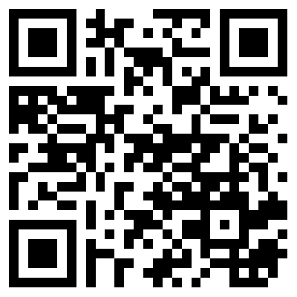
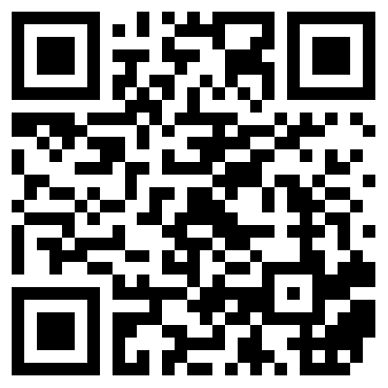
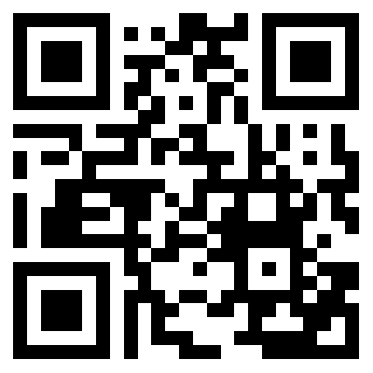
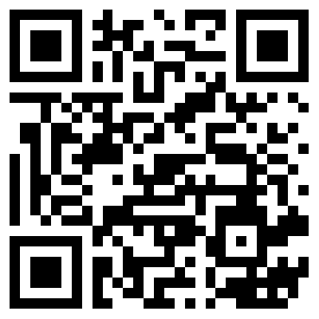
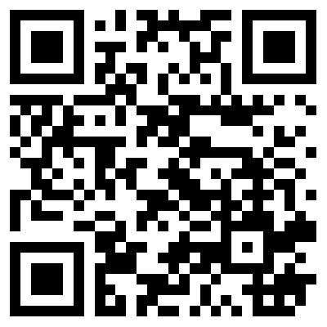
Follow K20 on Social Media!
Facebook.com/ K20Center | YouTube.com/ K20Center | Twitter.com/ K20Center | LinkedIn.com/ showcase/ K20-Center | Instagram.com/ K20Center

