Slide 2
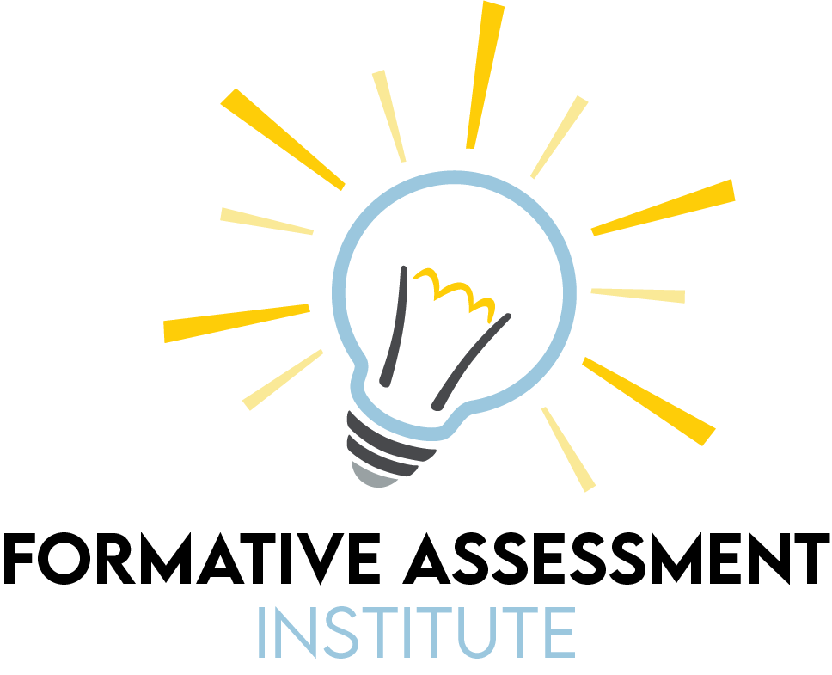

Slide 3


Slide 4
Formative Assessment in the Social Studies Classroom

Slide 5
Essential Question
What is formative assessment and what does it look like in the social studies classroom?

Slide 6
Session Objectives
Explore a variety of strategies that support formative assessment for the social studies classroom.
Examine metacognitive strategies for supporting students in their efforts to be self-directed learners.

Slide 7
PURPOSES OF FORMATIVE ASSESSMENT
Insert photo of the collaborative list developed in the first session.

Slide 8
Social Studies Practices
Engage in Democratic Processes
Analyze and Address Authentic Civil Issues
Acquire, Apply, and Evaluate Evidence
Read Critically and Interpret Informational Sources
Engage in Evidence-Based Writing

Slide 9

K20 LEARN Website
https://learn.k20center.ou.edu
Notes:
All the strategies we are going to look at come from lessons on LEARN

Slide 10

Tip of the Iceberg
Write what you think special considerations are for social studies formative assessments above the water line on the Tip of the Iceberg handout.
Notes:
K20 Center. (n.d.) Tip of the Iceberg. Strategies. https://learn.k20center.ou.edu/strategy/67

Slide 11

Claim-Evidence-Reasoning (CER)
Present a question that allows students to create a claim.
Have them look for evidence to support their claim in lesson materials or online research.
Instruct them to use evidence to support their claim.
Have them write reasoning that provides an explanation for the evidence and supports their claims.
Notes:
K20 Center. (n.d.). Claim, Evidence, Reasoning (CER). Retrieved from https://learn.k20center.ou.edu/strategy/156

Slide 12
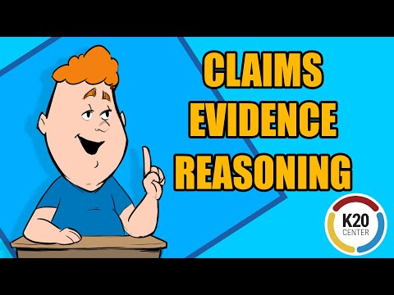

Slide 13
Claim-Evidence-Reasoning (CER)
What was the main cause of the French Revolution?
How did new technologies impact WWI and its combatants?
Did assimilation help or hinder the work of the Kiowa Six?
What was the impact of the Treaty of Versailles on Germany?
Notes:
K20 Center. (n.d.). Claim-Evidence-Reasoning (CER). Strategy. https://learn.k20center.ou.edu/strategy/156

Slide 14

Claim-Evidence-Reasoning (CER)
When could this strategy be used in a lesson?
How can this strategy inform instruction?
How can you adapt this strategy for your classroom?
https://learn.k20center.ou.edu/lesson/1195
Notes:
https://learn.k20center.ou.edu/lesson/1195

Slide 15

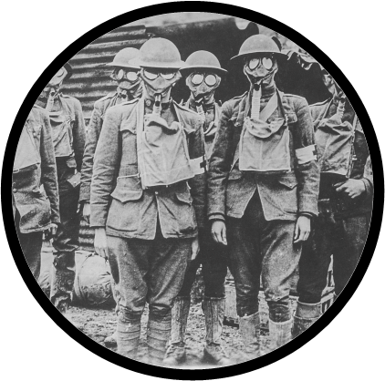
Lesson Showcase: Claim, Evidence, Reasoning
Oklahoma History Lesson (OKH.5.8)
  Transcending Boundaries: The Kiowa Six
  Students use the CER strategy to argue whether or not assimilation helped or hindered their artwork.
World History Lesson (WH 4.2)
  From Horses to Airplanes
  Students use the CER strategy to respond to a question about the impact of new technologies on World War I.
Notes:
① These are two K20 social studies lessons that use the Claim, Evidence, Reasoning strategy
Transcending Boundaries: The Kiowa Six: https://learn.k20center.ou.edu/lesson/1273
From Horses to Airplanes: https://learn.k20center.ou.edu/lesson/1704

Slide 16

T.A.C.O.S.
Provide students with a political cartoon and the T.A.C.O.S. acronym.
  Time Period: When does the cartoon take place?
  Action: What happens in the cartoon?
  Caption: What is the cartoon’s title or caption?
  Objects: What objects/symbols in the cartoon are important?
  Summary: What sentence summarizes the meaning of the cartoon?
Notes:
K20 Center. (n.d.). T.A.C.O.S. Strategies. https://learn.k20center.ou.edu/strategy/1196

Slide 17
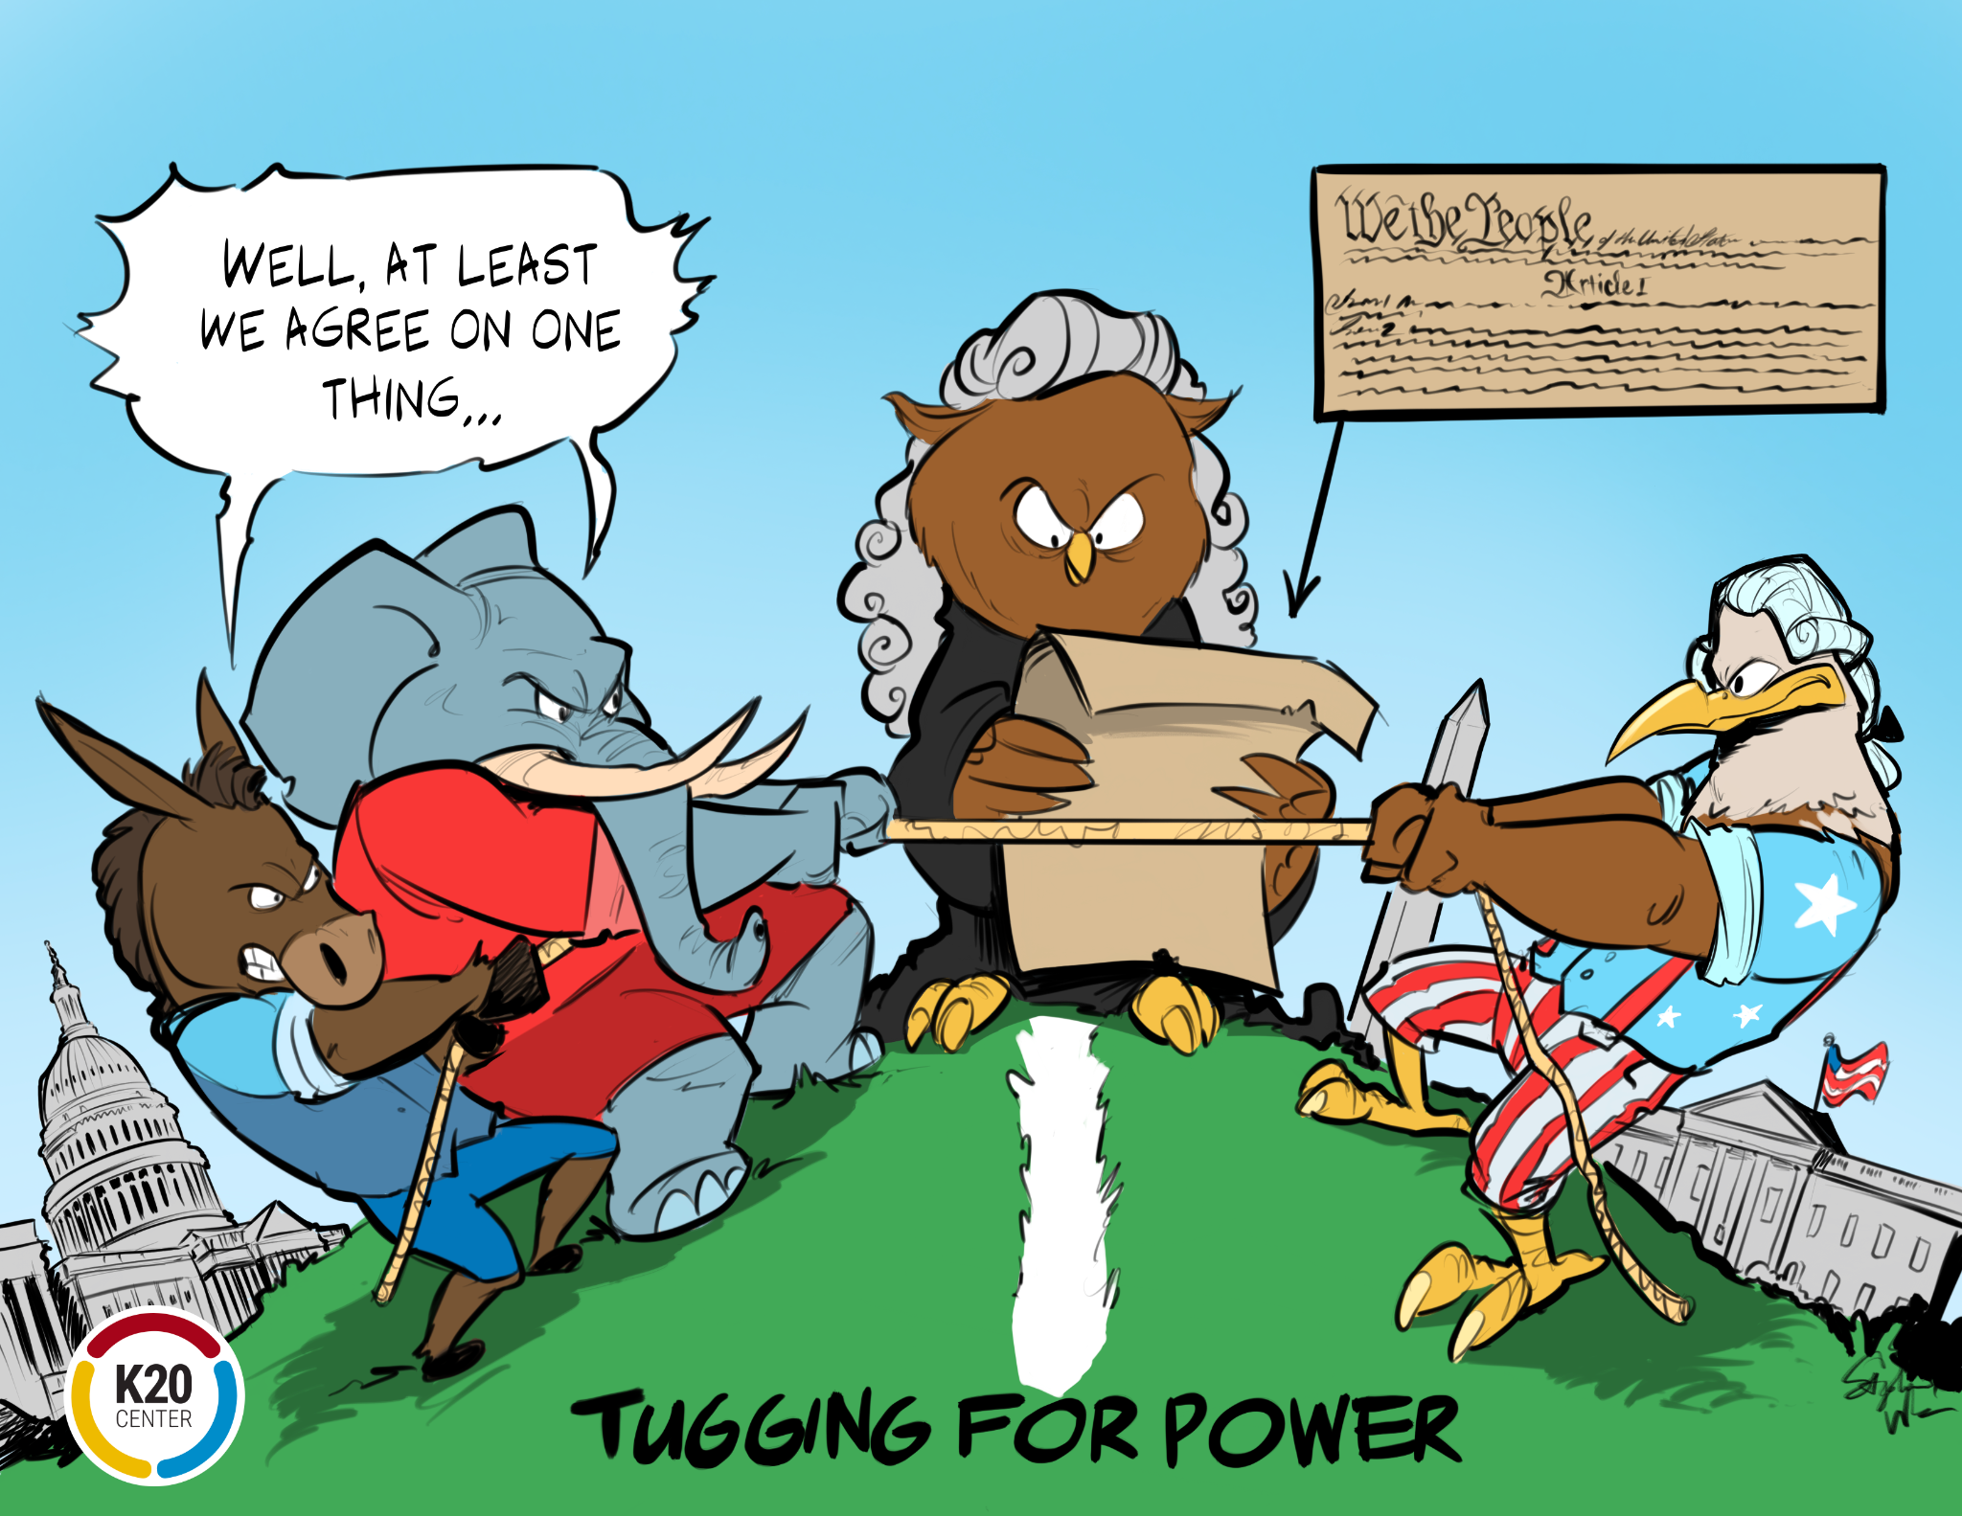
T.A.C.O.S.
Time Period: When does the cartoon take place?
Action: What happens in the cartoon?
Caption: What is the caption or title?
Objects: What significant objects are shown?
Summary: What one sentence message does the cartoon portray?
Notes:
K20 Center. (n.d.). T.A.C.O.S.. Strategies. Retrieved from https://learn.k20center.ou.edu/strategy/1196

Slide 18
T.A.C.O.S.
What should students notice?
How could you get students to interpret the meaning of the cartoon?
When could you use a cartoon in your lesson?
Notes:
K20 Center. (n.d.). T.A.C.O.S.. Strategies. Retrieved from https://learn.k20center.ou.edu/strategy/1196

Slide 19

T.A.C.O.S.
When could this strategy be used in a lesson?
How can this strategy inform instruction?
How can you use this in your classroom?

Slide 20


Lesson Showcase: T.A.C.O.S.
U.S. Government Lesson (OKH 5.8)
  The Power is Ours
  Students use the T.A.C.O.S. strategy to analyze a political cartoon about checks and balances.
World History Lesson (WH 4.5)
  You Take and You Take
  Students use the T.A.C.O.S. strategy to analyze political cartoons about the impact of imperialism on Africa.
Notes:
① These are two K20 social studies lessons that use the T.A.C.O.S. strategy
The Power is Ours: unpublished, add link
You Take and You Take: https://learn.k20center.ou.edu/lesson/1348

Slide 21

BREAK

Slide 22
Note Catcher
Take a moment to reflect on the assessment strategies presented so far.
Answer the following questions:
  How was it used?
  How can I adapt it for my class?
Notes:
Break after taking notes

Slide 23

Always, Sometimes, or Never True?
Have students examine a set of statements and reflect on their individual interpretations of each statement.
Ask them to decide if the statement is always, sometimes, or never true.
Have them write a short justification of their reasoning for deciding if the statement is always, sometimes, or never true.
Notes:
K20 Center. (n.d.). Always, Sometimes, or Never True. Strategies. https://learn.k20center.ou.edu/strategy/145

Slide 24
Always, Sometimes, or Never True?
Pre-contact cultures were hunter-gatherers who traveled across the continent.
Historians know a lot of information about the pre-contact cultures in America.
Archaeological investigations provide modern historians glimpses of pre-contact cultures and knowledge.
Pre-contact cultures rarely had significant accomplishments that impacted history.
Pre-contact cultures did not have complex religious, social, or cultural beliefs and structures.

Slide 25

Always, Sometimes, or Never True
When could this strategy be used in a lesson?
How can this strategy inform instruction?
How can you adapt this lesson for use in your classroom?
https://learn.k20center.ou.edu/lesson/725
Notes:
https://learn.k20center.ou.edu/lesson/725
https://upload.wikimedia.org/wikipedia/commons/e/ed/Craig_C_style_shell_gorget_Spiro_HRoe_2005.jpg

Slide 26

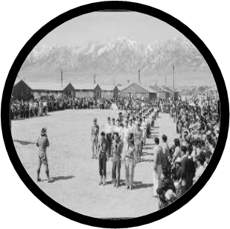
Lesson Showcase: Always, Sometimes, or Never
Oklahoma History Lesson (OKH 1.2)
  The Spiro Mound Builders
  Students use the Always, Sometimes, or Never True strategy to access their prior knowledge about pre-contact civilizations.
U.S. History Lesson (USH 1.3A)
  Immigration and the Asian American Experience
  Students use the Always, Sometimes, or Never True strategy to access their prior knowledge about immigration.
Notes:
① These are K20 social studies lessons that use the Always, Sometimes, or Never strategy
The Spiro Mound Builders: https://learn.k20center.ou.edu/lesson/725
Immigration and the Asian American Experience: https://learn.k20center.ou.edu/lesson/362

Slide 27

POMS: Point of Most Significance
Ask students to think about the most significant point of the content learned.
Have students write down their responses.
Ask students to share their responses and collect to review.
Analyze student responses to inform future instruction.
Notes:
K20 Center. (n.d.). Point of Most Significance. Strategies. https://learn.k20center.ou.edu/strategy/101

Slide 28

POMS: Point of Most Significance
View a video about Ralph Ellison.
Create a POMS about the video content.
Share your POMS with an Elbow Partner.
Share POMS with the class.
Notes:
https://www.pbs.org/video/onr-ralph-ellison/
Public Broadcasting Service. (2014, June 5). The Oklahoma News Report. PBS. Retrieved September 27, 2021, from https://www.pbs.org/video/onr-ralph-ellison/.

Slide 29

POMS: Point of Most Significance
When could this strategy be used in a lesson?
How can this strategy inform instruction?
How can you adapt this strategy to use in your classroom?
https://learn.k20center.ou.edu/lesson/729
Notes:
https://learn.k20center.ou.edu/lesson/729

Slide 30

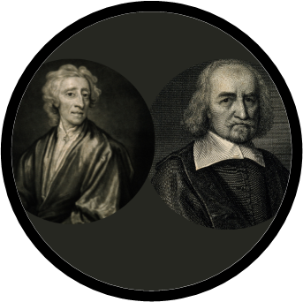
Lesson Showcase: Point of Most Significance
Oklahoma History Lesson (OKH 6.3)
  Students use the POMS strategy to summarize a video about Ralph Ellison’s life.
  The Literary Work of Ralph Ellison
World History Lesson (WH 2.7)
  What is the State of Our Nature?
  Students use the POMS strategy to summarize an article about the philosophies of John Locke and Thomas Hobbes.
Notes:
① These are two K20 social studies lessons that use the Point of Most Significance strategy
The Literary Work of Ralph Ellison: https://learn.k20center.ou.edu/lesson/729
What is the State of Our Nature?: https://learn.k20center.ou.edu/lesson/1685

Slide 31
Note Catcher
Take a moment to reflect on the assessment strategies that we have examined so far.
Answer the following questions:
  How were they used?
  How can I adapt them to use in my classroom?
Notes:
Break after taking notes

Slide 32
Selecting Assessment Strategies
When selecting an assessment strategy, make sure to select a strategy that meets these criteria:
    Is it consistent with your needs and your teaching style?
    Does it assess student mastery?
    Does it have a clear link to lesson objective(s)?
In addition to fulfilling course-specific standards, lessons and assessments need to engender development of Social Studies Practices.

Slide 33
Formative Assessment Needs a Learning Goal
“
Selecting a FACT [formative assessment classroom technique] without a teaching or learning goal in mind because it seems like a fun activity to use in the classroom is analogous to “activitymania”—selecting...activities that are fun and engaging to students but do not necessarily promote learning or inform teaching.
Page Keeley & Cheryl Rose Tobey

Slide 34
Create a Formative Assessment
Pick a strategy from the ones we have learned about today.
    Claim, Evidence, Reasoning
    T.A.C.O.S.
    Always, Sometimes, or Never True
    POMS: Point of Most Significance
    Tip of the Iceberg
Create a formative assessment for your content area.
Share on the Formative Assessment Collaborative Slides.

Slide 35
Tip of the Iceberg
Write what you have learned about using formative assessment in the social studies classroom below the water line on the Tip of the Iceberg handout.

