Slide 2


Slide 3


Slide 4
Formative Assessment in the Mathematics Classroom
Notes:
① Introduce yourself.
② Welcome participants.
Next: Show the essential question.

Slide 5
Essential Question
What is formative assessment and what does it look like in a mathematics classroom?
Notes:
① Share the essential question.
Next: Show the session objectives.

Slide 6
Session Objectives
Use and design tasks that will help make students’ thinking explicit.
Identify specific strategies that will elicit mathematical thinking in students and inform ongoing instruction.
Notes:
① Share the session objectives.
Next: Pass out the Note Catcher handout.

Slide 7
Are There Options in Order of Operations?
Notes:
① Ask participants to consider if these students followed order of operations.
② Ask participants to share their thinking with their elbow partners.
③ Ask for volunteers to share with the whole group.
Next: Participants get devices and go to the Instructional Strategies page on the K20 LEARN website.

Slide 8

Yes, Because…
Let’s take some time to explore the Instructional Strategies page on the K20 LEARN website. Go to: learn.k20center.ou.edu/strategies
Find one strategy you can use as an assessment strategy.
  Be ready to share your reasoning with the group.
Notes:
① Ask participants to get out their devices and go to the provided URL.
② Ask participants to find an assessment strategy and be ready to share their reasoning with the whole group.
③ Give participants direction regarding which of the 16 strategy pages you’d like them to focus on—be sure everyone’s screens show 12 results per page so that page numbers are the same.
④ Introduce the “Yes, Because…” strategy—this is how participants will share with the whole group.
⑤ Remind participants to use their Note Catcher handouts.
Next: BREAK
Strategy: K20 Center. (n.d.). Yes, Because…. Strategies. https://learn.k20center.ou.edu/strategy/193

Slide 9
Purpose
Formative assessment is not only about gathering data on students’ progress—it’s also about using that data
to guide your teaching and students’ learning.
Talk with an elbow partner about a time when you found success in using a formative assessment.
How would you define “success”?
Notes:
① Formative assessment is more than gathering data.
② Ask participants to think of a time when they found success in using a formative assessment.
③ Direct participants to talk with an elbow partner about how they define “success.”
④ Pass out the OK Mathematical Actions and Processes (MAPs) handout.
Next: Things to consider when selecting assessment strategies.

Slide 10
Selecting Assessment Strategies
When choosing an assessment strategy, pick one that:
  Meets your needs and fits your teaching style,
  Assesses student mastery, and
  Clearly connects to your lesson objective(s).
In addition to the course-specific standards, we need
to help our students develop Mathematical Actions
and Processes.
Notes:
① Pick a strategy that (1) meets your needs and fits your teaching style, (2) assesses student mastery, and (3) clearly connects to your lesson objective(s).
Next: OK Mathematical Actions and Processes (MAPs).

Slide 11
Mathematical Actions and Processes
Deep and Flexible Conceptual Understanding
Accurate and Appropriate Procedural Fluency
Strategies for Problem Solving
Mathematical Reasoning
Productive Mathematical Disposition
Ability to Make Conjectures, Model, and Generalize
Ability to Communicate Mathematically
Notes:
① Read through these process standards.
Next: Ways to assess/develop MAPs in students.
Source: Oklahoma State Department of Education. (2016). Oklahoma Academic Standards for Mathematics [PDF]. The State of Oklahoma. https://sde.ok.gov/sites/ok.gov.sde/files/OAS-Math-Final%20Version_3.pdf

Slide 12
Explain: Math Actions and Processes
What are some ways we can assess mathematical actions and processes?
What are some ways we can help students develop those actions and processes?
Discuss with an elbow partner.
Notes:
① How can we assess MAPs?
② How can we develop MAPs?
③ Have participants talk with an elbow partner.
Next: Formative assessment needs a learning goal (quote).

Slide 13
Formative Assessment Needs a Learning Goal
“
Selecting a FACT [formative assessment classroom technique] without a teaching or learning goal in mind because it seems like a fun activity to use in the classroom is analogous to ‘activitymania’—selecting mathematics activities that are fun and engaging to students but do not necessarily promote learning or inform teaching.”
–Page Keeley & Cheryl Rose Tobey
Notes:
① Read the quote.
② Give participants a moment to think about the quote.
Next: Activity 1: Not Like the Others.
Source: Keeley, P., & Tobey, C. R. (2011). Mathematics Formative Assessment: 75 Practical Strategies for Linking Assessment, Instruction, and Learning. Thousand Oaks, CA: Corwin, SAGE.

Slide 14
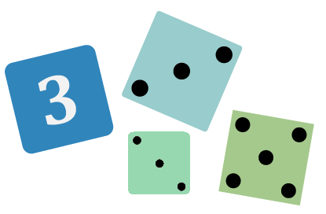
Activity 1: Not Like the Others
Students are provided with similar items, then are asked to choose which one is not like the others and to justify their reasoning. (K20 LEARN)
Notes:
① Read the “Not Like the Others” strategy description.
Next: Potential purposes of this strategy.
Strategy: K20 Center. (n.d.). Not Like the Others. Strategies. https://learn.k20center.ou.edu/strategy/77

Slide 15
Not Like the Others
Potential Purposes:
  Make students’ ideas explicit to themselves and to you, the teacher.
  Challenge students’ existing ideas and encourage intellectual curiosity.
  Provide a stimulus for discussion and mathematical argumentation.
  Promote the use of academic language in mathematics learning.
Notes:
① Read the potential purposes of this strategy.
Next: “Not Like the Others” example.
Source: Keeley, P., & Tobey, C. R. (2011). Mathematics Formative Assessment: 75 Practical Strategies for Linking Assessment, Instruction, and Learning. Thousand Oaks, CA: Corwin, SAGE.

Slide 16
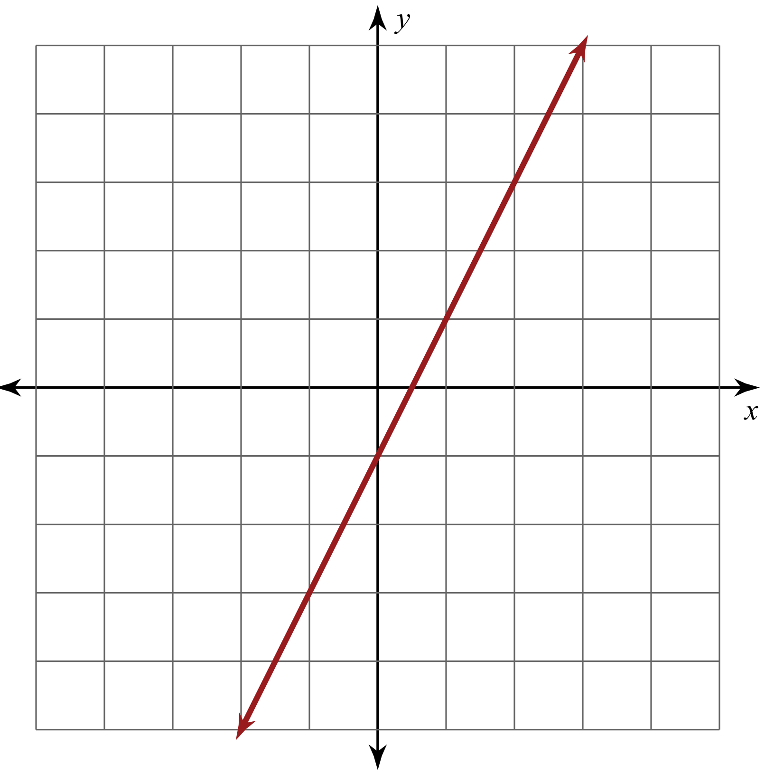
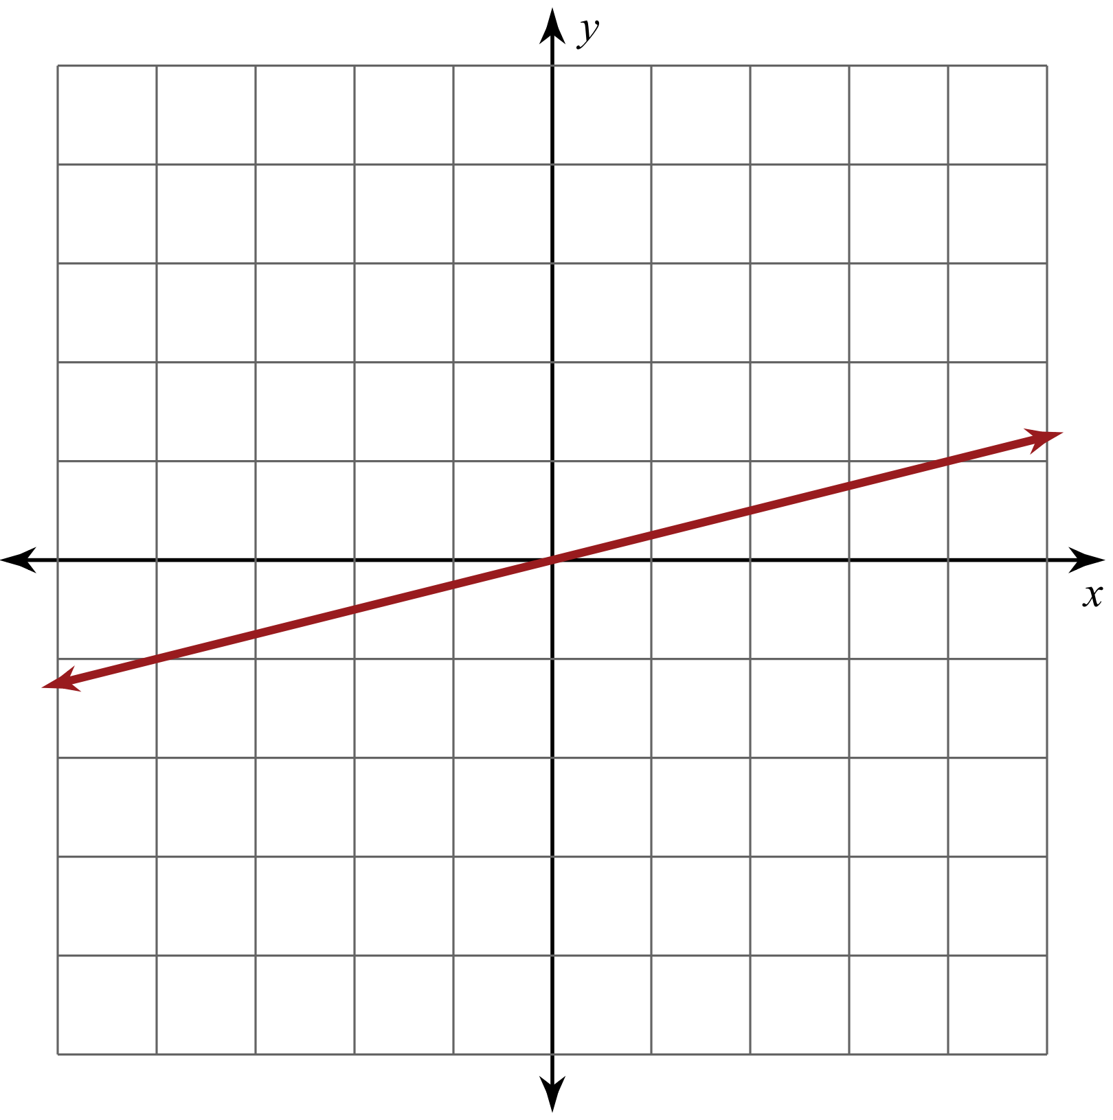
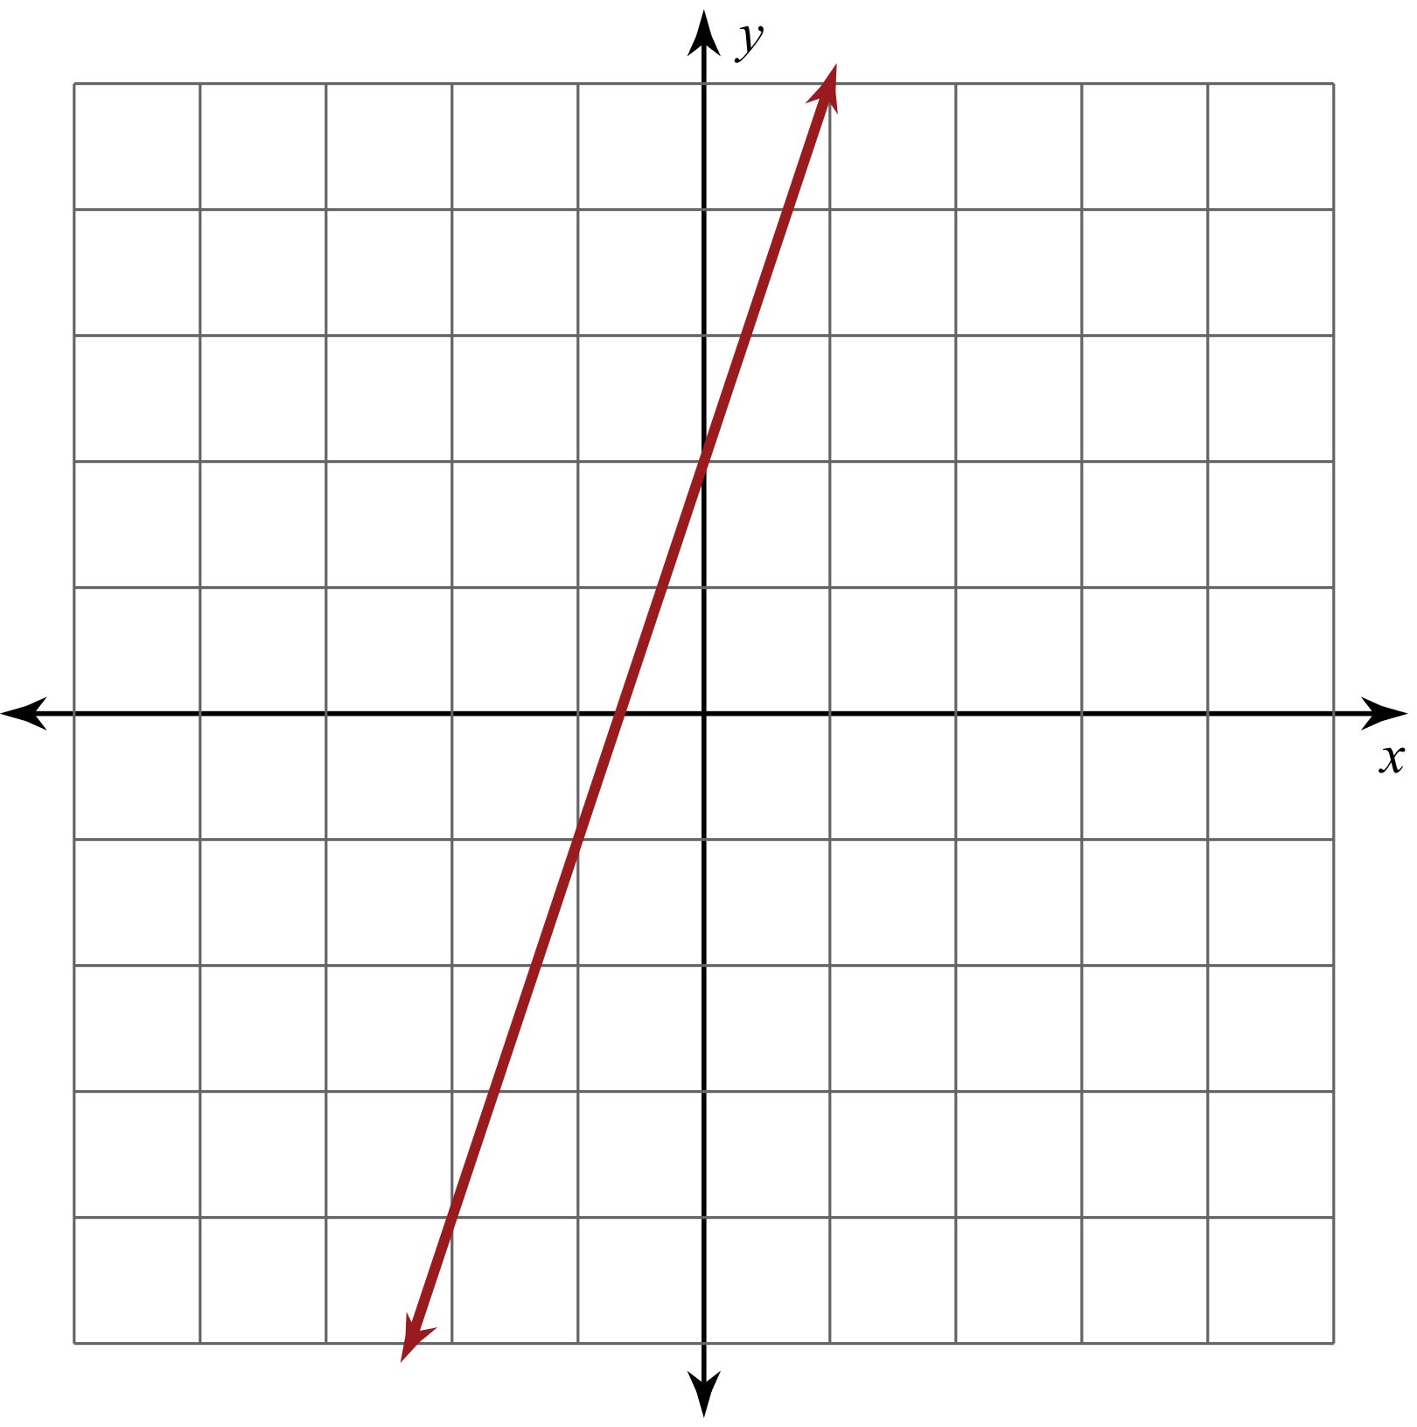
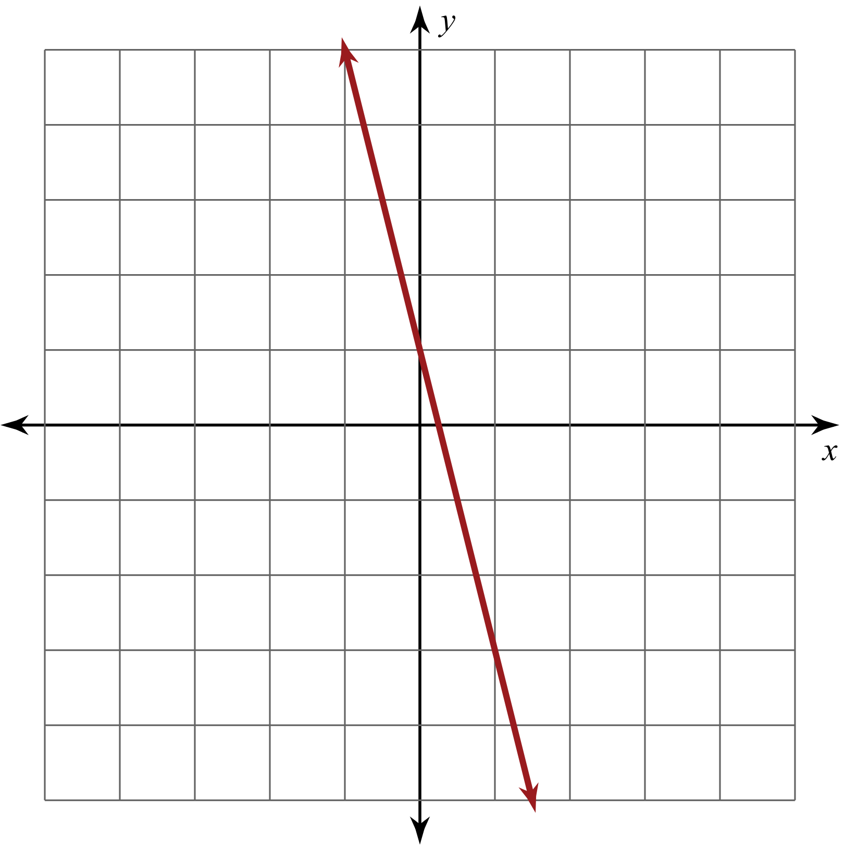
Not Like the Others
A | B
C | D
Decide which graph is not like the others.
Explain your reasoning.
Notes:
① Ask participants to assume the role of students.
② Ask participants to record their selection and reasoning on the back of the Note Catcher handout.
③ Ask for volunteers to share their selection with their reasoning.
Next: Participants create their own formative assessment using the “Not Like the Others” strategy. Be sure to share the link to the Math Assessment Strategies slide deck.

Slide 17
Not Like the Others
Develop a Not Like the Others formative assessment that you could use in the next couple of weeks.
Post your assessments in the Math Assessment Strategies slide deck.
  Be sure to consider the strategy’s
  placement in the lesson and the
  purpose of your assessment.
Notes:
① Provide participants with the Math Assessment Strategies slide deck link.
② Direct participants to open the slide deck.
③ Direct each participant to go to a different slide number to type their formative assessment idea.
④ Remind participants to include the lesson objective, course name, description of the assessment, and where they would put the strategy in a lesson with their reasoning.
Next: K20 lesson showcase—lessons that use “Not Like the Others.”

Slide 18
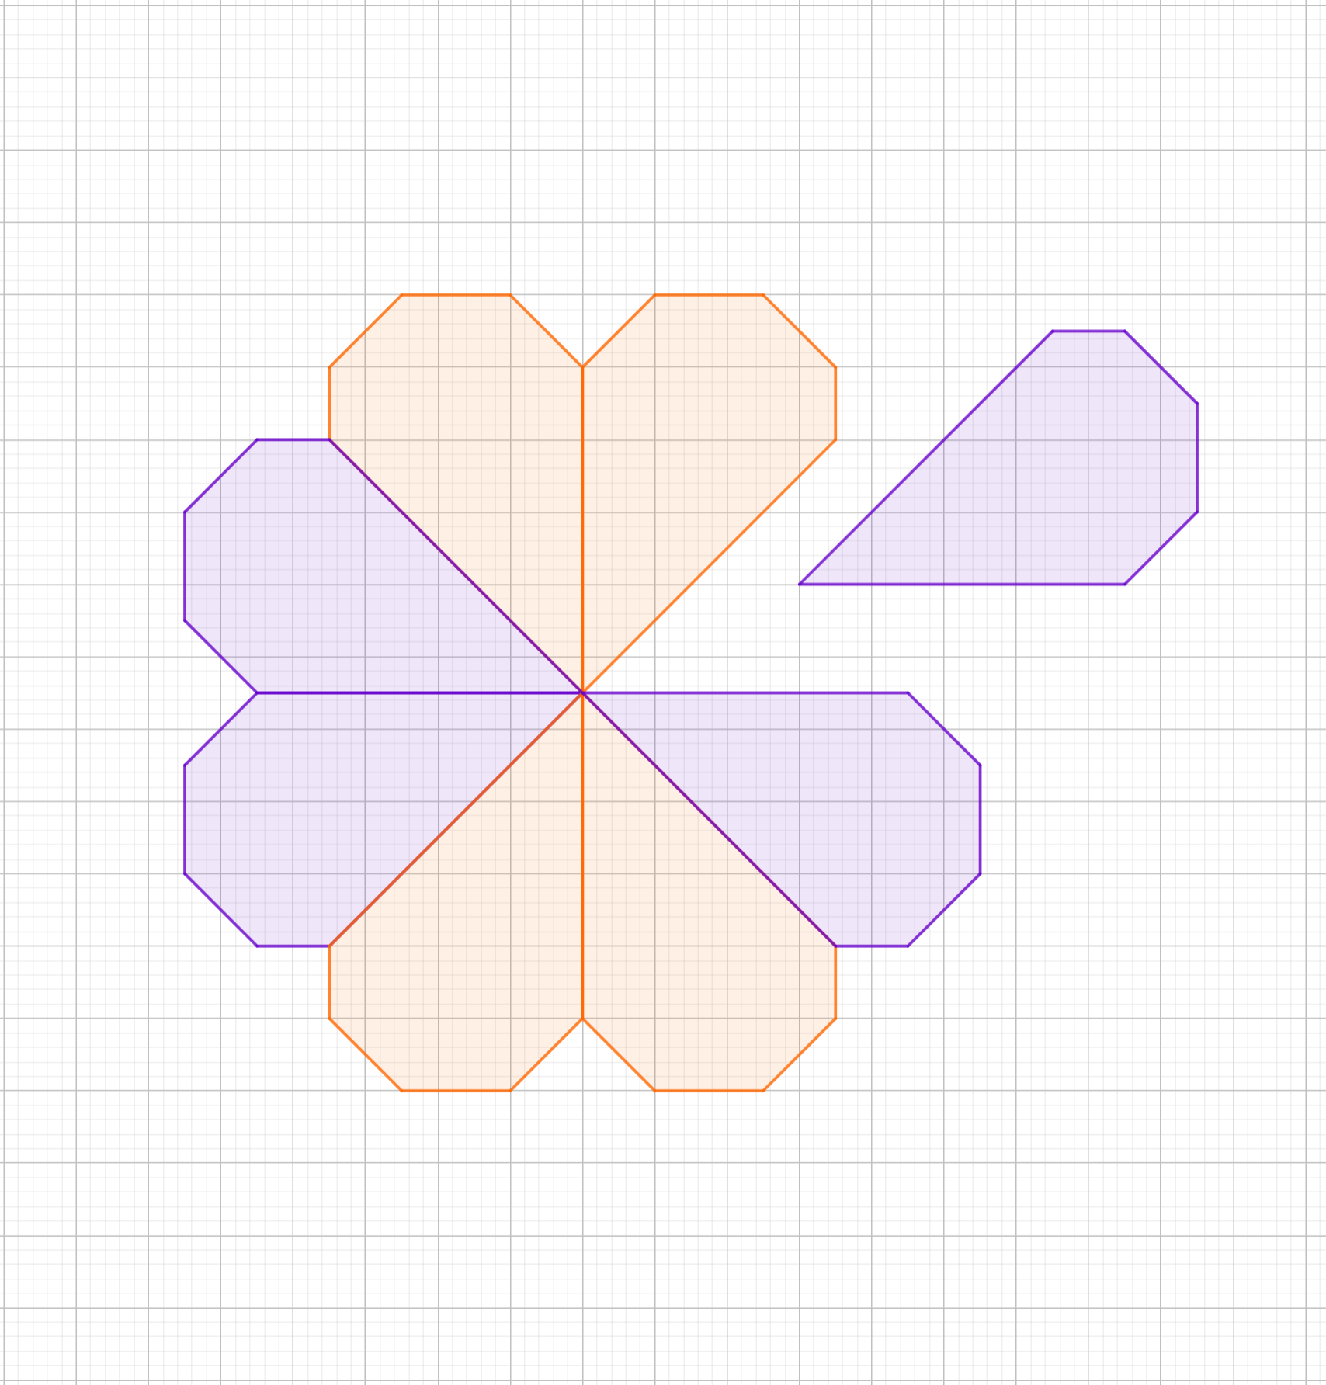
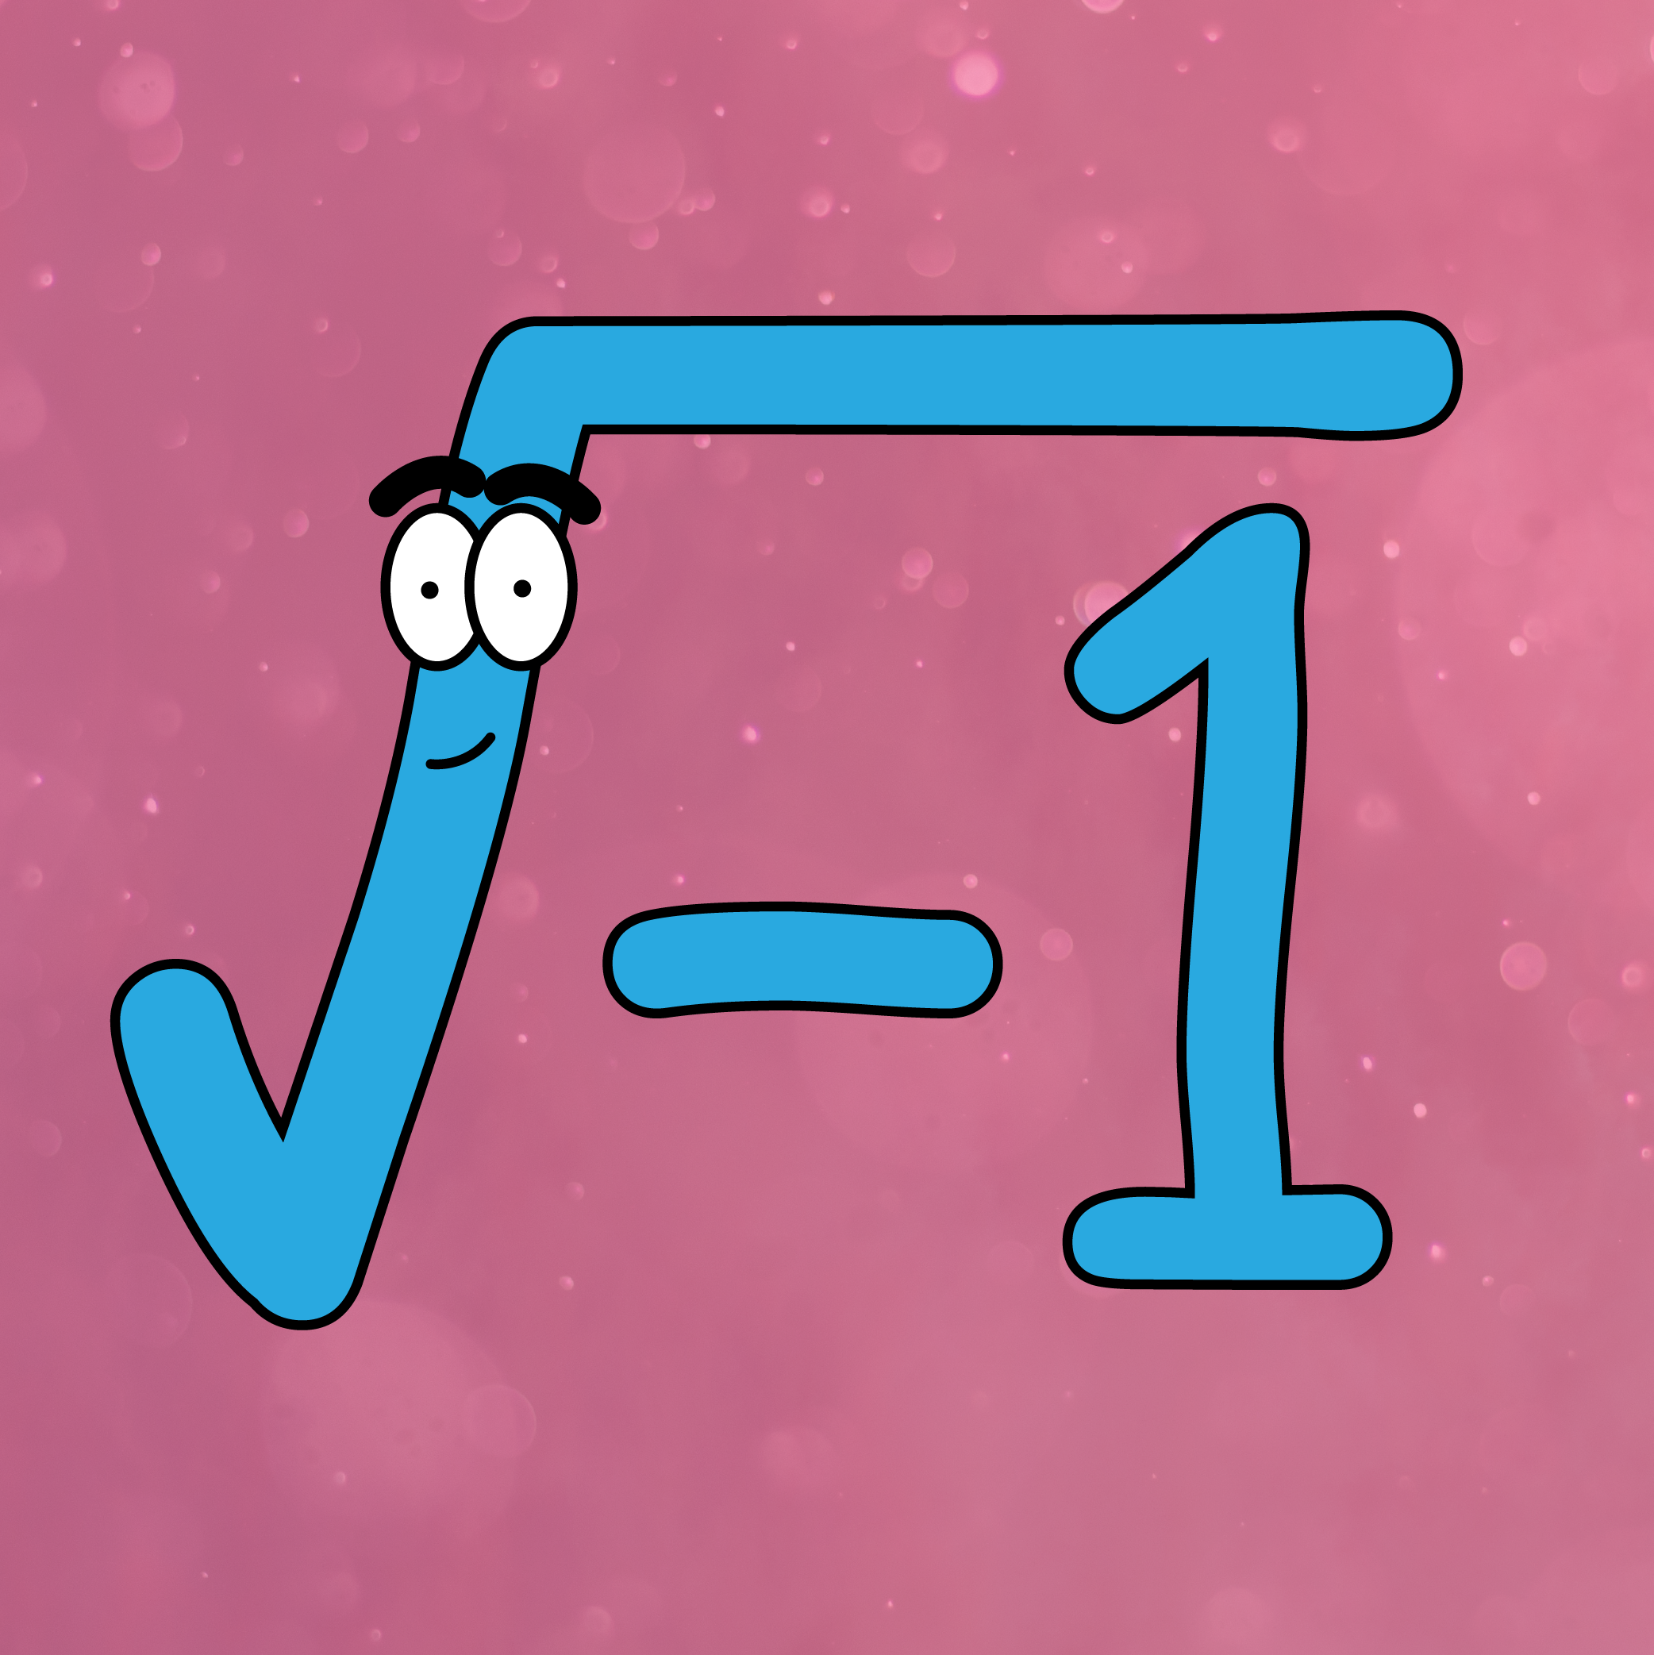
Lesson Showcase: Not Like the Others
Geometry Lesson (G.2D.1.7)
  A Perfect Match
  Students use the Not Like the Others strategy to compare
  similar and congruent triangles with the same area.
Algebra 2 Lesson (A2.N.1.1, A2.N.1.2)
  My Imaginary Friend, Part 1
  Students use the Not Like the Others strategy
  to get them in the mindset of finding patterns.
Notes:
① These are K20 math lessons that use the “Not Like the Others” strategy.
Next: Activity 2: Strategy Probe.
A Perfect Match: https://learn.k20center.ou.edu/lesson/1676
My Imaginary Friend, Part 1: https://learn.k20center.ou.edu/lesson/1477

Slide 19


Activity 2: Strategy Probe
Students are given a problem-solving task to complete, then are given sample responses to compare with their work. Students circle the method that most closely matches their process and then work to make sense of the other methods. (Keeley FACTs)
Notes:
① Read the “Strategy Probe” description.
Next: Potential purposes of this strategy.
Strategy: Keeley, P., & Tobey, C. R. (2011). Mathematics Formative Assessment: 75 Practical Strategies for Linking Assessment, Instruction, and Learning. Thousand Oaks, CA: Corwin, SAGE.

Slide 20
Strategy Probe
Potential Purposes:
  Help students consider alternative viewpoints.
  Challenge students’ existing ideas and encourage intellectual curiosity.
  Provide starting points for mathematical inquiry.
Notes:
① Read the potential purposes of this strategy.
Next: “Strategy Probe” example.
Source: Keeley, P., & Tobey, C. R. (2011). Mathematics Formative Assessment: 75 Practical Strategies for Linking Assessment, Instruction, and Learning. Thousand Oaks, CA: Corwin, SAGE.

Slide 21
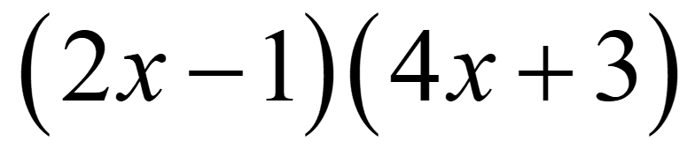
Strategy Probe Example
Expand:
  Be sure to show your thinking.
Notes:
① Ask participants to assume the role of students.
② Ask participants to show their work on the Note Catcher handout.
Next: Participants use “Strategy Probe” to select the method that most closely matches theirs.

Slide 22
Strategy Probe Example
Select the method that is most similar to your method.
A | B | C
Notes:
① Ask participants to select one of the given methods that matches their work most closely.
② Ask participants to show their work on the Note Catcher handout.
Next: Participants analyze the other methods.

Slide 23
Strategy Probe Example
Analyze the other methods that you did not select.
A | B | C
Notes:
① Ask participants to analyze the methods that they did not select.
Next: Participants discuss the different methods and their own work with their groups.

Slide 24
Strategy Probe Example
Discuss all methods with your group.
A | B | C
Notes:
① Ask participants to discuss the different methods and their own work with their groups.
Next: Did anyone use a method not shown?

Slide 25
Strategy Probe Example
Did anyone use a method not shown?
A | B | C
Notes:
① Ask participants if anyone used a method not shown.
② If someone used a different method, ask participant(s) to share it with the whole group.
③ Remind participants that this activity also helps students develop a deep and flexible conceptual understanding—which is one of the MAPs.
④ Remind participants to use the Note Catcher handout to take notes on how they might use the “Strategy Probe” technique in their own classrooms.
Next: BREAK

Slide 26

Activity 3: Quick Checks
These are ways of quickly assessing students at different points of the lesson, often called “temperature checks.” Like cooking and tasting the sauce as you season it, getting student feedback tells you
what to address. (K20 Center)
Notes:
① Read the description of “Quick Checks.”
Next: Potential purposes of this strategy.

Slide 27
Quick Checks
Potential Purposes:
  Use feedback to inform immediate or later adjustments to instruction.
  Evaluate the effectiveness of a lesson.
  Include and encourage participation from all learners.
Notes:
① Read the potential purposes.
Next: “Quick Checks” example—for use at the beginning of a lesson.
Source: Keeley, P., & Tobey, C. R. (2011). Mathematics Formative Assessment: 75 Practical Strategies for Linking Assessment, Instruction, and Learning. Thousand Oaks, CA: Corwin, SAGE.

Slide 28

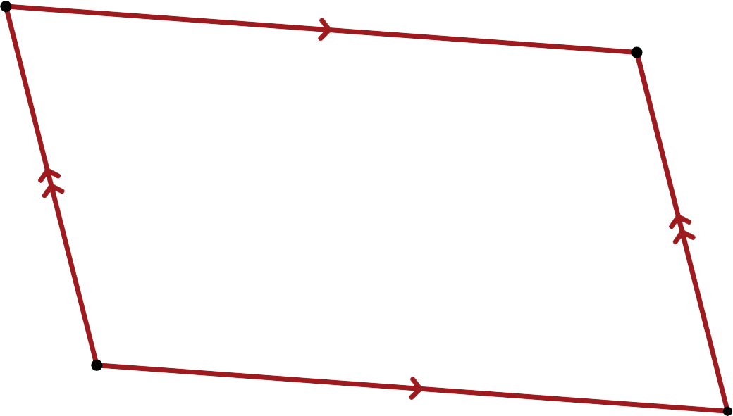
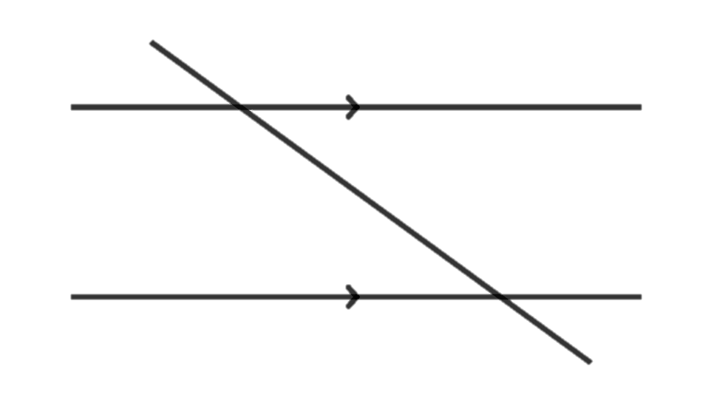
Beginning of the Lesson: Bell Ringers
What do you know about what you see below?
  (You could show any one of these.)
Notes:
① Ask participants to assume the role of students.
② Ask participants to show their work on the Note Catcher handout.
③ Remind participants that this type of broad questioning takes practice, like a classroom procedure.
Next: “Quick Checks” example—for use during a lesson.
Strategy: K20 Center. (n.d.). Bell ringers and exit tickets. Strategies. https://learn.k20center.ou.edu/strategy/125

Slide 29


During the Lesson
Thumbs Up, Thumbs Down
  Students give a thumbs up if they are ready to move and a thumbs down if they are not. (Keeley FACTs)
Notes:
① Read the description of this strategy.
Next: Another “Quick Checks” example—also for use during a lesson.
Strategy: Keeley, P., & Tobey, C. R. (2011). Mathematics Formative Assessment: 75 Practical Strategies for Linking Assessment, Instruction, and Learning. Thousand Oaks, CA: Corwin, SAGE.

Slide 30

During the Lesson
Fist to Five
  Students indicate the extent of their understanding by holding up their hand with the appropriate number of fingers. (K20 LEARN)
Notes:
① Read the description of this strategy.
Next: “Quick Checks” example—for use at the end of a lesson.
Strategy: K20 Center. (n.d.). Fist to Five. Strategies. https://learn.k20center.ou.edu/strategy/68

Slide 31
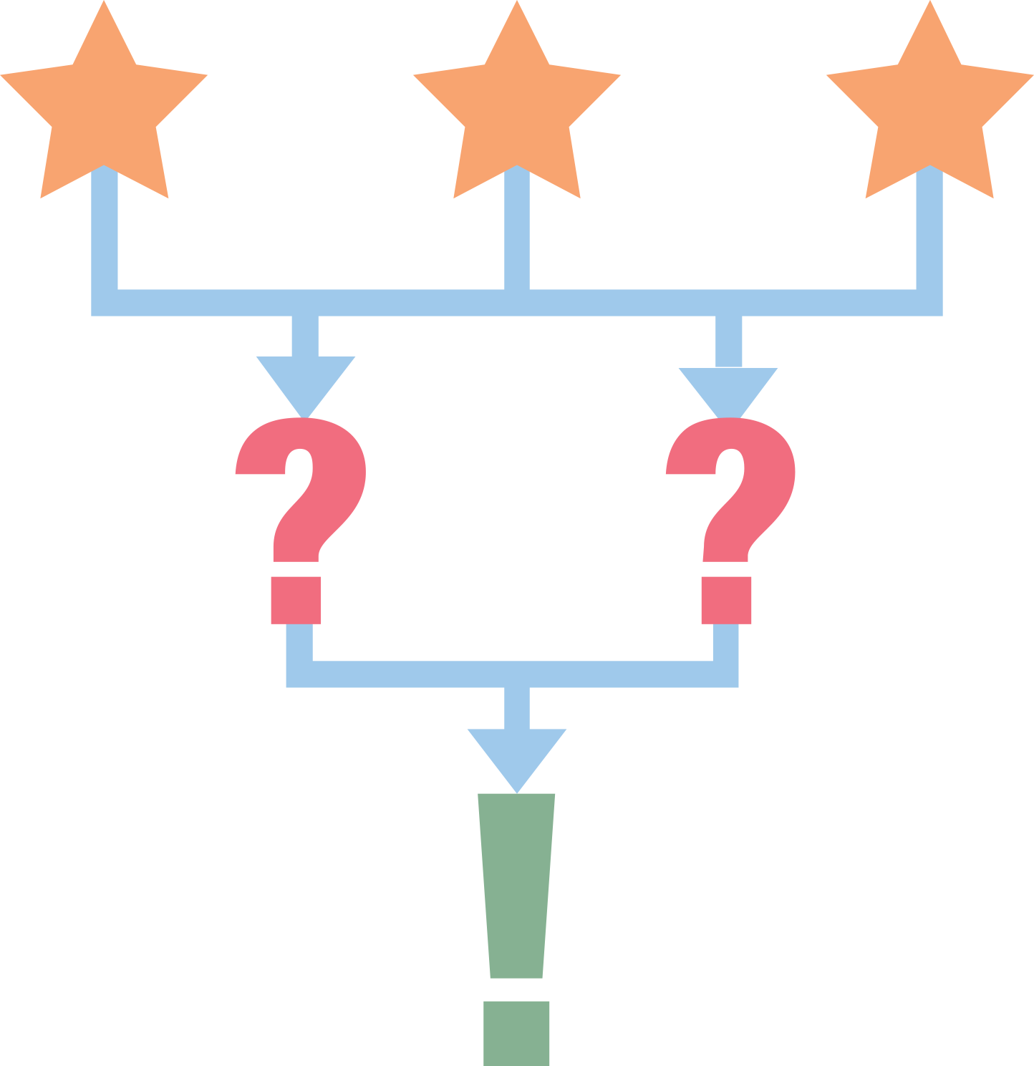
End of the Lesson
3-2-1
  Students write 3 things they learned,
  2 questions they still have, and 1 thing they found interesting. (K20 LEARN)
  This can be modified. For example, students could write 3 things they learned, 2 comments they have about the lesson, and 1 question they still have.
Notes:
① Read the description of this strategy.
Next: Another “Quick Checks” example—for use at the end of a lesson.
Strategy: K20 Center. (n.d.). 3-2-1. Strategies. https://learn.k20center.ou.edu/strategy/117

Slide 32

End of the Lesson
Muddiest Point
  Students write about the part of the lesson they found the “muddiest” (most confusing) and the part they found the clearest or easiest.
  (K20 LEARN)
Notes:
① Read the description of this strategy.
Next: Participants create their own formative assessment using a “Quick Check” strategy on the Math Assessment Strategies slide deck.
Strategy: K20 Center. (n.d.). Muddiest Point. Strategies. https://learn.k20center.ou.edu/strategy/109

Slide 33
Quick Checks
Develop a Quick Check formative assessment that you could use in the next couple of weeks.
Post your assessments in the Math Assessment Strategies slide deck.
  Be sure to consider the strategy’s
  placement in the lesson and the
  purpose of your assessment.
Notes:
① Direct participants to open the Math Assessment Strategies slide deck.
② Direct each participant to go to a different slide number to type their formative assessment idea.
③ Remind participants to include the lesson objective, course name, description of the assessment, and where they would put the strategy in a lesson with their reasoning.
Next: K20 lesson showcase—lesson that uses “Fist to Five.”

Slide 34

Lesson Showcase: Fist to Five
Algebra 2 Lesson (A2.N.1.2)
  My Imaginary Friend, Part 2
  Students use the Fist to Five strategy to reflect on what they learned throughout the lesson.
Notes:
① This is a K20 math lesson that uses the “Fist to Five” strategy.
Next: K20 lesson showcase—lessons that use “3-2-1.”
My Imaginary Friend, Part 2: https://learn.k20center.ou.edu/lesson/1539

Slide 35
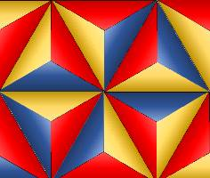
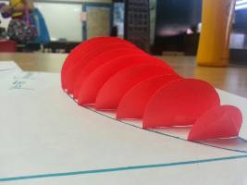
Lesson Showcase: 3-2-1
Geometry Lesson (G.2D.1.7)
  If at First You’re Not the Same, Try Triangles! (Part 1)
  Students use the 3-2-1 strategy to reflect on what they learned throughout the lesson.
Geometry Lesson (G.3D.1.1, G.3D.1.2)
  What Does That Look Like?
  Students use the 3-2-1 strategy to reflect on what they learned throughout the lesson.
Notes:
① These are K20 math lessons that use the “3-2-1” strategy.
Next: K20 lesson showcase—lessons that use “Muddiest Point.”
If at First You're Not the Same, Try Triangles! (Part 1): https://learn.k20center.ou.edu/lesson/407
What Does That Look Like?: https://learn.k20center.ou.edu/lesson/271

Slide 36


Lesson Showcase: Muddiest Point
Algebra 1 Lesson (A1.F.3.2, A1.F.3.3)
  Shiver Me Functions!
  Students complete a Muddiest Point activity to identify what still needs to be clarified.
Algebra 1 Lesson (A1.A.3.1)
  Journey of the Isolated Variable, Part 3
  Students respond to a Muddiest Point prompt
  to identify any remaining questions or confusion
  about literal equations.
Notes:
① These are K20 math lessons that use the “Muddiest Point” strategy.
Next: Activity 4: My Favorite Mistake.
Shiver Me Functions: https://learn.k20center.ou.edu/lesson/373
Journey of the Isolated Variable, Part 3: https://learn.k20center.ou.edu/lesson/1253

Slide 37

Activity 4: My Favorite Mistake
Students solve a problem and write their responses on index cards. Collect and sort the cards into two groups: correct and incorrect. Next, select a favorite mistake
and share the anonymous answer with the class.
Ask students what was done correctly. Then,
discuss what should be changed. (K20 LEARN)
Notes:
① Read the “My Favorite Mistake” strategy description.
Next: Potential purposes of this strategy.
Strategy: K20 Center. (n.d.). My Favorite Mistake. Strategies. https://learn.k20center.ou.edu/strategy/115

Slide 38
My Favorite Mistake
Potential Purpose:
  Increase students’ comfort and confidence in making their own ideas public.
Notes:
① Read the potential purpose.
Next: Set the stage to demonstrate the “My Favorite Mistake” strategy.
Source: Keeley, P., & Tobey, C. R. (2011). Mathematics Formative Assessment: 75 Practical Strategies for Linking Assessment, Instruction, and Learning. Thousand Oaks, CA: Corwin, SAGE.

Slide 39
My Favorite Mistake
Students were asked
to solve the equation:
I have selected my favorite mistake (on the right).
Notes:
① Describe how students were asked to solve an equation.
② Describe how work was collected from students.
③ As the teacher, you have selected your favorite mistake.
Next: Model the strategy by asking the group [class] what was done well and to find the mistake.

Slide 40
My Favorite Mistake
What did this student do well?
Where is the mistake?
Notes:
① Model the “My Favorite Mistake” strategy by asking the whole group [class] what the student did well (which parts of their work are correct).
② After many responses, ask the group [class] to find the mistake.
Next: “What? So What? Now What?” reflection.

Slide 41

What? So What? Now What?
What?
  What did you learn today?
So What?
  Why is formative assessment important?
Now What?
  What are you going to do with this new knowledge?
Notes:
① Ask participants to reflect on what they have learned by answering the “What? So What? Now What?” prompts.
② Direct participants to record their responses on the Note Catcher handout and consider how they might use this strategy in their own classrooms.
Next: K20 lesson showcase—lessons that use “What? So What? Now What?”
Strategy: K20 Center. (n.d.). What? So What? Now What? Strategies. https://learn.k20center.ou.edu/strategy/95

Slide 42

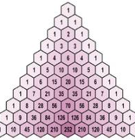
Lesson Showcase: What? So What? Now What?
Geometry Lesson (G.RT.1.2, G.RT.1.3, G.RT.1.4)
  Trig-O-Nom-E-Tree!
  Students use the What? So What? Now What? strategy
  to reflect on what they have learned.
Algebra 2 Lesson (A2.A.2.2)
  Expanding Binomials, Expanding Your Mind (Part 1)
  Students respond to What? So What? Now What?
  prompts to help the teacher determine whether
  the class is ready to move on.
Notes:
① These are K20 math lessons that use the “What? So What? Now What?” strategy.
Next: End of session
Trig-O-Nom-E-Tree!: https://learn.k20center.ou.edu/lesson/537
Expanding Binomials, Expanding Your Mind (Part 1): https://learn.k20center.ou.edu/lesson/560

