Slide 4
Formative Assessment in the English Language Arts Classroom

Slide 5
Essential Question
What is formative assessment and what does it look like in the English language arts classroom?

Slide 6
Session Objectives
Explore a variety of strategies that support formative assessment in the English language arts classroom.
Examine metacognitive strategies for supporting students in their efforts to be self-directed learners.

Slide 7
INSERT A PHOTO OF THEIR PURPOSES from Anchor Chart

Slide 8
Magnetic Statements
Read each of the statements hanging around the room.
Choose one of the statements that you are most attracted to.
Discuss your reasons with the others gathered around the same statement.
Be prepared to share out.
Notes:
K20 Center. (n.d.) Magnetic Statements. Strategies. https://learn.k20center.ou.edu/strategy/166

Slide 9
Magnetic Statements
When a teacher teaches, no matter how well he or she might design a lesson, what a child learns is unpredictable. Children do not always learn what we teach. That is why the most important assessment does not happen at the end of learning - it happens during the learning, when there is still time to do something with the information.
Dylan Wiliam

Slide 10
Magnetic Statements
In an effective classroom students should not only know what they are doing. They should also know why and how.
Harry Wong

Slide 11
Magnetic Statements
As soon as students get a grade the learning stops. We may not like it, but the research reviewed here shows that this is a relatively stable feature of how human minds work.
Dylan Wiliam

Slide 12
Magnetic Statements
When teachers do formative assessment effectively, students learn at roughly double the rate than they do without it.
Dylan Wiliam

Slide 13
Magnetic Statements
For teachers, as for students, the most effective evaluation comes from someone who sits beside us and helps us grow.
Carol Ann Tomlinson

Slide 14
Magnetic Statements
Not everything that counts can be counted, and not everything that can be counted counts.
William Bruce Cameron

Slide 15
Reflection Questions
Why did we do this strategy here?
Could we have used it in a different part of the session?
How could you use this when teaching writing?
How would it change if you used it in a literature lesson?

Slide 16
English Language Arts Strands
Speaking and Listening
Reading Foundations
Reading & Writing Processes
Critical Reading & Writing
Language
Research
Multimodal Literacies
Independent Reading & Writing
Notes:
2021 Oklahoma Academic Standards for English Language Arts.

Slide 17
K20 LEARN Website
https://learn.k20center.ou.edu
Notes:
All the strategies we are going to look at come from/come from lessons on LEARN

Slide 18
Caption This
Look closely at the images, paying attention to all of the details.
Use the handout to collect your thoughts about each image.
Share your caption with an Elbow Partner.
Notes:
K20 Center. (n.d.). Caption This. Strategies. https://learn.k20center.ou.edu/strategy/82

Slide 19
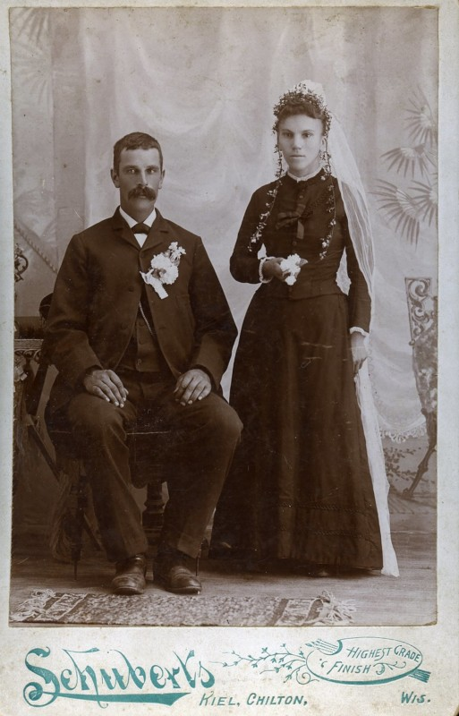
Caption This
Look closely at the image, paying attention to all the details.
Use the handout to collect your thoughts about the image.
Share your caption with your Elbow Partner.
Notes:
K20 Center. (n.d.). Elbow Partners. Strategies. https://learn.k20center.ou.edu/strategy/116)
Maresca, F. (n.d.). I do, I do. The Ricco/Maresca Gallery. [Photograph]. 1116250554 843199625 https://petapixel.com/2017/07/03/wedding-photos-looked-like-late-1800s/

Slide 20
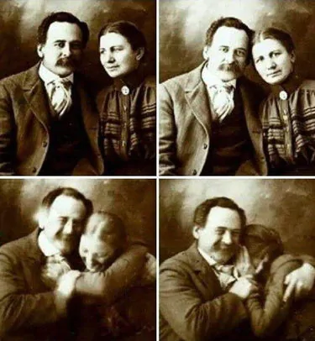
Caption This
Look closely at the image, paying attention to all of the details.
Use the handout to collect your thoughts about the image.
Share your caption with your Elbow Partner.
Notes:
U/AdamCannon. (2018). A Victorian couple trying not to laugh while having their portraits done. [Digital image]. Retrieved December 09, 2020, from https://www.reddit.com/r/aww/comments/9ae9xy/a_victorian_couple_trying_not_to_laugh_while/

Slide 21
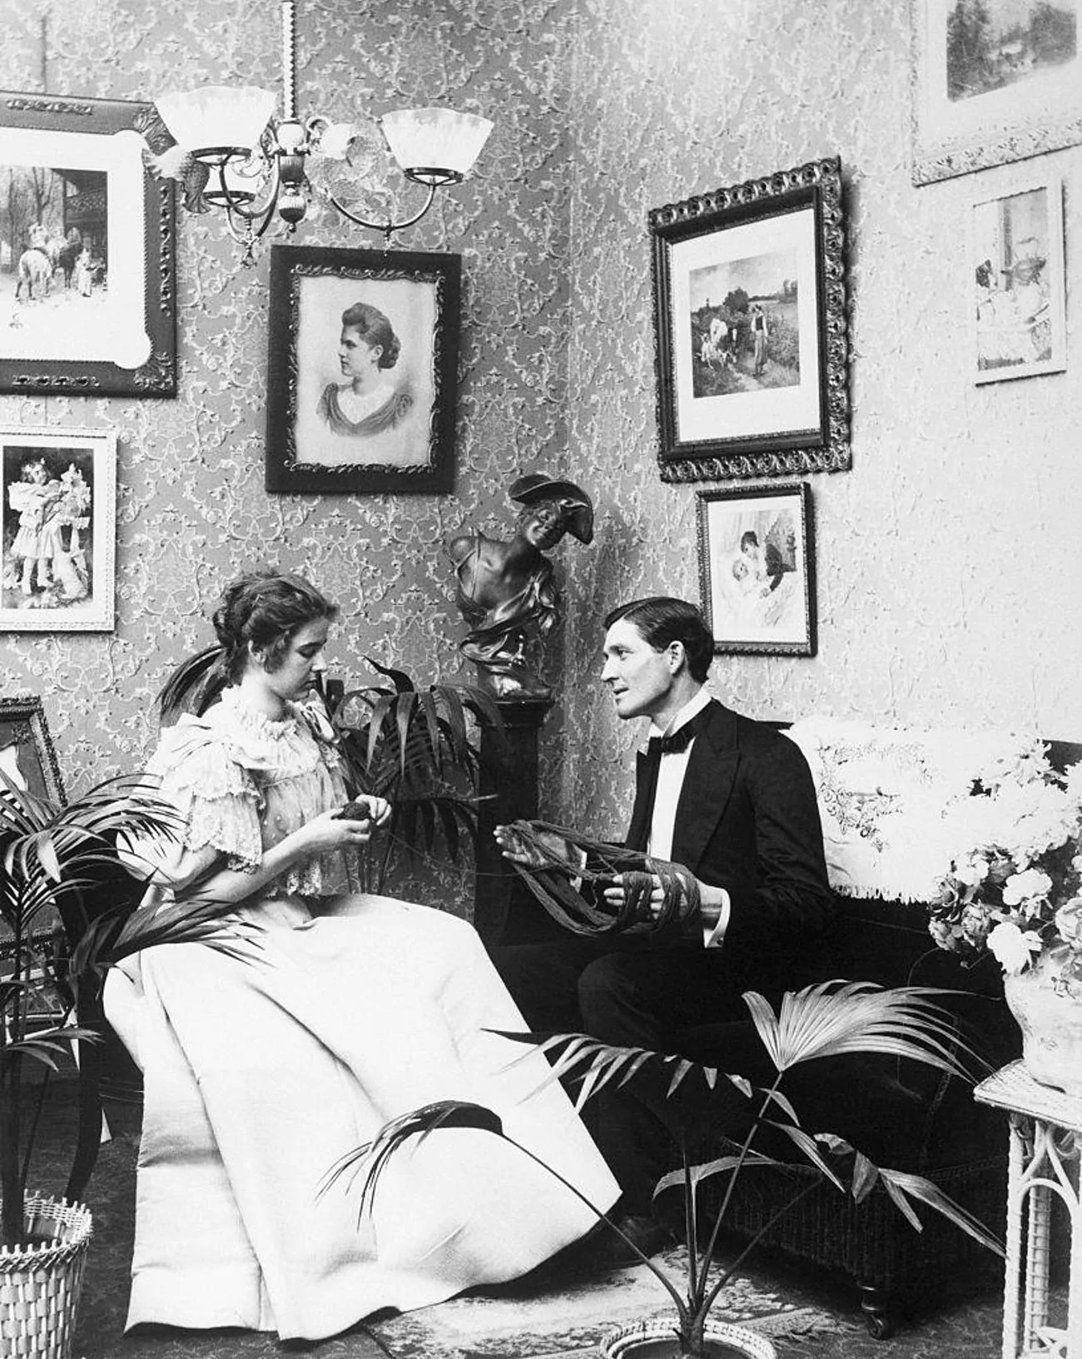
Caption This
Look closely at the image, paying attention to all of the details.
Use the handout to collect your thoughts about the image.
Share your caption with your Elbow Partner.
Notes:
Dillinger, S. (2019, Mar 21). Photos of adorable 19th-century couples. https://www.ranker.com/list/cute-1800s-couples-photos/samantha-dillinger

Slide 22
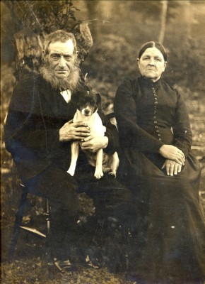
Caption This
Look closely at the image, paying attention to all of the details.
Use the handout to collect your thoughts about the image.
Share your caption with your Elbow Partner.
Notes:
Hallam, F. (n.d.). Old couple with dog, photographed before 1900. [Photograph]. (1890). Bottesford Local History Archive In 1116285682 843222538. https://www.bottesfordhistory.org.uk/content/catalogue_item/bottesford-local-history-archive/photographs-contributed-by-miss-margaret-taylor-and-mr-frank-hallam/old-couple-with-dog-photographed-before-1900

Slide 23
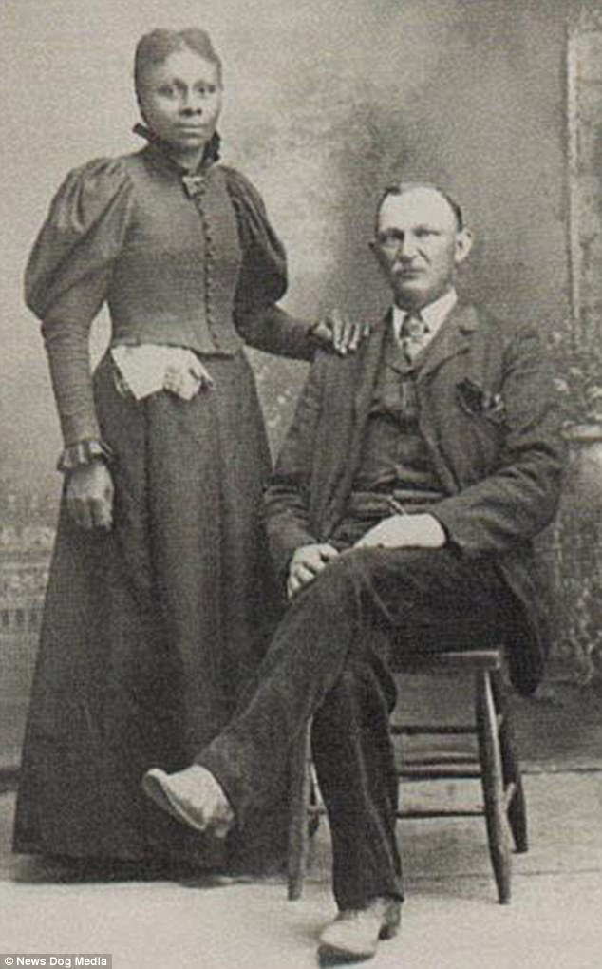
Caption This
Look closely at the image, paying attention to all of the details.
Use the handout to collect your thoughts about the image.
Share your caption with an Elbow Partner.
Notes:
Carter, H. (2018, January 18). The brave American couples who refused to let prejudice tear them apart - decades before laws prohibiting interracial marriages were finally banned [Digital image]. Retrieved December 09, 2020, from https://www.dailymail.co.uk/femail/article-5283243/19th-Century-images-capture-brave-interracial-couples.html

Slide 24
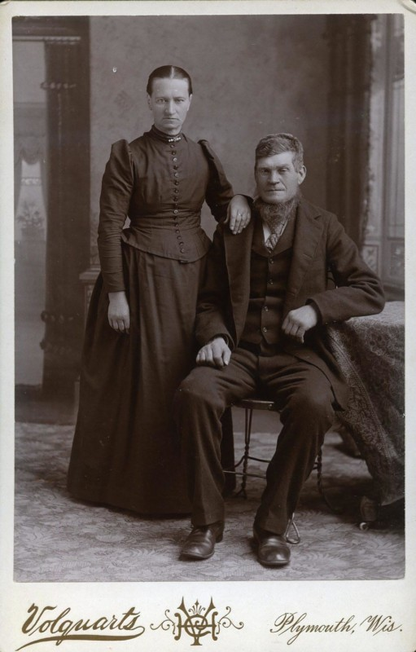
Caption This
Look closely at the image, paying attention to all of the details.
Use the handout to collect your thoughts about the image.
Share your caption with your Elbow Partner.
Notes:
https://petapixel.com/2017/07/03/wedding-photos-looked-like-late-1800s/
[Photograph]. (2017, June 29). I DO, I DO, The Ricco/Maresca Gallery, New York In 1116250554 843199625 F. Maresca (Comp.).

Slide 25
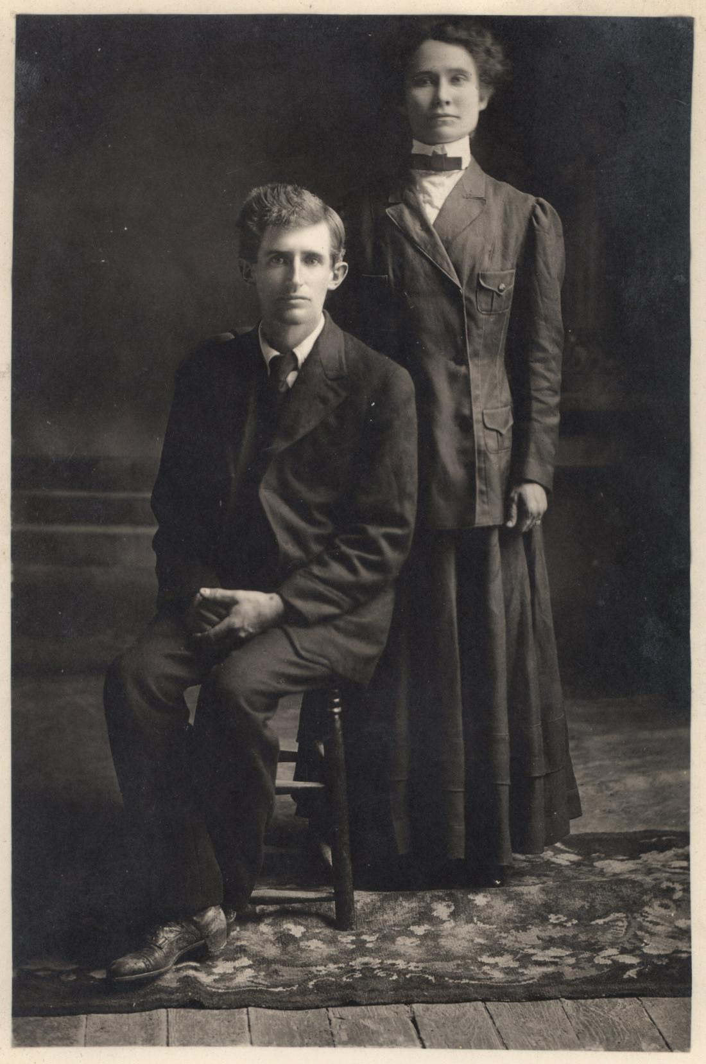
Totally Different Stories
What information could this assessment tell you about your students?
How could the lesson change if you used it in a different spot?
How would it change if you used it in a different context?
https://learn.k20center.ou.edu/lesson/1086?rev=9209
Notes:
K20 Center. (n.d.) Totally Different Stories. Lesson. https://learn.k20center.ou.edu/lesson/1086?rev=9209
Chopin, K. (n.d.). Story of An Hour. https://www.commonlit.org/en/texts/story-of-an-hour
Chopin, K. (n.d.) The Awakening. https://learn.k20center.ou.edu/lesson/1086/Excerpt-from-The-Awakening-Totally-Different-Stories.docx?rev=9209
flickr. (n.d.) Unknown couple. Woman standing. Man sitting. [Photograph]. https://www.flickr.com/photos/freeparking/507248108
Share examples of comparing and contrasting book covers of the same novel, movie v. book cover,

Slide 26
How Believable Are They?
As you watch, think about the following:
Do you believe these storytellers? Why or why not?
What makes these stories believable or not believable?
What do you like or dislike about these stories?
Be prepared to share your responses with the group.

Slide 27
Notes:
Video Source: BuzzFeed Unsolved Network. (2019, June 22). People tell their spookiest ghost stories [Video]. YouTube. https://www.youtube.com/watch?v=1D1BqTYQ_rg

Slide 28
Fist to Five
On a scale of 0 to 5, how much do you believe these two stories?
Notes:
https://learn.k20center.ou.edu/lesson/975?rev=5761

Slide 29
How Believable Were They?
Now that you’ve watched the video, consider these questions:
Did you believe these storytellers? Why or why not?
What made these stories believable or not believable?
What did you like or dislike about these stories?
Notes:
Turn and talk: To answer the questions
Using this strategy: What does this tell you about your students knowledge about credible sources and reliability?
Padlet: Answering all the questions
Emoji Reflection - https://learn.k20center.ou.edu/strategy/927
Fist to Five - https://learn.k20center.ou.edu/strategy/68
Make emoji sticks

Slide 30
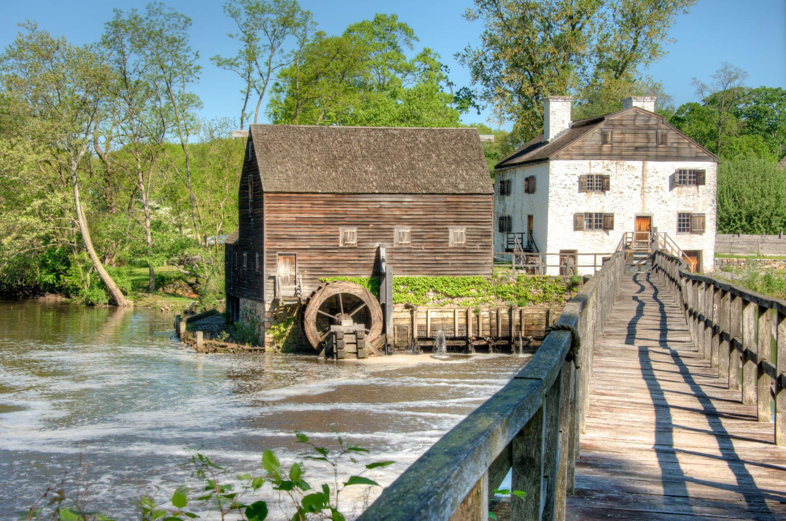
Ichabod and Brom: Ghostfacers
Why was this strategy used here?
Could you have used it in a different part of the lesson?
How could the lesson change if you used it in a different spot?
How would it change if you used it with a different piece of literature?
https://learn.k20center.ou.edu/lesson/975?rev=5761
Notes:
https://learn.k20center.ou.edu/lesson/975?rev=5761
Bestbudbrian. (2014, May 16). Philipsburg Manor (Sleepy Hollow), New York [Digital image]. Wikimedia Commons. https://commons.wikimedia.org/wiki/File:Philipsburg_Manor_(Sleepy_Hollow),_New_York.jpg

Slide 31
Note Catcher
Take a moment to reflect on the assessment strategies that we have participated in so far.
Answer the following questions:
How was it used?
How can I use it?
Notes:
Break after taking notes

Slide 32
Why-Lighting
In your assigned reading:
Highlight the main ideas that support or disprove the existence of aliens.
In the margins, jot down why the information is important.
Notes:
K20 Center. (n.d.). Why-Lighting. Strategies. https://learn.k20center.ou.edu/strategy/128

Slide 33
Why-Lighting
With your group:
Discuss any information you highlighted that supports the existence of aliens.
Discuss any information you highlighted that disproves the existence of aliens.

Slide 34
Alienstock
How could you adapt this lesson for your class?
What information can you glean from your students’ responses?
What skills/standards/content would you use this particular assessment to work toward?
https://learn.k20center.ou.edu/lesson/397
Notes:
https://learn.k20center.ou.edu/lesson/397

Slide 35
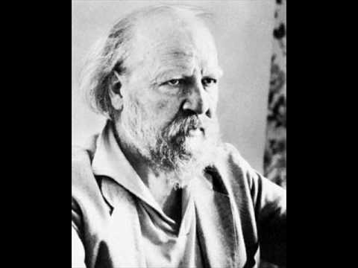
They Say/I Say Writing
As you watch the video of William Goulding speak, listen carefully for the following information:
General topic of the speech
Main argument
Examples/quotes that support the main argument
Notes:
YouTube. (2010). Golding's Introduction to Lord of the Flies. [Video]. YouTube. https://www.youtube.com/watch?v=vYnfSV27vLY&t=2s.

Slide 36
They Say/I Say Writing
Write two paragraphs to summarize Golding’s and your views about the novel.
Paragraph 1: Summarize the information you gathered from the video and text.
Paragraph 2: Summarize your views on the topic.
Notes:
K20 Center. (n.d.). They Say/I Say Writing. Strategies. https://learn.k20center.ou.edu/strategy/1644

Slide 37
They Say/I Say Writing
Write one paragraph that summarizes the information you gathered from the video.
The general argument made by (author) in the work, (title), is that (general topic). More specifically, (author's last name) argues that (main argument). She/he writes, “ (provide specific example/quote to support main argument).” In this passage, (author's last name) is suggesting that (explain the purpose of the example/quote). In conclusion, (author's last name)’s belief is that (restate main argument).
Notes:
Golding, W., & Lowry, L. (2016). Lord of the flies. Penguin Books.

Slide 38
They Say/I Say Writing
Write one paragraph that summarizes your view on the topic.
In my view, (author's last name) is wrong/right (choose one), because (provide general argument). More specifically, I believe that (give a specific reason/s). For example, (give a textual or real-life example to support your argument). Although (author's last name) might object that (explain what the author's counter-argument would be)*, I maintain that (provide your reasoning to support your side). Therefore, I conclude that (restate your opinion).
*Even if you agree with the author, find a point of contention. Where would the author disagree, even if slightly?
Notes:
Golding, W. & Lowry, L. (2016). Lord of the Flies. Penguin Graphic Deluxe Edition. Penguin Classics.

Slide 39
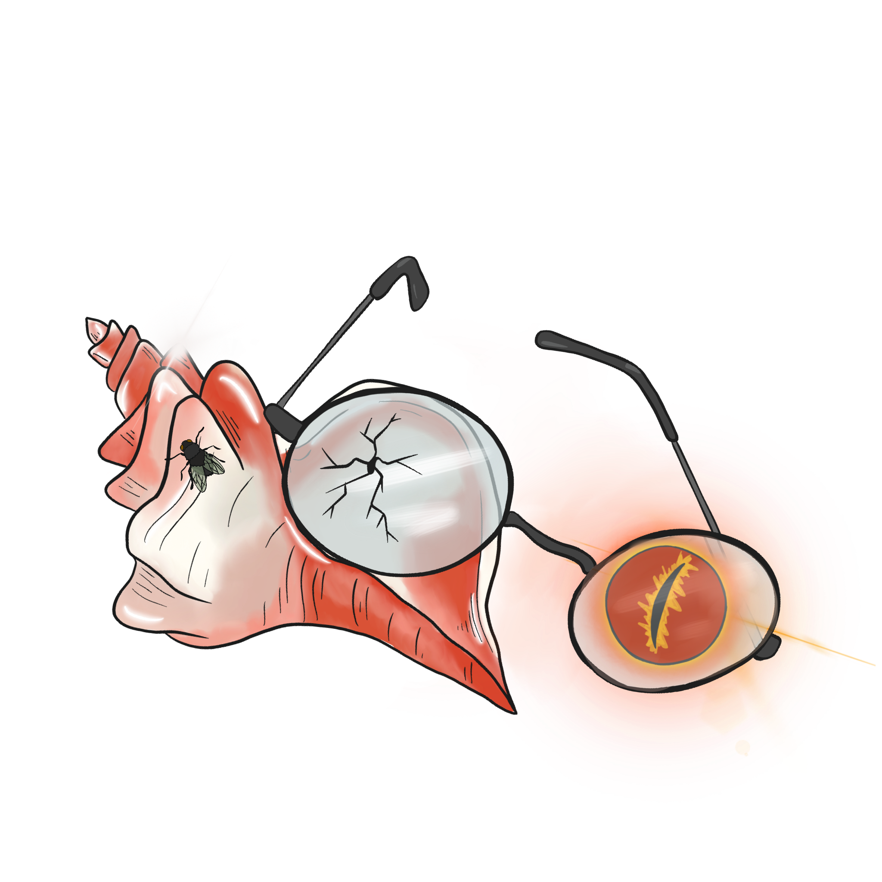
Lord of the Flies Unit: Lesson 8 (In the End)
Why was this strategy used here?
Could you have used it in a different part of the lesson?
How would you adapt it if you used it in a different piece of literature?
What does this show about student learning?
https://learn.k20center.oLu.edu/lesson/1662?rev=10024
Notes:
K20 Center. (n.d.). Lord of the Flies Unit: Lesson 8: In the End. [Lesson]. https://learn.k20center.ou.edu/lesson/1662?rev=10024

Slide 40
ABC Graffiti
Work in small groups to brainstorm words or phrases that connect to the following question:
What are different temptations people face?
Be prepared to move after time is called. You’ll need only the marker provided to your group.
Notes:
Posters or Shared Google Doc
The Odyssey- What is there about teaching The Odyssey specifically that would help students understand the story? Why is this particular question fitting to use this in the lesson?

Slide 41
What are different temptations people face?
Round 1
In your small group, generate words or phrases related to the topic for each letter of the alphabet.

Slide 42
What are different temptations people face?
Round 2
Rotate to the next poster and read through the list. Add words and phrases for the letters that have not already been addressed.

Slide 43
What are different temptations people face?
Round 3
Once again, rotate to the next poster and read through the list. Add words and phrases for the letters that have not already been addressed.

Slide 44
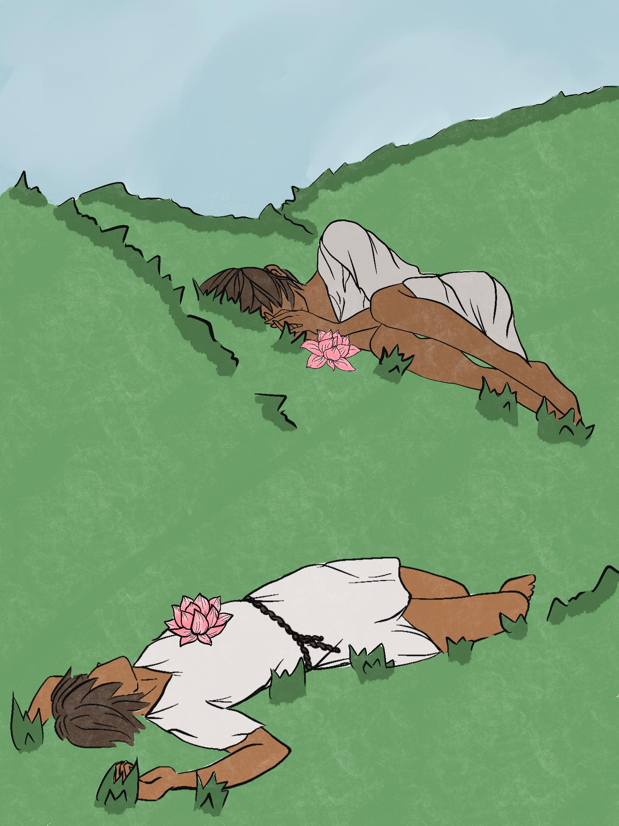
Just Say No! The Lotus Eaters
How could you adapt this lesson for your class?
What are some temptations your class might share?
How might you used this in:____ ?
What information can you glean from your students’ responses?
What skills/standards/content might you use this particular assessment to work toward?
https://learn.k20center.ou.edu/lesson/945?rev=8885
Notes:
https://learn.k20center.ou.edu/lesson/945?rev=8885
Why was this used here?
Could you have used it in a different part of the lesson?

Slide 45
Note Catcher
Take a moment to reflect on the assessment strategies that we have examined and answer the following questions:
How was it used?
How can I use it?
Notes:
Break after taking notes

Slide 46
Formative Assessment Needs a Learning Goal
“
Selecting a FACT [formative assessment classroom technique] without a teaching or learning goal in mind because it seems like a fun activity to use in the classroom is analogous to “activity mania”—selecting...activities that are fun and engaging to students but do not necessarily promote learning or inform teaching.
-Page Keeley & Cheryl Rose Tobey

Slide 47
Creating Your Own Formative Assessment
Select one of the assessment strategies demonstrated today.
Create a formative assessment for a topic or content you will be teaching next quarter.
Things to consider:
What information or skills do you want your students to demonstrate in the assessment?
How will you know if they are successful?
What are some misconceptions that might arise?
How might you address these misconceptions?
Notes:
Provide examples of how they could adjust/revise some of the strategies for their needs.
Take one of these and think about it specifically through the lens of your content and what you will be teaching this next quarter.

Slide 48
Trek Eval

