Slide 2
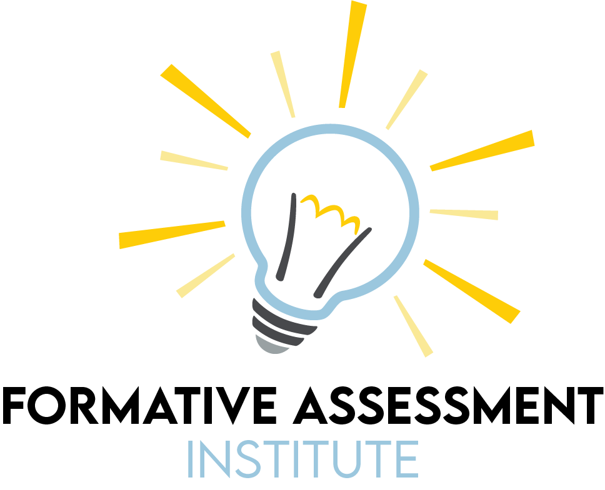

Slide 3
Formative Assessment and Your Content Area

Slide 4
GEAR UP for the FUTURE Goals
Increase cohort academic performance and preparation for postsecondary education (PSE).
Increase high school graduation and PSE participation.
Increase student educational expectations and increase student and family knowledge of PSE options, preparation, and financing.
Notes:
Instructor/Facilitator Notes:

Slide 5
GEAR UP O+K=C Goals
Increase students’ engagement in learning.
Increase students’ academic preparation for PSE upon graduation.
Increase schools’ high school graduation and PSE enrollment rates.
Increase students’ and their families’ knowledge of PSE options, preparation, and financing.
Notes:
Instructor/Facilitator Notes: Ayanna
Here our are grant specific goals for GEAR UP OKC

Slide 6
GEAR UP for MY SUCCESS Goals
Increase cohort academic performance and preparation for PSE.
Increase high school graduation and PSE participation.
Increase student educational expectations and increase student and family knowledge of PSE options, preparation, and financing.
Notes:
Instructor/Facilitator Notes:

Slide 7
Essential Question
What is the role of assessment in the design of effective learning environments?

Slide 8
Lesson Objectives
Define formative assessment.
Analyze strategies to determine their purpose in the formative assessment-centered classroom.

Slide 9
PURPOSES OF FORMATIVE ASSESSMENT
Insert photo of the collaborative list developed in the first session.

Slide 10
Collaborative Word Cloud
What are some characteristics of formative assessment?
Notes:
Word Cloud - Work in small groups to generate 3-5 characteristics unique to formative assessment. Put them in a word cloud and share with the group. Ask them to think about what we have done so far to come up with their ideas.
Examples - ongoing, informs instruction, not graded...
K20 Center. (n.d.) Collaborative Word Cloud. Strategies. https://learn.k20center.ou.edu/strategy/103

Slide 11
Collaborative Word Cloud
Insert a photo of the collaborative word cloud.

Slide 12
Frayer Model
What is formative assessment?
Definition in your own words
Characteristics
Examples
Non-examples
Notes:
K20 Center. (n.d.) Frayer Model. Strategies. https://learn.k20center.ou.edu/strategy/126

Slide 13
Page Keeley Definition
Formative assessment is a systematic process of collecting evidence about students’ thinking and learning to inform instruction and provide feedback to the students while simultaneously promoting learning. It happens during the learning process.
It is assessment for learning rather than assessment of learning, and it can also be assessment as learning.
Notes:
Keeley, P. (2019). GUEST Editorial: Formative Assessment in the Science Classroom: What It Is and What It Is Not. Science and Children, 56(9), 8–11. https://www.jstor.org/stable/26901465

Slide 14
Assessment vs. Evaluation
Assessment
Evaluation
Uses classroom research to provide useful feedback for the improvement of teaching and learning.
Feedback from the student to the instructor about the student’s learning.
Uses methods and measures to judge student learning and understanding of the material for the purposes of grading and reporting.
Feedback from the instructor to the student about the student’s learning.
Notes:
Just an additional point. These terms are often used interchangeably but they have different purposes. Formative assessment should never be evaluation. That is why we say that assessments should not receive grades (other than participation).

Slide 15
Metacognition - Thinking About Thinking
Awareness of your own thinking processes.
What did we do?
What works for me?
Can I explain what I learned?
What questions do I still have?
How do I know that?
Should I ask for extra help?
Notes:
One of the hardest things to think about is assessment AS learning. As teachers, we are charged with getting students to think about their own learning. This is called metacognition.

Slide 16
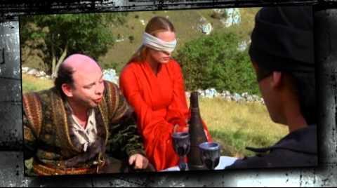
Notes:
YouTube. (2011). YouTube. Retrieved October 14, 2021, from https://www.youtube.com/watch?v=9s0UURBihH8&t=47s.
Interviews - ://www.colorado.edu/assett/resources/strategies-student-success/metacognition-video-series-gets-you-thinking
Short animated - https://www.youtube.com/watch?v=QJWsIJQHUxM
Princess Bride - https://www.youtube.com/watch?v=9s0UURBihH8&t=47s
Metacognition: awareness of your own thinking processes. George Does the Opposite

Slide 17
What Are You Doing? Why Are You Doing It?
This instructional strategy is a quick formative assessment of your class's understanding of the purpose of a learning activity.
The data collected in this quick check-in will tell you if your students are engaged both with their hands-on and their minds-on.
How might you use this in your content area?
Notes:
K20 Center. (n.d.) What Are You Doing and Why? Strategies. https://learn.k20center.ou.edu/strategy/1872?rev=11592

Slide 18
Note Catcher
Take a moment to reflect on the assessment strategies that we have explored.
Answer the following questions:
How were they used?
How can I use them?

Slide 19
Welcome Back!
Find a seat with your PLC/content area groups, and we’ll get started in just a few minutes.

Slide 20
Card Sort
With your group
Read each brief scenario.
Determine if the scenario is one of the following:
Assessment as Learning
Assessment of Learning
Assessment for Learning
Sort them according to these three categories.
Notes:
K20 Center. (n.d.). Card Sort. Strategies. https://learn.k20center.ou.edu/strategy/147

Slide 21
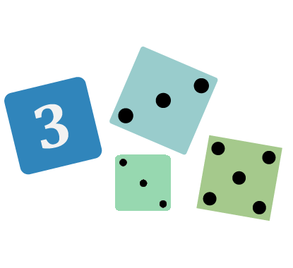
Not Like the Others
This strategy challenges students to identify similarities and differences among a group of words or pictures.
Students select a word or picture from a group that they believe does not fit.
Then they justify their choices to their peers.
Notes:
Now that we have explored the characteristics and purposes of formative assessment in general, the rest of our time will be devoted to looking at how formative assessment can be used in specific content areas.
K20 Center. (n.d.). Not Like the Othes. Strategies. https://learn.k20center.ou.edu/strategy/77

Slide 22
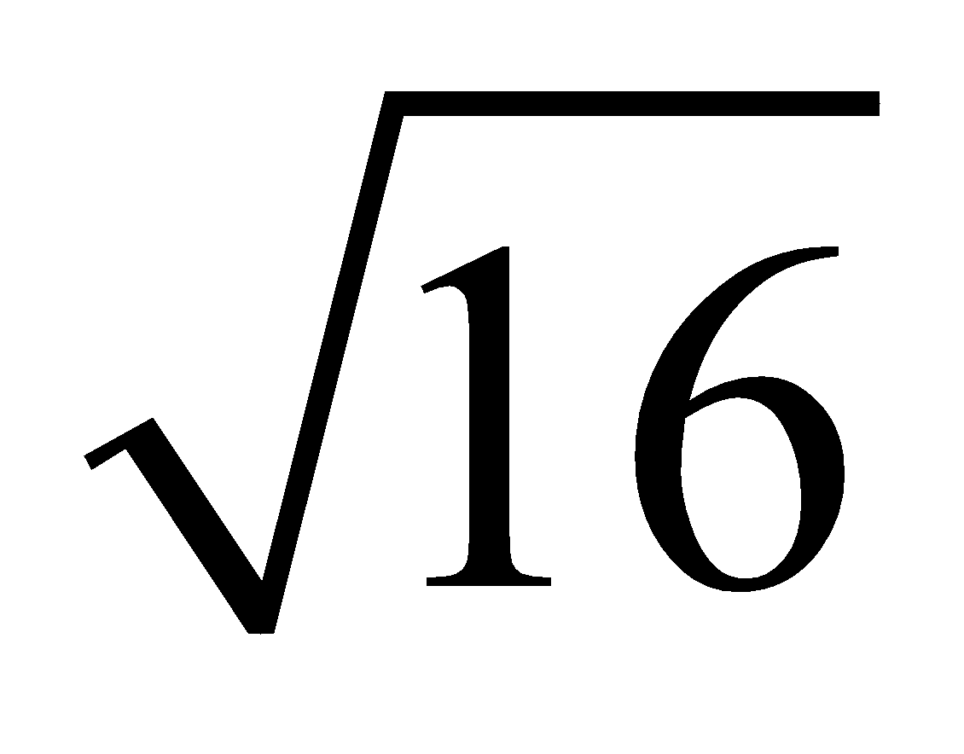
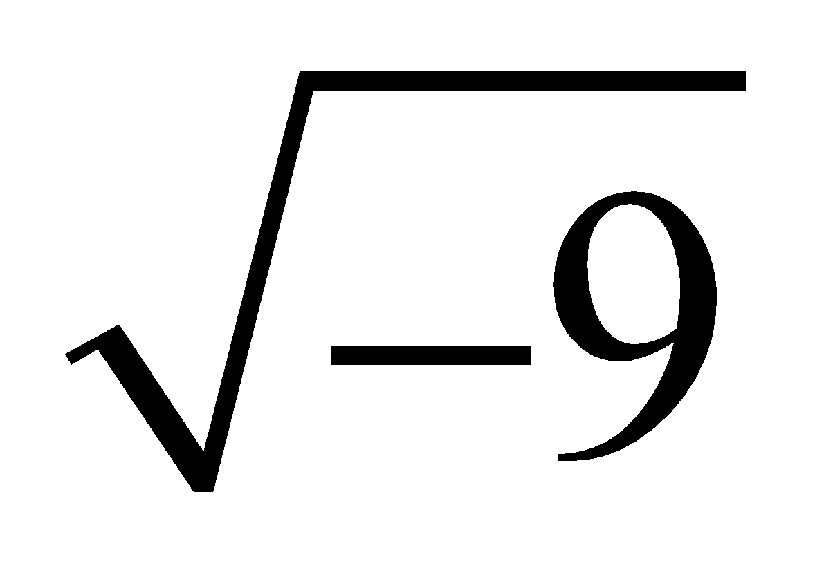
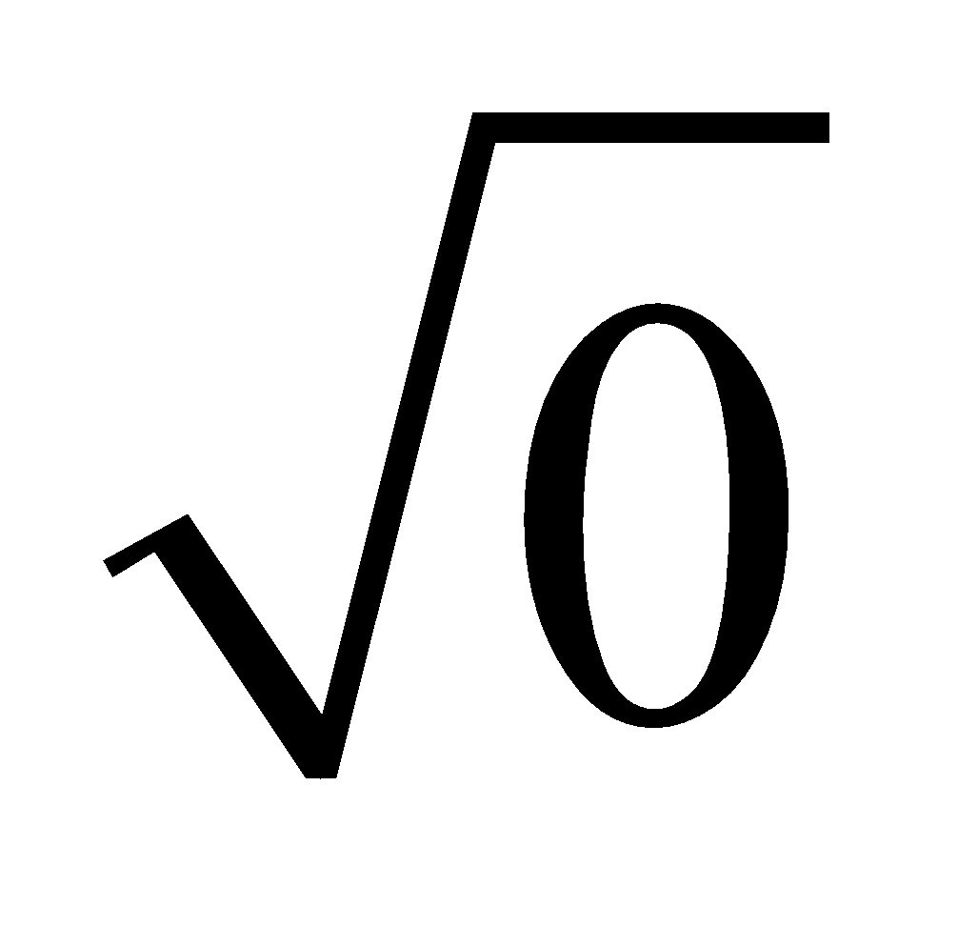
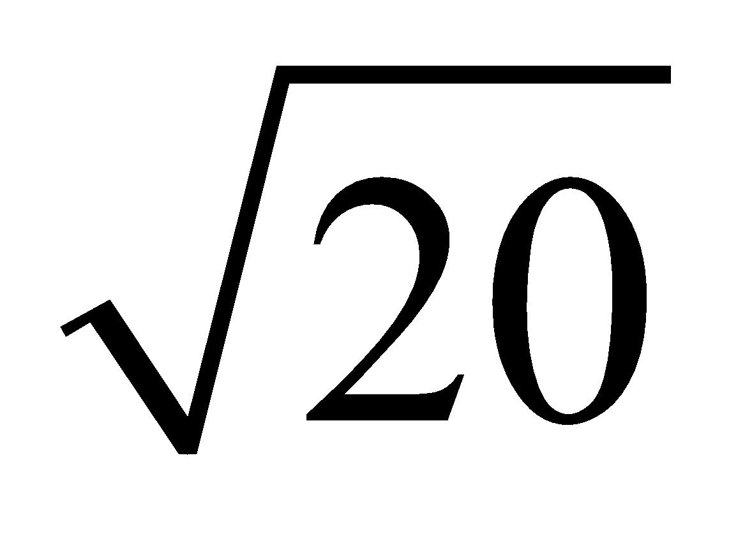
Not Like the Others - Math
Which is the “odd one out”? Circle the one in each set that does not belong. |  |  |  |  | Explanation
Algebra I Example
Geometry Example | Kite | Rectangle | Rhombus | Square
Algebra II Example
What type of data are you collecting from your students and how can you use it?
Notes:
K20 Center. (n.d.). Not Like the Othes. Strategies. https://learn.k20center.ou.edu/strategy/77

Slide 23
Not Like the Others - Social Studies
Which is the “odd one out”? Circle the one in each set that does not belong. |  |  |  |  | Explanation
US History Example | Civil War | World War I | World War II | Cold War
World History Example | American Revolution | Haitian Revolution | French Revolution | Bolshevik Revolution
US Government Example | The 10th Amendment | Anti-Federalists | Education | Supremacy Clause
What type of data are you collecting from your students and how can you use it?
Notes:
K20 Center. (n.d.). Not Like the Othes. Strategies. https://learn.k20center.ou.edu/strategy/77

Slide 24
Not Like the Others - English Language Arts
Which is the “odd one out”? Circle the one in each set that does not belong. |  |  |  |  | Explanation
Parts of Speech Example | Noun | Interrogative | Adverb | Conjunction
Shakespeare Characters Example | Romeo | Othello | Queen Elizabeth | Hamlet
What type of data are you collecting from your students and how can you use it?

Slide 25
Not Like the Others - Science
Which is the “odd one out”? Circle the one in each set that does not belong. |  |  |  |  | Explanation
Life Science Example | light | carbon dioxide | water | sugar
Physical Science Example | gravitational | electric | magnetic | contact
Earth Science Example | thermal convection | radioactive decay | gravity | tectonic plates
What type of data are you collecting from your students and how can you use it?

Slide 26
Justified True or False Statements
Students decide whether provided statements are true or false and justify their answer using evidence.
This strategy provides individuals or small groups with an opportunity to activate their thinking about a particular topic and look into how knowledge is created.
Notes:
K20 Center. (n.d.). Justified True or False Statements. Strategies. https://learn.k20center.ou.edu/strategy/174

Slide 27
Justified True or False Statements - Math
Statement | T | F | Explain Your Reasoning
Quadratic equations always have 2 real solutions.
When solving a quadratic equation, the quadratic formula is a method that will always work.
The solutions of a quadratic equation are also known as roots, zeros, solutions, and x-intercepts.
Notes:
K20 Center. (n.d.). Justified True or False Statements. Strategies. https://learn.k20center.ou.edu/strategy/174

Slide 28
Justified True or False Statements -
Social Studies
Statement | T | F | Explain Your Reasoning
The United States has a system of government in which all power is held at the federal level.
In a representative democracy citizens elect all leaders in the government.
Citizens have many ways of participating in government.
Elections for president are held every two years.
Notes:
K20 Center. (n.d.). Justified True or False Statements. Strategies. https://learn.k20center.ou.edu/strategy/174

Slide 29
Justified True or False Statements -
English Language Arts
Statement | T | F | Explain Your Reasoning
When the work is finished, we’re going to go out for pizza.
Ken mowed the lawn and Jeff washed the car.
The boys played while the girls painted, and everyone had a good time.
There is a big box of baby clothes in the back of the closet.
Decide if each statement is a complex sentence: true or false and provide your reasoning.
Notes:
K20 Center. (n.d.). Justified True or False Statements. Strategies. https://learn.k20center.ou.edu/strategy/174

Slide 30
Justified True or False Statements - Science
Statement | T | F | Explain Your Reasoning
All DNA codes for protein.
All cells in an organism contain the same genetic content.
Each chromosome is a single, very long DNA molecule.
Chromosomes swap sections during mitosis to create genetic variation.
Notes:
K20 Center. (n.d.). Justified True or False Statements. Strategies. https://learn.k20center.ou.edu/strategy/174

Slide 31
Note Catcher
Take a moment to reflect on the assessment strategies we have explored.
Aswer the following questions:
How were they used?
How can I use them?

Slide 32
Now it’s your turn!
With your group, examine the student work samples you brought with you:
What does the work tell you about where the students are?
Are there any misconceptions your students are having?
What next steps do you need to take in instruction based on where your students currently are?

Slide 33
TREK Evaluation

