Slide 2
What’s a 5E?
Building Authentic Science Instruction

Slide 3
Learning Objectives
Review the 5E instructional model by participating in and analyzing a LEARN lesson.
Maximize authentic instruction by practicing how to modify existing 5E lessons for potential use in your classroom.

Slide 4


Slide 5
Card Sort
Place the lesson cards in the order in which you believe this lesson should be taught.
Place the “E” cards (bolded) and phase descriptions (italicized) with the appropriate step.
Finish with a complete five-step lesson in chronological order. Each step should have one of each type of card (three total).
Review together.
Notes:
Hand out the card sort activity. Allow groups to work through sorting the cards into the order they should be taught, while pairing with the E’s and their purpose.

Slide 6


Slide 7
What’s a GMO?
Essential Questions:
Is everything that is legally acceptable always ethically acceptable?
What is a genetically modified organism (GMO) and how are they produced?
What are the ethical dilemmas surrounding GMOs and their use?
Notes:
Learn Lesson: https://learn.k20center.ou.edu/lesson/c6bfdf1bdae28bf55e9d679bc10277df

Slide 8
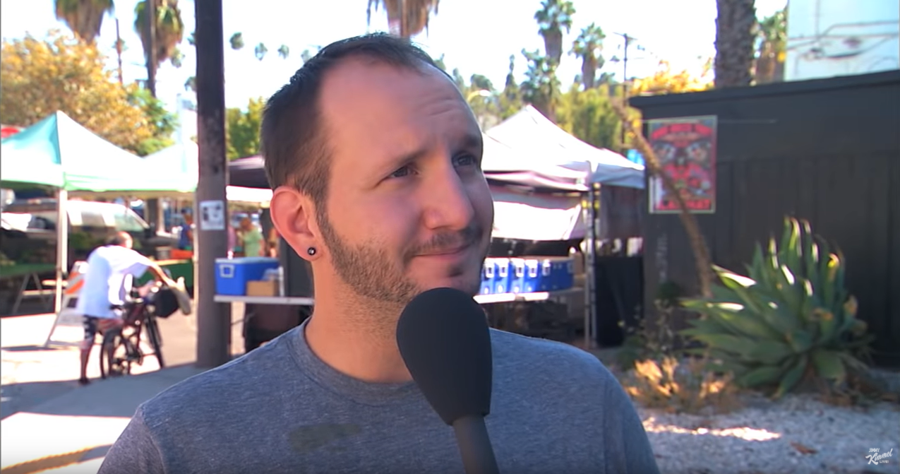
What’s a GMO?
Jimmy Kimmel Live. (9 October 2014). What's a GMO?. Youtube.com. Retrieved from https://www.youtube.com/watch?v=EzEr23XJwFY&feature=youtu.be

Slide 9

Sticky Bars
Are GMOs a good thing or a bad thing?
On your sticky note, write why you believe GMOs are good, bad, or somewhere in between.
Place it the line where you feel it best reflects your opinion.
Good
Bad
Notes:
Ask: Do you believe GMO’s are a good thing? On a sticky note write your reason for your belief and post on the poster paper.

Slide 10
Debate Protocol
Opening Statements (1 minute ea.)
Rebuttals (1 minute ea.)
Cross-Examinations (2-3 minutes ea.)
Second Rebuttals or Second Statements (1 minute ea.)
Closing Statements (1 minute ea.)
Audience Questions (2-5 minutes; optional)
Notes:
This is the overall format for a classroom debate. For today’s purposes we will be shortening this to just the bolded phases: opening statements, rebuttals, and cross-examinations.
Hand out playing cards to establish teams. Teams should sit together.
Aces (and Jokers): Affirmative Genetically Modified Animals (Defense)
Jacks: Negative Genetically Modified Animals (Prosecution)
Kings: Affirmative Genetically Modified Crops (Defense)
Queens: Negative Genetically Modified Crops (Prosecution)

Slide 11
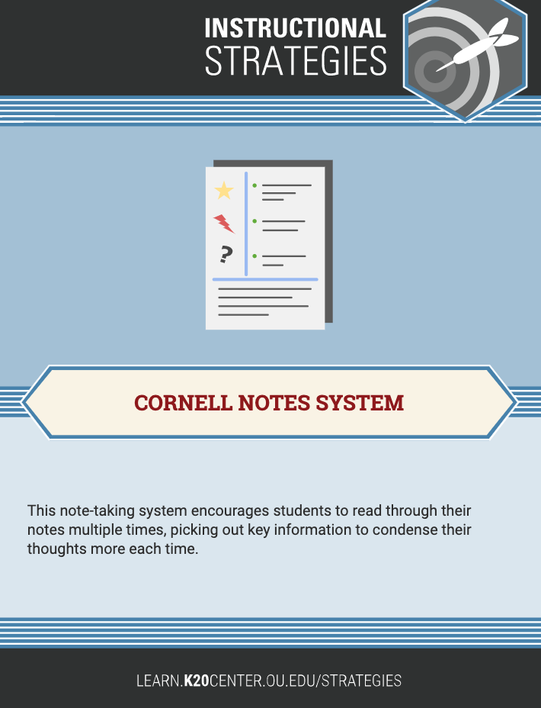
Research
Take notes with the Cornell Notes System:
Address main ideas.
Use the resources at this link: http://bit.ly/GMOResearch
You can also find other credible sources through independent research.

Slide 12
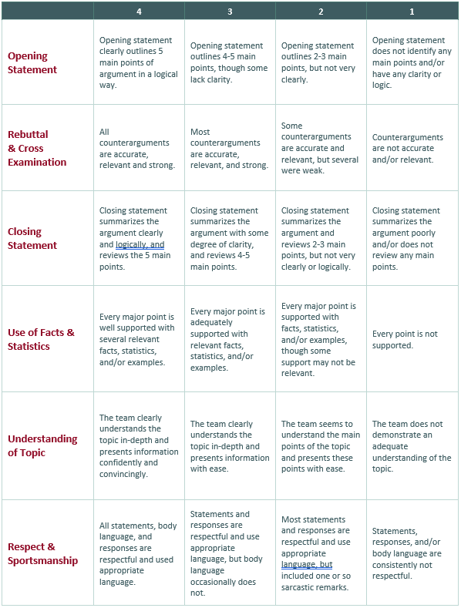
Case Preparation
In your groups:
Assign a role to everyone.
Develop your statements.
Refer to the evaluation rubric.
Notes:
Assign roles specific to your classroom (for example, timekeeper, spokesperson, facilitator, scribe, etc.)

Slide 13
Debate
Opening Statement (Affirmative: 1 min.)
Opening Statement (Negative: 1 min.)
Rebuttal (Negative: 1 min.)
Rebuttal (Affirmative: 1 min.)
Cross-Examination (Affirmative: 2 min.)
Cross-Examination (Negative: 2 min.)
When you are not participating in the debate, complete the evaluation form.

Slide 14
Flipgrid
Insert a shortened link (or QR code) to your created FlipGrid here
Create videos answering two of the following prompts:
  Is everything that is legally acceptable always ethically acceptable?
  How are GMOs produced?
  What are the ethical dilemmas surrounding GMOs?
Then, respond to a peer’s post.

Slide 15


Slide 16
Inform, Verify, Practice vs. 5E
Traditional: (VIP) Inform-Verify-Practice | Learning Theory (Piaget) | 5E Learning Cycle
InVestigate | Assimilation | Engage
 | Disequilibrium | Explore
“Inform” (Discuss & Inform if necessary) | Accommodation | Explain
Practice | Re-equilibration | Elaborate
 | Organization | Evaluate
Notes:
The 5E lesson model aligns well with Piaget’s Learning Theory, where the traditional IVP does not.
Revisit the Card Sort activity (Did we do the lesson in the order we sorted the cards? How do we need to change it? Why?)

Slide 17
How was the GMO lesson?
5E Design Rubric
MS-LS4-5: Gather and synthesize information about the technologies that have changed the way humans influence the inheritance of desired traits in organisms.
Rate the GMO lesson based on the rubric.
Make a FlipGrid video answering:
  Did any areas not meet the rubric’s standards?
  Why were these areas low?
  What can you take away from this to inform your classroom practices?
Respond to at least one other video.
Insert a shortened link (or QR code) to your created FlipGrid here
Notes:
Flip Grid becomes more intuitive the more you use it. This is often uncomfortable for us as adults, but students love it.

Slide 18


Slide 19
Work Time
In grade-level groups:
Be prepared to share:
Modify a lesson into 5E format.
  Your own lesson
  Provided lesson
Use the rubric to evaluate your lesson.
Complete the Instructional Strategy Note Sheet.
Lesson Snapshots
One thing you’ll do in your classroom next week as a result of this activity
What can the next activity do better next time?

Slide 20


Slide 21
Evaluate: Padlet
Lesson Snapshots (for example:)
  Engage: Students view a video clip and use Sticky Bars to discuss what they know about GMOs and whether they are good or bad.
  Explore: Students research GMOs.
  Explain: Students prepare opening and closing statements for a debate.
  Extend: Students debate pros, cons, and ethical concerns regarding GMOs.
  Evaluate: Students not involved in the debate serve as the jury.
One thing you’ll do in your classroom next week as a result of this activity
What the next activity can do better next time?

