Slide 1
Thinking Outside the Equation
Please feel free to sit anywhere you like and make yourself comfortable!

Slide 2
Let’s break some ice, shall we?
Notes:
Icebreaker/Introductions (4 Fours activity)
Ask groups to engage in the 4 Fours activity and make sure they have introduced themselves to their table.
Whole group share
Lindsay and Cacey introduce themselves

Slide 3
To begin thinking outside the equation, we need to establish some
agreed-upon norms.

Slide 4
Round 1
Think about what you need from us in order for this experience to be successful? (30 seconds)
Find an elbow partner and share your thoughts (1 minute)
Share with the whole group your expectations for our time together (2 minutes)
Notes:
Possible responses:
Resources
Tangible activities

Slide 5
Round 2
Think about what you need from each other in order for this experience to be successful? (30 seconds)
Find an elbow partner and share your thoughts (1 minute)
Share with the whole group your expectations for our time together (2 minutes)
Notes:
Possible responses:
Collaborative
Open and honest with each other about expectations

Slide 6
Round 3
Here are some expectations we have of you while you’re here.
Notes:
Active participation
An open mind
Willingness to try
When introducing the session make sure it is explicitly stated that they will experience disequilibrium while exploring

Slide 7
Mindset
Notes:
Mindset:
Briefly outline what we are going to talk about in this learning activity.
5E format
An opportunity to be reflective on your practice and your school’s philosophy.

Slide 8
I Think/We Think
Engage
What is your school’s mindset towards mathematics?
What does your typical day look like?
What are your expectations for your students?
Notes:
Template for t-chart can be found here: https://drive.google.com/drive/u/0/folders/1tLKeSHoSvGuFb0JC81HbrSxL4NFr22PA

Slide 9
Explore/Explain
What is growth mindset?
Jigsaw
Discussion
Clarification
Notes:
Ask participants to break into groups of 4
Distribute excerpts from 4 articles to have teachers read (These should be short).
Ask teachers to decide on two or three main ideas from their article.

Slide 10
Where are we going?
As we move through activities, be thinking about what shifts would need to take place in your classroom and school (that you can control).
Parking lot:
Keep these ideas/things in mind as we move through our time together.
Extend
Notes:
Objectives/instructional slides - introduce research and consider the shift in your classroom that might need to take place.

Slide 11
Spatial Reasoning:
Droodles & Unit Origami
Notes:
Mindset:
Briefly outline what we are going to talk about in this learning activity.
5E format
An opportunity to be reflective on your practice and your school’s philosophy.

Slide 12
Droodles
Select a droodle from the table at the front of the room.
Analyze the droodle and be ready to discuss what you’ve observed.

Slide 13
Engage
Analyzing Droodles
What patterns did you notice?
What geometric patterns are present?
What do you think your students would see?

Slide 14
Unit Origami
Explore
What is unit origami?
Directions:
Using the handout, follow the steps to create one star building unit (We’re here to troubleshoot!)
Make five more!
Construct a cube

Slide 15
Analyze
Unfold your star building unit.
What do you notice?
What geometric shapes are present?
Explore

Slide 16
Share/Discuss
What would happen if the size of the paper changed?
Is the volume a function of the size of the paper?
Does doubling the size of the original square double the volume of the cube?
How would the areas of the face of the cube change if we had used 16-inch squares?
Explain

Slide 17
Reflect/Break
Extend
Thinking about growth mindset in your practice, what things would you need to change and how would you change them in order to implement this task?
What mathematics are students being engaged in?
In what ways was this task low floor/high ceiling?
What was the task? How is it meaningful to students? How can you implement this into your class with your students?
What standards were addressed within this activity for my grade level?

Slide 18
Parking Lot
Extend
Take a few moments to reflect on our time together so far.
Use the parking lot to jot down activities, thoughts, and resources you have found to be insightful.

Slide 19
Non-routine Geometry
Notes:
Non-routine Geometry:
Participants work in groups and think outside the box to solve problems (1-4-5 square, geometry brain teaser, or how many squares or rectangles, area of trapezoids on graph paper).

Slide 20
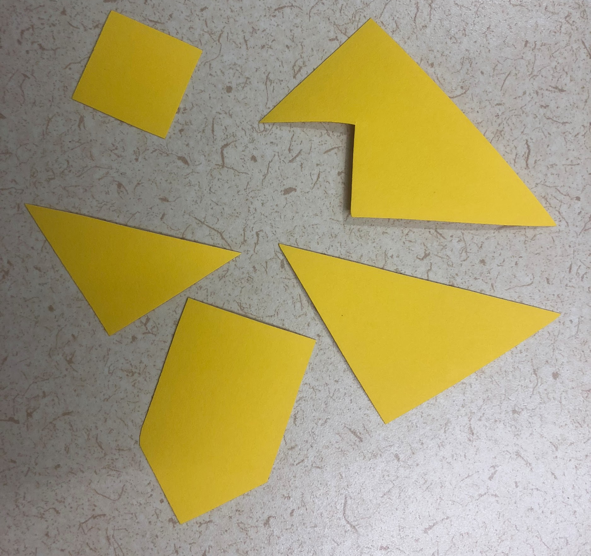
1-4-5 Square
Engage
With your small group complete the following tasks:
Task 1: Make a square using only 1 piece.
Task 2: Make a square using 4 pieces.
Task 3: Make a square using all 5 pieces.
Notes:
Task can be found at https://mathequalslove.blogspot.com/2015/05/1-4-5-square-puzzle-challenge.html

Slide 21
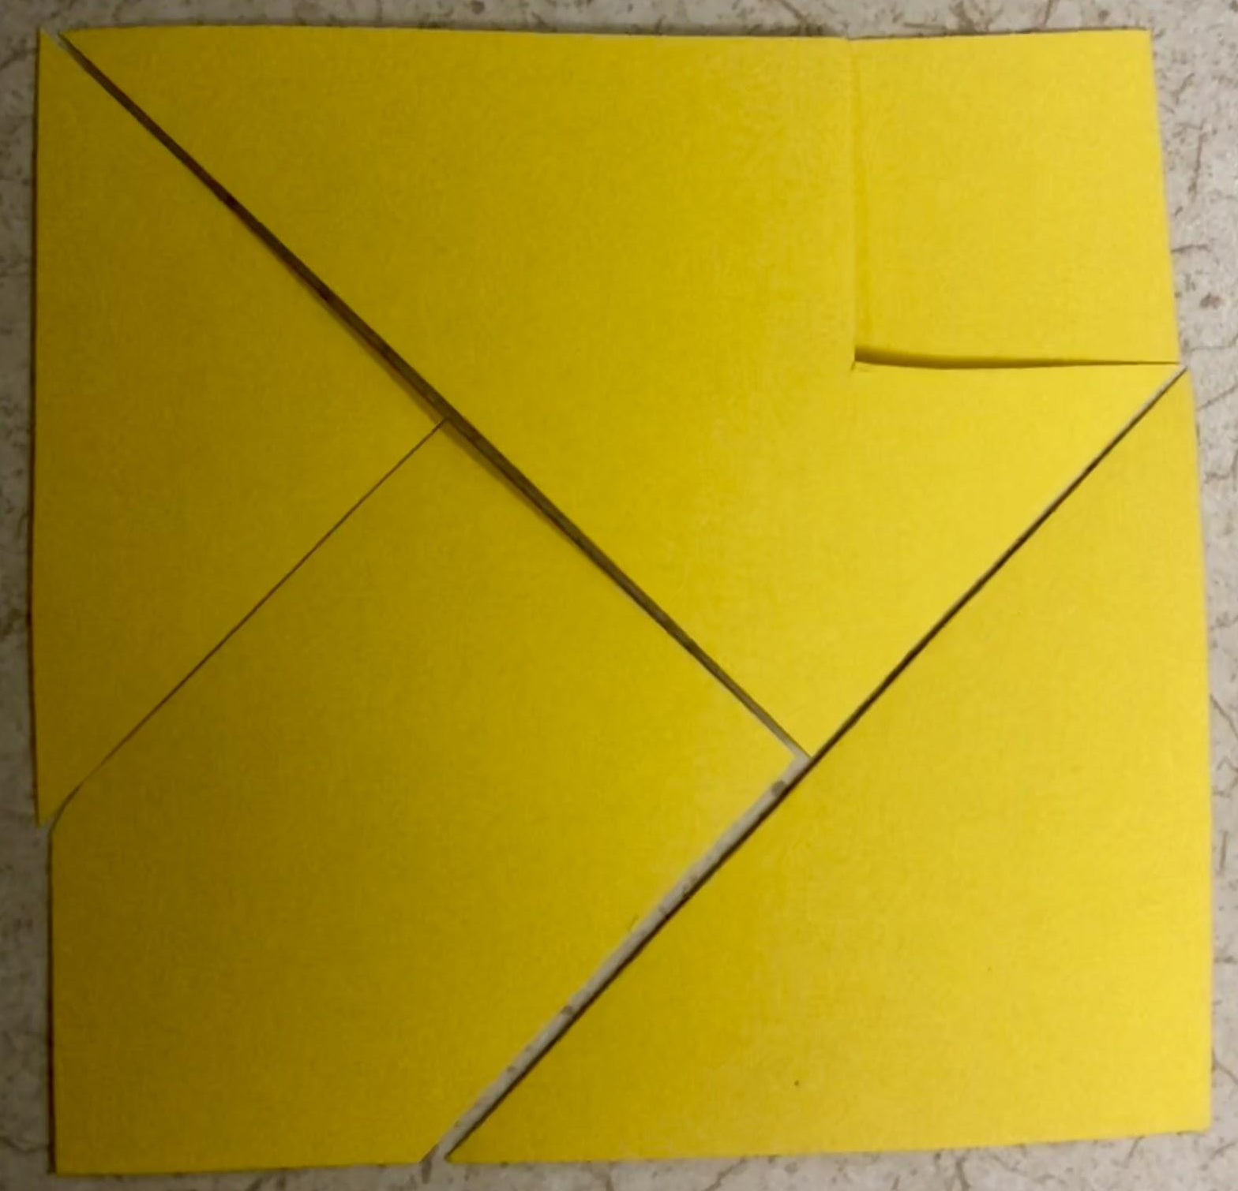
3-2-1 Launch Lunch
Explore (literally)
Before we break for lunch, you have a task to do while you’re out and about in Norman.
Geometry Scavenger Hunt
https://tinyurl.com/2018geoscavengerhunt
Notes:
While at lunch, locate and take pictures of the items items listed on the Geometry Scavenger Hunt Checklist.

Slide 22
Welcome back!

Slide 23
Presentation of Photos
What did you learn/notice about the activity?
Explain

Slide 24
Reflection
Thinking about growth mindset in your practice, what things would you need to change and how would you change them in order to implement this task?
What mathematics are students being engaged in?
In what ways was this task low floor/high ceiling?
What was the task? How is it meaningful to students? How can you implement this into your class with your students?
What standards were addressed within this activity?
Extend

Slide 25
BREAK!

Slide 26
1-4-5 Square
Engage
With your small group complete the following tasks:
Task 1: Make a square using only 1 piece.
Task 2: Make a square using 4 pieces.
Task 3: Make a square using all 5 pieces.
Notes:
Task can be found at https://mathequalslove.blogspot.com/2015/05/1-4-5-square-puzzle-challenge.html

Slide 27
3-2-1 Launch Lunch
Explore (literally)
Before we break for lunch, you have a task to do while you’re out and about in Norman.
Geometry Scavenger Hunt
Notes:
While at lunch, locate and take pictures of the items items listed on the Geometry Scavenger Hunt Checklist.

Slide 28
Instructional Strategy Note Sheet
Explore (literally)
Break up into small groups.
Discuss in teams instructional strategies that have been used.
What might you implement into your classroom?
Discuss in teams learning activities used so far.
What might you replicate/modify in your classroom?

Slide 29
Sequences and Series Art
Transitioning from geometry to algebra with art!
Notes:
Handout sequences and series art project
Ask participants to choose one of the shapes to explore:
Nested squares
Fibonacci
Sierpinski
Koch

Slide 30
Homework
How can we take and redefine/reuse/recreate textbook problems and make more unconventional with a low floor/high ceiling?
Tomorrow bring your ideas, problems, projects, etc. with you.

Slide 31
Thinking Outside the Equation: Day 2
Please feel free to sit anywhere you like and make yourself comfortable!

Slide 32
Collective Brain Dump
Yesterday we talked a lot about growth mindsets and engaged in several learning activities to begin thinking about non-routine mathematical tasks.
Working individually, you have 2 minutes to create a list that represents your knowledge of the topic (so far).
Notes:
Teachers provide an artifact (preferably a graphic representation like a video, image, etc.) that represents a specific topic. Individual students brainstorm independently, collaborate in small groups, and share with the whole group.
PROCEDURE
Provide an artifact that triggers students' memories.
Students have 3-4 minutes to create a list that represents their knowledge of the topic the artifact represents.
Arrange students into small groups.
Students collaborate with their groups to share knowledge and add to their lists.
When groups seem to be done sharing with one another, have each group share their knowledge with the whole class.
As groups share, write list items on the board or projector to create a whole-class product.
Using the whole-class list, address misconceptions and gaps in knowledge.

Slide 33
Sharing Ideas
Small group discussion.
Reduce your lists to just a few key points
Share as a whole group
Clarify Misconceptions
Notes:
Number participants to mix things up!

Slide 34
Non-routine Tasks
As mathematics teachers, our job is to “sell a product to a market that does not want it, but is forced by law to buy it” (Meyer, 2010).

Slide 35
Mobius Madness
Engage
Notes:
Create a Mobius Strip
Draw a line down the center. What happened? Why do you think this happened?
We’re going to cut down the line, what do you think will happen?
What actually happened?
Create a second Mobius Strip
This time cut it one third from the edge (stay one third from edge all the way around.
What happens?
Can you see which parts of the new object are made from which parts of the original mobius band?
Create third mobius band and a loop with no twist (both need to be the same length)
Tape the two objects together at right angles
Cut down the middle of each object
What happens?
Bring in Klein bottle and talk about this being a four-dimensional representation

Slide 36
Problem Solving
Three Tasks in 45 minutes
Explore
Notes:
Hexominoes
Quadrilaterals task
Four Women Crossing the bridge

Slide 37
Presentation
Explain
What did you learn in your task?
What surprised you?
Where did you use problem solving?

Slide 38
Reflection
Thinking about growth mindset in your practice, what things would you need to change and how would you change them in order to implement these tasks?
What mathematics are students being engaged in?
In what ways was this task low floor/high ceiling?
What was the task? How is it meaningful to students? How can you implement this into your class with your students?
What standards were addressed within this activity?
Extend

Slide 39
More (Yes, more) Non-routine Tasks

Slide 40
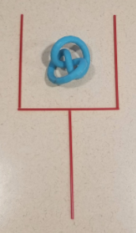
Engage
At your table you will see a set of four coffee stirrers and an object.
Use them to form this shape:

Slide 41
Engage
In only TWO moves, rearrange the stirrers so that the object is on the outside of the stirrers, while preserving the image of the sticks.

Slide 42
I Notice/I Wonder
Explore
As you are working through each station, you have some metacognitive work to do!
At each station jot down what you notice about the task that makes it non-routine
At the same time, if you have wonderings about what this might look like in your class, jot that down too!
Notes:
Around the room you will find stations with non-routine tasks.
You have approximately 15 minutes to work through each station before we switch.
If you don’t finish its ok
Paper folding task (Geometry)
Squares to Stairs (Algebra)
Square packing problem
Clinometers or ADA Accessibility?
Hexaflexagons?
Pascal’s Triangle http://www.geometer.org/mathcircles/pascal.pdf
, it’ll be OK!

Slide 43
Discussion from I notice/I wonder
In groups of three or four, discuss what you noticed? (5 minutes)
What are you wondering? (5 minutes)
Whole group discussion (5 minutes)
Notes:
For whole group discussion add these:
What did you notice about the way questions are framed?
What did you notice about the accessibility of the assignment?

Slide 44
Remember your homework assignment from last night?
Notes:
If you brought your own tasks, set them up in state room
Working in groups of 3, find one of your group member’s tasks. Work for 15 minutes making this task non-routine
Switch to your next group member’s task (15 minutes)
Finally, move to your third group member’s task. ions around th

