Slide 2
Twinning!
Discovering The Similarities Between Coaching
and Teaching

Slide 3

Magnetic Statements
Read the six quotes posted around the room.
Stand by the one that most attracts you.
Think about the questions:
  Why were you attracted to the quote?
  How is the quote applicable in the classroom?
Notes:
K20 Center. (2020). Magnetic Statements. Strategies. https://learn.k20center.ou.edu/strategy/166
Ask participants to move around the room, read the 6 quotes posted, and stand by the one that most attracts them. Before participants move, explain to them that once they have discovered the quote that most attracts them, think about the questions:
Why were you attracted to the quote?
How is the quote applicable in the classroom?
After the discussions, small groups will share their answers to the large group.

Slide 4
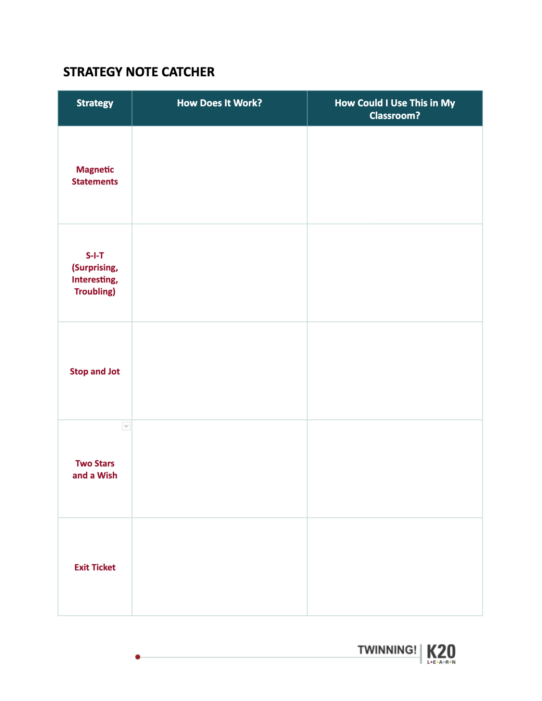
Instructional Strategy Note Catcher
Notes:
Distribute a copy of the attached Instructional Strategy Note Catcher to paraticipants.
Encourage them to use it to write down their ideas for personalizing a strategy to be used as an instructional tool in their classrooms.
When the new strategies are modeled, allow time for participants to reflect on how to use these strategies.
Allow a moment for participants to write about the Magnetic Statements activity.
Ask them how they might adapt it for use in their classrooms.

Slide 5
Essential Questions
Why do coaches make great teachers?
How are the roles of coaching and teaching similar?
What characteristics and strategies work for both coaching and teaching?

Slide 6
Objectives
Identify similarities between the roles of coaching and teaching.
Examine and partake in student-centered strategies they can use in their classrooms to promote active engagement.

Slide 7

S-I-T
As you watch the video look for:
One Surprising fact or idea
One Interesting fact or idea
One Troubling fact or idea
Notes:
K20 Center. (n.d.) S-I-T (Surprising, Interesting, Troubling). Strategies. https://learn.k20center.ou.edu/strategy/926
Introduce the S-I-T Strategy to participants. Tell participants to look for one Surprising fact or idea, one Interesting fact or idea, and one Troubling fact or idea as they watch the video on slide 8 . Participants should use the S-I-T handout to add their video reflection responses.

Slide 8
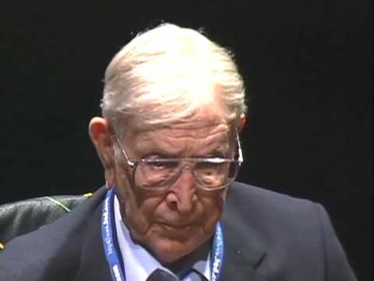
Notes:
Wooden, J. (2009, Mar 26). The difference between winning and succeeding. [Video]. Ted Talk. YouTube. https://www.youtube.com/watch?v=0MM-psvqiG8
After playing the video (stop after 6:39) and providing time to complete the S-I-T handout, ask participants to share their responses with an Elbow Partner.
Ask for volunteers to share their responses to the large group.
Allow a moment for participants to write about the S-I-T activity on their Note Catcher.
Ask them how they might adapt it for use in their classrooms.

Slide 9

Stop and Jot
Read the article exerpts from “Reasons Why Coaches Make the Best Teachers.”
As you read the excerpts on the left side, pause at each question on the right.
Take notes before reading further.
Share your thoughts with an Elbow Partner.
Share your responses with the whole group.
Share your thoughts about adapting this strategy for use in your classroom.
Notes:
K20 Center. (n.d.). Stop and Jot. Strategies. https://learn.k20center.ou.edu/strategy/168
K20 Center. (n.d.). Elbow Partner. https://learn.k20center.ou.edu/strategy/116
Cutler, D. (2014, June 2). 5 reasons why coaches make the best teachers. NAIS Connect. https://connect.nais.org/blogs/david-cutler/2014/06/02/5-reasons-why-coaches-make-the-best-teachers
Pass out the attached reading, “Reasons Why Coaches Make the Best Teachers.”
Review the Stop and Jot strategy.
While reading, have participants use the Stop and Jot strategy by reading the left side and stopping to answer the questions on the right side of the handout.
When participants have completed their notetaking, have them discuss their responses to the questions with their Elbow Partner,.
Ask partners to share to the whole group.
Allow a moment for participants to write about the Stop and Jot activity on their Note Catcher.
Ask them to share how they might adapt it for use in their classrooms.

Slide 10

Two Stars and a Wish
“Effective coaches make effective
teachers; effective teachers make
effective coaches.”
Two ideas that you like or feel positive about the statement (stars).
One way you can improve within your role as a coach and teacher (wish).
Notes:
K20 Center. (n.d.). Two Stars and a Wish. Strategies. https://learn.k20center.ou.edu/strategy/83
Introduce participants to the Two Stars and a Wish strategy.
Share the statement: Effective coaches make effective teachers; effective teachers make effective coaches.
Ask participants to reflect on the statement and write down two ideas that they like or feel positive about the statement (two stars).
Have participants write down one way they can improve within their roles as a coach and teacher (one wish).
When finished writing their responses, ask participants to share their two stars and a wish with an Elbow Partner or to the whole group.
Provide a moment for participants to write about the Two Stars and a Wish instructional strategy on their Note Catcher.
Ask them to share how they might adapt the strategy for use in their classroom.

Slide 11
Keep Calm and Evaluate
"This week, I plan to use _________________ strategy."
Notes:
K20 Center. (2020). Bell Ringers and Exit Tickets. Strategies. https://learn.k20center.ou.edu/strategy/125
As an Exit Ticket, ask the participants to use a sticky note to explain a strategy they learned today.
Have them complete the following sentence: "This week, I plan to use _________________ strategy."
Invite participants to briefly explain (on the Post-it) how they will implement the strategy in their classroom.
Post the Post-it notes on the wall or poster paper for all participants to see as they leave the session.

Slide 12
References
Bloom, G., Durand-Bush, N. Schinke R., Salmela, J. (1998). The importance of mentoring in the development of coaches and athletes. International Journal of Sport Psychology, 20(3), 267-281.
Chu, D. (1981). Teacher/Coach orientation and role socialization: A description and explanation. Journal of Teaching in Physical Education, 3(2), 3-8.
Figone, A. (1994). Teacher-Coach role conflict: Its impact on students and student-athletes. Physical Educator, 51(1), 29-34.
Fletcher, S. (2013). Touching practice and physical education: Deconstruction of a contemporary moral panic. Sport, Education and Society, 18(5), 694-709.

