Slide 2
What Do You Meme?
Secondary Strategies

Slide 3
Session Objectives
Explore a variety of student-centered instructional strategies.
Identify and discuss what makes an instructional strategy student-centered.
Apply cross-curricular strategies in the secondary classroom.

Slide 4
Magnetic Statements
This strategy is designed to actively engage students’ prior knowledge and thinking.
Around the room, you will find 5 statements that represent answers to the question:
What does student-centered learning mean to you?
Move towards the statement that most attracts you.
Once you have found your statement, discuss with your group what drew you to this statement.

Slide 5
Magnetic Statements
What does student-centered learning mean to you?
As a group, create an example to share out about what in this statement looks like/can look like in your classroom.
Share out your example.

Slide 6
Magnetic Statements
How can you use this strategy to foster student-centered learning in your classroom?

Slide 7
Essential Questions
What makes an instructional strategy effective?
What makes an instructional strategy student-centered?

Slide 8
How do we foster student-centered learning in the classroom?
The strategies highlighted today are student-centered and can be applied to all the core disciplines.
As we work with each strategy, consider how you can adapt it into your classroom.

Slide 9
Why-Lighting
This strategy is designed to engage students actively in interpretation, summary, and reflection processes.
As you read the attachment about Student-Centered Learning, highlight the main points or pieces of information that are important to you and your understanding of student-centered learning.
For the sections that you highlight, explain why you did so in the margin.
Be prepared to share out your explanations.

Slide 10
Why-Lighting
How can you use this strategy to foster student-centered learning in your classroom?

Slide 11
Pass the Problem
This strategy is designed to foster collaboration among students.
Students work in pairs to respond to a multi-step problem, explaining their reasoning as they progress through the problem.

Slide 12
Pass the Problem
With your elbow partner, work to simplify the mathematical expression on the handout.
Take turns going back and forth working through the problem and writing a step of the simplification process.
Continue until the expression is simplified.
Once the problem is completed, write a sentence that explains your thinking.

Slide 13
Pass the Problem
How can you use this strategy to foster student-centered learning in your classroom?

Slide 14
Fishbone
This strategy, designed to encourage critical thinking, can serve as a brainstorming tool and can guide students to examine the causes of a particular effect or outcome.
Begin by writing the effect or outcome on the “fish head” of the problem.
Use the “fishbones” to record the factors that contributed to the effect or outcome.
With your elbow partner, discuss possible factors that contribute to the effect and complete the diagram.

Slide 15
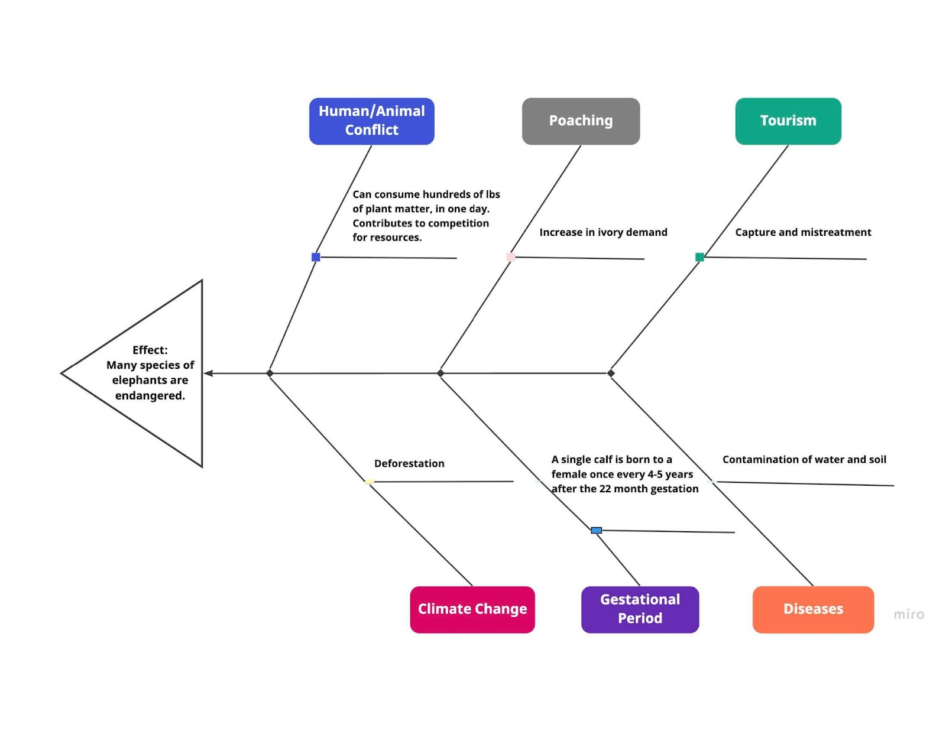

Slide 16
What Do You Meme?
This strategy, designed as a communication tool, encourages creativity and reflection while demonstrating understanding of a topic.
Using an online meme generator such as https://makeameme.org/ create a meme that reflects your understanding of the following:
18th Amendment: Prohibition of Alcohol Sales
19th Amendment: Women’s Right to Vote
Using the “search blank memes” feature, find an image and add text.
=

Slide 17
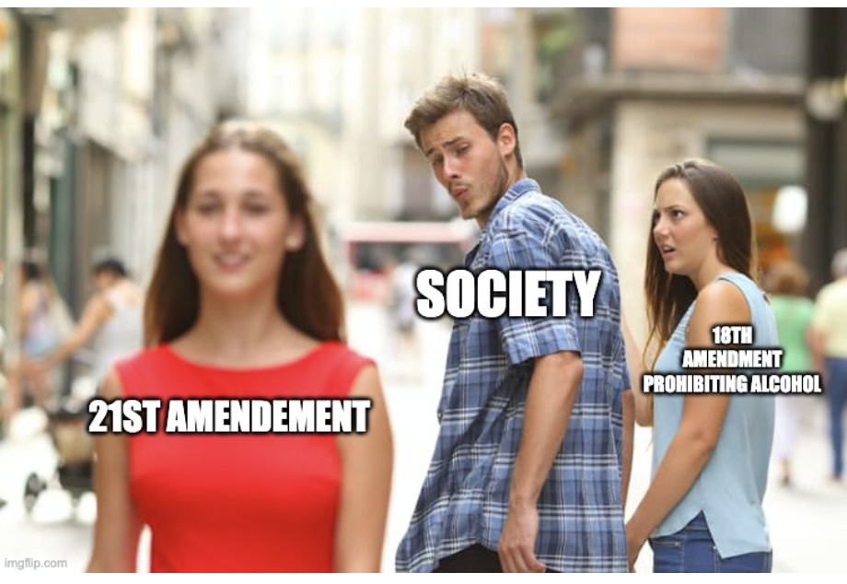

Slide 18
What Do You Meme?
How can you use this strategy to foster student-centered learning in your classroom?

Slide 19
How can these strategies foster a student-centered classroom?

Slide 20
LEARN Website
190 published strategies
Over 500 published lessons
Several other PDs and student resources

