Slide 2
A Family Quest

Slide 3
Essential Question
How can the QUEST mobile web page assist schools and families when it comes to supporting students in their post-secondary education or career?

Slide 4
Lesson Objectives
Participants will discover how the use of technology can assist in family involvement.
Participants will discover how technology can prepare students and families for a post secondary education or career.
Participants will create an account and explore the GEAR-UP QUEST mobile web page.
Participants will evaluate and discuss the benefits of using and recommending the QUEST mobile web page to families.

Slide 5
Sole Mates
Find an individual in the room who is wearing footwear most similar to yours.
Introduce yourself to your partner and discuss the following questions:
  Partner’s name and profession
  What is something you’re looking forward to seeing or doing over the holiday season?
  What are two items they can’t live without?
Record your partner's responses and be prepared to share out with the group.

Slide 6
Mobile Mentimeter
Scan the QR code.
OR
Go to Menti.com.
Enter [code] to answer the questions as your presenter reads them.

Slide 7
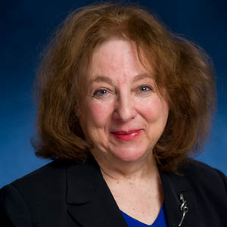
Dr. Joyce Epstein's Framework for Family Involvement
Dr. Joyce Epstein of Johns Hopkins University has developed a framework for defining six different types of family involvement. This framework assists educators in developing school and family partnership programs.

Slide 8
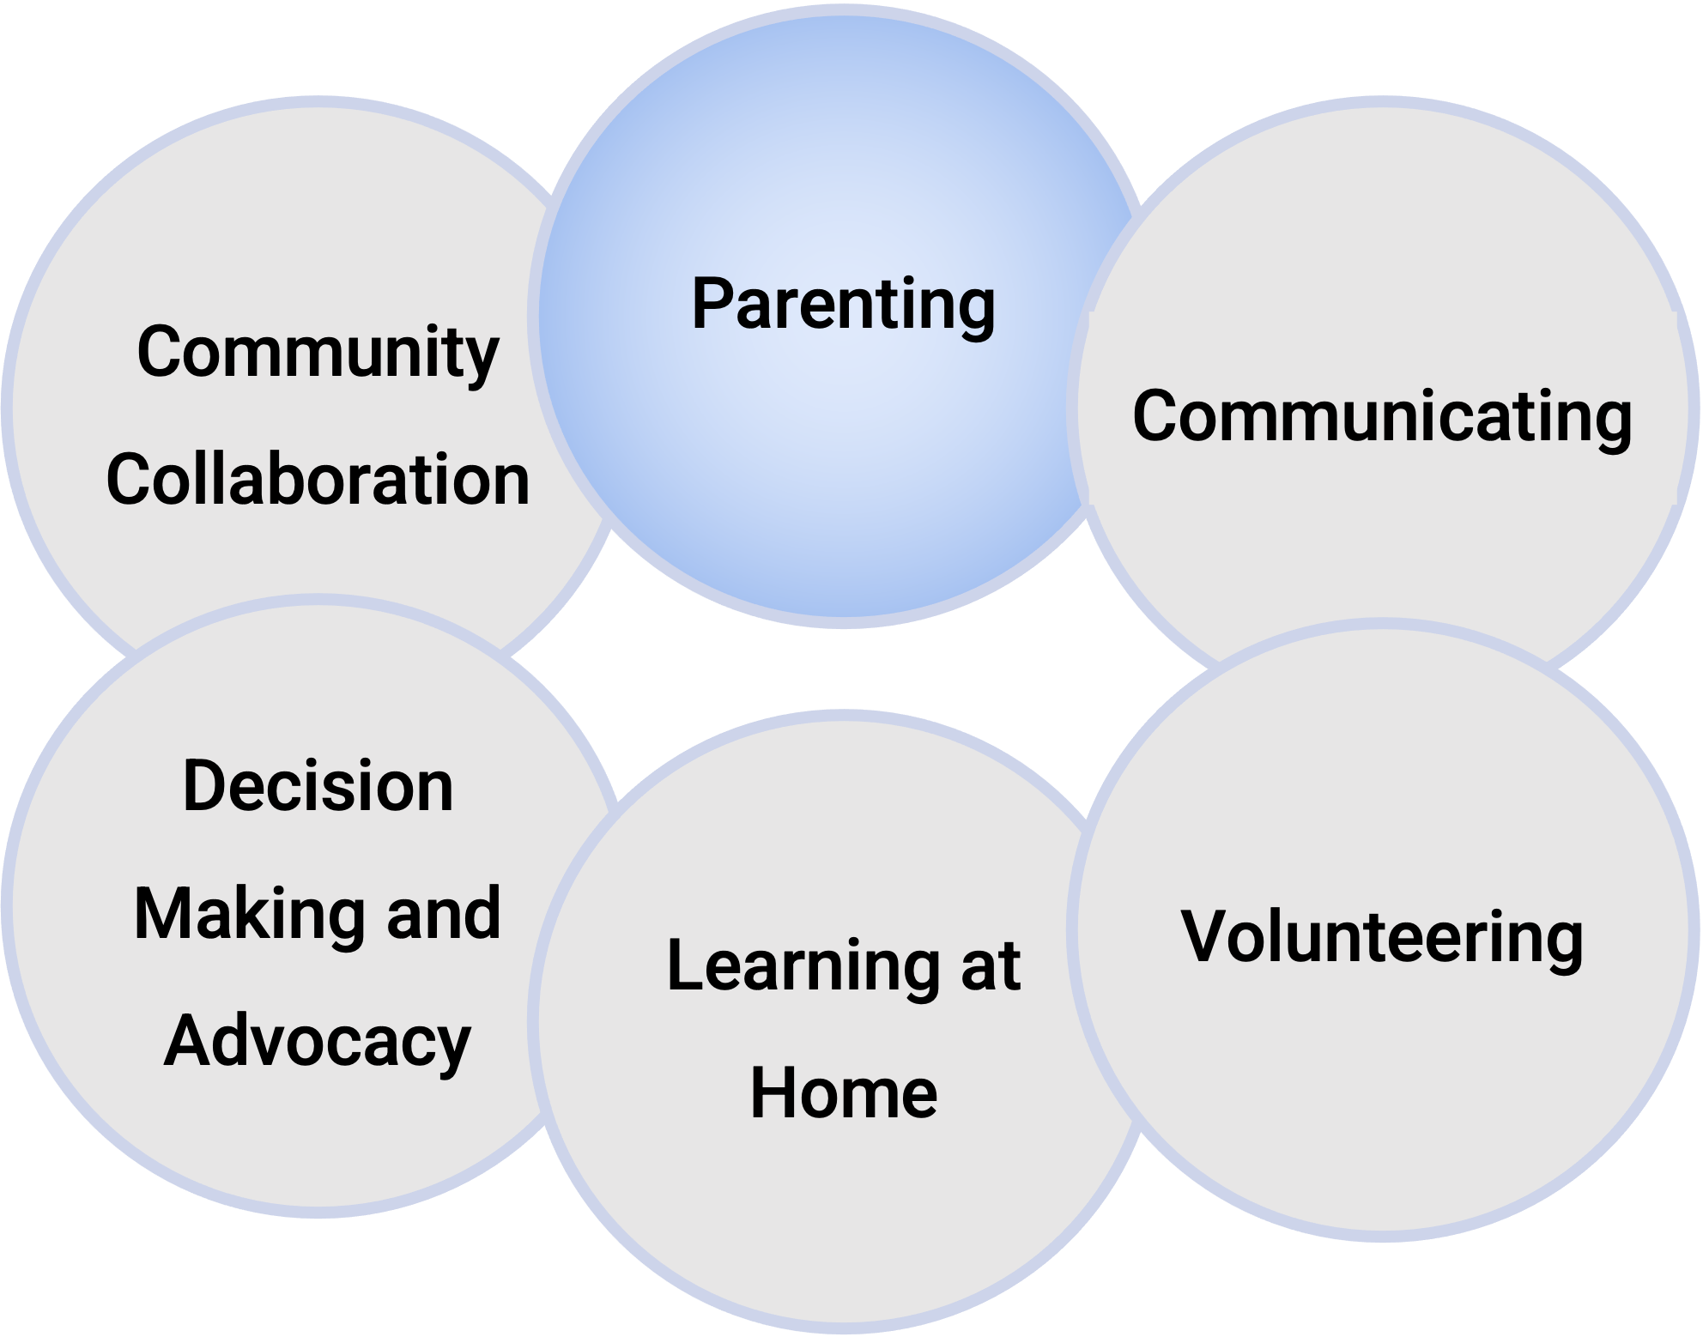
Epstein’s Framework
PARENTING is helping all families establish home environments that support children as students.
Parenting may include any or all of the following:
Parent education and other courses or training for parents (e.g., GED, college credit, family literacy).
Family support programs that can assist families with health, nutrition, and other services.
Home visits at transition points to elementary, middle, and high school.

Slide 9
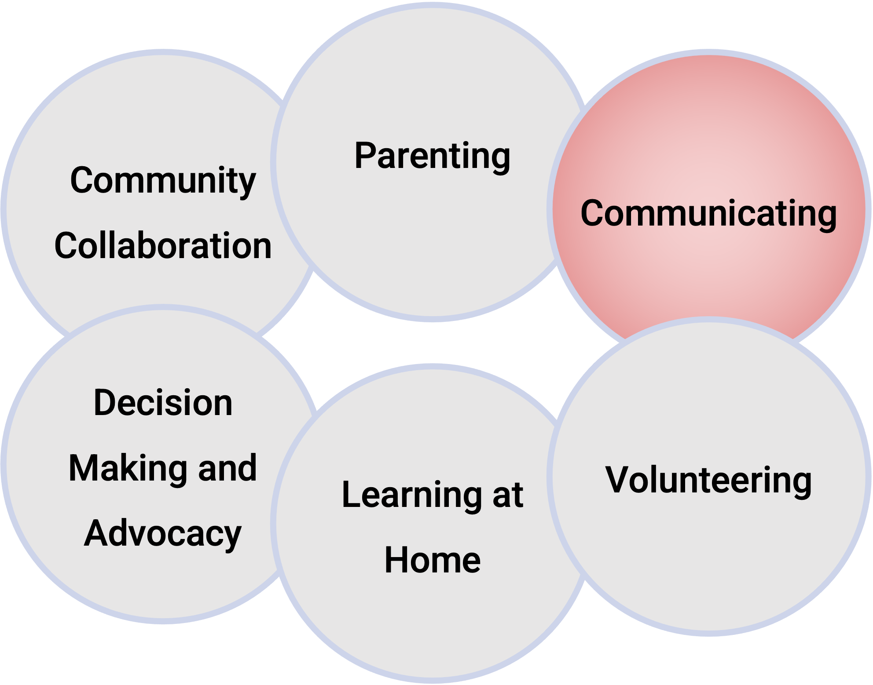
Epstein’s Framework
COMMUNICATING is designing effective forms of school-to-home and home-to-school communications about school programs and student progress.
Communicating may include the following:
Conferences with parents and if needed, having a language translators present.
Regular schedule of useful notices, memos, phone calls, newsletters, and other communications.

Slide 10
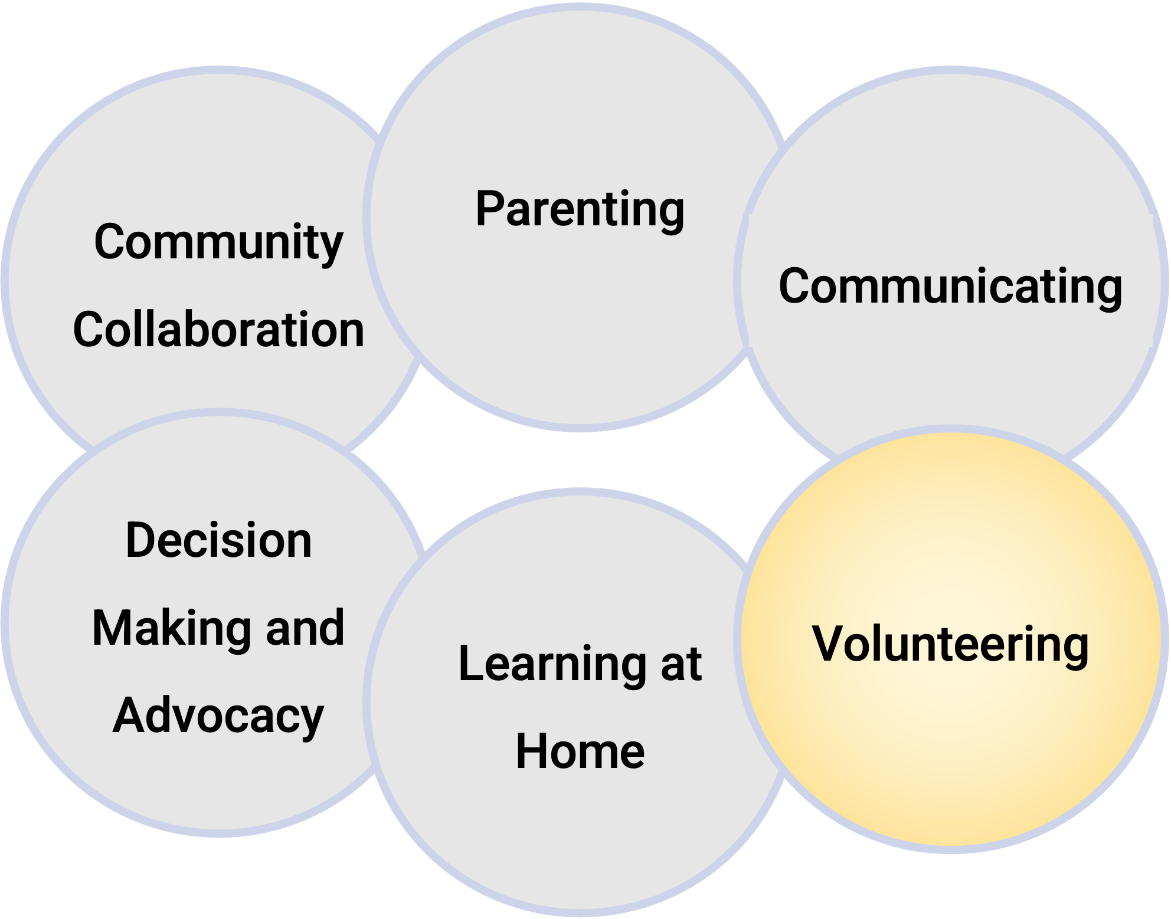
Epstein’s Framework
VOLUNTEERING is recruiting and organizing parent help and support.
Volunteering may include the following:
  Maintaining a school/classroom volunteer program to help teachers, administrators, students, and other parents.
  Managing a parent room or family center for volunteer work, meetings, and resources for families.
  Instituting an annual postcard survey to identify all talents, available times, and locations of volunteers.

Slide 11
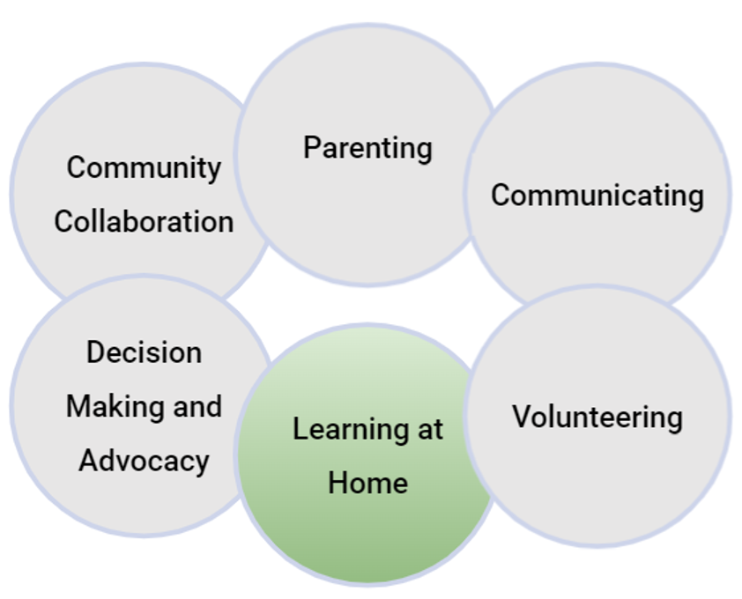
Epstein’s Framework
LEARNING AT HOME is providing information and ideas to families about how to help students at home with homework and engage in other curriculum-related activities, decisions, and planning.
Learning at Home may include the following:
  Providing information for families about skills required for students in all subjects at each grade.
  Making sure that families understand homework policies and how to monitor and discuss schoolwork at home.
  Ensuring parents have access to calendars with activities for parents and students to do at home or in the community.

Slide 12
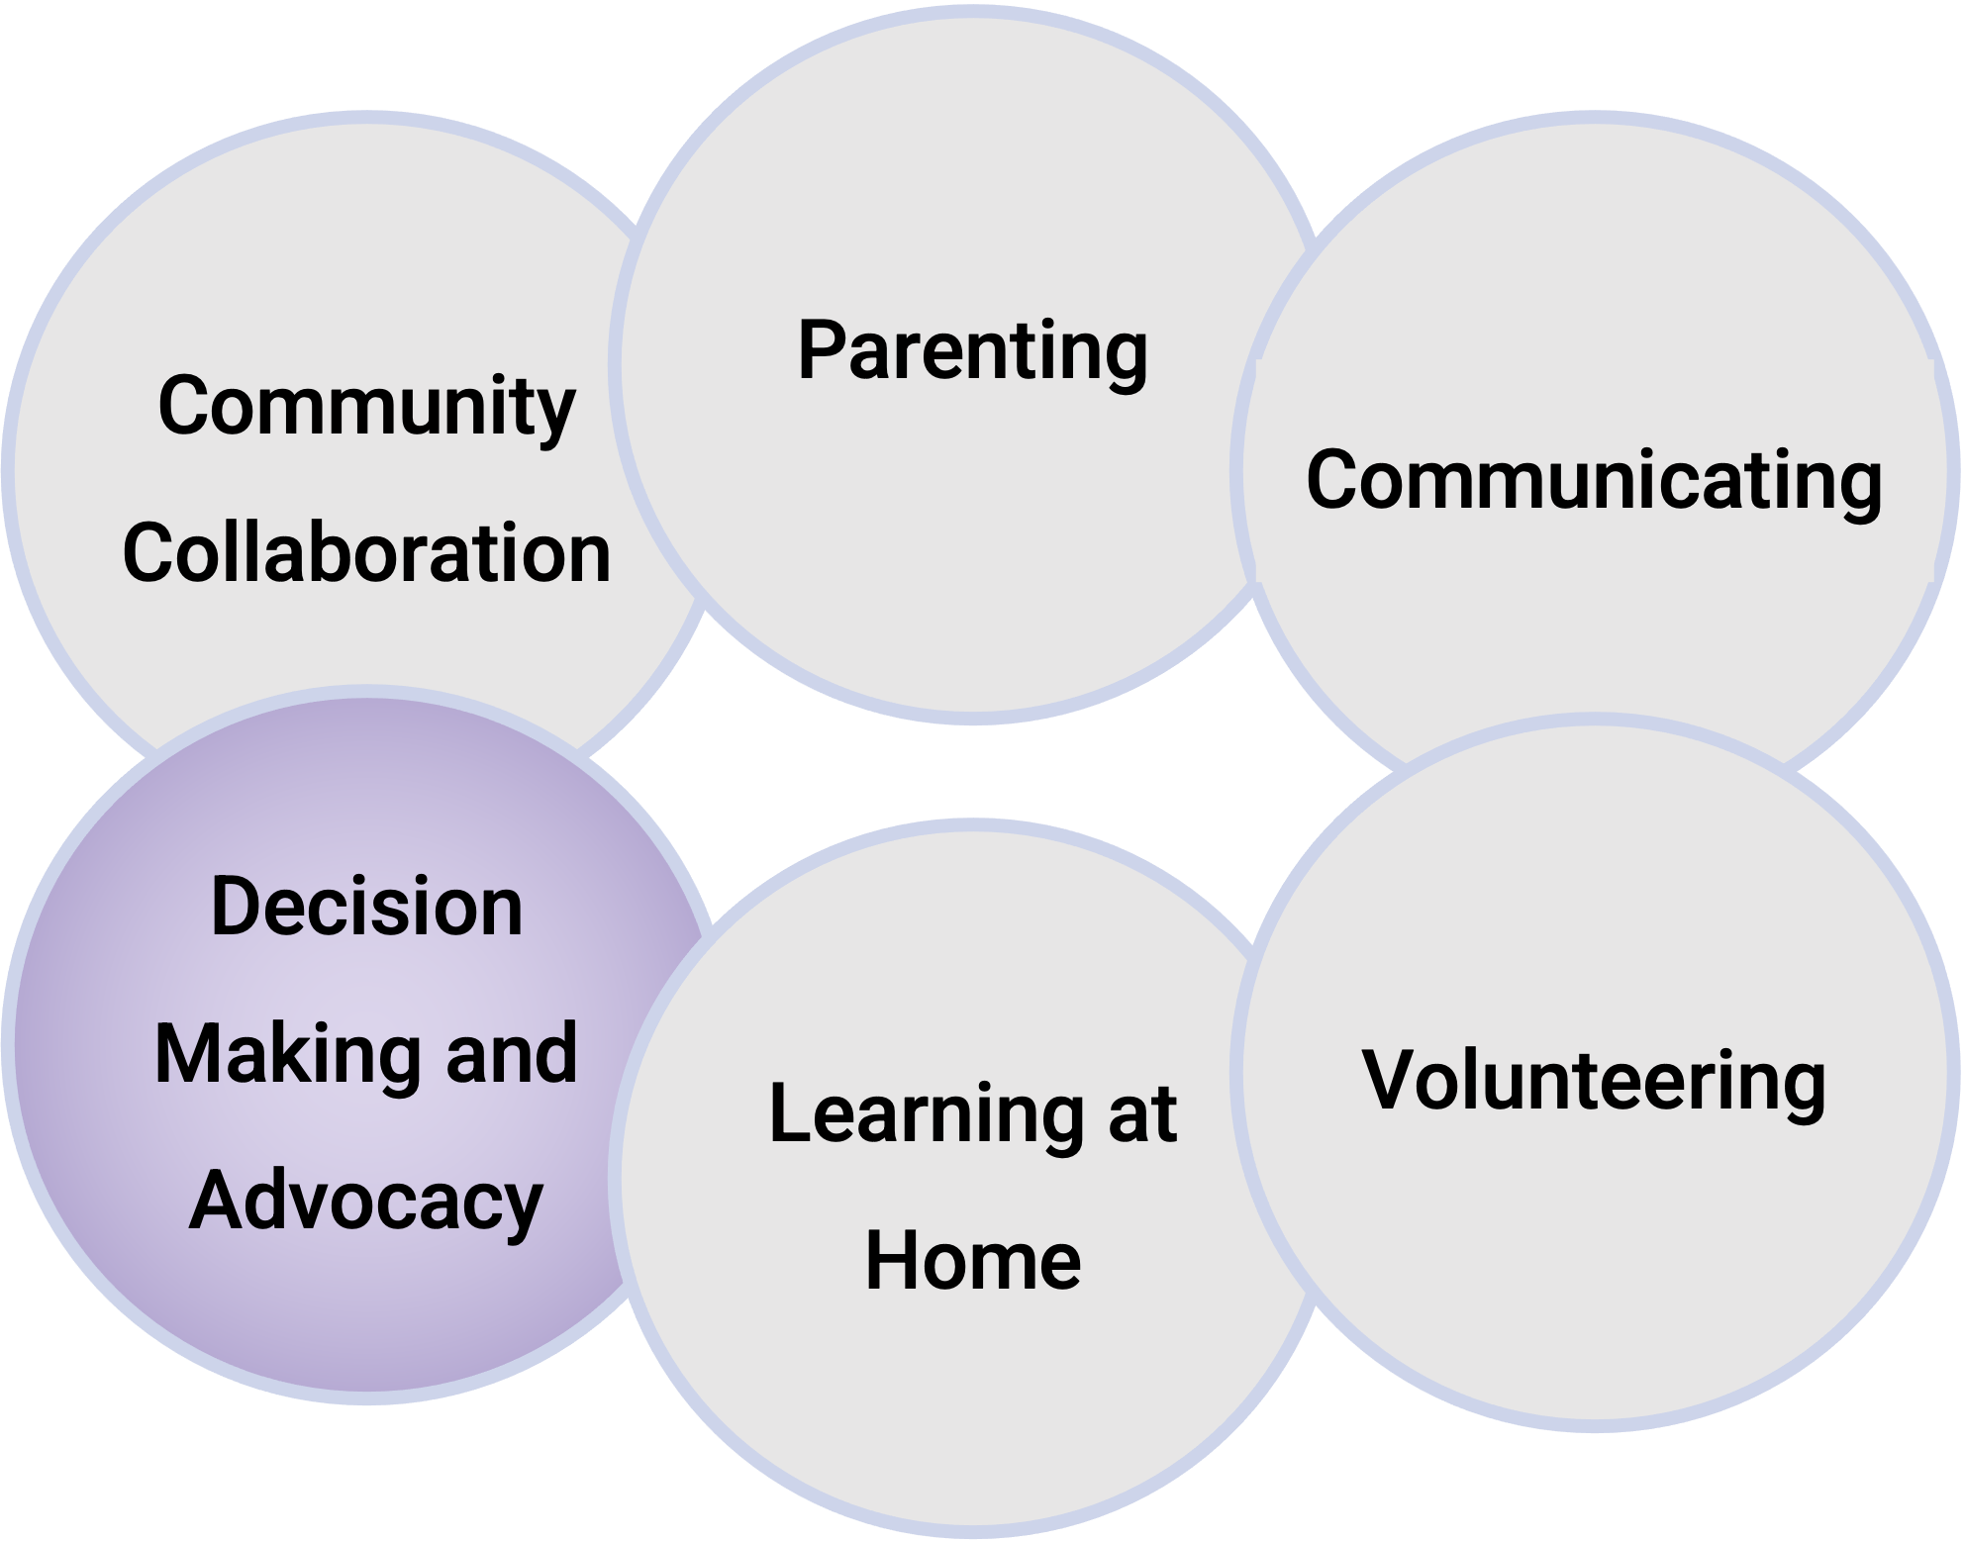
Epstein’s Framework
DECISION MAKING AND ADVOCACY is including parents in school decisions, developing parent leaders and representatives.
Decision making and advocacy may include the following:
  Promoting active participation in PTA/PTO or other parent organizations, advisory councils, or committees for parent leadership and participation.
  Encouraging Independent advocacy groups to lobby and work school reform and improvements.
  Providing Information about school or local elections for school representatives.

Slide 13
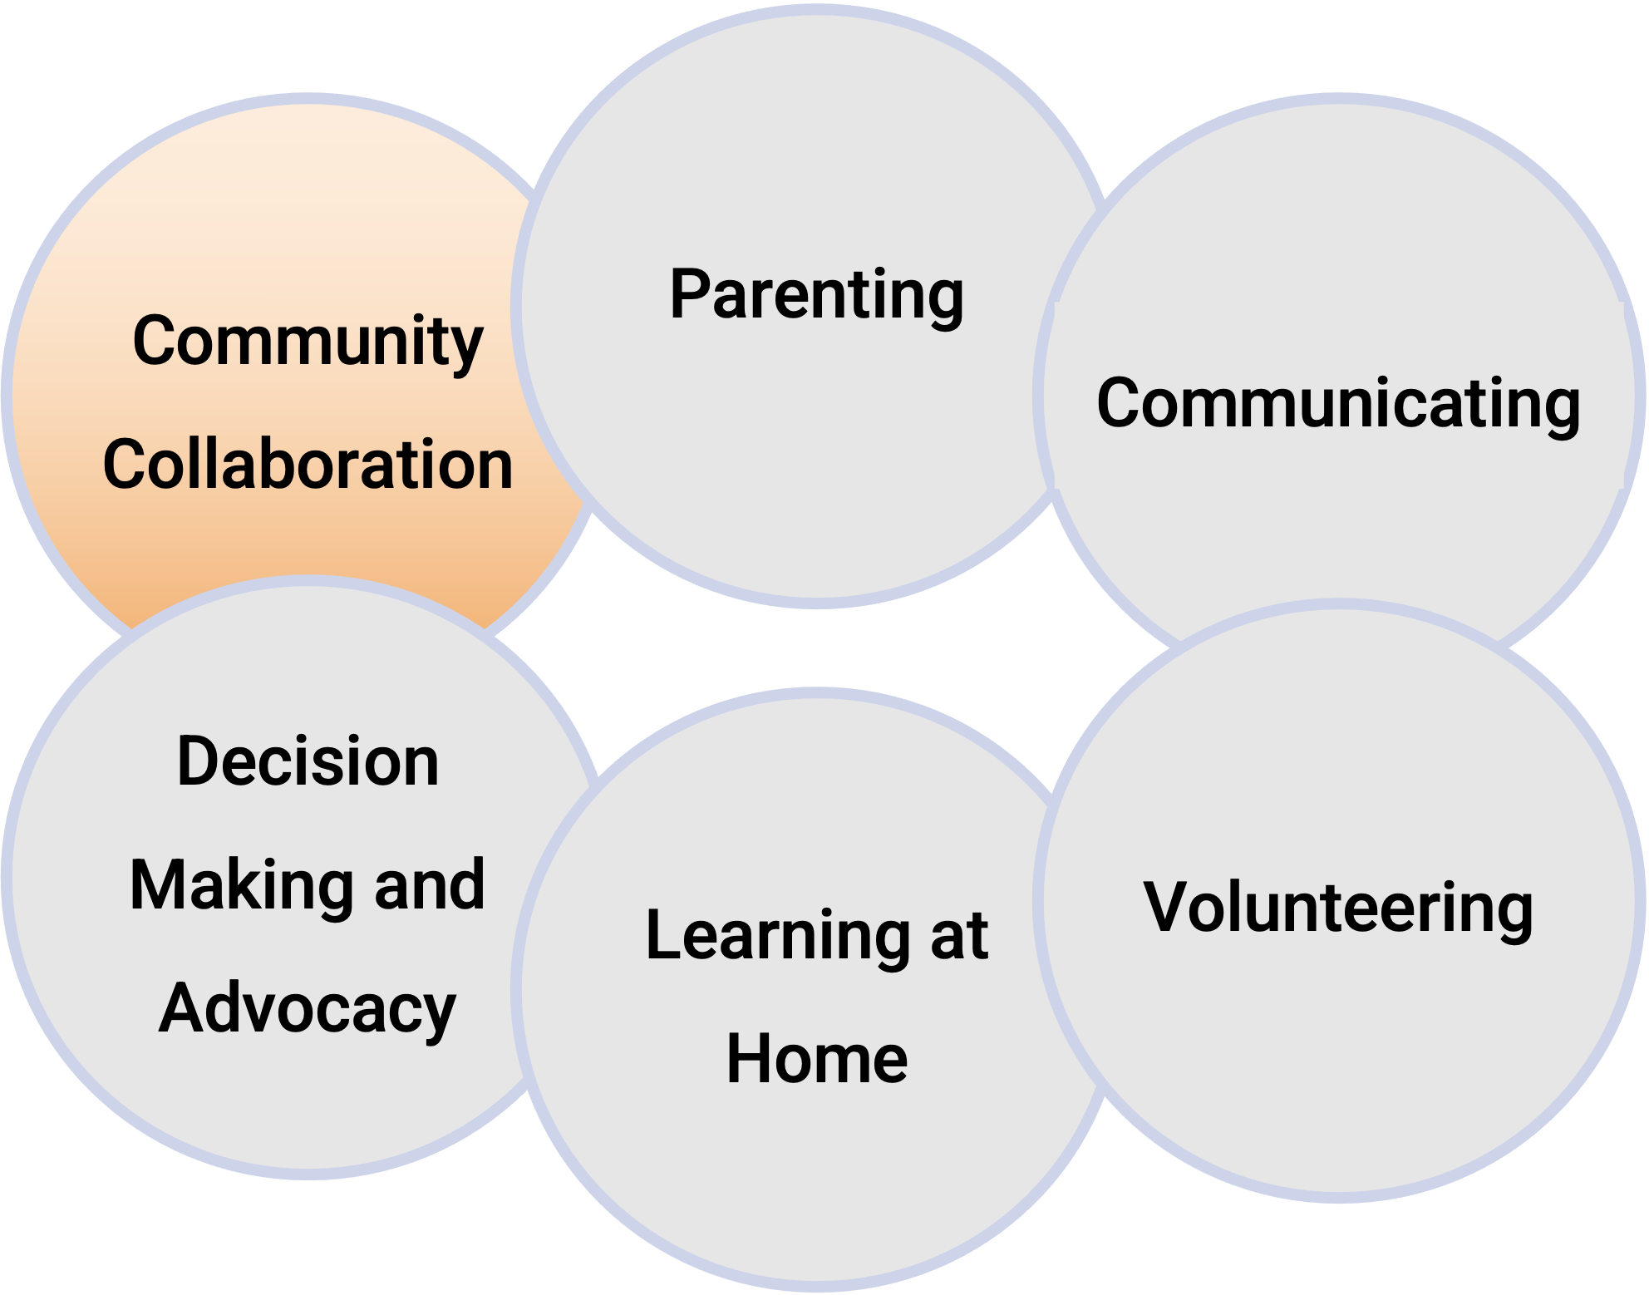
Epstein’s Framework
COLLABORATING WITH THE COMMUNITY is identifying and integrating resources and services from the community to strengthen school programs, family practices, and student learning and development.
Collaborating with the community may include the following:
  Ensuring that students and families know about resources on community health, cultural, recreational, social support, and other programs or services.
  Providing information on community activities that link to learning skills and talents.

Slide 14
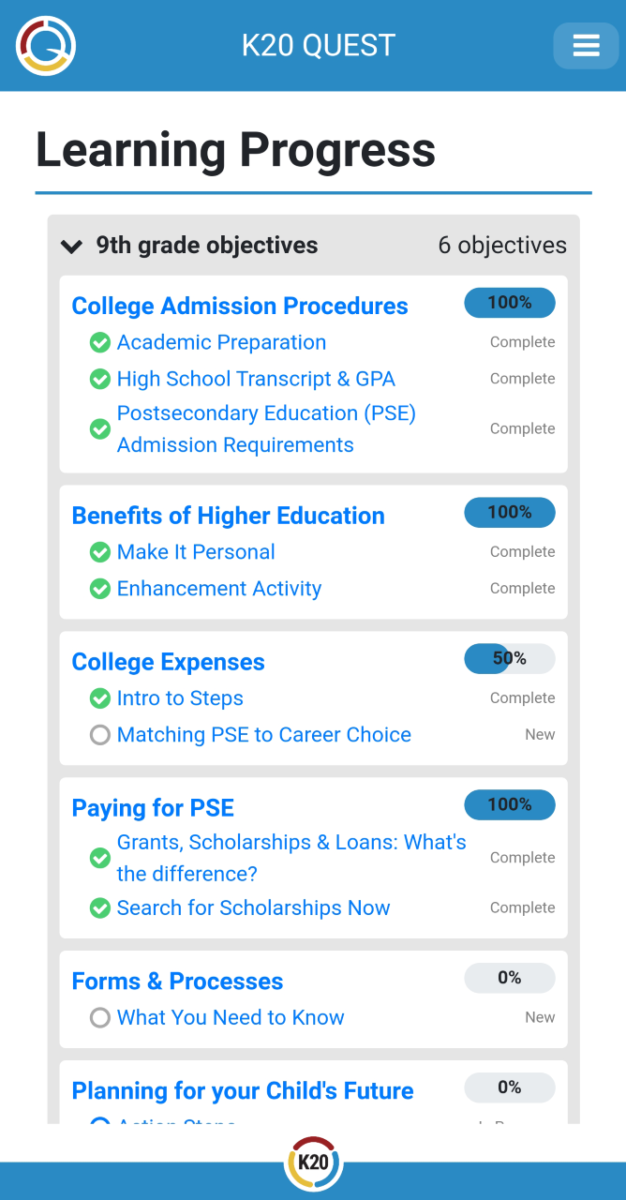
Welcome to QUEST
What is QUEST?
The Quest mobile web page helps your students’ families guide their students’ college and career preparation at each grade level. QUEST provides timely access that is grade specific to relevant information about preparation for post-secondary education (PSE).
Using the Quest app, families can have access to the following information:
Tips on how to help their students prepare for careers
Forms to track scholarships, award, and activities;
Notifications about GEAR UP events and activities

Slide 15
Quest Benefits Everyone
Families | Students | School Staff
Student support Automatic updates Easy and convenient | Next steps & tasks Pathways for PSE Timely information | Direct communication Convenient resources Great beginner’s guide

Slide 16
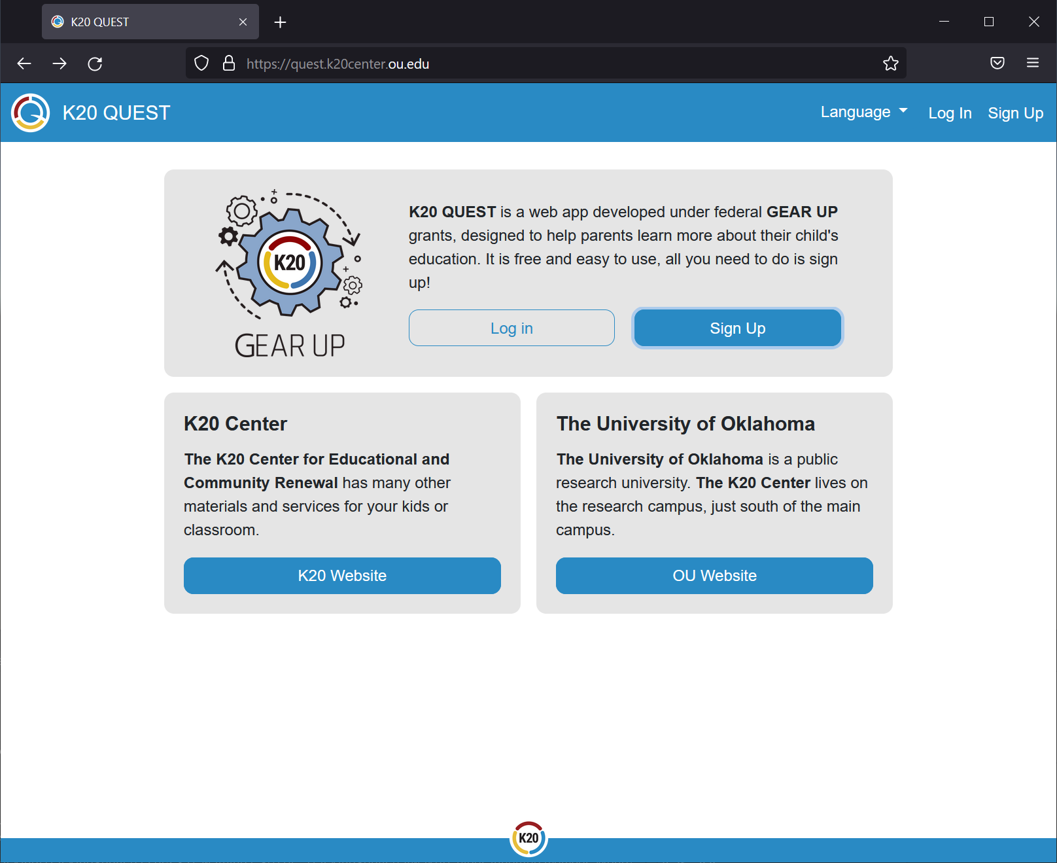
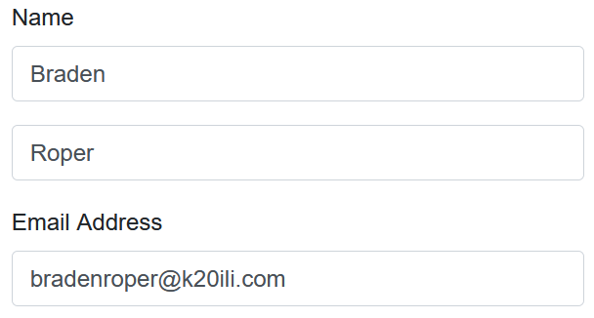
Creating a QUEST Account
Go to “quest.k20center.ou.edu”
Click “Sign Up”
Enter Name
For Email Address, enter “yourname@k20ili.com”
Enter Password

Slide 17
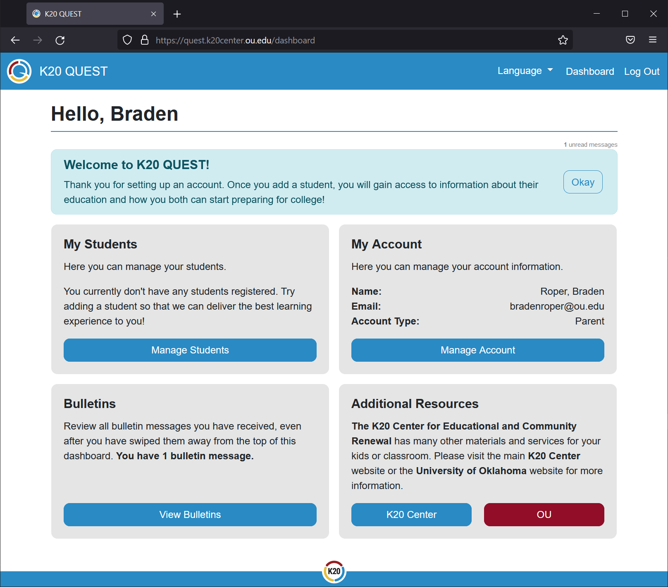
Understanding the Dashboard
Bulletin Messages
Account Management
My Students
  Select “Manage Students”

Slide 18
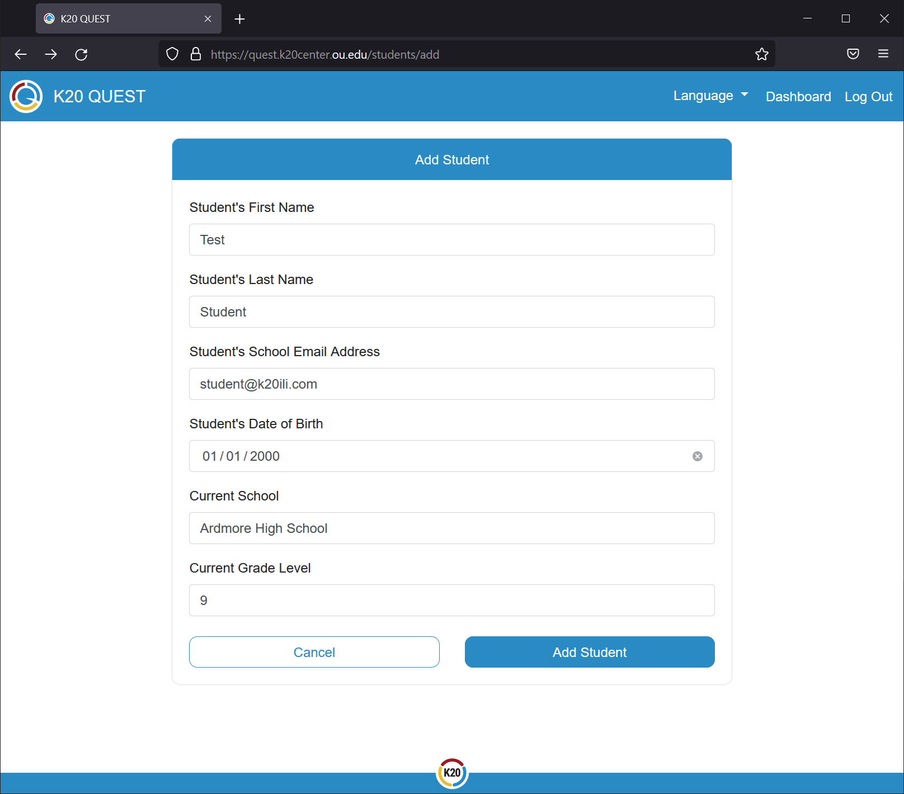
Adding a Student
Fill out the form
Use “student@k20ili.com” for the email address.
Use “Ardmore High School” for the school.
Use “9” for the Grade Level.

Slide 19
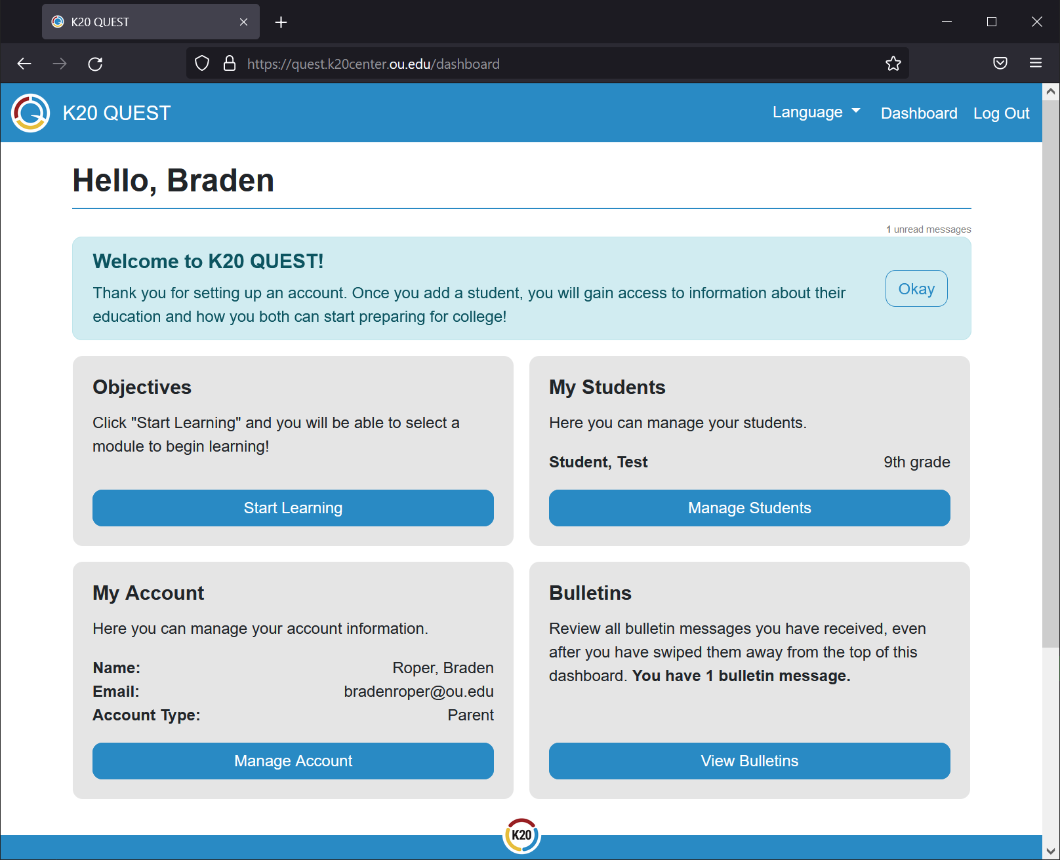
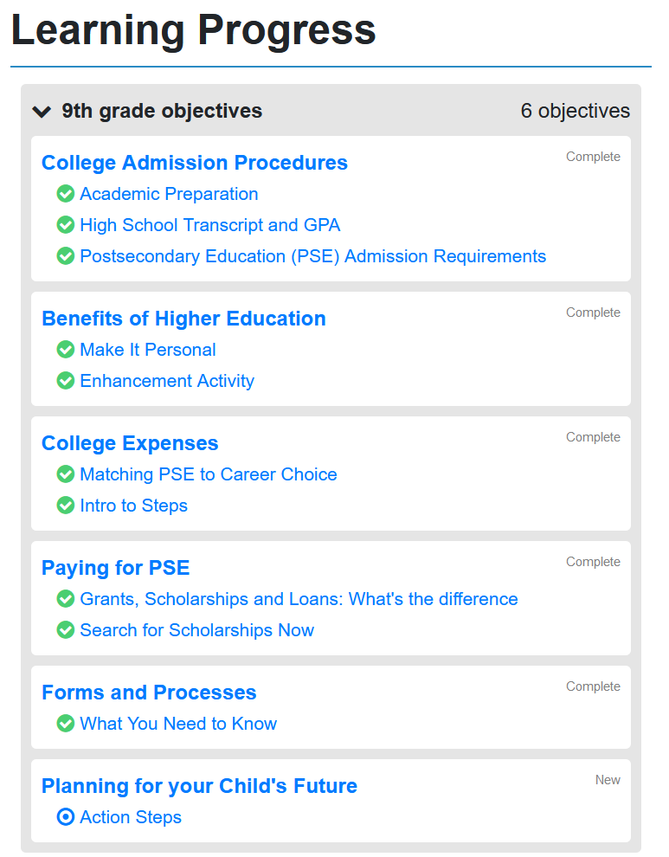
Accessing the Content
Select
“Start Learning”
Expand
“9th grade objectives”
You now have access to all content relevant to parents of 9th graders.

Slide 20

QUEST Gallery Walk
For each of the following objectives, read the section and add a comment to the corresponding sticky note. You’ll have two minutes for each.
College Admission Procedures
Benefits of Higher Education
College Expenses
Paying for PSE
Forms and Processes
Planning for your Child's Future

Slide 21
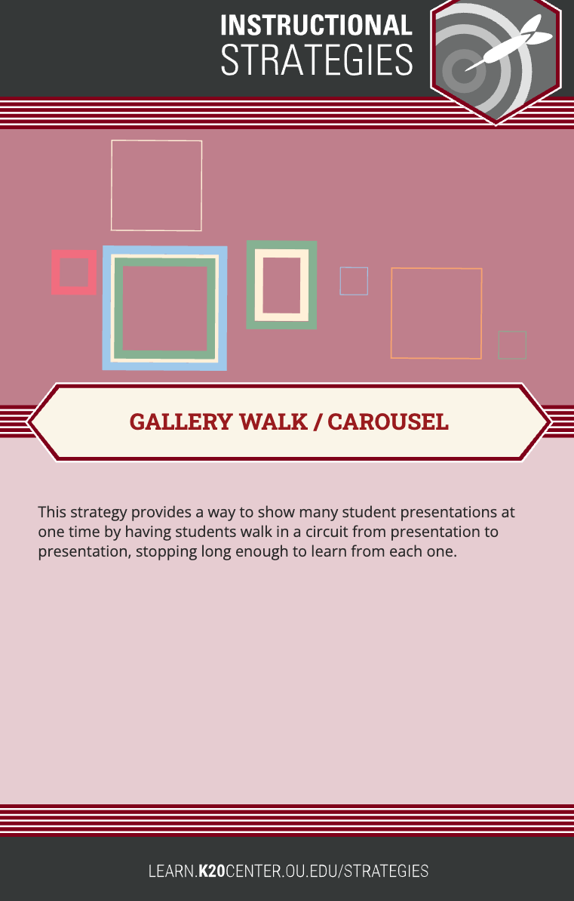
QUEST Gallery Walk
Return to the table/objective where you started out, and review as a group all the post-it comments. Next, as a group, select one sticky note from your table to share out with the whole group.
College Admission Procedures
Benefits of Higher Education
College Expenses
Paying for PSE
Forms and Processes
Planning for your Child's Future

Slide 22
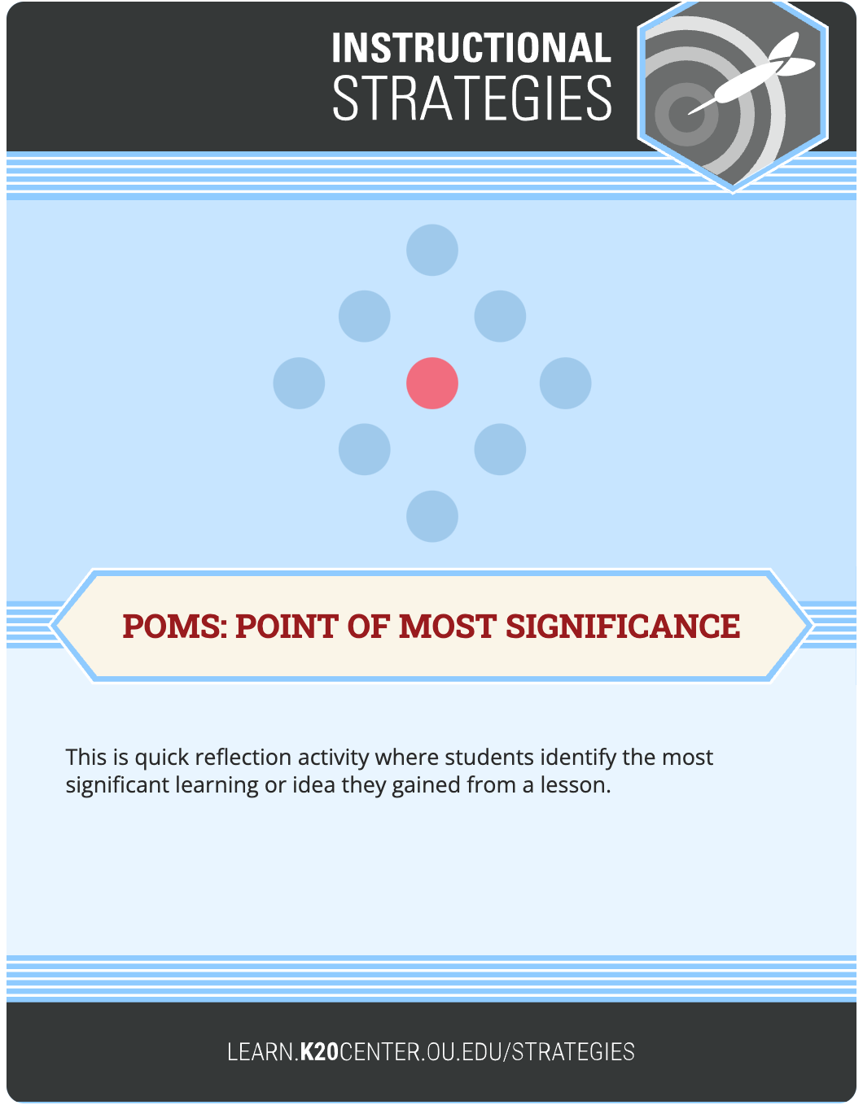
POMS (Points of Most Significance)
Reflect on the most significant learning or idea you gained from the session, and share it out with your sole mate from the beginning of the session.

