Slide 2
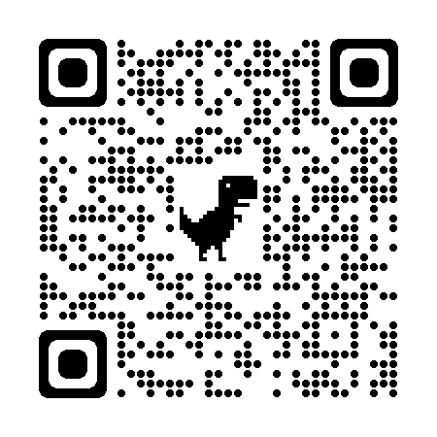
Welcome! While We’re Getting Started…
Go to http://tinkercad.com/join
Select “Educators start here”
Create an account
You will use this later in the session.

Slide 3
Authenticity in 3D

Slide 4
Essential Question
How can 3D printers be used authentically to support learning?

Slide 5
Lesson Objectives
Distinguish between examples and non-examples of authentic 3D printing.
Brainstorm and develop ways to integrate 3D printing into your curriculum.
Build competencies in basic 3D modeling using Tinkercad.

Slide 6
Jamboard
Insert QR code to your Jamboard
Take some time to review the 3D printed models at your table.
Which model enhances the instruction in an appropriate way? How?

Slide 7
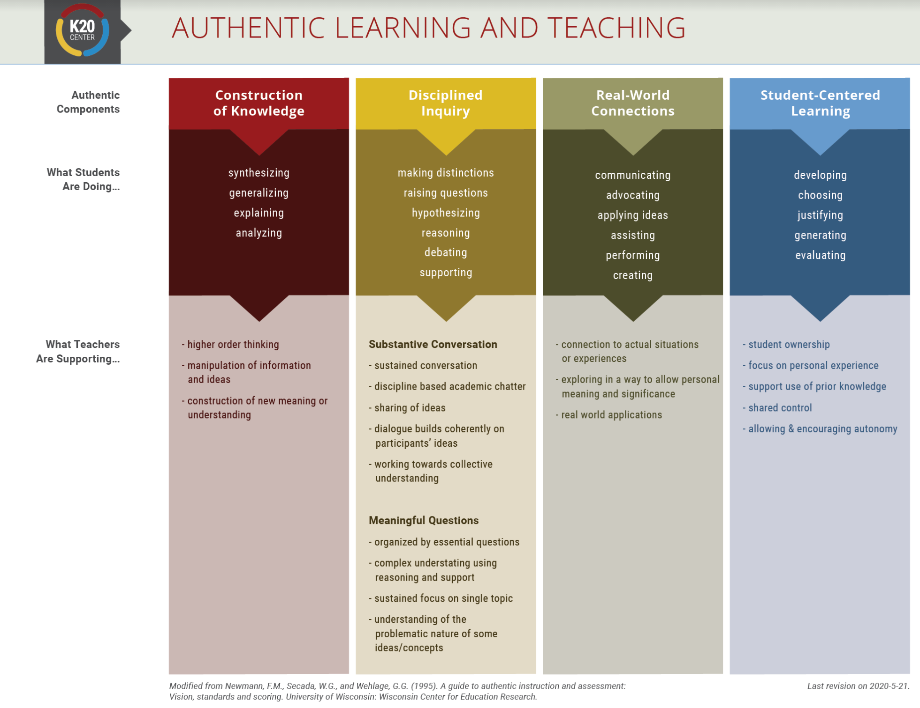
Components of Authenticity
Construction of Knowledge
Real-World Connections
Synthesizing
Generalizing
Explaining
Analyzing
Communicating
Advocating
Applying ideas
Assisting
Performing
Creating
Disciplined Inquiry
Student-Centered Learning
Making distinctions
Raising questions
Hypothesizing
Reasoning
Debating
Supporting
Developing
Choosing
Justifying
Generating
Evaluating

Slide 8
Jigsaw
Read your group’s assigned section.
Discuss in your groups and jot down ideas on your handout.
Be prepared to have your group’s spokesperson share out.
Notes:
Lesson link: https://learn.k20center.ou.edu/lesson/1763
Pass out Authenticity framework, lesson narrative, and note catcher

Slide 9
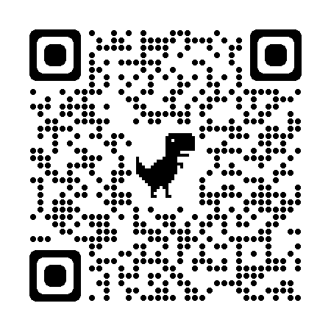
Follow the Green, Not the Dream
http://k20.ou.edu/3d-lesson
Notes:
Lesson link: https://learn.k20center.ou.edu/lesson/1763
Pass out Authenticity framework, lesson narrative, and note catcher
Stay on this slide after time is up to reflect

Slide 10
Application Determines Authenticity
Revisit the models at your table.
What do we have to bring to them to make them authentic?
Think about these learning examples.
How could you see students authentically using a 3D printer in your classroom?

Slide 11
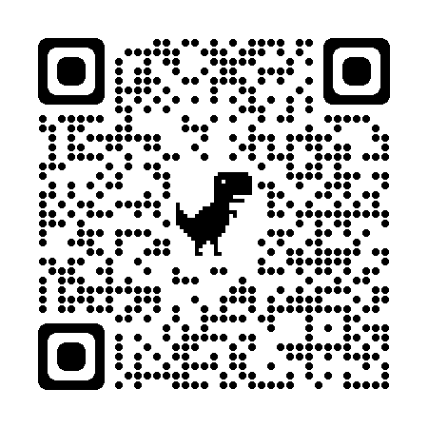
3D Modeling 101 with Tinkercad
How well do you know the Tinkercad app?
With your group, use the scavenger hunt to identify and explore key features of the application
http://k20.ou.edu/3d-tinkercad
Notes:
https://www.tinkercad.com/learn/designs
Pass out scavenger hunt
As you complete this activity raise your hand if you have any questions or run into issues with the training activities.
Mention external printing services.

Slide 12
Tinkercad Reflection
What was the easiest thing you did? The most challenging?
What application of curriculum standards do you see?
What makes a 3D printing assignment authentic learning?

