Slide 2
Name Tent
Please fold your cardstock in half.
Write your name and the school where you teach.
Place it in front of you!

Slide 3
Authenticity in Math: Digital Breakouts
K20 Center

Slide 5
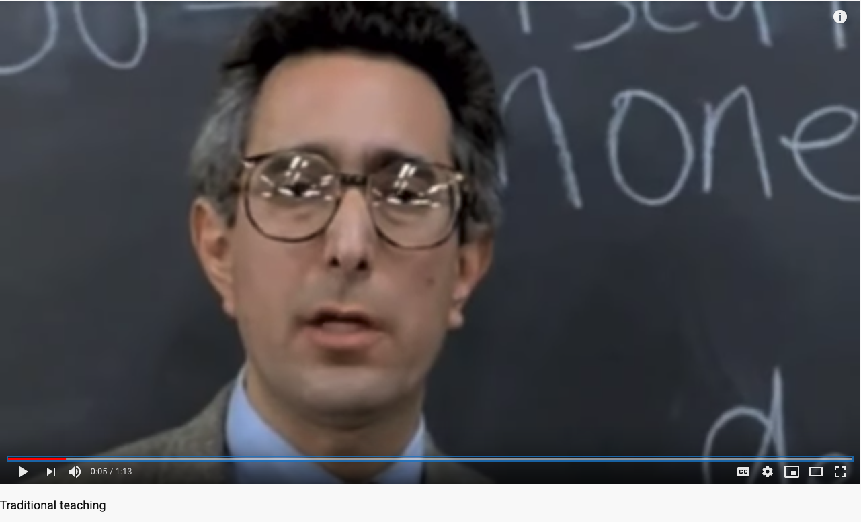
Traditional Teaching
Notes:
https://youtu.be/aWYcOR18-x0

Slide 6
Video Reflection
Was there a time in your life that you felt this way in the classroom?
What was happening in the classroom that made you feel that way?
Even though content standards were being addressed, does this environment increase academic performance and engagement?

Slide 7
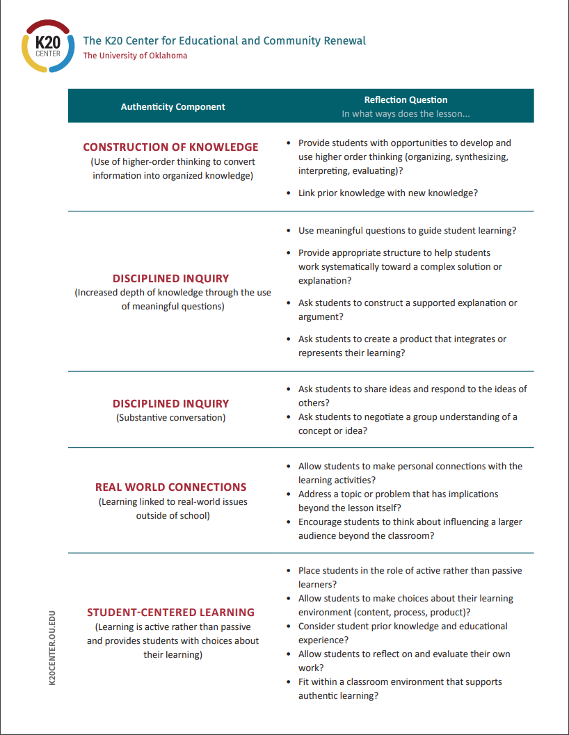
Authentic Lesson Reflection Tool

Slide 8
Essential Question
How can an authentic, technology-enriched learning environment increase student engagement and academic performance?
Notes:
Margaret

Slide 9
Objectives
Identify instructional strategies modeled that support authentic instruction and Oklahoma Math State Standards.
Analyze an authentic activity integrating technology and reflect on this experience to determine the relevant components of authenticity.
Create a plan for authentically integrating technology in a lesson.

Slide 11
Give yourself ONE point for each of the following that describes you:
I can create a Google Form.
I can create a simple website using a tool (like blogger, Wiki, or Google Sites).
I am comfortable using spreadsheets to organize data.
I know how to use the main components of Google Suites (Docs, Forms, Drive).
I enjoy solving puzzles.

Slide 12
Find Your Partner
Based on your number, find someone who does not have the same number as you.
Get to know each other! Discuss:
How have you used Google Suites in your classroom so far?
What questions or hopes do you have about Google Suites?
Notes:
Use this pairing for the walkthrough building Google Sites later. There should be some sort of processing question here. Talk to each other about how you have used Google Suite in your classroom so far. Talk about questions you have or hopes if you don’t have much experience yet.

Slide 13
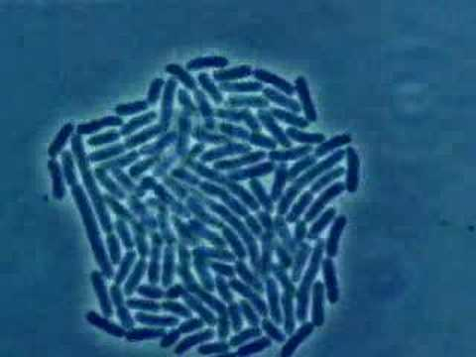
Math Lesson: Epidemic Outbreak
Can you save the world?
Notes:
https://www.youtube.com/watch?v=gEwzDydciWc

Slide 14
learn.k20center.ou.edu
Lesson Snapshot
Exponent Rules—“Can You Save the World in Time?”
Notes:
https://learn.k20center.ou.edu/lesson/b5aef944bb8300a7bdb6f1a67f02c303

Slide 15
What Are Digital Breakouts?
Have you ever participated in an escape room?
Think of this as a digital version.
You can purchase kits from Breakout EDU or you can create them for free using GSuite.
Locks
Color Locks
Directional Locks
Word Locks
Date Locks
Emoji Locks
Notes:
(Mandy) Get into your pairs from Fold in the Line mention GEAR UP and technology purchases and that they will reflect on the components of Authenticity

Slide 16
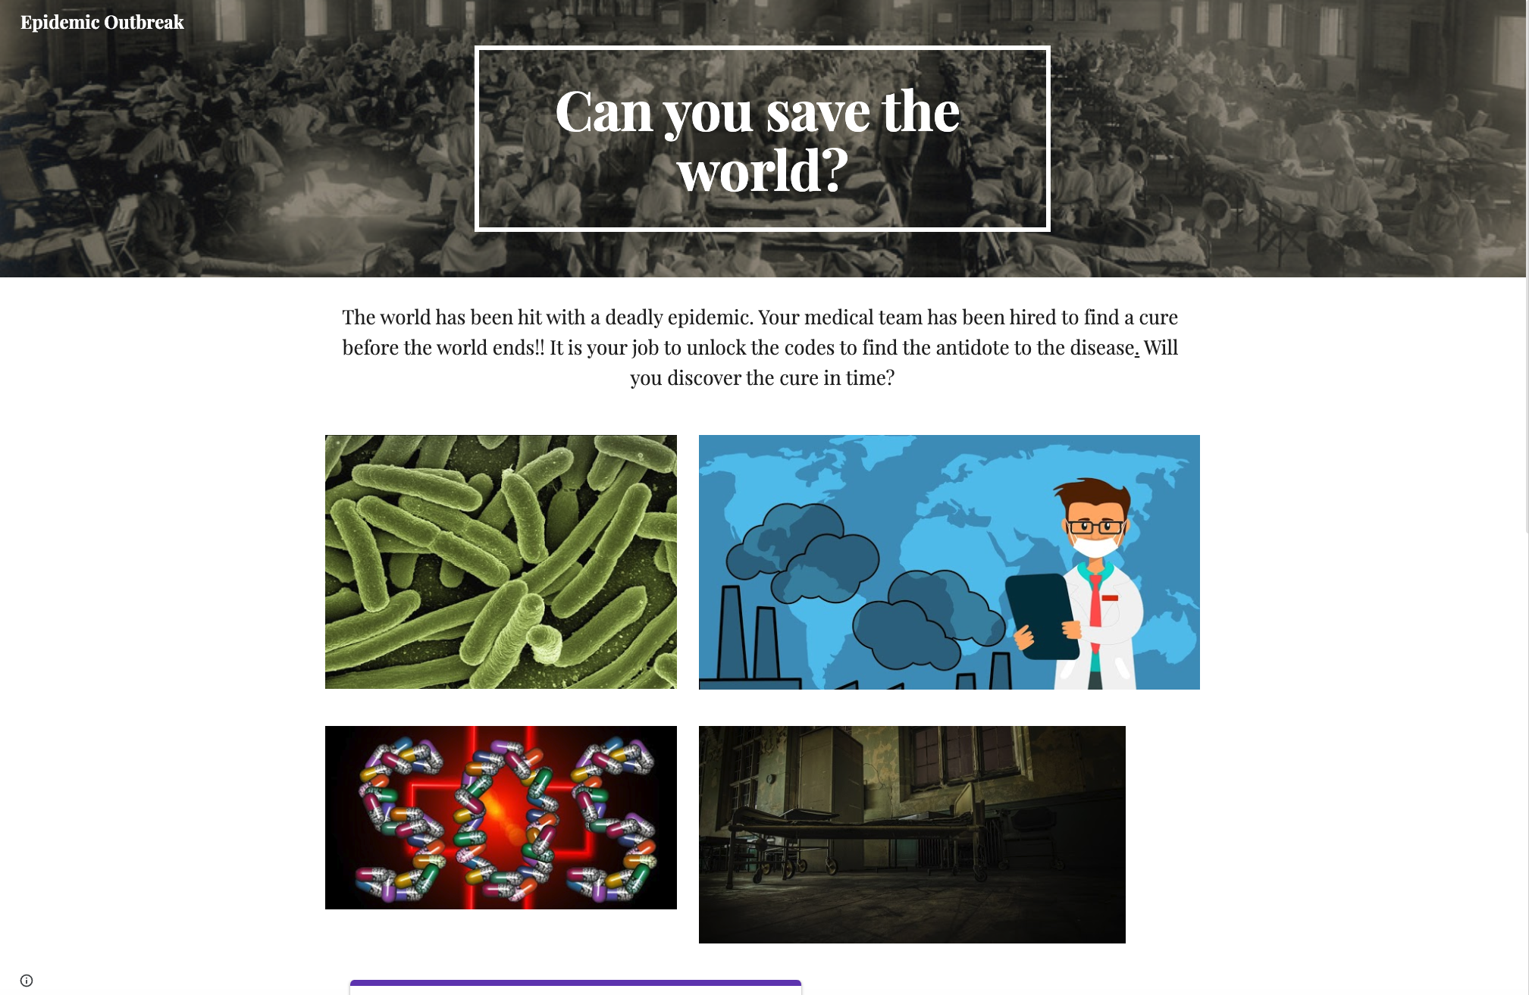
WE NEED YOUR HELP!
The world has been hit with a deadly epidemic. Your medical team has been hired to find a cure before the world ends!
Notes:
Hand out the worksheet to fill in the locks.
http://bit.ly/epidemicbreakout

Slide 18
Did You Save the World?
What was your experience with the activity and lesson?
How can you implement a breakout into your classroom that aligns with standards?

Slide 19
Authentic Lesson Reflection Tool

Slide 20
Authentic Lesson Reflection Tool
Use the lesson reflection tool to think about the ways in which this activity aligns with the components of authenticity.
How could this activity be modified to make it even more authentic?
How could this activity have been done without the use of technology?

Slide 22
Breakout Brainstorm
Before walking through the components of the breakout, let’s brainstorm what content you would be interested in converting to a breakout format.
Use the standard organizer to help you decide what content you want to incorporate and the math problems associated with it.

Slide 23
How to Build a Breakout
Google Sites
Google Forms
Conditional Formatting = Color Locks

Slide 24
Need more ideas for clues and locks?
Consider these:
YouTube videos
A keyword can be used as a lock solution.
Brief passages or documents with multiple choice questions
The correct answers can be used as a lock solution.
Maps
Information can be used a lock solution or directional lock solution.
Puzzles
Use Jigsaw Planet and your own images to create puzzles to hyperlink.
Google Draw
Create a document that, when solved, reveals a word that solves a lock.
Notes:
Jigsaw Planet: https://www.jigsawplanet.com/

Slide 25
How to Hack
Want to use a pre-made digital breakout but don’t know the correct answers?
Right-click on the lock form, but not in an answer blank.
Select “View Frame Source.”
Scroll to the bottom of the page, past all of the code, until you see separated lines and white space.
In the parentheses, you will see the lock titles and the corresponding answers.

Slide 26
Tutorials and Premade Breakouts
Step-by-step tutorial with videos and templates:
Sandbox with 240 pre-made breakouts constructed by fellow teachers:
Notes:
http://bit.ly/K20breakouts
https://sites.google.com/site/digitalbreakoutjb/sandbox

Slide 28
Create Your Own
Now that we have gone over the basics of digital breakouts, use the organizers to put together your own.
Follow the plan you created in the Breakout Brainstorm.
Use the How to Build a Breakout guide (or the tutorial website) for step-by-step instructions.
Need more guidance or help?
Let us know!

Slide 29
Authentic Lesson Reflection Tool
Notes:
Susan and Milton:
Use the tool to provide detail in the discussion of the components.

Slide 30
LEARN Lesson Repository
Notes:
https://learn.k20center.ou.edu/

