Slide 2
Move, Flip, and Slide!
Engage With Scaffolded Classroom Practices

Slide 3
Name Tents
On your table, you will find a folded piece of cardstock.
Please put your name on one side and answer the following questions on the back:
Where are you from?
How long have you been in professional education?
What has been the most challenging part of this year?
What has been a highlight for you this year?
What is most important to you as an educator?

Slide 4




At the Door
Jellyfish
Turkey
Dairy Farmer
Happy Salmon

Slide 5
Instructional Strategy Notes
On your Instructional Strategy Notes sheet, answer the following questions regarding the different types of handshakes:
How was it used?
How will I use it?
Repeat the process with each strategy you try.

Slide 6
Brainstorm
How do you use technology in the classroom?
On a sticky note, write about the different ways your students use technology.
Post them around the room.

Slide 7
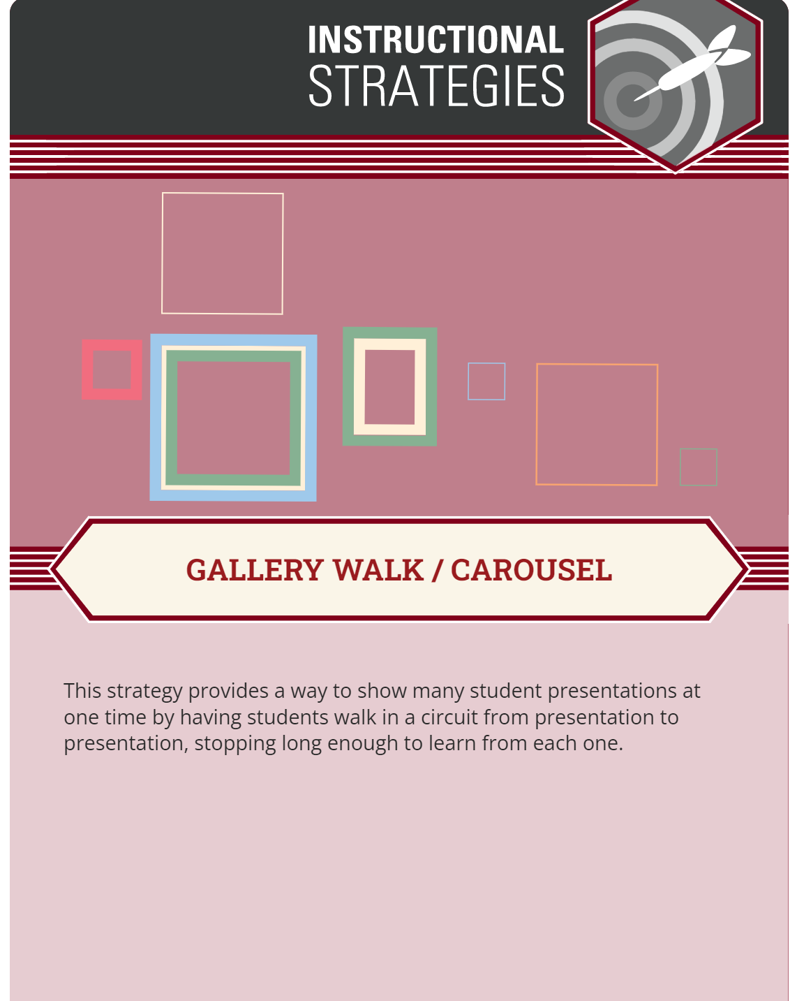
Gallery Walk
Walk around the room and read
about the different ways students
use technology in the classroom.
Notes:
K20 Center. (n.d.). Gallery Walk/Carousel. Strategies. https://learn.k20center.ou.edu/strategy/118

Slide 8
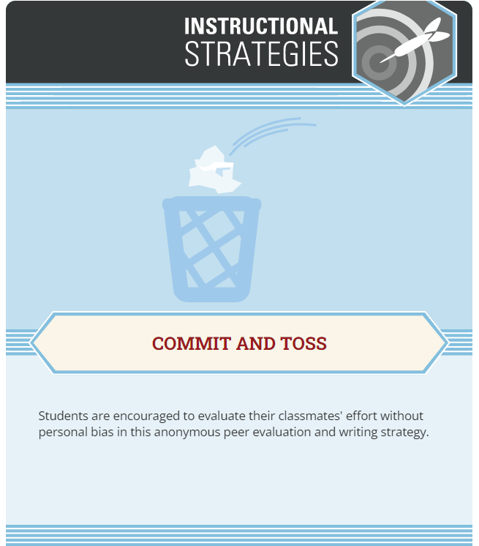

Commit and Toss Strategy
On a sticky note, write your biggest TAKEAWAY from the posts you read during your Gallery Walk.
Crumple up your response and throw it on the floor.
Notes:
K20 Center. (n.d.). Commit and Toss. Strategies. https://learn.k20center.ou.edu/strategy/119
https://tenor.com/view/david-wood-throw-paper-gif-18838376

Slide 9
Essential Question
What do you think makes social media so engaging to your students?

Slide 10
Session Objectives
Understand how Flipgrid can be used for communication inside and outside the classroom.
Engage with instructional strategies you can use in your classroom.

Slide 11
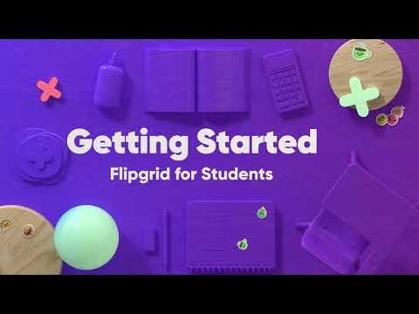
How-To Flipgrid Video
Notes:
Flipgrid. (2021, September 17). Students: Getting Started with Flipgrid. [Video]. YouTube. https://www.youtube.com/watch?v=kR1FxImNPSs

Slide 12
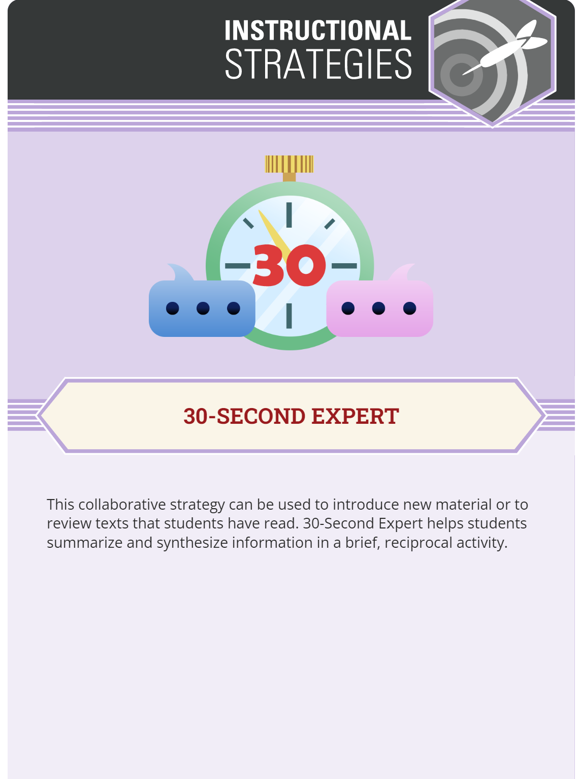
30-Second Expert Strategy
What did you learn from the Flipgrid video?
Find a partner.
The first person will take 30 seconds to share everything they learned from the video.
Switch places.
The second person will repeat back what they heard and then add anything else they learned from the video.
Questions?
Notes:
K20 Center. (n.d.). 30-Second Expert. Strategies. https://learn.k20center.ou.edu/strategy/1048

Slide 13
Flipgrid Time
Go to Flipgrid.com
Click on the green + sign
Enter the Join Code: 8eb8996b

Slide 14
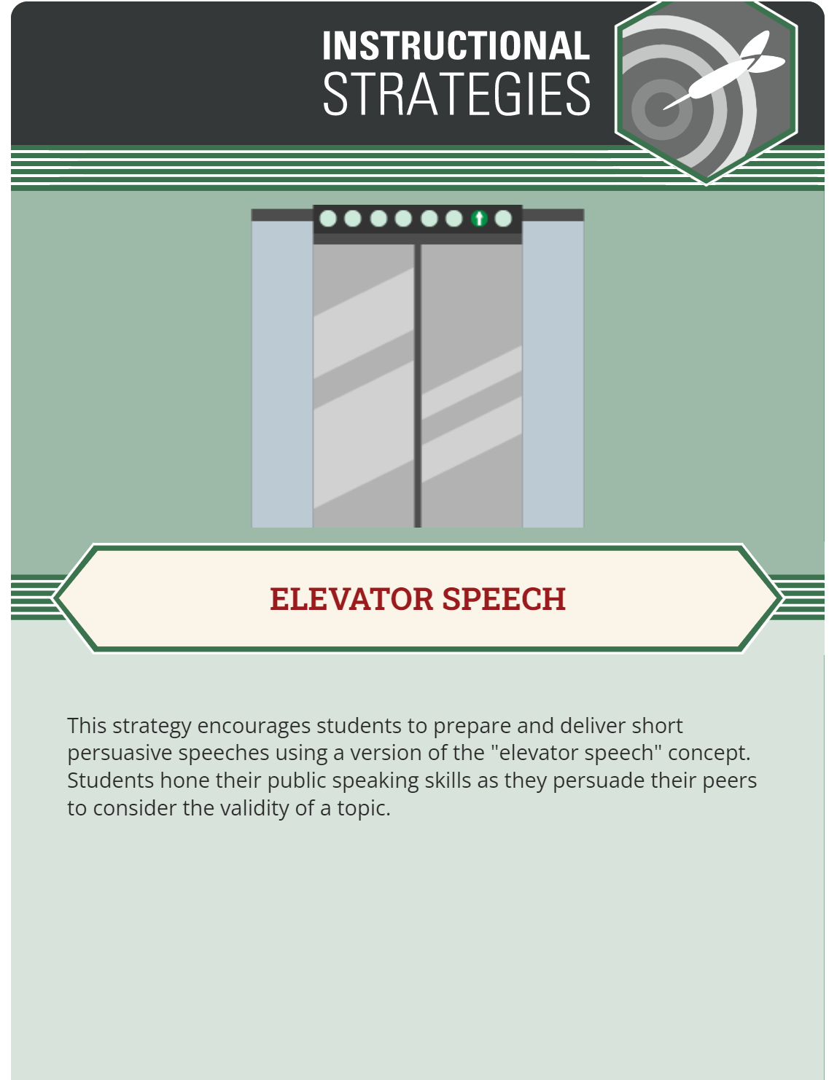
Elevator Speech
🎯 You have 60 seconds to share your Name Tent with your colleagues. Have fun using the Video Effects to create an “All About Me” post!
Creative Options
🔮 Choose a Filter to change the tone.
🔠 Use Text to share your name or adjectives/short phrases to describe you.
✏️ Use the Pen to draw or sketch whatever you wish.
📈 Use a Board to create a split screen effect.
📷 Upload a Photo from your device or camera roll.
🔳 Use a Frame to add a pop of style.
🎬 Transform your response with a Backdrop or add your own custom Backdrop.
😃 Add emoji Stickers that represent your interests.
🦄 Animate your response with GIFs.
Notes:
K20 Center. (n.d.). Elevator Speech. Strategies. https://learn.k20center.ou.edu/strategy/57

Slide 15

Share Your Video

Slide 16
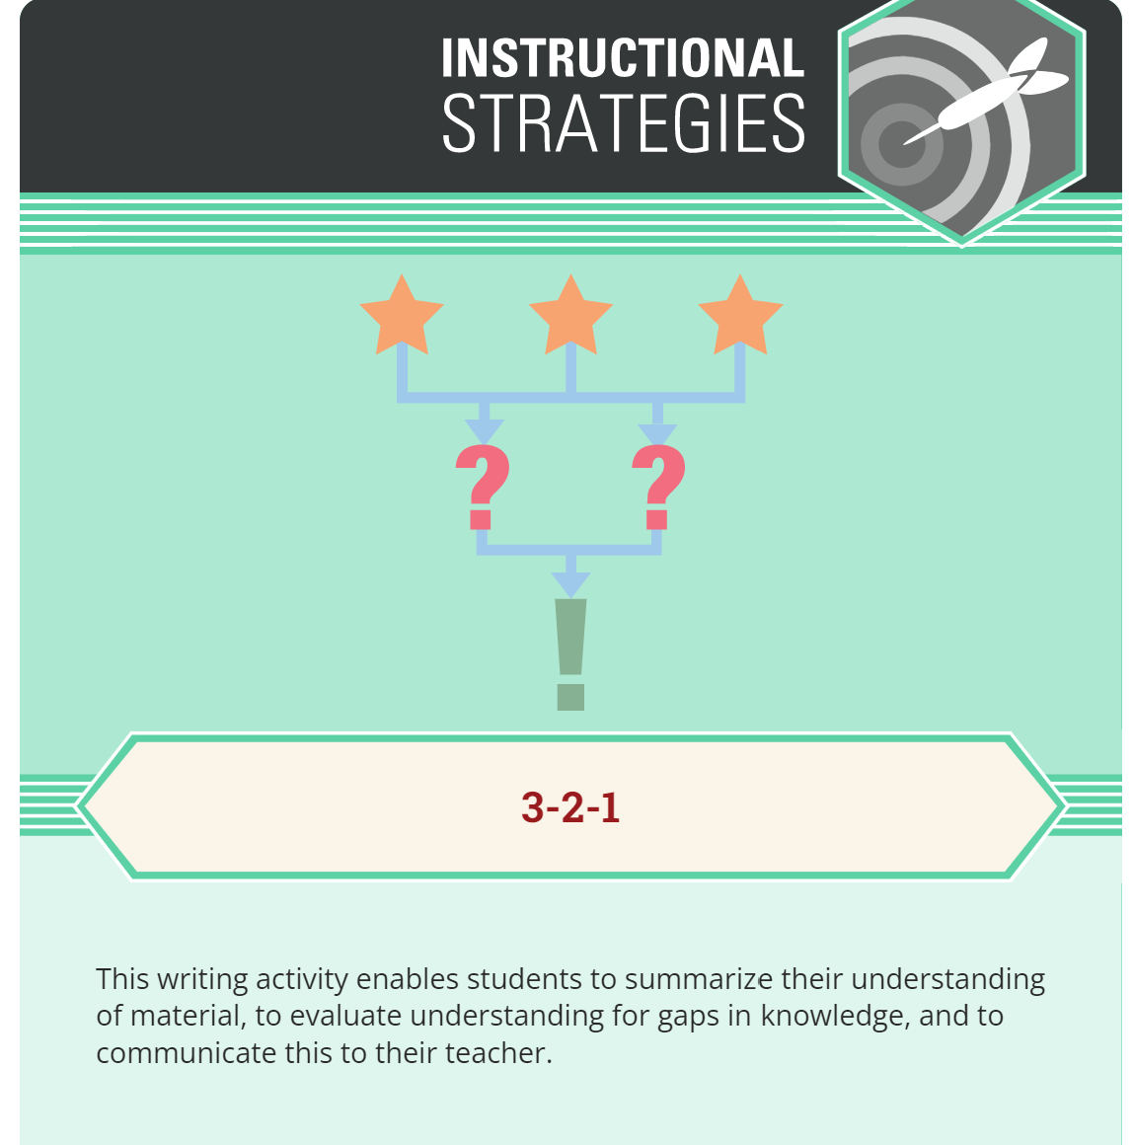
3-2-1 Strategy
What are three things you learned from the activity today?
What are two things you learned about yourself?
What is one question you have about what you learned today?
Notes:
K20 Center. (n.d.). 3-2-1. Strategies. https://learn.k20center.ou.edu/strategy/117

Slide 17
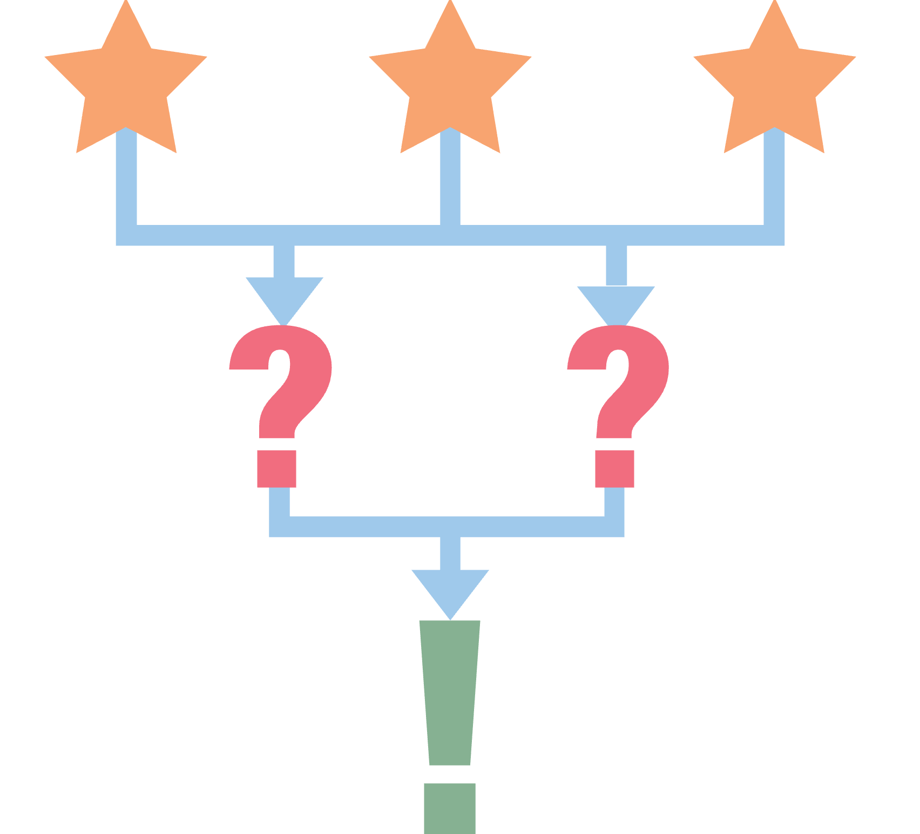
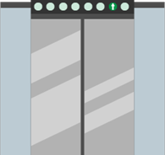


LEARN Strategy Reflection
Handshakes
Name Tents
Gallery Walk
Commit and Toss
30-Second Expert
Flipgrid
Elevator Speech
3-2-1/Exit Ticket

Slide 18
Revisit the Instructional Strategies Notes
How was it used?
How will I use it?
Repeat the process with each strategy you tried.

Slide 19

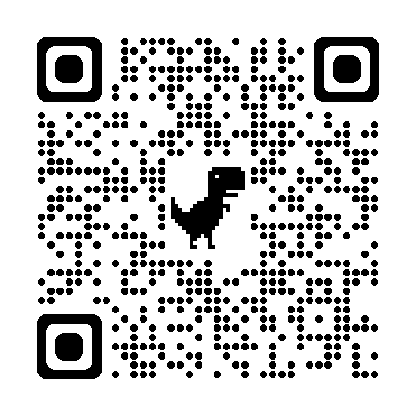
K20 LEARN Website
Virtual Learning
Instructional Strategies
5E Lessons

Slide 20






Follow Us on Social Media!

