Slide 2
Pushing Play on the
Game of Life
Notes:
2m

Slide 3
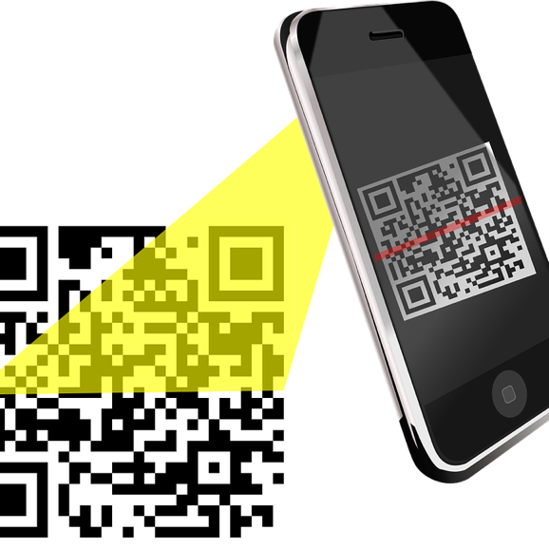
Mentimeter
What are common student misconceptions about life after high school?
Menti.com [CODE HERE]
MENTI LINK HERE
INSERT QR CODE HERE
Notes:
Link to get a copy of the Mentimeter: https://www.mentimeter.com/s/e63525550a1092b90d7129d565874b2d/f3b6b44b4f1f See lesson narrative for further instructions on how to make a copy.
3 minutes
Common student misconceptions of life after high school. leads into the why this important. These responses align with the goals for Game of Life

Slide 4
Essential Questions
What is needed to host a successful Game of Life event?
What are the benefits of hosting Game of Life?

Slide 5
Objectives
Experience a modified version of the Game of Life.
Discuss challenges of implementing the Game of Life.
Develop a plan for implementing a Game of Life activity at your own location.
Notes:
30 minutes

Slide 6
Play the Game of Life!
Each player should have a color-coded ledger with an occupation, yearly income, and family status.
You will have an opportunity to rotate through a few of the stations from the game and record your purchases and ledger balance.
Watch out for the Chance Wheel!
Notes:
Before the activity begins, give participants each a ledger (print on different colors - according to the wheel of chance if you have one). Facilitators will spin the wheel throughout the event (about every 10 minutes) and the those with that color will travel to the Chance Booth to draw the chance card. Some are positive scenarios while others are negative scenarios.
Start out with wheel to call over first group. All groups rotate together in this sample. In the student game they can move from booth to booth as they choose as long as they visit all booths.
8 minutes
The sample booth packet includes the volunteer side handouts and the student “facing” documents. PD participants may be interesting in viewing both at the booth.
Participants explore the following stations by rotating through them:
Chance
Car/car insurance (can be grouped together)
Childcare/house (can be grouped together)
Groceries and Fast Food

Slide 7
How Am I Feeling? What Am I Thinking?
Record on a sticky note what you are thinking and feeling after experiencing this activity.
Notes:
K20 Center. (n.d.). How Am I Feeling? What Am I Thinking? Strategies. https://learn.k20center.ou.edu/strategy/187
Now that you have played, what are your thoughts/feelings about the experience? Write on a post it note, then we will have a few folks share out. Connect back to student misconceptions.
3 minutes
Possible responses: a little overwhelmed about setting it up, overspending issues. Go back to the housing booth and downgrade. When they do this, they just get the difference back: visit a money counselor station. This would be helpful for kids to see what choices are really available to them after high school.
This is a great time to consider the concerns or worries about organizing this event. Get these out in the open and as we continue through this next part of the session, you will get some of these answered/resolved.

Slide 8
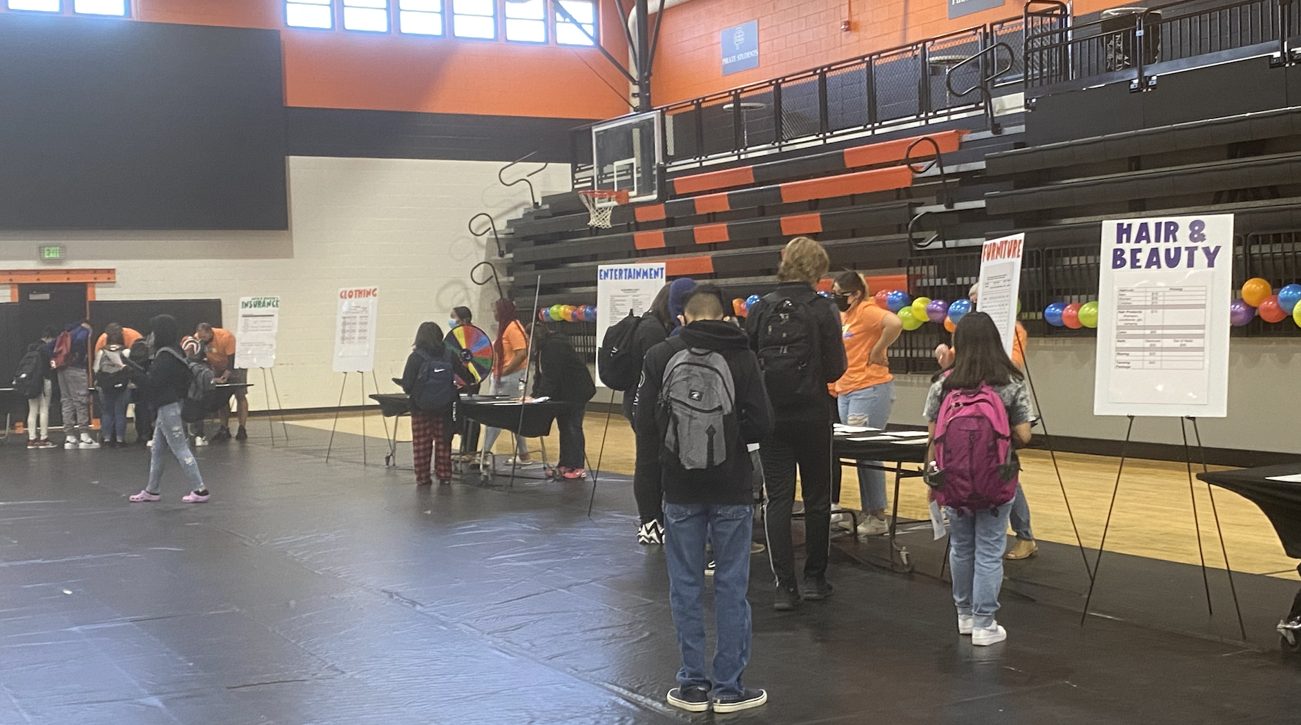
The PCO Experience
Notes:
Explain:
2 minutes
Mention how Putnam City Original used iPads with this activity but not all the site will be able to do this b/c of limited access to tech. Also, they had a lot of add-ons and coding that went into the QR codes and connecting that with the amounts deducted. Students could create a digital worksheet (sheets or excel) that contains built in formulas to easily calculate their running expenses. These can be created into graphs and charts that update during the session or evaluated after the session.

Slide 9
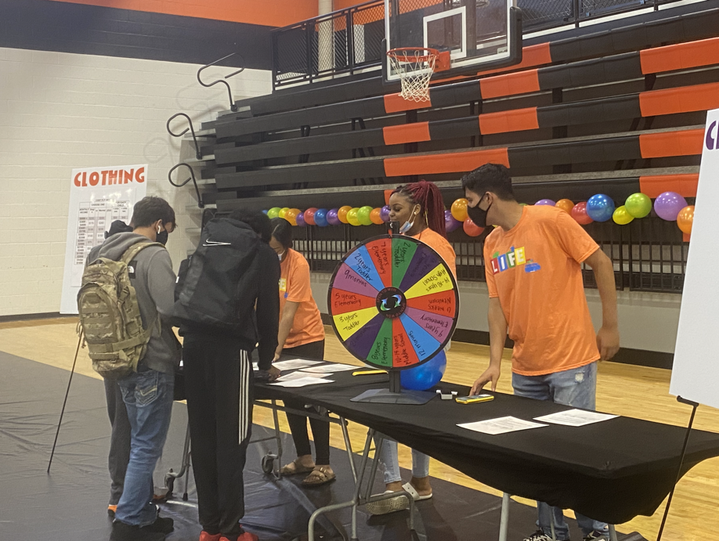
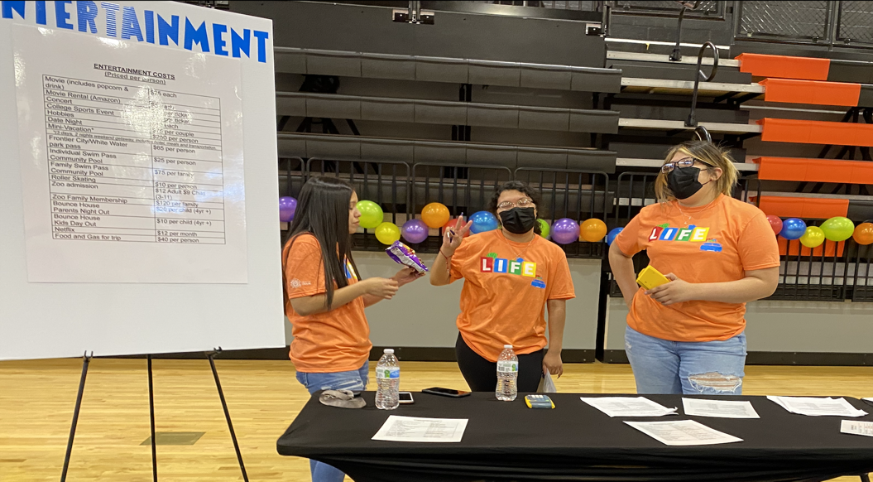
The PCO Experience
Teacher Buy-In
Extra Teachers Involved
Notes:
Explain
3 minutes
30 minutes so far
To create teacher buy-in, this was their plan. This is what they wanted it to look like. The goal was to have community members to run the booths, but because of Covid, they had to have their senior leadership class run the booths.

Slide 10
Lawton Experience
Notes:
https://youtu.be/iloNTIQ3hMw
Explain
5 minutes
Video Link:https://youtu.be/iloNTIQ3hMw
These are the reflections of the students and staff after they completed their experience. Debriefing any activity with students is important, and it is key to this activity. Students need to be able to communicate what they have learned throughout the experience and directly connect it to their future.
As you saw in the video, students were surprised by all of the budget needs.

Slide 11
Explore Materials by S-I-T-ing With Them
As you explore the sample handouts for the activity, consider the following:
Strongest aspect of this activity
Most Intimidating part of facilitating this activity
Timing of the activity
Notes:
K20 Center. (n.d.). S-I-T (Surprising, Interesting, Troubling). Strategies. https://learn.k20center.ou.edu/strategy/926
Explain:
Participants will review the Booth Material Sample Packet.
Set out post it notes to “annotate” the handouts with each consideration for SIT.
5 minutes
Allow participants to review the materials by using the instructional strategy S-I-T, but modified for
Strongest aspect of this activity,
Most intimidating part of facilitating this activity, and
Timing of the activity.
Participants will share out or discuss in small groups what they have identified within the documents.

Slide 12
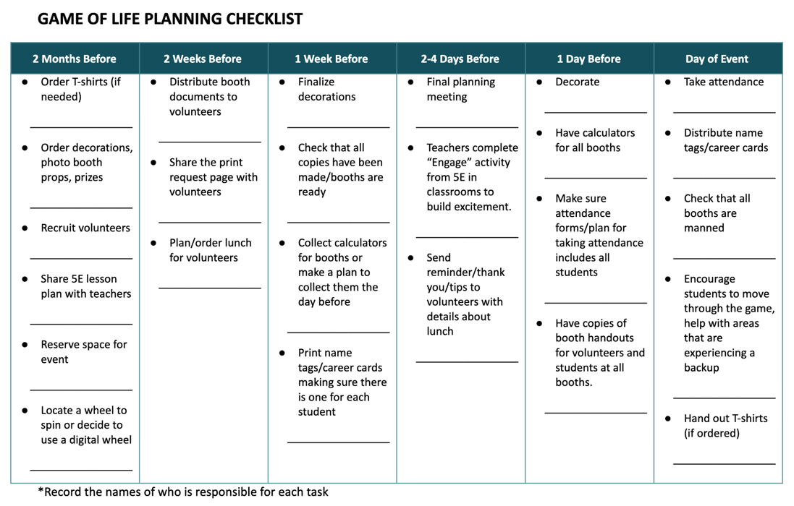
Planning Document
Use this organizer and the scheduled event date to backwards plan your Game of Life event.
Identify who and what you need to make it happen on time!
Notes:
Extend
5 minutes

Slide 13
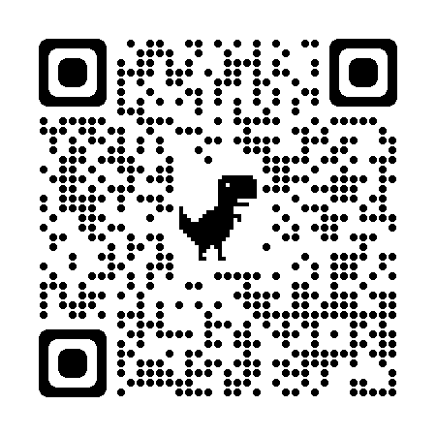
LEARN Strategies and the Game of Life
Notes:
Shorter session - 3 minutes just show published resource.
Longer session - 30 minutes
All of these resources can be accessed on LEARN > Educator Resources (really Postsecondary Education Activities) - https://learn.k20center.ou.edu/educator-resource/1710
Participants will explore the Event version of GOL published on LEARN. They will review the handouts and begin thinking about what their next steps.

Slide 14
Share Out: Planning Doc Q&A
Notes:
5 minutes
Image Source: https://pixabay.com/vectors/question-mark-sign-question-ask-350168/

Slide 15
Exit Ticket
How does Game of Life address some of the misconceptions students have about life after high school?
Notes:
K20 Center. Bell Ringers and Exit Tickets. Strategies. https://learn.k20center.ou.edu/strategy/125
Evaluate: How does Game of Life address some of the misconceptions students have about life after high school? About funding?
2 minutes

