Slide 2
Discourse in Science

Slide 3
Essential Question
Why is discourse important to science instruction?
How do we foster discourse in the science classroom?

Slide 4
Learning Goals
Participants will explore instructional strategies and resources that promote discourse in the science classroom.
Participants will analyze how these instructional strategies and resources promote discourse in the science classroom.

Slide 5
What is Classroom Discourse?
What words or phrases would you use to describe ‘discourse’ as it relates to the science classroom?
Mentimeter:
<insert Mentimeter link or QR code here>
Notes:
Link to a forced copy of the Mentimeter Word Cloud: https://www.mentimeter.com/s/4593d7304a1cc71aee4622398c8e4269/b99f3bab01e8
See LEARN for instructions on how to add it to your Mentimeter account and share: https://learn.k20center.ou.edu/professional-learning/2215

Slide 6
What is Classroom Discourse?
Classroom discourse encompasses a variety of written and spoken forms of communication.
Classroom discourse includes students’ engaging in expressing their ideas, discussing their reasoning, and representing their thinking.
Discourse is talking, listening, writing, reflecting, and representing.

Slide 7
Why is Classroom Discourse Important?
Authentic discourse incorporates the following dynamics into the classroom:
Students develop a deeper understanding of the content.
Students participate authentically in content-centered discussions.
Classroom is student-centered.
Students share ideas and respond to the ideas of others.
Students use higher-order thinking skills, such as organizing, synthesizing, and interpreting.
Students express their ideas by constructing supported explanations of their thinking, both written and verbal.
Mentimeter:
<insert Mentimeter link or code here>
Notes:
Return to Mentimeter and have participants rank the above.

Slide 8
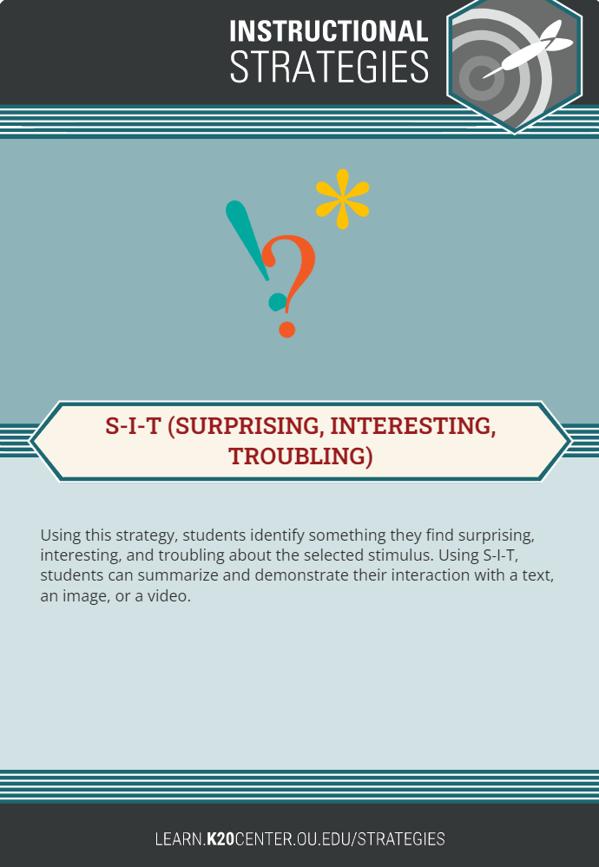
S-I-T: Surprising, Interesting, Troubling
S-I-T provides tools students can use to analyze texts, videos, or images.
Give students a text, video, or image. Based on their observations and analyses, have them identify one surprising fact or idea, one interesting fact or idea, and one troubling fact or idea.
Ask students to share their ideas and reasoning with small groups and/or the whole class.

Slide 9
S-I-T: Surprising, Interesting, Troubling
Using the handout “Cystic Fibrosis,” write down an idea or fact which affects you in the following ways:
One fact or idea that surprises you.
One fact or idea that interests you.
One fact or idea that troubles you.
How can the S-I-T strategy foster discourse in your classroom?
Notes:
Now that you have been introduced to the strategy, you are going to participate how you would use this in the classroom. You will view a document discussing Cystic Fibrosis. You will first read through this information and find one SIT.
You can find this resource on LEARN: Cystic Fibrosis: A DNA Case Study, https://learn.k20center.ou.edu/lesson/496.

Slide 10
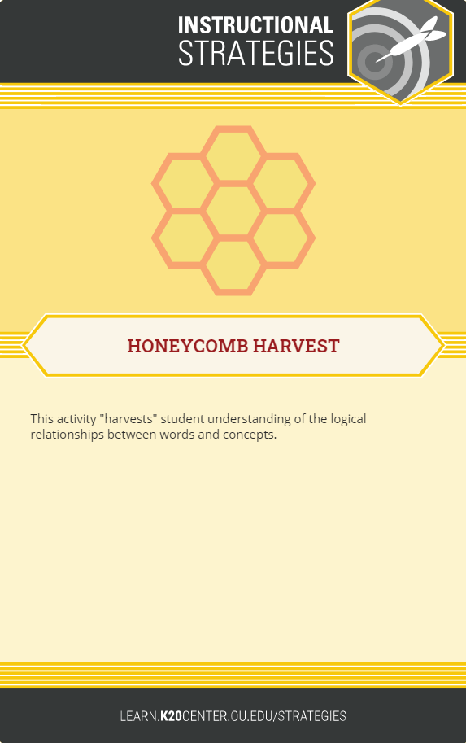
Honeycomb Harvest
This strategy is designed to help students understand logical relationships among words and concepts.
Give students a set of hexagons containing different concepts related to the content they are studying.
Have students work individually or in groups to arrange the hexagons so the sides of related hexagons touch.
Ask students to justify their arrangements.
Make your own: https://pamhook.com/solo-apps/hexagon-generator/

Slide 11
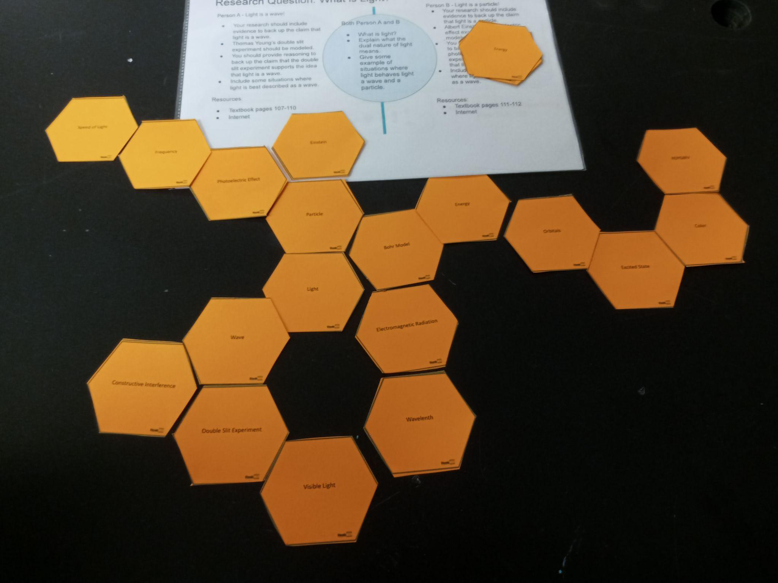
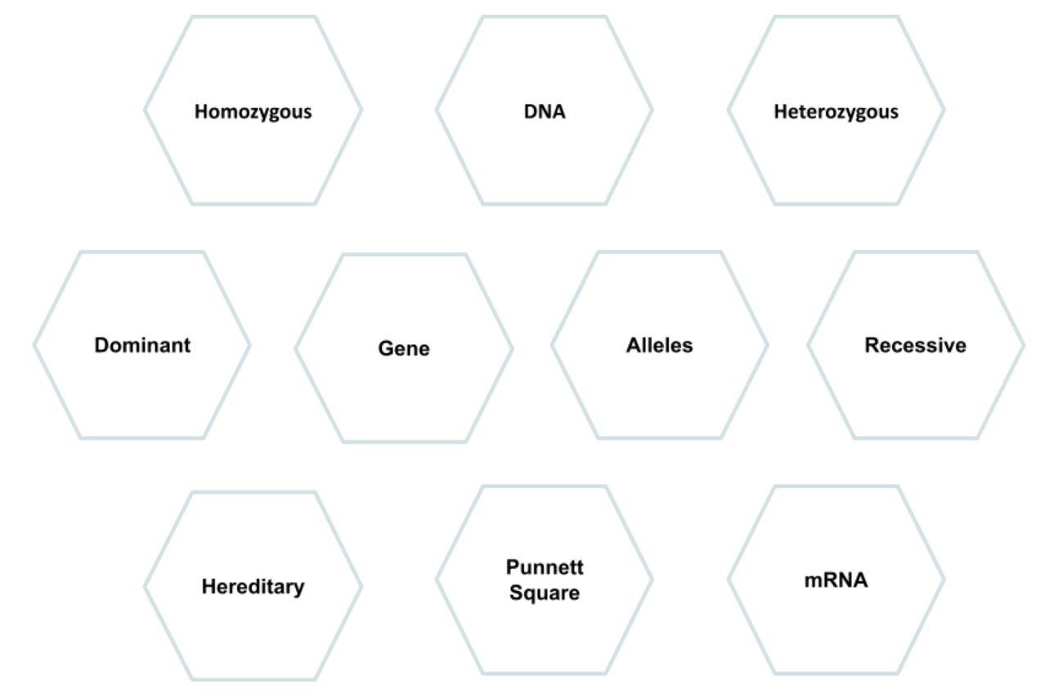
Honeycomb Harvest Sample
How can the Honeycomb Harvest Strategy foster discourse in your classroom?
Notes:
The QR code is a link to PAMHOOK, where participants can create honeycombs of their own.

Slide 12
Say Something
Say Something is a strategy that helps students participate effectively in academic conversations with their peers.
Sentence starters prompt students to express their ideas, ask questions, and support their claims with evidence.
Notes:
Edutopia. (2018, Nov. 16). Encouraging academic conversations with talk moves. https://www.youtube.com/watch?v=kSI4imt0dXg&feature=youtu.be

Slide 13
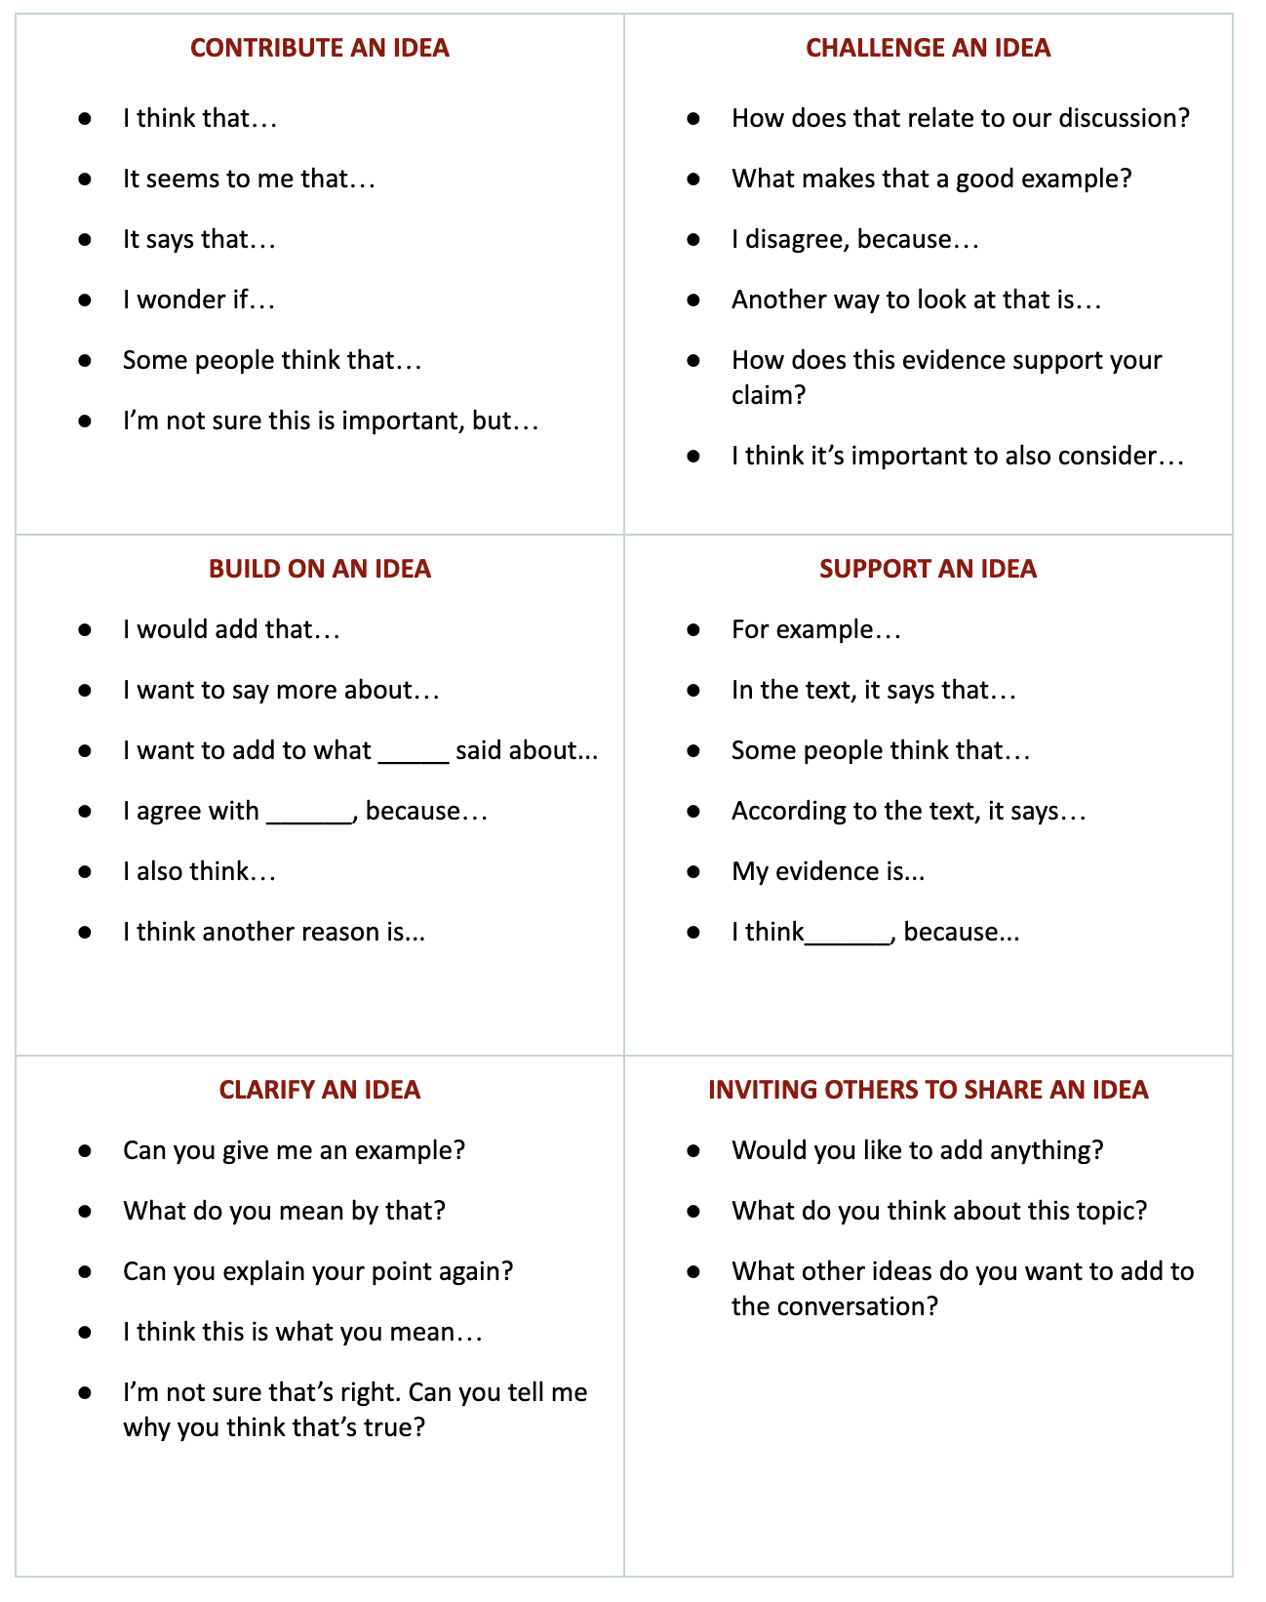
Say Something
Use sentence starters to prompt classroom conversation.
Use the starters from the handout as you watch the following video.

Slide 14
How can Say Something foster discourse in your classroom?
Notes:
Pass out the Say Something handout. We are going to watch the video “Facts and Stories of the Blue Fugates,” https://www.youtube.com/watch?v=hDBsitoq2Sw. As you watch, reference the Say Something sentence stems and consider how you and your students might use at least one sentence stem to engage in an academic conversation about this text.

Slide 15
Reflection
Which of today’s strategies can you implement in your classroom? Why?
How can these strategies be effective in promoting discourse? Explain.
How can you modify these strategies to work with your students? Explain.

Slide 16
LEARN
Where can I find these 5E lesson resources?
https://learn.k20center.ou.edu/
Cystic Fibrosis: A DNA Case Study
Why So Blue?
Notes:
Cystic Fibrosis: A DNA Case Study: https://learn.k20center.ou.edu/lesson/496
Why So Blue?: https://learn.k20center.ou.edu/lesson/391

