Slide 2
Interactive Classrooms
Social Studies

Slide 3
GEAR UP for the FUTURE Goals
Increase cohort academic performance and preparation for postsecondary education (PSE)
Increase high school graduation and PSE participation
Increase student educational expectations and increase student and family knowledge of PSE options, preparation, and financing
Notes:
(5 min) goals and objectives
Replace goals in this slide with the appropriate GEAR UP grant goals.

Slide 4
Objectives
1. Participants will explore various tech applications and their potential use in the classroom.
2. Participants will be able to choose at least one instructional tech tool and identify its application in the Social Studies classroom.
3. Participants will apply their understanding of the SAMR model of technology integration to the chosen technology tool.
Notes:
(5 min) goals and objectives
Context

Slide 5


Slide 6

Self-Assessment
How techie are you?
Do you LOVE all things technology? Are you willing to press buttons and see what happens? Do you integrate tech into your classroom in various ways?
  Please form a group to the left.
Are you freaked out by technology? Do you try to avoid it at all costs?
  Please form a group to the right.
The presenter will place a label on your back. Do NOT look at YOUR tag, but you can look at the backs of peers.
Notes:
Participants will form two groups (A and B) based on their answers. The presenter will then use the Group A kick me stickers for Group A and the Group B kick me stickers for Group B. This makes sure that a techie person is paired with a non-techie person.
If this is a large group, have pairs do a square pair once they have found their partner.

Slide 7

Kick Me Strategy
A presenter will put a label on your back.
Do NOT look at your own label.
You may ask other participants two “Yes” or “No” questions to try to figure out who you are.
  Once you have each asked your questions, repeat the process with someone else until you have correctly surmised who you are.
Your identity will pair you with someone else in this room. Once you have identified yourself, find your partner!
Notes:
Give participants the category to help direct them and the questioning.

Slide 8


Slide 9

Task Cards
Using Technology as an Educational Tool
With your partner or group, work through the tasks on the cards.
Each card is associated with a technology resource that could be used in your classroom.
Use the Note Catcher to take down any helpful or pertinent information for your personal use.
Notes:
The pairs or square pairs will work together on each task card.
Pass out the notecatcher while they are working.
This should take approximately 30 minutes.

Slide 10


Slide 11


Slide 12
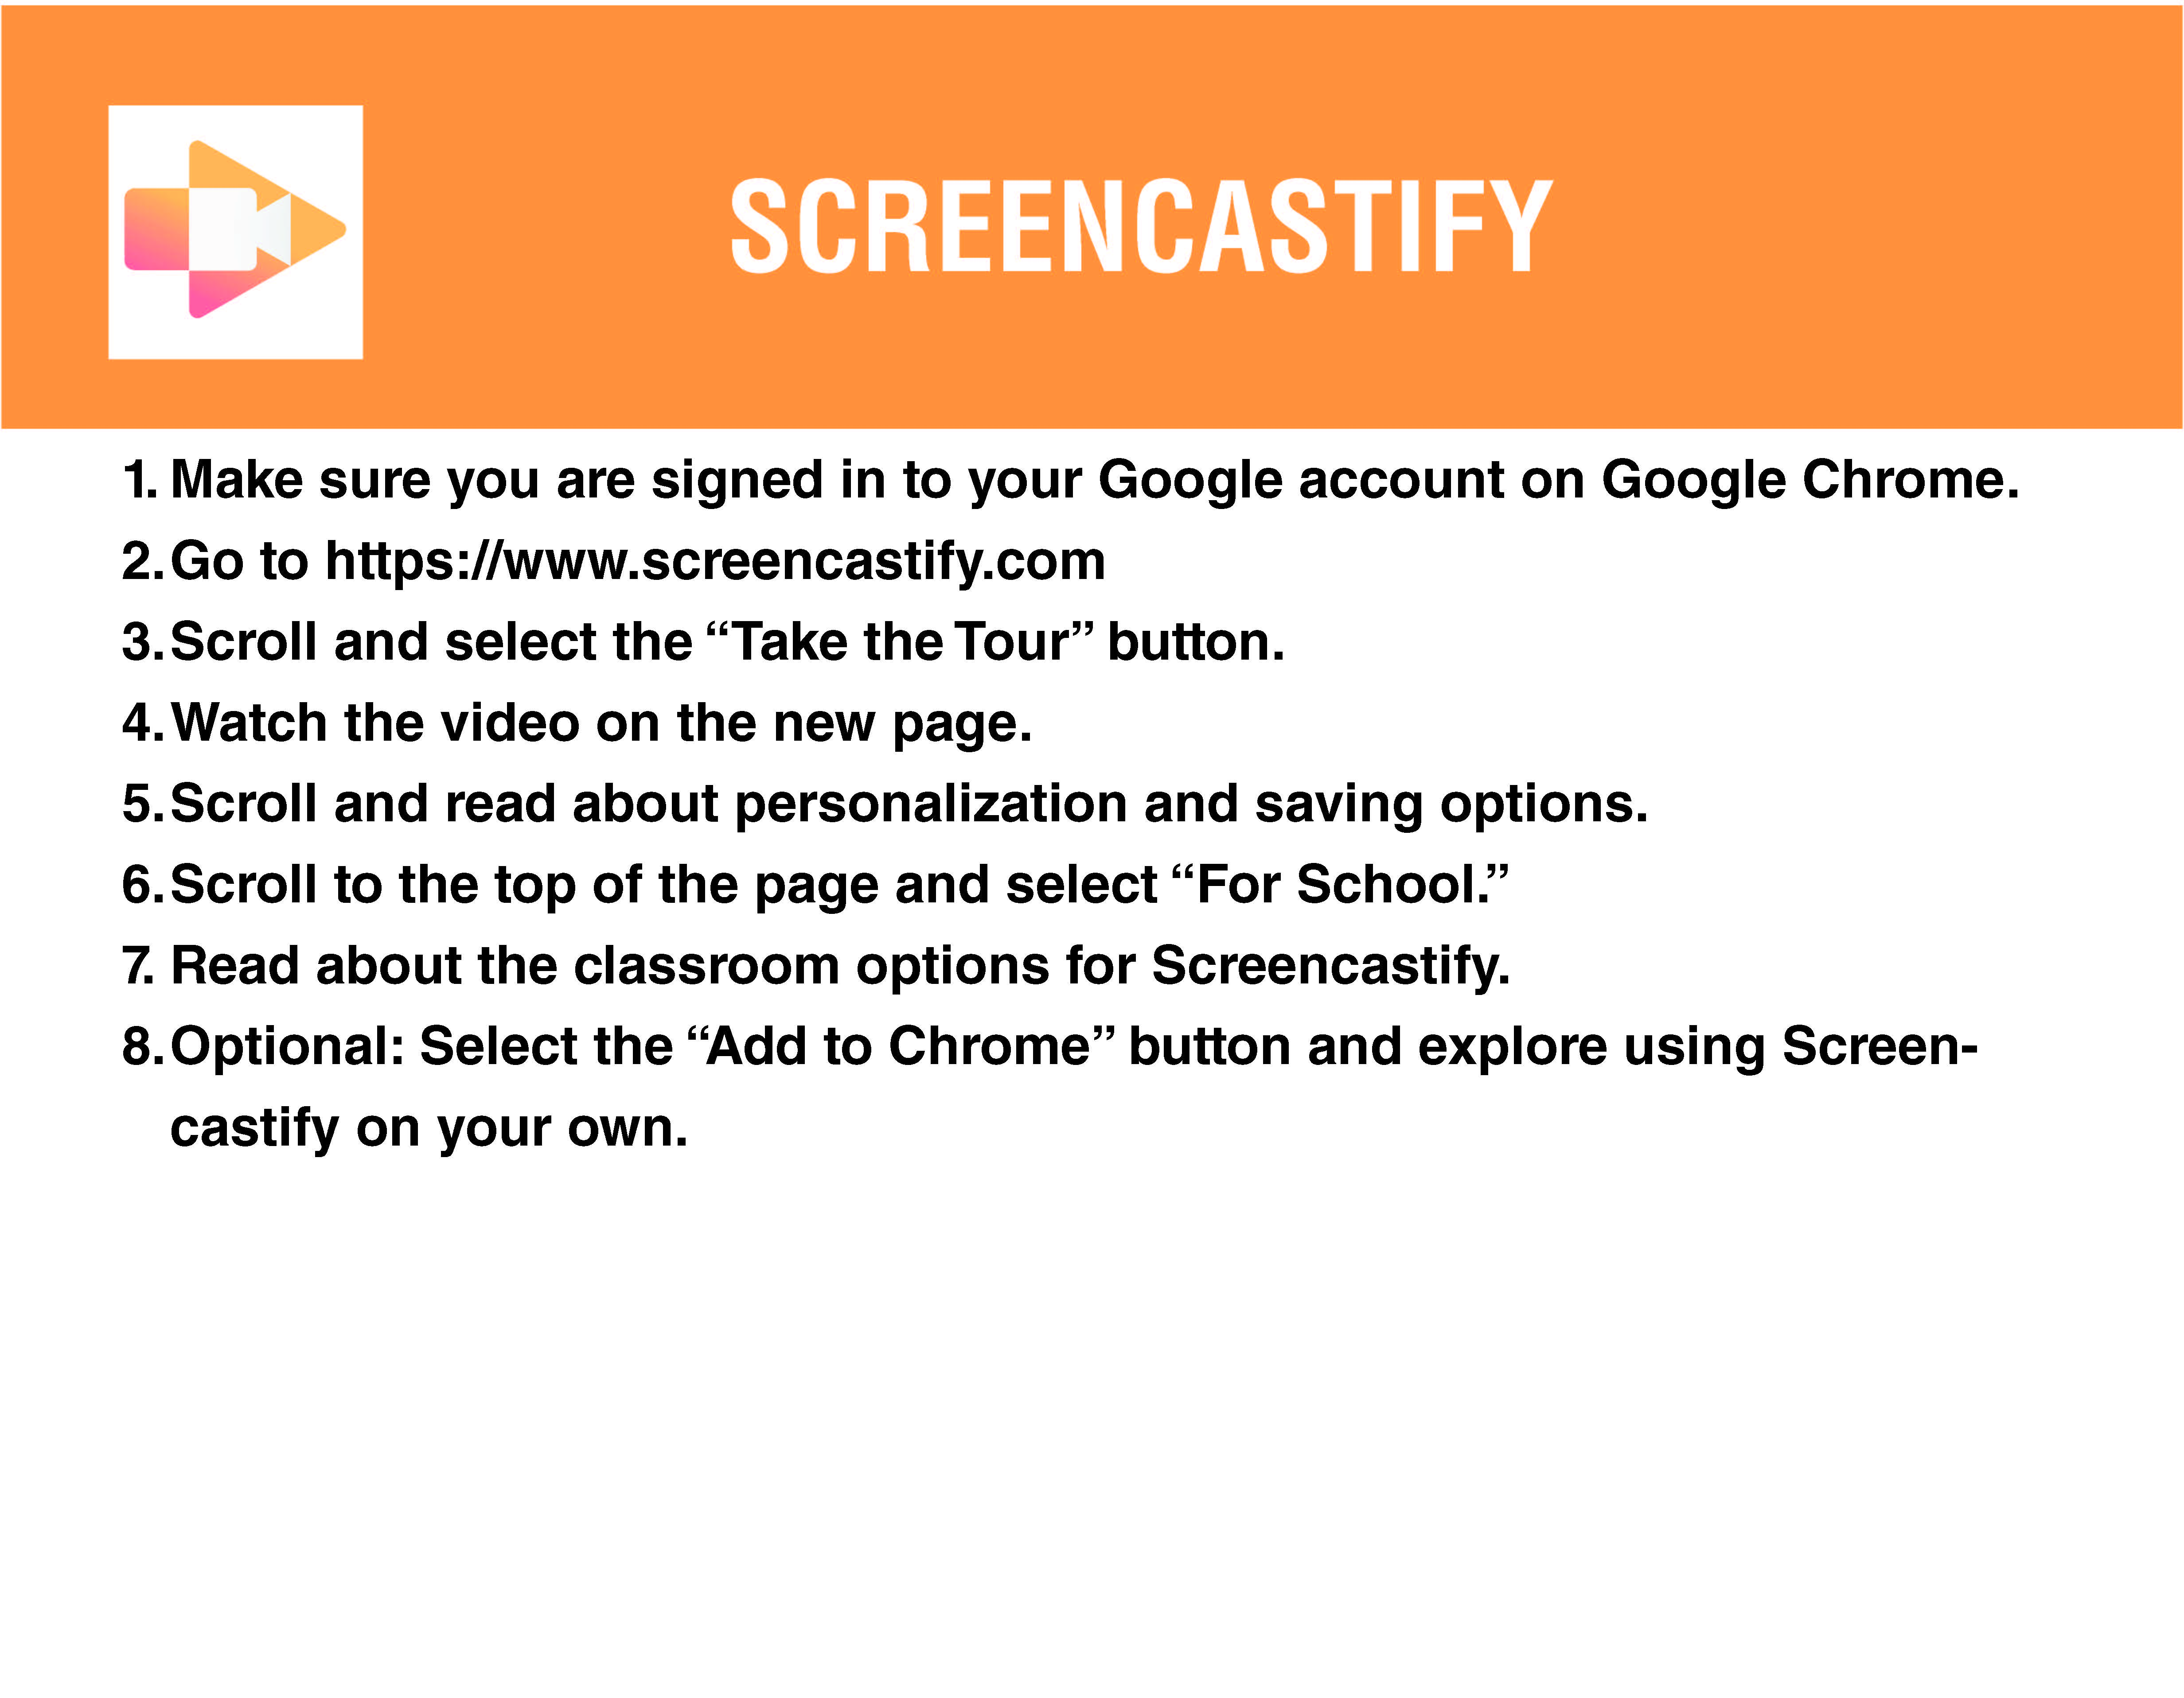

Slide 13


Slide 14


Slide 15

Four Corners
Choose ONE of the social studies technology resources that you just explored.
Which would you be most likely to use in your classroom?
Notes:
Place the four corner posters around the room. Then ask participants to go to the poster/resource they are most likely to use.

Slide 16
Presentation task
In your group or groups, create a short poster presentation about your tech choice that includes:
  What is it?
  How would you use it in the classroom?
  Three to five examples of its possible use
Notes:
Once they are in their groups, have them create a presentation on poster paper. Give them approximately 20 minutes.

Slide 17


Slide 18
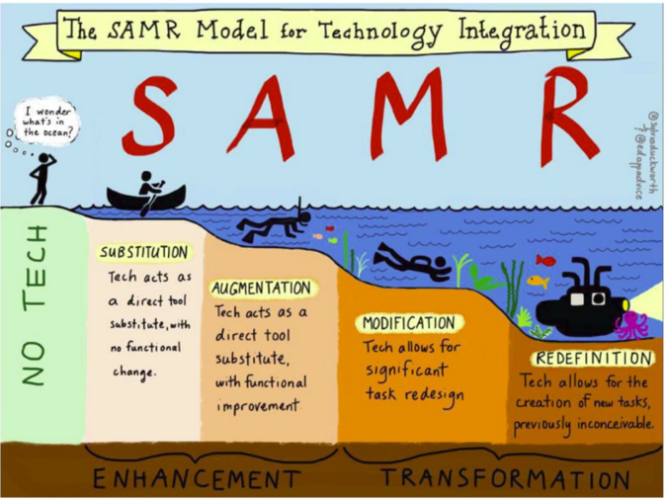

SAMR Recap
Technology Integration
Review the SAMR Model handout.
Discuss with your group an example of tech integration for substitution, augmentation, modification, and redefinition.
Notes:
Take time to make sure that groups understand how these tech integration levels might be manifested in the classroom. Ask for groups to share out as you go through the different levels.

Slide 19
Gallery Walk
With your group, you will rotate clockwise to another presentation.
Using your SAMR handout, choose ONE classroom example of the use of the chosen tech and determine its SAMR level of integration. Leave a sticky note by it.
Leave any feedback or comment post-it notes.
Leave any questions you have.
Your group will continue to rotate until you are back to your original presentation.
Notes:
This should take approximately 15 minutes. Participants will need their SAMR handout

Slide 20


Slide 21
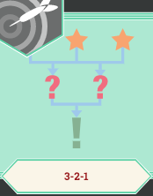
3-2-1
On a sticky note, write:
  3—What are three things you learned about these resources?
  2—What are two challenges you might encounter?
  1—What one lesson idea do you have for your preferred resource?
Notes:
Participants can use multiple post its here. Have them place them on a board. Read through them briefly, picking out a few to address with the whole group.

Slide 22
Rapid Feedback

