Slide 1






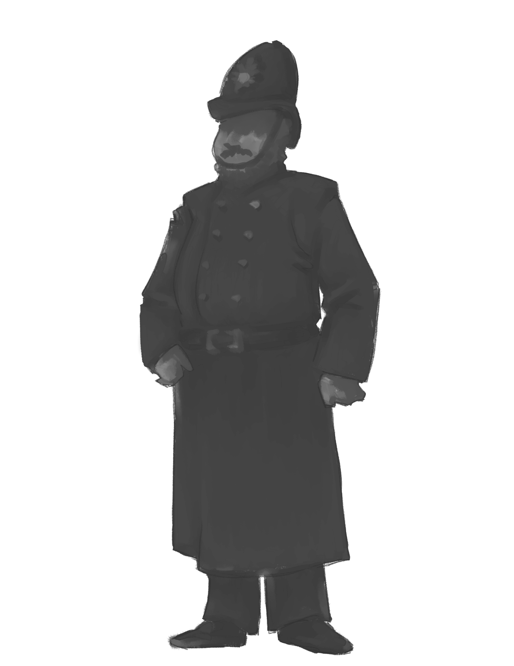
Empowered
Learner

Slide 2
1.1 Empowered Learner
Students leverage technology to take an active role in choosing, achieving, and demonstrating competency in their learning goals, informed by the learning sciences.

Slide 3
1.1 Empowered Learner
What are some key components of this standard?
How does teaching this standard look in the classroom?

Slide 4
Insert Tech Tool Name Here
Key Components
How might this look in the classroom?

