Slide 1
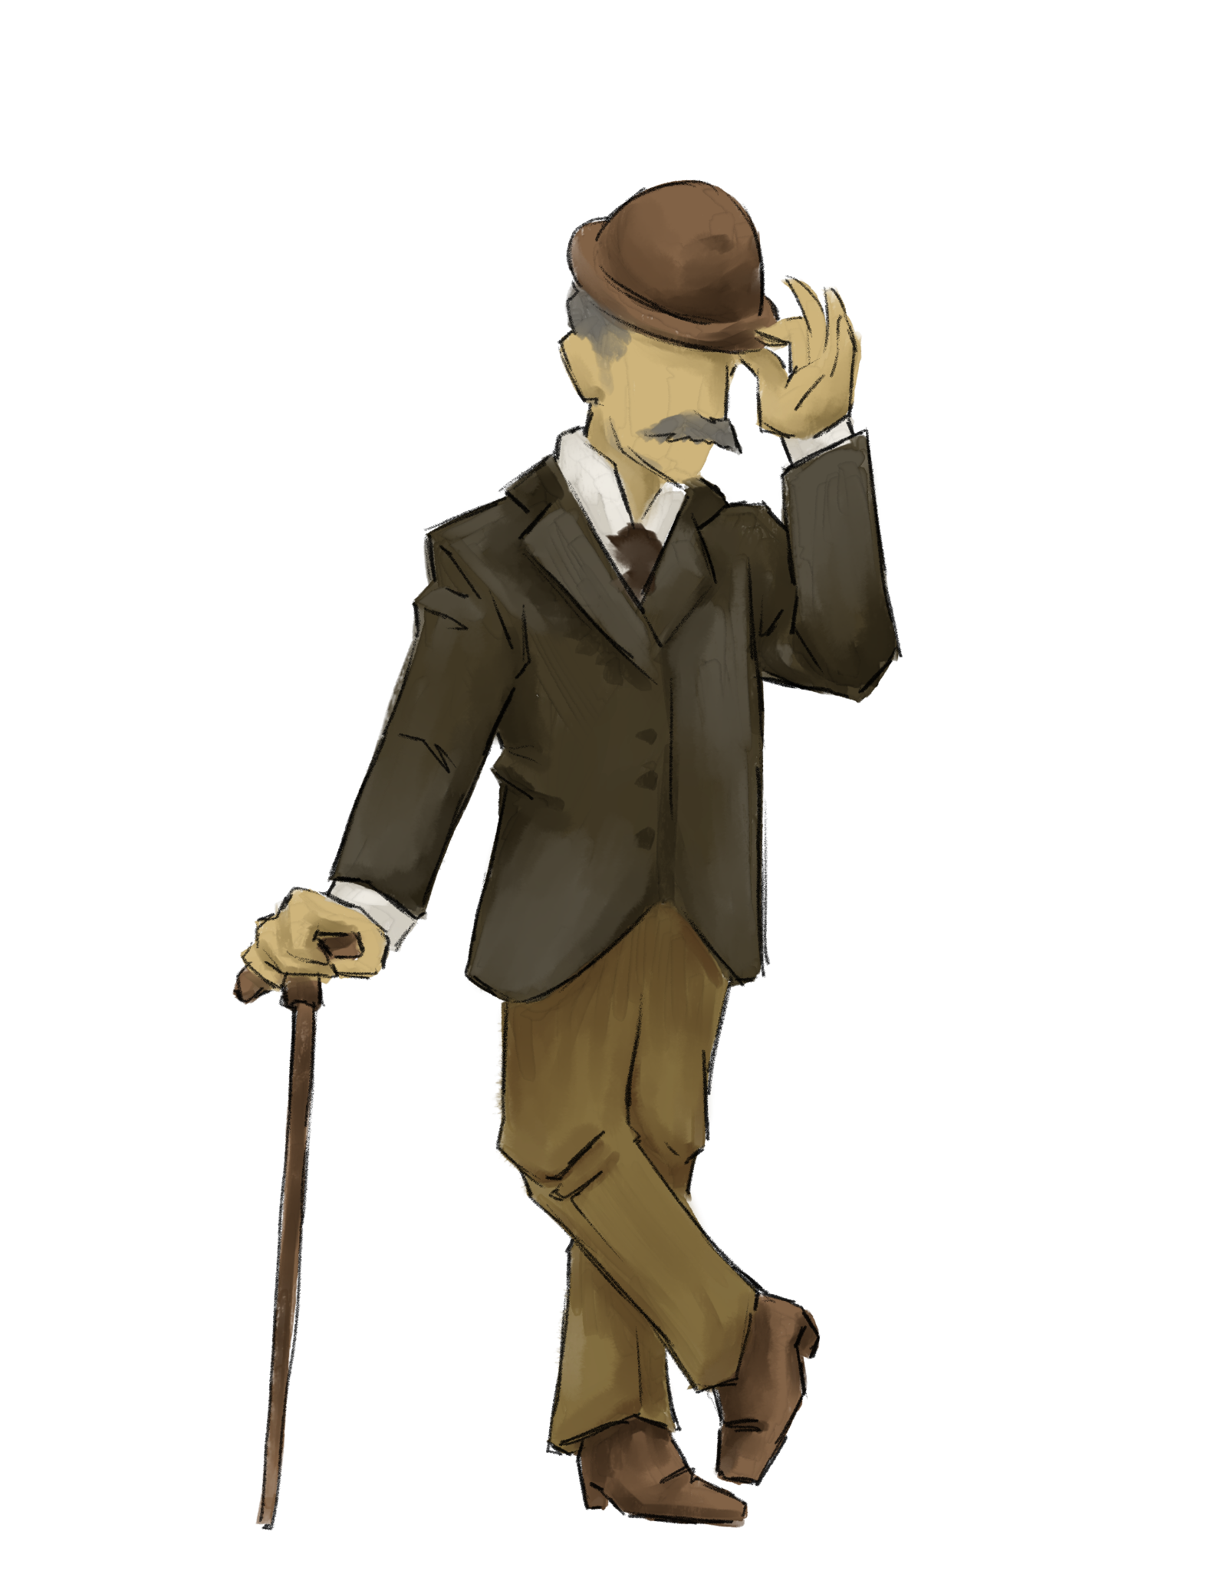
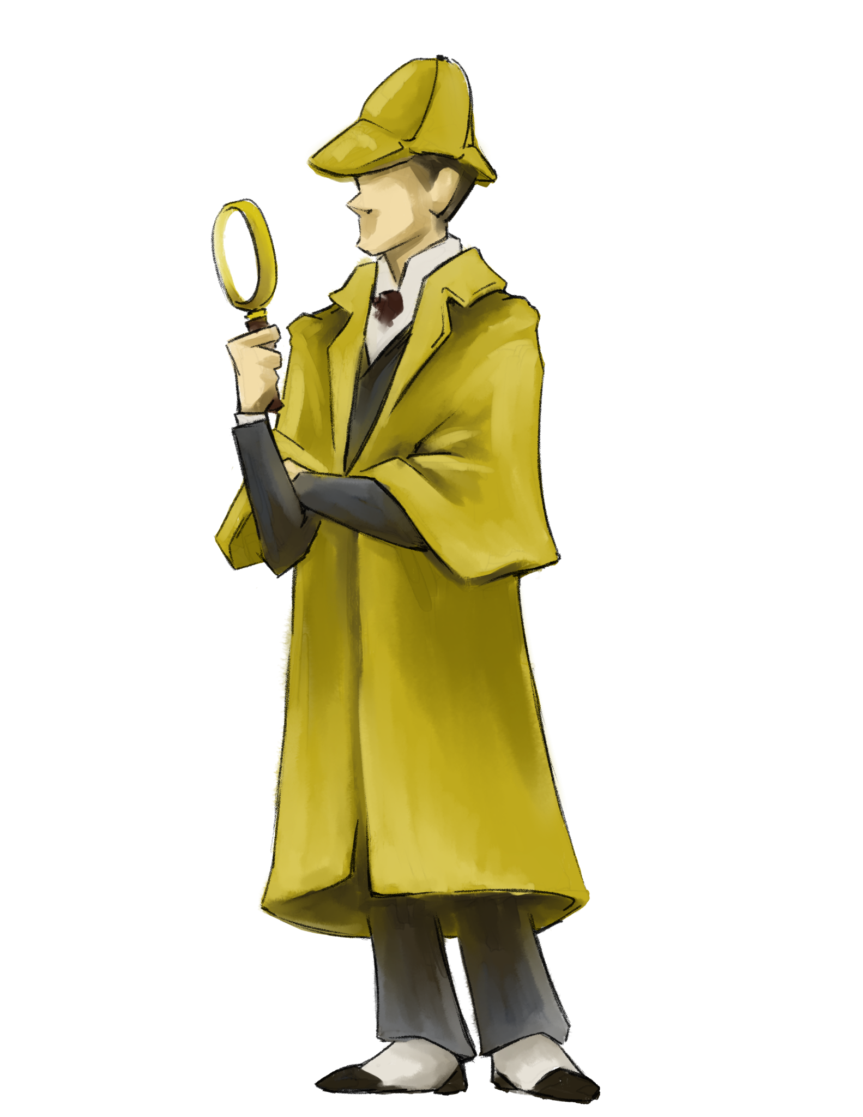
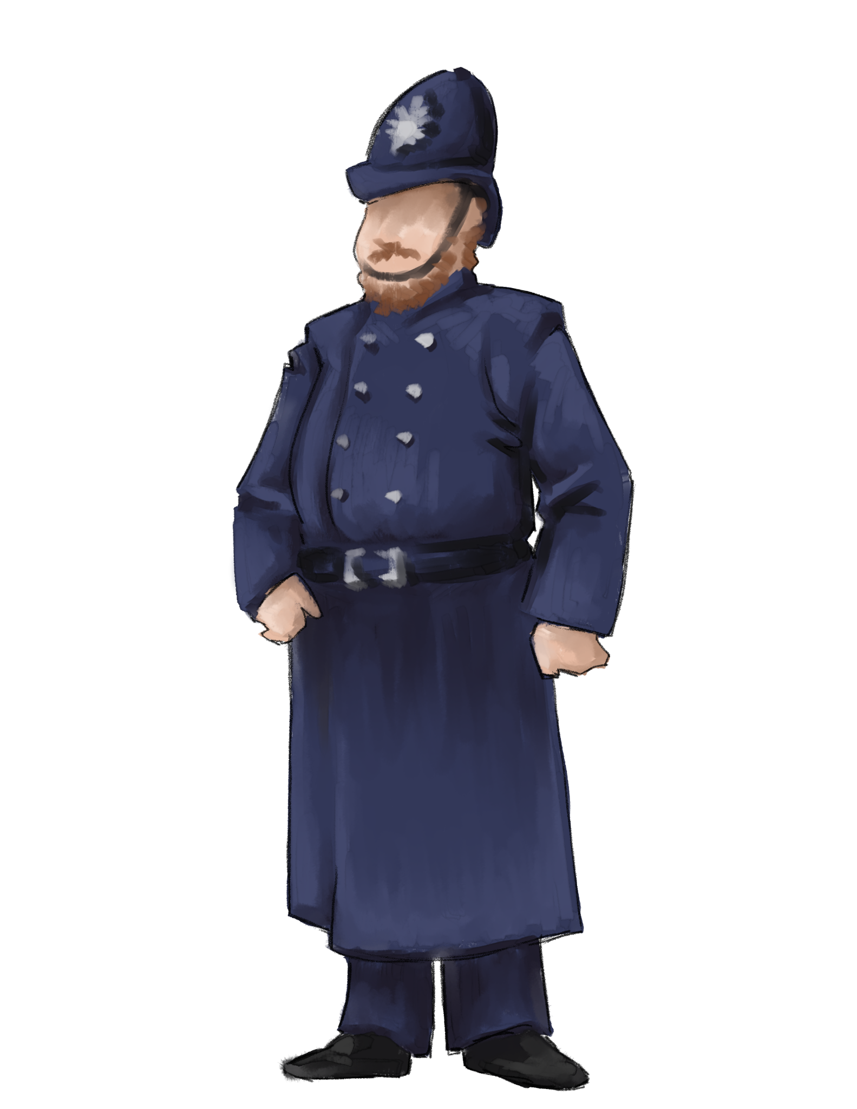
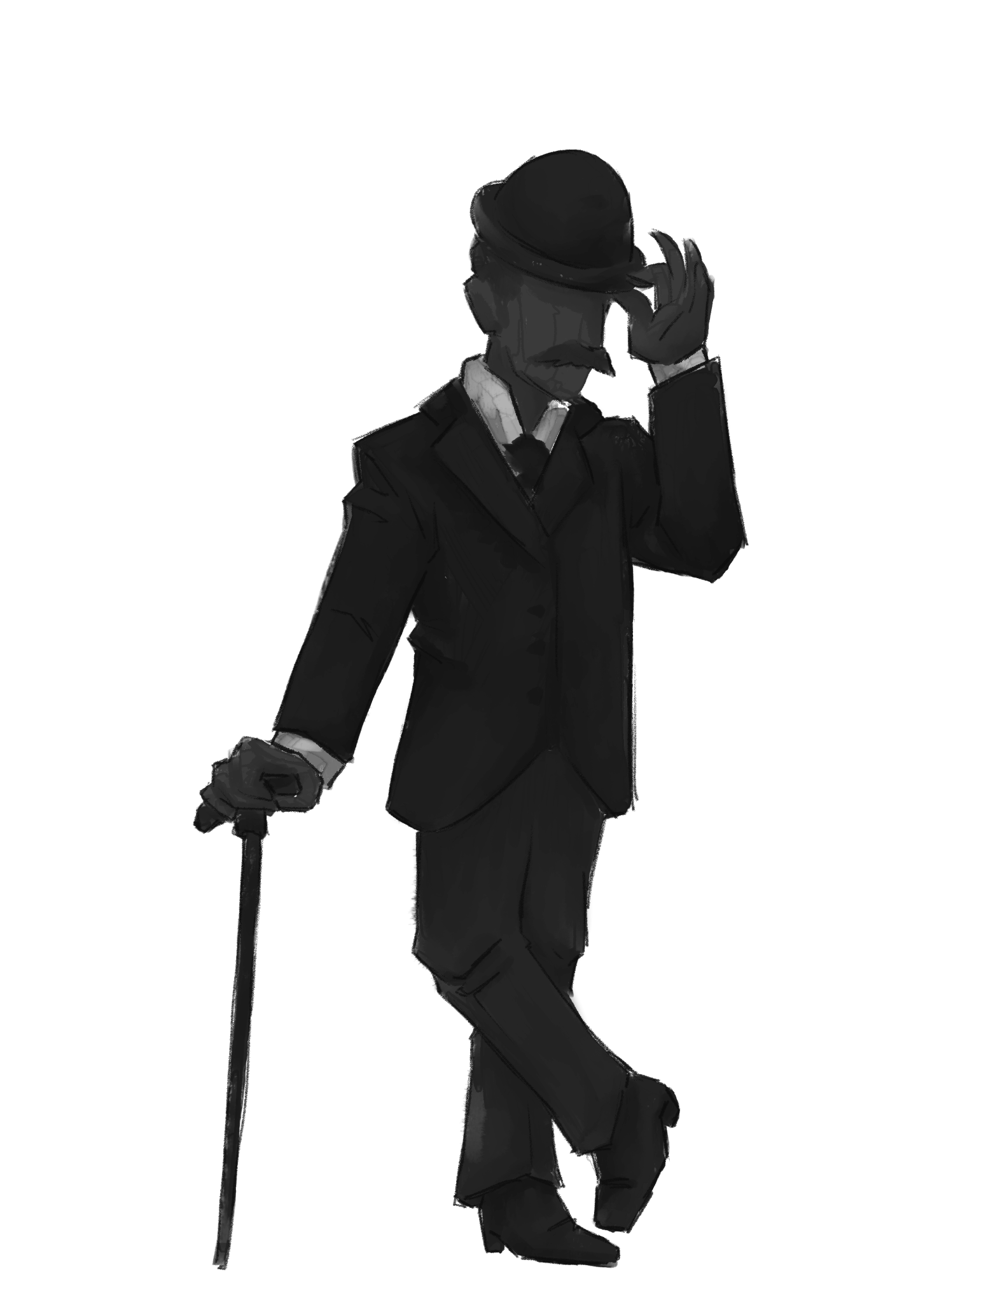

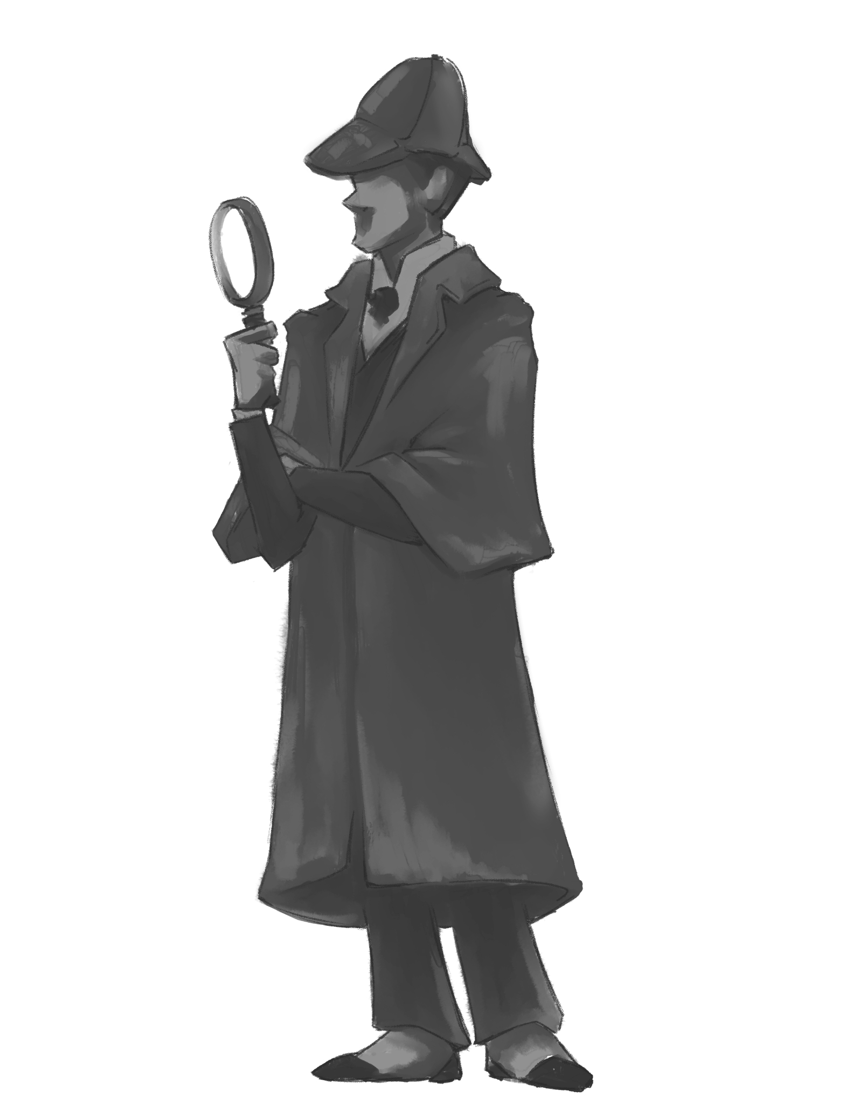
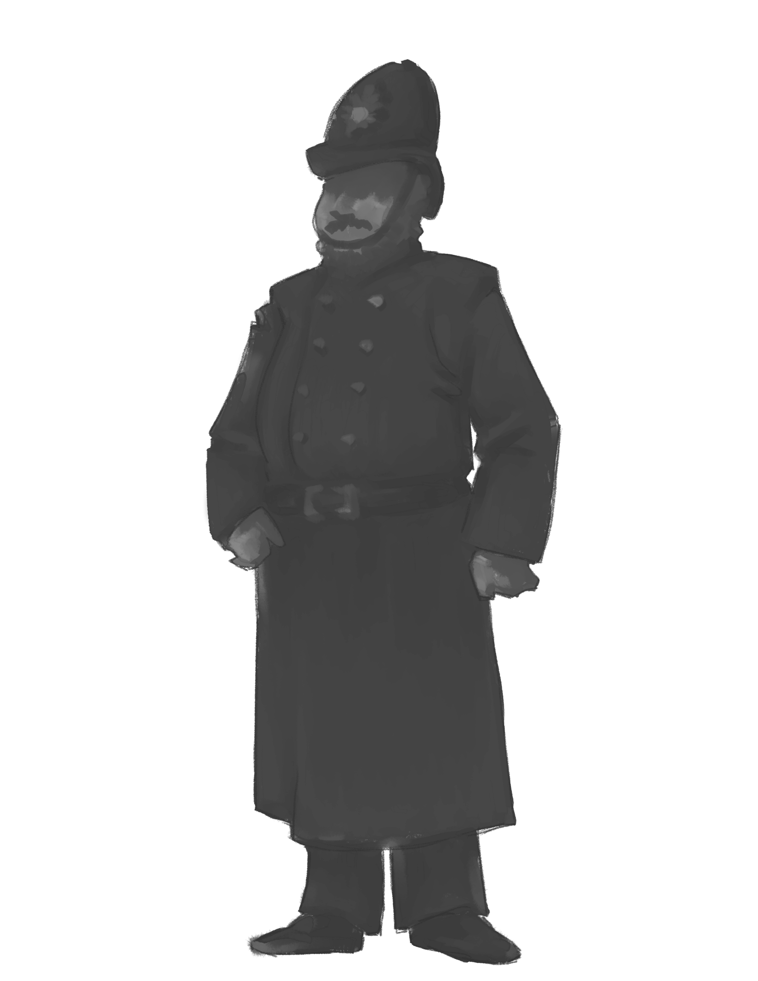
Digital
Citizen

Slide 2
1.2 Digital Citizen
Students recognize the rights, responsibilities and opportunities of living, learning and working in an interconnected digital world, and they act and model in ways that are safe, legal, and ethical.

Slide 3
1.1 Empowered Learner
What are some key components of this standard?
How does teaching this standard look in the classroom?

Slide 4
Insert Tech Tool Name Here
Key Components
How might this look in the classroom?

