Slide 1
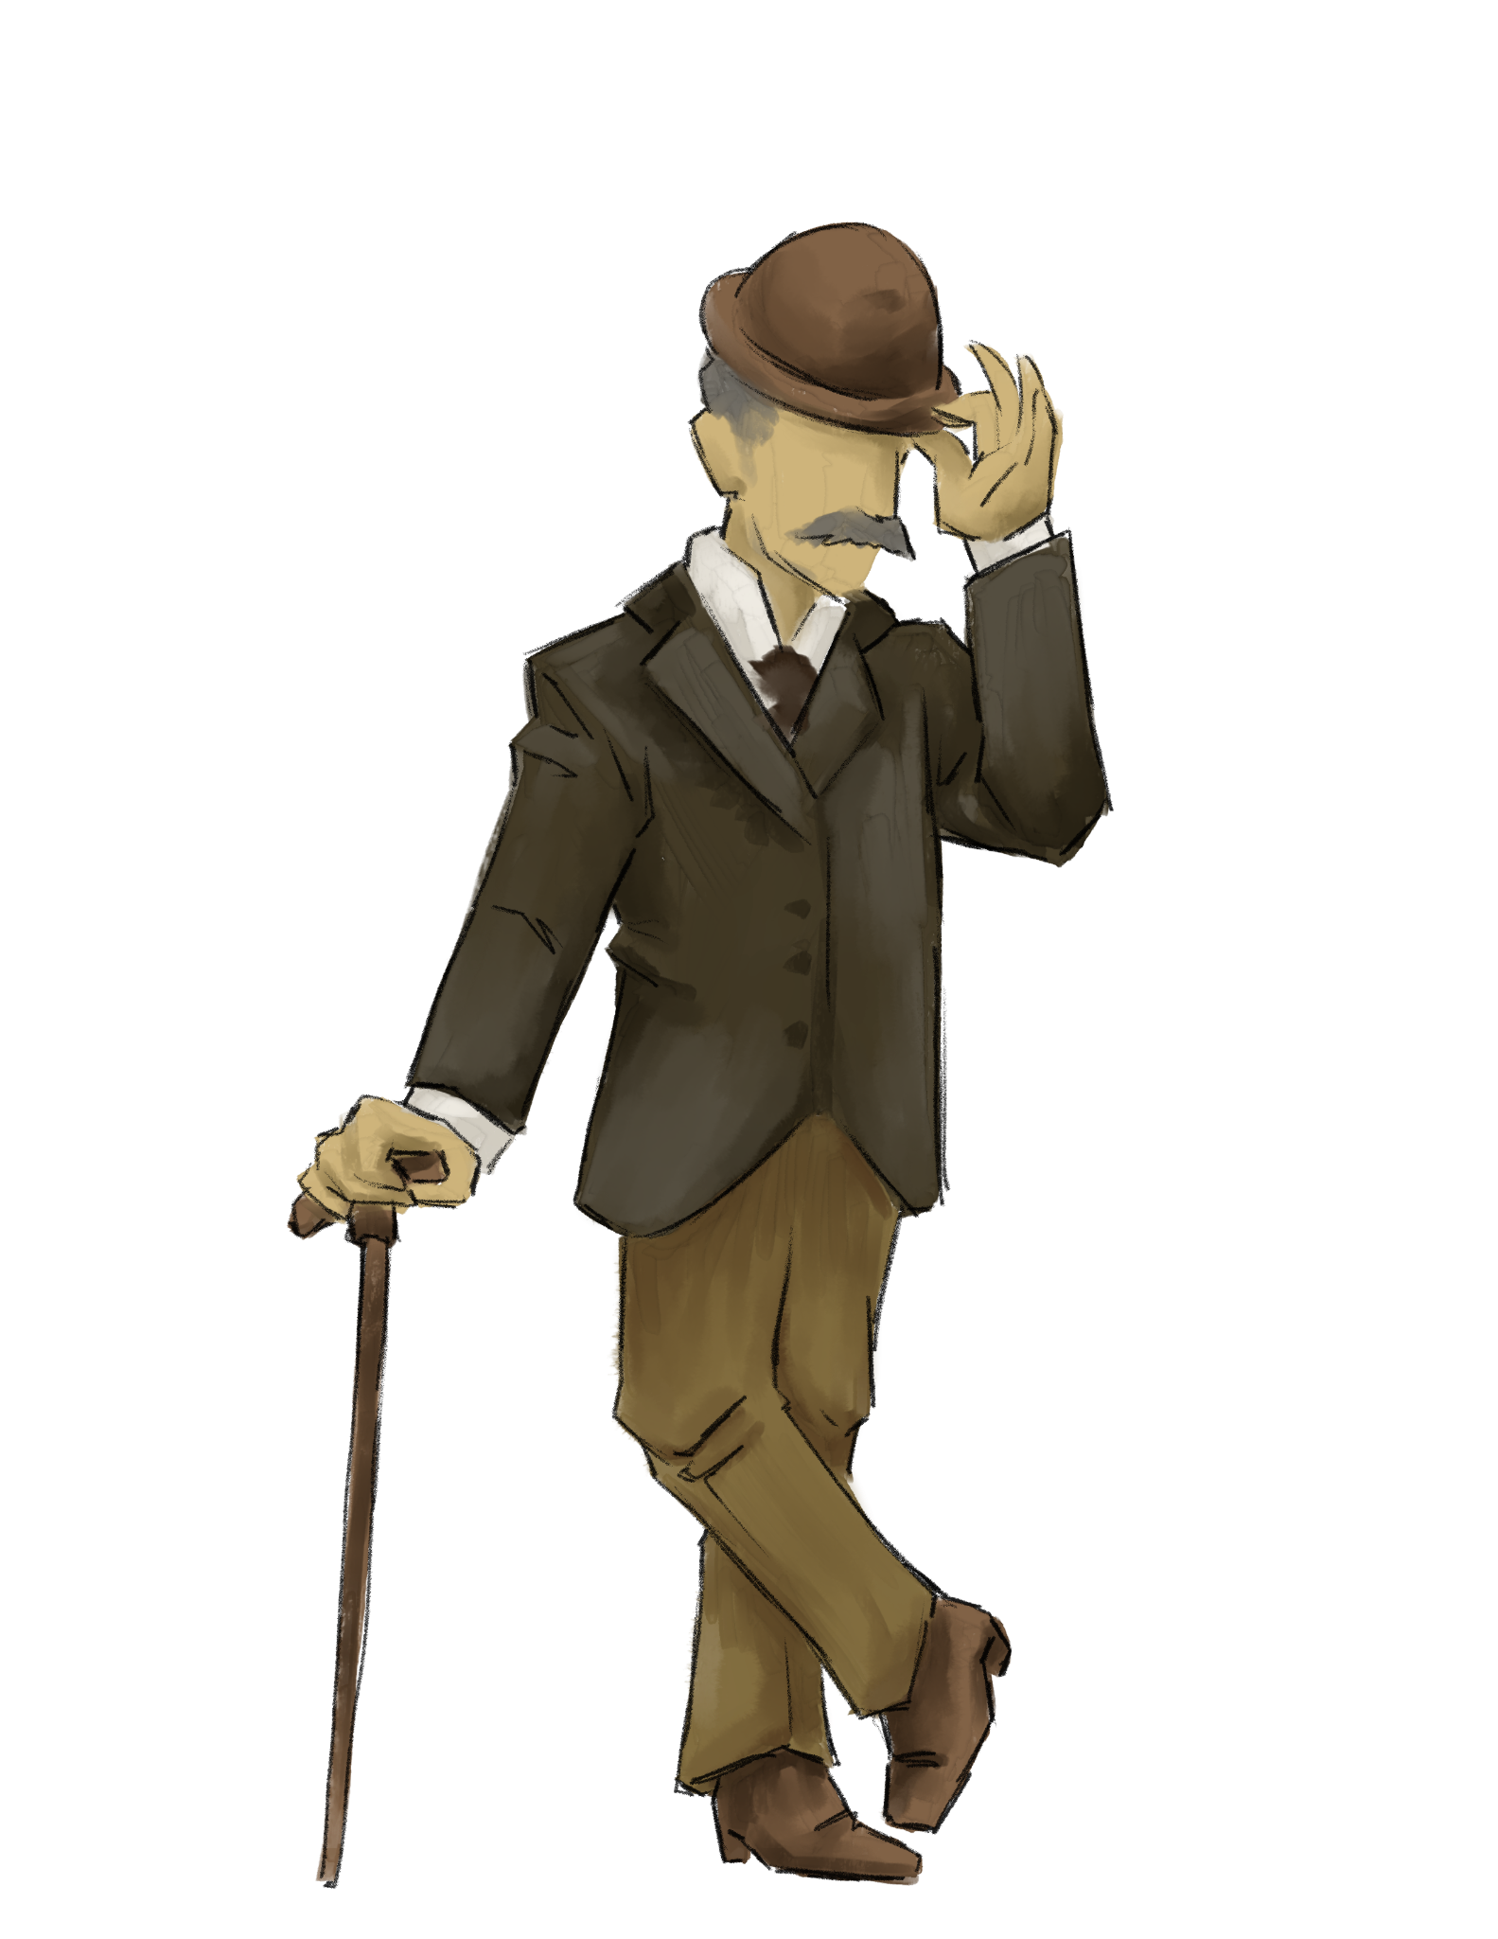
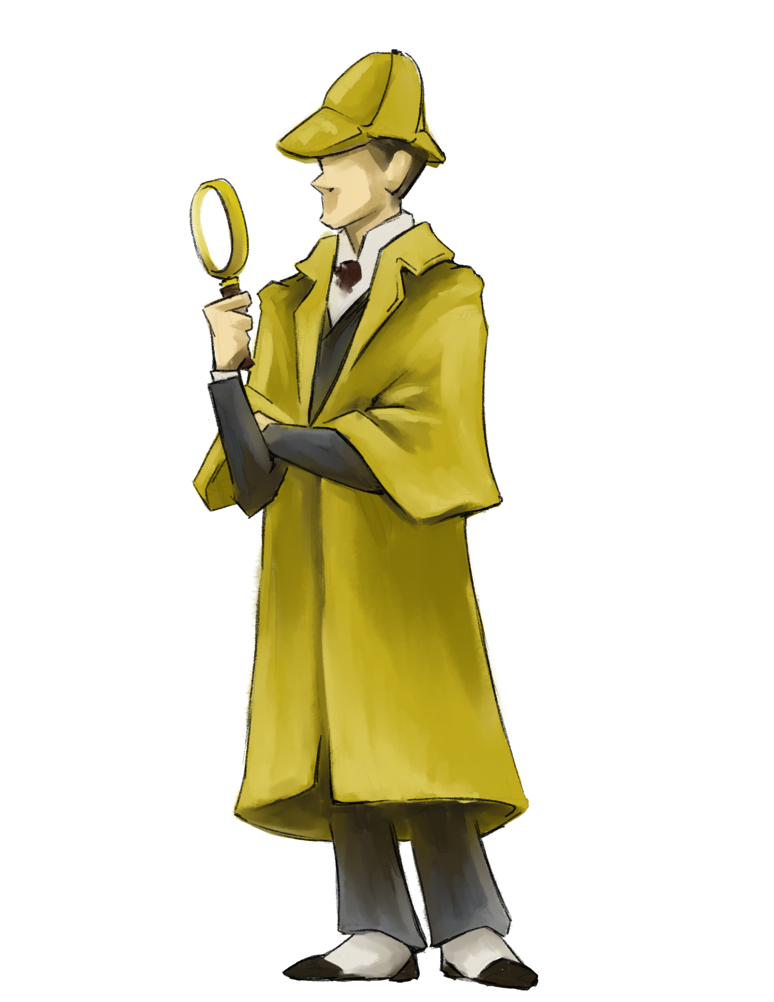
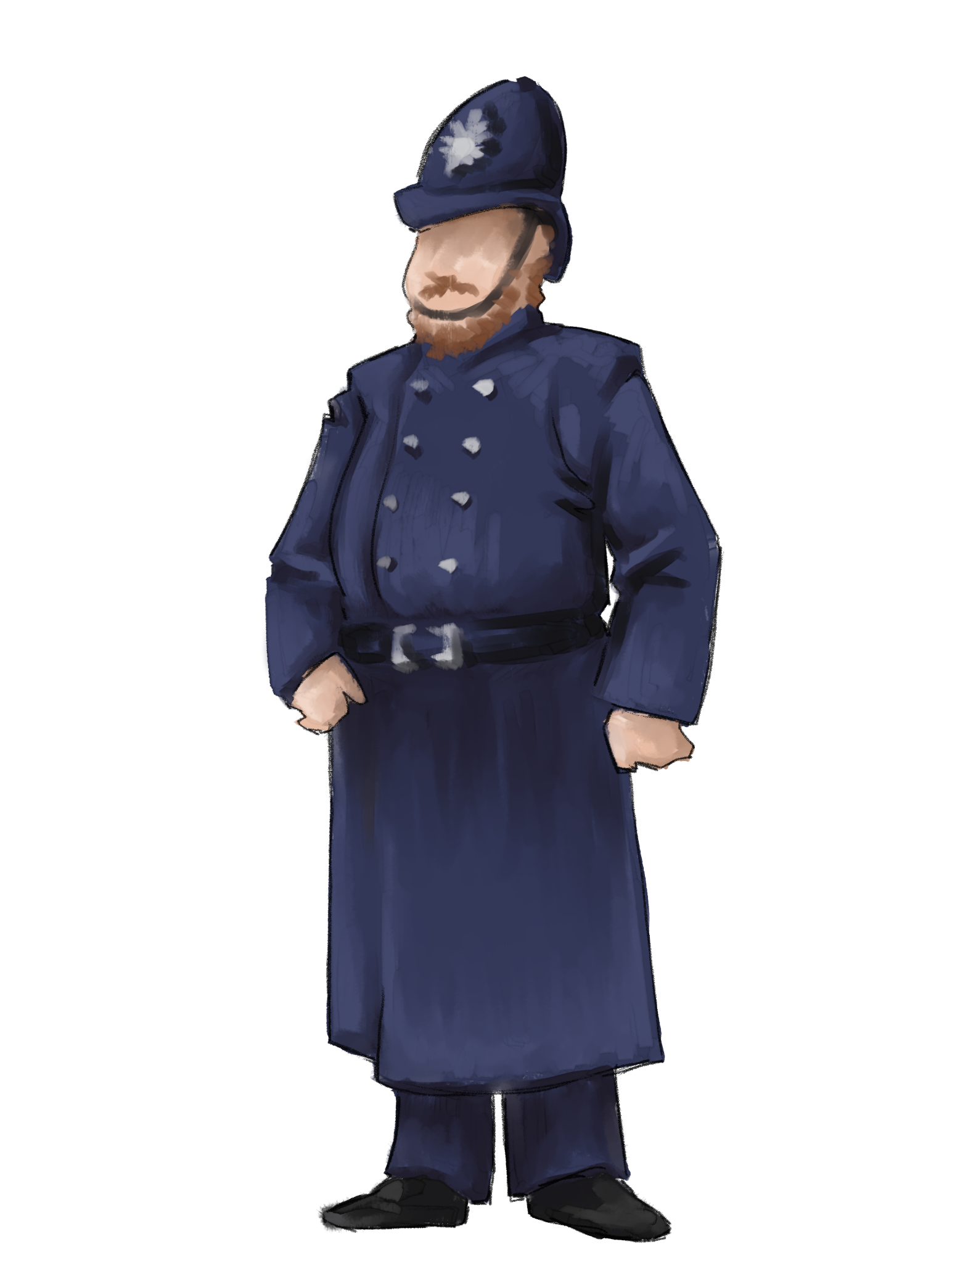
Knowledge
Constructor

Slide 2
1.3 Knowledge Constructor
Students critically curate a variety of resources using digital tools to construct knowledge, produce creative artifacts. and make meaningful learning experiences for themselves and others.

Slide 3
1.1 Empowered Learner
What are some key components of this standard?
How does teaching this standard look in the classroom?

Slide 4
Insert Tech Tool Name Here
Key Components
How might this look in the classroom?

