Slide 1
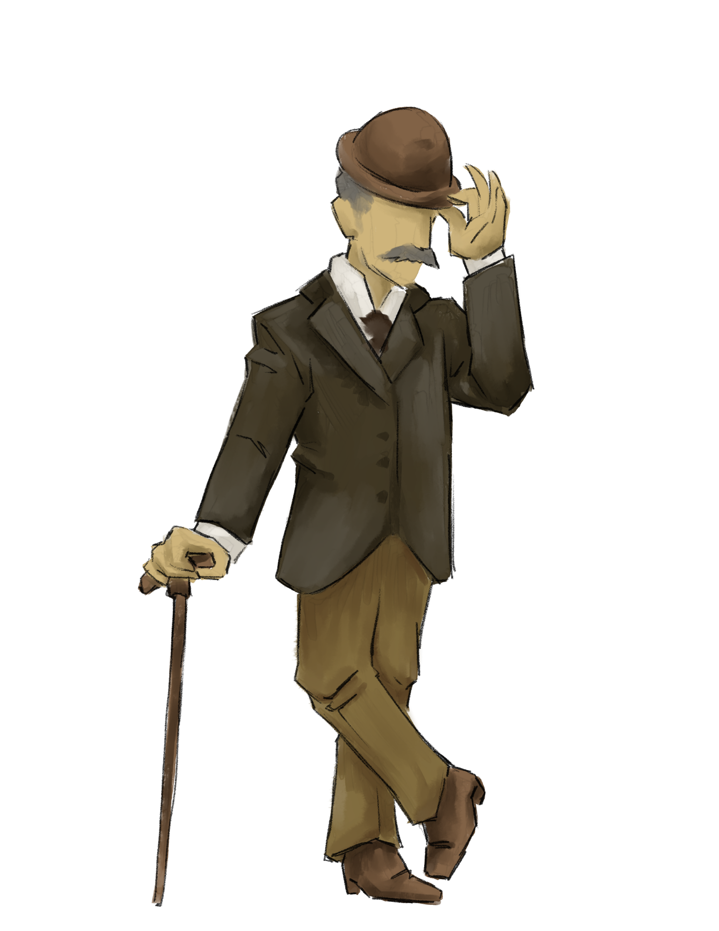
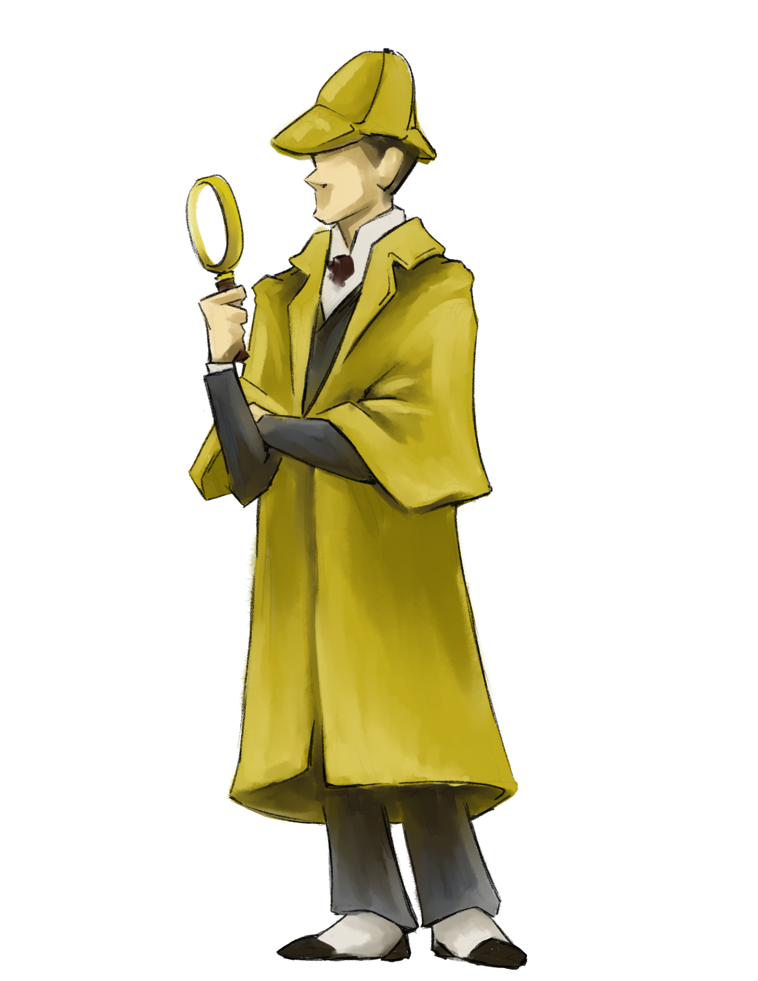
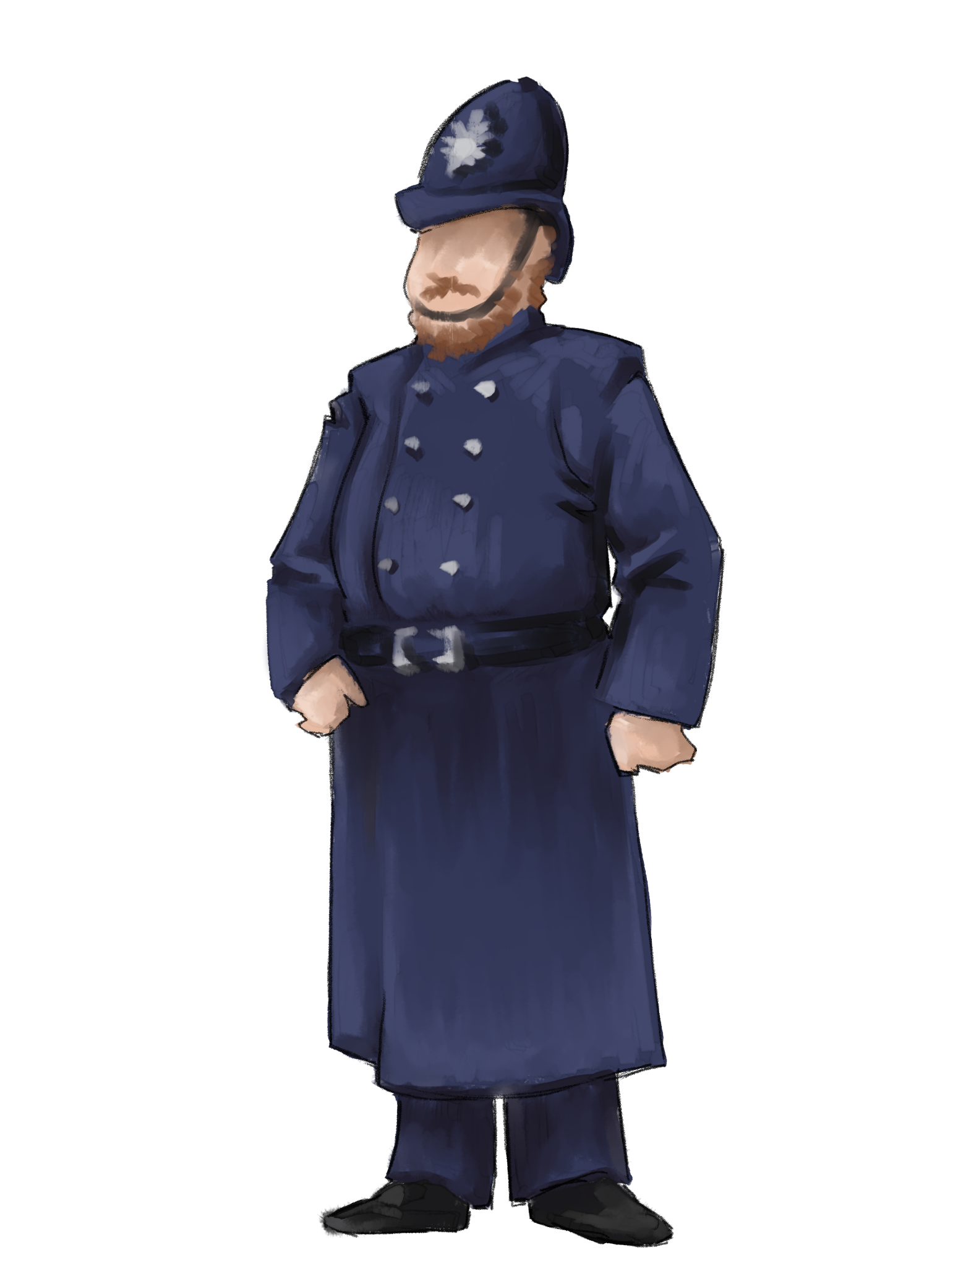
Computational
Thinker

Slide 2
1.5 Computational Thinker
Students develop and employ strategies for understanding and solving problems in ways that leverage the power of technological methods to develop and test solutions.

Slide 3
1.1 Empowered Learner
What are some key components of this standard?
How does teaching this standard look in the classroom?

Slide 4
Insert Tech Tool Name Here
Key Components
How might this look in the classroom?

