Slide 1
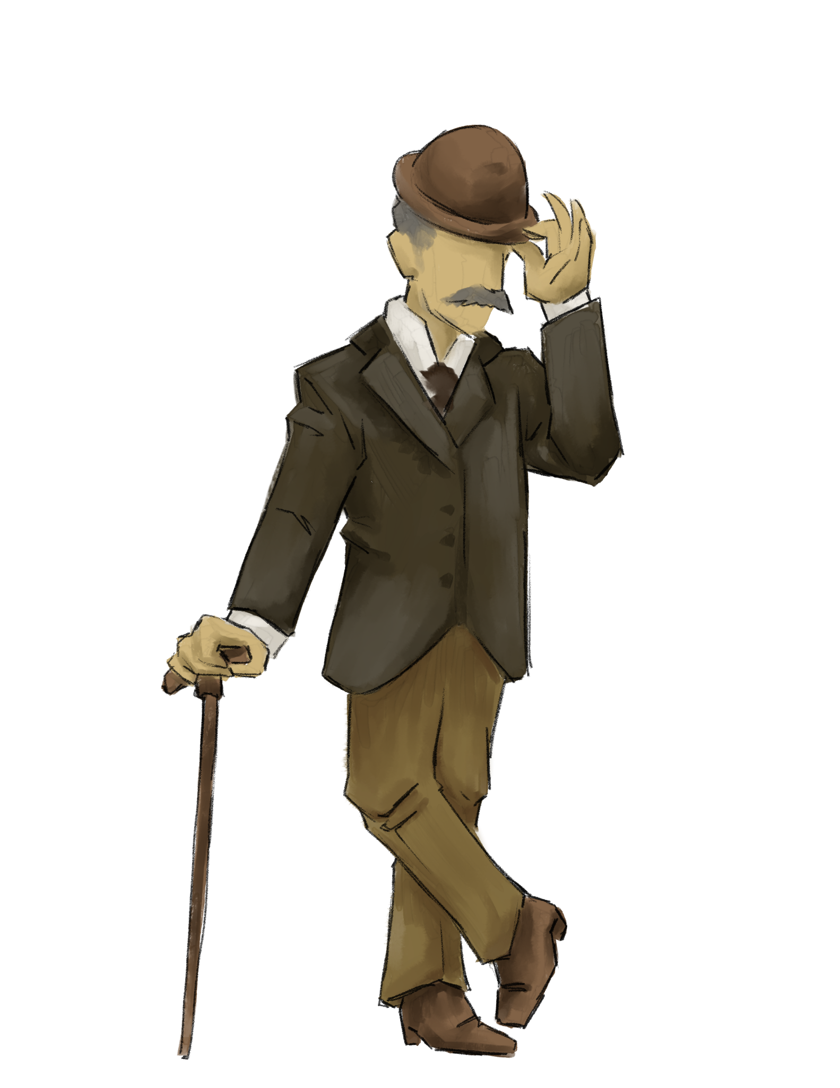
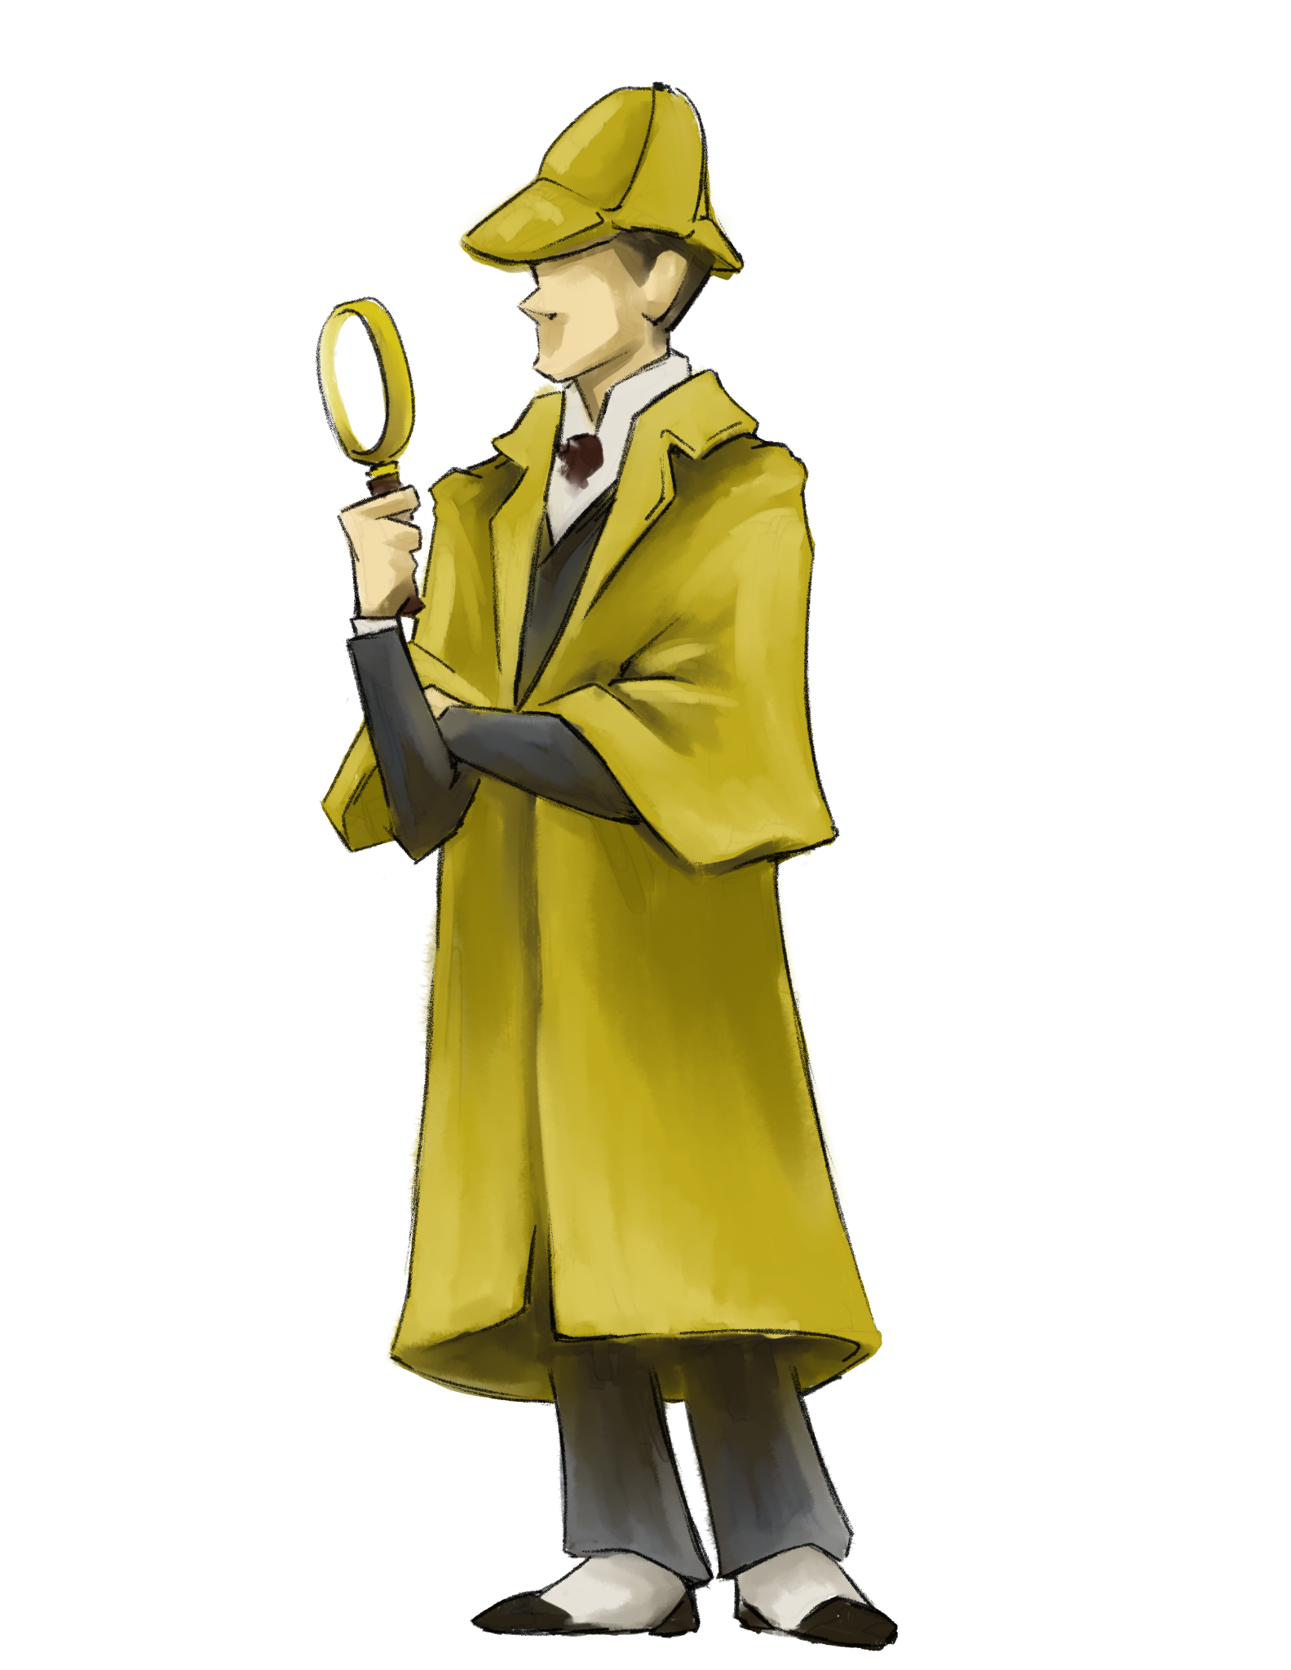
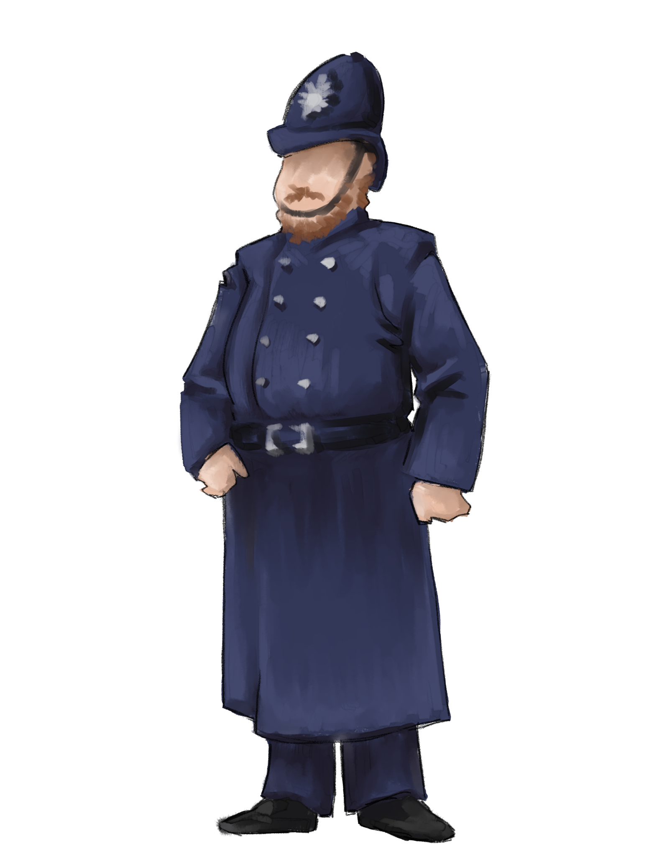
Creative
Communicator

Slide 2
1.6 Creative Communicator
Students communicate clearly and express themselves creatively for a variety of purposes using the platforms, tools, styles, formats, and digital media appropriate to their goals.

Slide 3
1.1 Empowered Learner
What are some key components of this standard?
How does teaching this standard look in the classroom?

Slide 4
Insert Tech Tool Name Here
Key Components
How might this look in the classroom?

