Slide 1
CSI Reboot
NAME Public Schools
Notes:
ENGAGE:
CSI Reboot
Carry Forward, Close Out, Create New
All text in yellow throughout the slideshow will need to be update for each district prior to presenting PD.
Add the name of the District to the title slide.

Slide 2
Carry Forward; Close Out; Create New
Reflect on the past
Learn from one another
Plan for the future

Slide 3

SUVs or BMWs
S: What do you like to do on a Saturday night?
U: Name something unique about yourself.
V: What is your dream vacation?
B: Where were you born?
M: What type of music do you listen to?
W: What have you binge-watched lately?
Notes:
ENGAGE
Ask participants to choose either a SUV or a BMW.
At their table each group takes time sharing their answers to the three questions they chose.
Click on timer to begin.
K20 Center. (2021, September 21). K20 Center 5 minute timer. YouTube. https://www.youtube.com/watch?v=EVS_yYQoLJg&t=1s

Slide 4
Objectives
Review original strategic plan.
Analyze current data.
Review/revise student achievement goal area.
Review/revise other goal areas.
Review/revise accountability plan.
Notes:
ENGAGE
Go over objectives as a whole group.

Slide 5
Objectives
Day 1
Review original strategic plan.
Analyze current data.
Review/revise student achievement goal area.
Day 2
Review/revise other goal areas.
Review/revise accountability plan.
Notes:
ENGAGE
Break down the objectives into the two days.

Slide 6
Essential Questions
What has worked/not worked?
What has changed in the environment?
What needs to be removed from the plan?
What needs to be added to the plan?
Notes:
ENGAGE
Go over essential questions as a whole group. Use the questions below to guide participants thought process.
Have Learner Expectations, Core Beliefs, and Core Values changed?
Have finances changed drastically?
Has your organization taken on new responsibilities that affect your goals?
Have there been any economic or external factors that could affect your district goals?

Slide 7
State of the District
insert district information and photo of superintendent
Notes:
ENGAGE
Insert the districts State of the District information along with the superintendent’s photo.
Give participants time to look over their State of the District.

Slide 8
✓
✓
✓
✓
PHASE I Engage
PHASE II Plan
PHASE III Action
PHASE IV Achieve
Who are we?
Where are we now?
Where do we
want to go?
How will we know
when we get there?
How do we plan to get there?
Notes:
ENGAGE
Just a reminder of our 4-Phase Model which results in a community- and a data-driven continuous strategic plan
Began Strategic Planning in the second semester of ________
We completed phase I with the community forums and surveys. You then met as teams in phase II to analyze data and determine your goal areas and objectives. Then for the Phase 3 and 4 you got into deciding where you wanted to go and exactly how will you were going to get there.

Slide 9
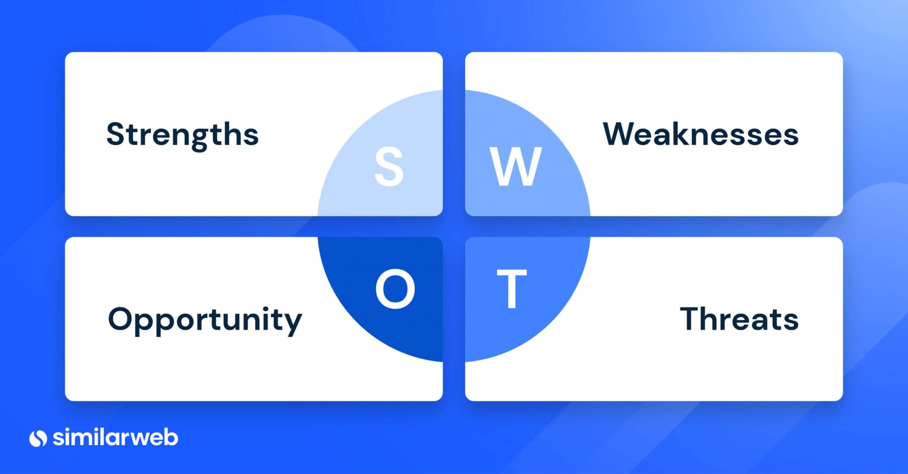
SWOT Analysis
Notes:
ENGAGE
Let’s begin our reflection by doing a SWOT analysis of the districts strategic plan
A SWOT Analysis helps you to understand the strengths and weaknesses of your strategic plan. It helps to identify opportunities and threats to your plan.
Strengths and Weaknesses are factors that you can control
Opportunities and Threats are external factors usually out of your control but are important to consider when planning
Work in Goal Area Team groups. Pass out a few of the SWOT handouts for examples.
Assign a leader and a recorder of each group.
Leader makes sure team members respond in-turn and contribute an idea or pass.
Recorder records the ideas contributed on the poster.
Work through each quadrant separately about 3 minutes per quadrant
Process each quadrant separately
In your Goal Area Team discuss the responses in each quadrant. Based on your discussion, put an asterisk at the end of the item in each quadrant that your group believes is the most important.
Look over each quadrant separately and ask a group member to share their asterisk (processing a quadrant at a time)
Explain that we can use the results of this activity as we start to do revisions/additions to the strategic plan
Work in teams being sure each team has alumni members. Do the SWOT through a carousel activity.
The purpose is to celebrate strengths, use info regarding threats to avoid moving forward, avoid weaknesses in the next plan and capitalize on the opportunities.
Become more familiar with the plan.

Slide 10


Carousel
Your group will rotate through the SWOT
posters for each of the other goal areas.
You have 5 minutes to view what the
previous group has written.
Brainstorm and add any additional
information.
When time is up, move on to the next goal area.
Notes:
ENGAGE
Introduce the Carousel instructional strategy.
Explain that each group will take time to view the other goal area’s SWOT poster.
Give participants 5 minutes to view and brainstorm another group's SWOT poster.
Encourage participants to focus on strengths and weaknesses.
After 5 minutes have each group rotate to the next goal area SWOT poster.
Continue every 5 minutes until each group has viewed all the goal areas.
As a group take time to discuss what they discovered about their continuous strategic plan.
K20 Center. (n.d.). Gallery Walk/Carousel. Strategies. https://learn.k20center.ou.edu/strategy/118
K20center. (2021, September 21). K20 Center 3 minute timer. YouTube. https://www.youtube.com/watch?v=iISP02KPau0&list=PL-aUhEQeaZXLMF3fItNDxiuSkEr0pq0c2&index=5

Slide 11
Let’s take a 5-minute break!
Notes:
K20center. (2021, September 21). K20 Center 5 minute timer. YouTube. Retrieved August 16, 2022, from https://www.youtube.com/watch?v=EVS_yYQoLJg&t=1s

Slide 12
Characteristics of a Performance Culture
Risk-taking/asking questions
Alignment of beliefs, values, mission, goals
Simplicity and focus
Rigorous tracking/accountability
“Culture drives great results.”
Jack Welch
Notes:
EXPLORE
Based on the most recent CSI Community Survey results and the SWOT, updated learner expectations, core beliefs, core values have been identified.

Slide 13
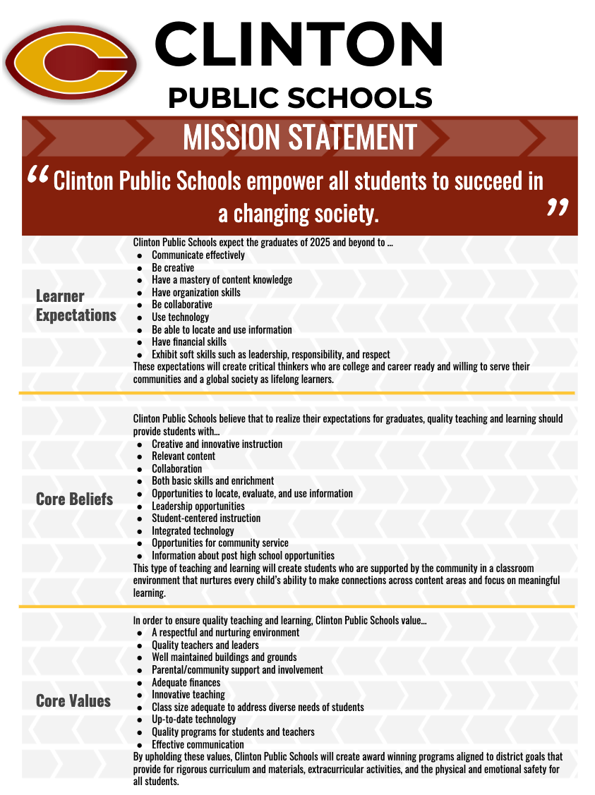
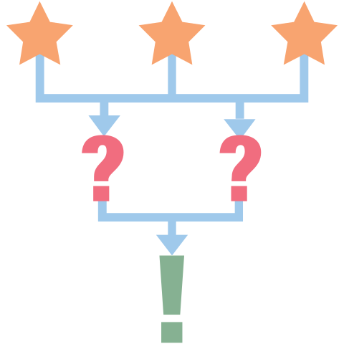
3 - 2 - 1
3 items that you agree with
2 items that surprise you
1 question you have
Notes:
EXPLORE
Customize this slide for each district. Insert NEW CSI Community Survey data.
Pass out the 3-2-1 Handout.
Activity by table group:
Based on the most recent CSI Community Survey results
3 items that you agree with and why
2 items that surprised you
1 question you still have
K20 Center. (n.d.). 3-2-1. Strategies. https://learn.k20center.ou.edu/strategy/117
PreWork:
Communication - internal/external - about Reboot process and survey opportunity
Timeline for CSI Community Stakeholder Survey open/close dates

Slide 14
Goal Areas and Objectives
Examine the Student Achievement goal area and objectives. Consider these questions:
Are our goals/objectives still relevant?
Do they reflect your community’s Learner Expectations, Core Beliefs, and Core Values?
Notes:
Customize this slide for each district. Insert NEW CSI Community Survey data.
EXPLAIN
Make this more of an overview.
Refer group to look at first page of digital scorecard.
First let’s look at the “big picture” of your strategic plan.
Consider the questions on the slide
Walk participants through examining their goal areas and objectives.

Slide 15
Student Achievement Performance Measures
Using the digital scorecard, you will:
Analyze SA data for each performance measure.
Determine if the target was met.
Set a new target and benchmarks in the rows below the statement.
Record all new information on digital scorecard in red font.
Make a copy of the instruction sheet: http://k20.ou.edu/stu
Notes:
EXPLAIN
Go over the process of analyzing student achievement data and using the digital scorecard.
Activity: Look at scorecard (performance measures), insert a row under a statement; put in a new baseline, did you meet your target? Set your target. What are new benchmarks?
Notes: Using scorecards, work in groups based on the number of initiatives to analyze new SA data and find new baselines and suggest benchmarks, but we will then come back to whole group and approve/adjust benchmarks together.
Working in student achievement data ONLY
Pre-work:
Obtain scorecard and WE go in and add lines for the new PMs.
Request same student achievement data prior to professional development.
OSTP
Benchmark
ACT
AP
OCCR

Slide 16

Agreement Circle
Create a large circle.
As each revision is read, decide if you agree or disagree with the revision.
  If you agree, go to the inside of the circle.
  If you disagree, stay on the outside.
Listen to each side share their opinion.
Make a final decision.
Majority rules!
Notes:
EXTEND
Introduce the agreement circle instructional strategy to the participants.
Have the participants form a large circle.
Read the red changes from the Student Achievement scorecard.
Give participants 5-10 seconds to decide if they agree or disagree. If participants agree they move to the inside of the circle. If they disagree they stay on the outside.
Give each group a few minutes to defend their opinion.
Then ask participants to make a final decision.
If the majority of the group is in agreement then the revision stays. If the majority of the group disagrees then the revision is removed or striked through.
This can also be done with thumbs up or thumbs down if you do not have the space for a large circle.
Give each revision a three minute timer to keep from running out of time.
K20 Center. (n.d.). Agreement Circle. Strategies. https://learn.k20center.ou.edu/strategy/157
K20center. (2021, September 21). K20 Center 3 minute timer. YouTube. Retrieved August 16, 2022, from https://www.youtube.com/watch?v=iISP02KPau0

Slide 17


Slide 18

Picture Perfect
Find a picture on your device that best represents you.
Explain the picture to your group and what it says about you.
Notes:
EXPLAIN
Participants can find a picture on their phone or google one if needed.
Monitor time and encourage participants to take turns.

Slide 19
Student Achievement Initiatives
Examine student achievement initiatives for each objective:
Is the initiative relevant to assisting in accomplishing the objectives and meeting the performance measures?
Do action steps need to be revised or deleted?
Do new action steps need to be added?
Record recommendations on scorecard in RED.
Notes:
EXPLAIN
Put participants in initiative groups (we really need a list of who is invited to participate, what is their roll, and have they been involved in the process).
Give the groups the following instructions:
Strike through initiatives determined to be irrelevant
If initiative is kept, look at action steps and strike through steps that need to be deleted.
Insert a new row to rewrite a revised action step
Insert/add row to insert new action steps

Slide 20
Let’s take a 5-minute break!
Notes:
K20center. (2021, September 21). K20 Center 5 minute timer. YouTube. Retrieved August 16, 2022, from https://www.youtube.com/watch?v=EVS_yYQoLJg&t=1s

Slide 21
8-Up
You have 5 minutes to work with your small group.
Come to a consensus on the revisions
to the Student Achievement scorecard.
Then, you will join another group and work
to come to a consensus on the revisions.
Continue to join groups until there are only two groups left in the room.
Notes:
EXTEND
Introduce the 8 up strategy to the participants.
Inform the participants they will work in small groups to come to a consensus on their Student Achievement scorecard revisions.
Then each group will join with another group and work together to come to a consensus on the Student Achievement scorecard revisions. This will continue until you have two groups left.
Once there are two groups, work together to come to a consensus between the two groups for a final revision.
Use the five minute timer to keep any group from taking too long to come to a consensus.
K20 Center. (n.d.). 8 Up. Strategies. https://learn.k20center.ou.edu/strategy/2494
K20center. (2021, September 21). K20 Center 5 minute timer. YouTube. Retrieved August 16, 2022, from https://www.youtube.com/watch?v=EVS_yYQoLJg&t=1s

Slide 22
Agreement Circle
Create a large circle.
As each revision is read, decide if you agree or disagree with the revision.
  If you agree, go to the inside of the circle.
  If you disagree, stay on the outside.
Listen to each side share their opinion.
Make a final decision.
Majority rules!
Notes:
EXTEND
Introduce the agreement circle instructional strategy to the participants.
Have the participants form a large circle.
Read the red changes from the Student Achievement scorecard.
Give participants 5-10 seconds to decide if they agree or disagree. If participants agree they move to the inside of the circle. If they disagree they stay on the outside.
Give each group a few minutes to defend their opinion.
Then ask participants to make a final decision.
If the majority of the group is in agreement then the revision stays. If the majority of the group disagrees then the revision is removed or striked through.
This can also be done with thumbs up or thumbs down if you do not have the space for a large circle.
Give each revision a three minute timer to keep from running out of time.
K20 Center. (n.d.). Agreement Circle. Strategies. https://learn.k20center.ou.edu/strategy/157
K20center. (2021, September 21). K20 Center 3 minute timer. YouTube. Retrieved August 16, 2022, from https://www.youtube.com/watch?v=iISP02KPau0

Slide 23

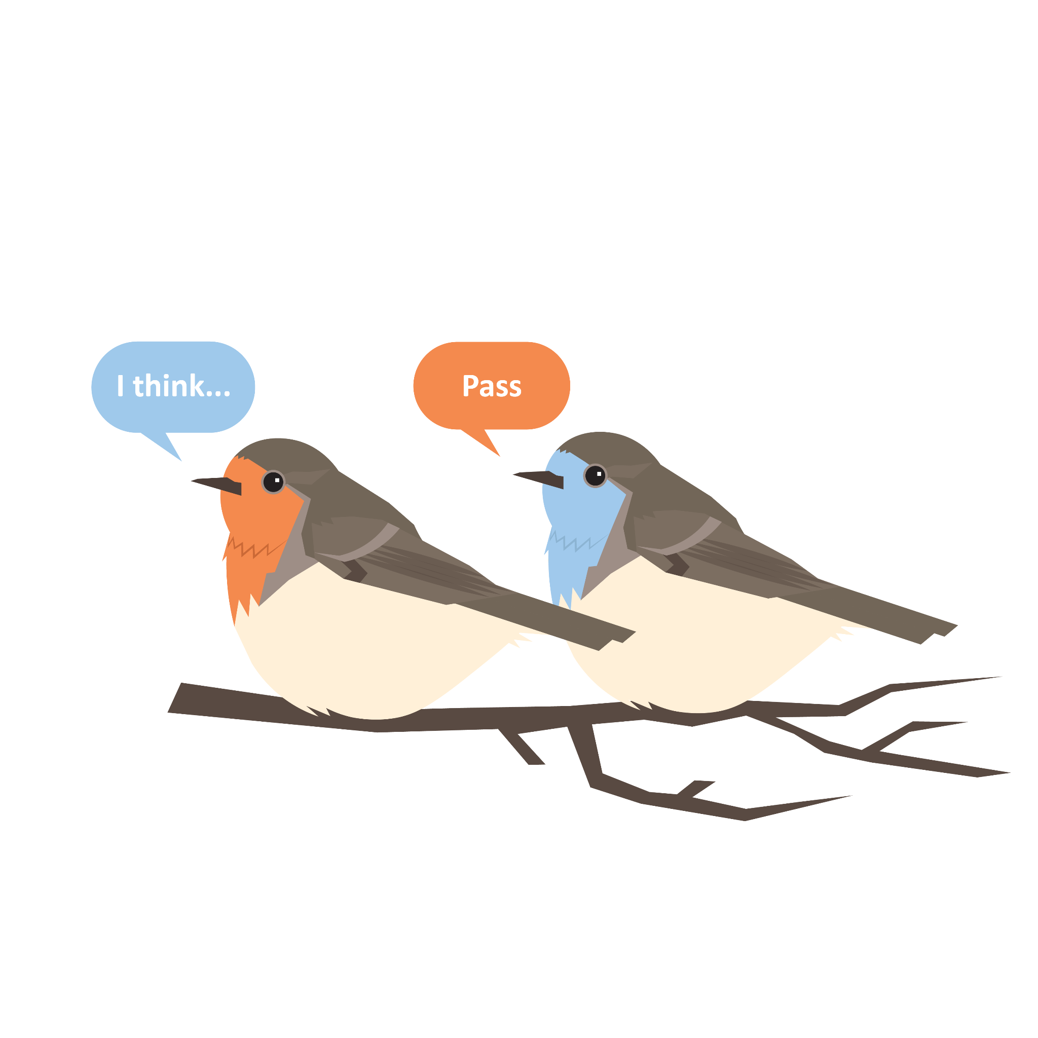
ABC Graffiti: What have you learned?
At your table, choose one person to be the scribe. Go around the table in a Round Robin process and discuss the following question:
What have you learned about the process and your data today?
Notes:
EVALUATE
ABC Graffiti: divide into groups to brainstorm answers to the question “What have you learned about the process and your data today?”
Pass out the ABC Graffiti handout and have each table choose a scribe.
Give each group time to discuss and write down their thoughts. This should be done in a round robin fashion where everyone gets to contribute.
K20 Center. (n.d.). ABC Graffiti. Strategies. https://learn.k20center.ou.edu/strategy/96
K20 Center. (n.d.). Round Robin. Strategies. https://learn.k20center.ou.edu/strategy/2183
K20center. (2021, September 21). K20 Center 3 minute timer. YouTube. Retrieved August 16, 2022, from https://www.youtube.com/watch?v=iISP02KPau0
Walk around the room as they are discussing and join in the conversations.

Slide 24
CSI Reboot
NAME Public Schools
Notes:
ENGAGE:
CSI Reboot
Carry Forward, Close Out, Create New
All text in yellow throughout the slideshow will need to be update for each district prior to presenting PD.
Add the name of the District to the title slide.

Slide 25
Carry Forward; Close Out; Create New
Reflect on the past
Learn from one another
Plan for the future

Slide 26
Objectives
Day 1
Review original strategic plan.
Analyze current data.
Review/revise student achievement goal area.
Day 2
Review/revise other goal areas.
Review/revise accountability plan.
Notes:
ENGAGE
Review the objectives completed from the previous day.
Introduce the objectives for today.

Slide 27
Essential Questions
What has worked/not worked?
What has changed in the environment?
What needs to be removed from the plan?
What needs to be added to the plan?
Notes:
ENGAGE
Have Learner Expectations, Core Beliefs, and Core Values changed?
Have finances changed drastically?
Has your organization taken on new responsibilities that affect your goals?
Have there been any economic or external factors that could affect your district goals?

Slide 28

POMS
Reflect on Day 1.
What was the most important thing you discovered?
Notes:
ENGAGE
Introduce the POMS instructional strategy.
Ask participants to think about what they did yesterday during the first day of the professional development
Ask, “What was the most important thing they discovered?”
Give participants 30 seconds to think over what they would share.
Allow participants to share at their table or volunteer their thoughts.
K20 Center. (n.d.). POMS. Strategies. https://learn.k20center.ou.edu/strategy/101

Slide 29
Goal Areas and Objectives
Examine each goal area and objectives. Consider these questions:
Are our goals/objectives still relevant?
Do they reflect our community’s Learner Expectations, Core Beliefs, and Core Values?
Notes:
EXPLORE
Update this slide for each district’s CSI Community Survey information
Give participants time to look over the Goal Areas and objectives and think about the question displayed on the slide.

Slide 30
Four Corners
Examine each goal area and objectives.
On a sticky note, write down items that are relevant, no longer relevant, or new objectives.
Place each sticky note on the correct Goal Area poster.
  Green: still relevant
  Blue: no longer relevant
  Yellow: new objective/action step
Notes:
EXPLORE
Update this slide for each district’s CSI Community Survey information.
Update the sticky note color based on what you have available.
Introduce the Four Corners instructional Strategy.
Point out the Goal Area Posters around the room and pass out the sticky notes
Inform participants they will be looking over their other goal area’s digital scorecards and making notes of things that are still relevant, not relevant, and about what they might add for future objectives.
They will write their ideas down on the sticky notes and add them to the posters around the room.
Point out the color coding of the sticky notes and inform participants this is to help each group when they update their digital scorecard.
Remind participants that this is their opportunity to share their thoughts and input on each Goal Area.
K20 Center. (n.d.). Four Corners. Strategies. https://learn.k20center.ou.edu/strategy/138

Slide 31
Let’s take a 5-minute break!
Notes:
Break slides can be moved and used at any point in the presentation.
K20center. (2021, September 21). K20 Center 5 minute timer. YouTube. Retrieved August 16, 2022, from https://www.youtube.com/watch?v=EVS_yYQoLJg&t=1s

Slide 32
Goal Area Initiatives Review
Examine each initiative for each of the objectives in your assigned goal area.
Consider these questions:
Are the initiatives relevant to assisting in accomplishing the objectives and meeting the performance measures?
What initiatives did we accomplish/did not accomplish?
What are the reasons we did not accomplish an initiative?
Notes:
EXPLAIN
Walk participants through examining their goal areas and objectives use the Goal Area and Objective Revision handout.
Divide the group into a team for each goal area in their Strategic Plan, except for Student Achievement.
Go over the process of analyzing their other goals and using the digital scorecard.
Encourage the participants to use the Four Corners posters from the previous activity to include the thoughts and ideas of their colleagues.
The participants will need to strike through initiatives determined to be irrelevant. If initiative is kept, look at action steps and strike through steps that need to be deleted. Insert a new row to rewrite a revised action step. Insert/add row to insert new action steps.
Give participants the time needed to complete this work.
You may need to break for lunch during this activity and finish the work once participants return.

Slide 33
Performance Measures
Using the digital scorecard, you will:
Analyze the data for each performance measure for your Goal Area.
Determine if the target was met.
Set a new target and benchmarks in the rows below the statement.
Record all new information on digital scorecard in RED.
Notes:
EXPLAIN
Go over the process of analyzing student achievement data and using the digital scorecard.
Activity: Look at scorecard (performance measures), insert a row under a statement; put in a new baseline, did you meet your target? Set your target. What are new benchmarks?
Notes: Using scorecards, work in groups based on the number of initiatives to analyze new SA data and find new baselines and suggest benchmarks, but we will then come back to whole group and approve/adjust benchmarks together.
Working in student achievement data ONLY
Pre-work:
Obtain scorecard and WE go in and add lines for the new PMs.
Request same student achievement data prior to professional development.
OSTP
Benchmark
ACT
AP
OCCR

Slide 34
Initiatives
Examine your goal area initiatives for each objective:
Make a copy of this document: http://k20.ou.edu/goals
Is the initiative relevant to assisting in accomplishing the objectives and meeting the performance measures?
Do action steps need to be revised or deleted?
Do new action steps need to be added?
Record recommendations on scorecard in RED.
Notes:
EXPLAIN
Put participants in initiative groups (we really need a list of who is invited to participate, what is their roll, and have they been involved in the process).
Give the groups the following instructions:
Strike through initiatives determined to be irrelevant
If initiative is kept, look at action steps and strike through steps that need to be deleted.
Insert a new row to rewrite a revised action step
Insert/add row to insert new action steps

Slide 35
Notes:
Lunch slide can be moved to any point in the presentation.

Slide 36
Digital Gallery Walk
Look at the changes made to the other goals:
Reflect on the revisions and additions contributed by your colleagues.
Consider how they align with the changes you have made.
Notes:
EXPLAIN
You are guiding the participants through a digital gallery walk.
Instruct the participants to review the Goal areas they did not participate in revising on their devices.
Give them time to reflect and discuss at their tables no more than 5-8 minutes.
K20 Center. (n.d.). Gallery Walk. Strategies. https://learn.k20center.ou.edu/strategy/118

Slide 37
What structures do you have in place for accountability?
At your table, think of the following questions:
What meetings do you hold at the district level to discuss your strategic plan?
Who attends the meetings?
How often do you meet?
Have a Round Robin discussion about the questions.
Notes:
Extend
K20 Center. (n.d.). Round Robin. Strategies. https://learn.k20center.ou.edu/strategy/2183

Slide 38
Reflect on Processes and Structures
What contributed to the success of your strategic plan accountability and transparency?
What were the obstacles?
What changes need to be made?
Notes:
EXTEND
Facilitate a whole group discussion reflecting on the district's strategic plan and accountability/transparency.

Slide 39
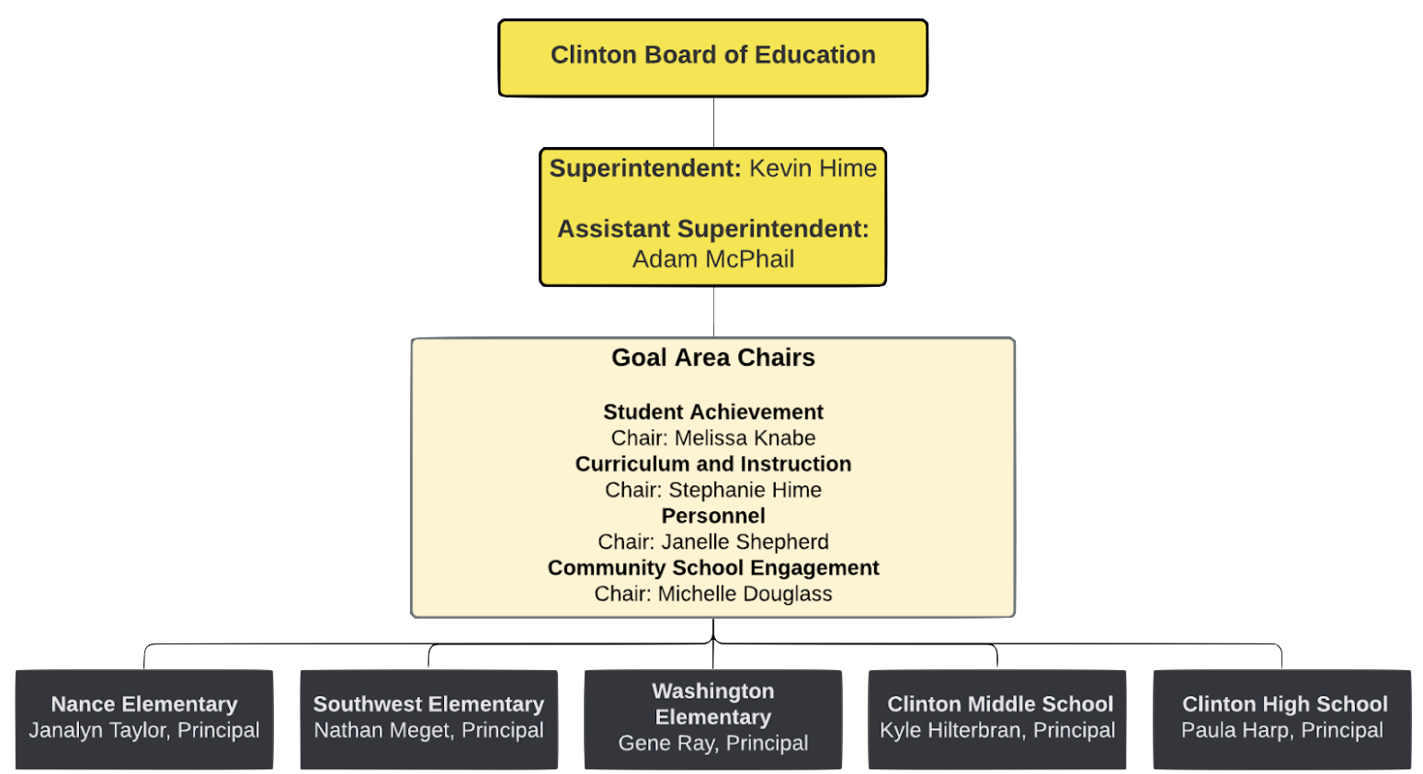
Notes:
EXTEND
Update this slide to show the district’s Accountability Flowchart.
Show the participants their Accountability Flowchart.
Guide them in a discussion about their accountability flow chart and how it worked over the last 5 years.
Potential questions:
Is this what their accountability plan actually looked like?
If not, what was the process they followed?
What worked well?
What did not work well?

Slide 40
Round Robin
School Board Reports
Who should report to the board?
What should they report?
How often should they report?
Why should the board be updated on the Strategic Plan?
Notes:
EXTEND
Introduce participants to the instructional strategy Round Robin
At their tables have the discuss one question at a time. Moving around the table and giving each participant an opportunity to share.
As a group come back together to discuss what worked well and what they need to adjust for the future.
K20 Center. (n.d.). Round Robin. Strategies. https://learn.k20center.ou.edu/strategy/2183

Slide 41

Reflect on Processes and Structures
What contributed to the success of your strategic plan accountability and transparency?
What were the obstacles?
What changes need to be made?
Notes:
EXTEND
Facilitate a whole group discussion reflecting on the district's strategic plan and accountability/transparency.

Slide 42
Let’s take a 5-minute break!
Notes:
Break slides can be moved and used at any point in the presentation.
K20center. (2021, September 21). K20 Center 5 minute timer. YouTube. Retrieved August 16, 2022, from https://www.youtube.com/watch?v=EVS_yYQoLJg&t=1s

Slide 43
ABC Graffiti
How do you intend to reintroduce your Focus Forward Plan and involve others?
Notes:
EVALUATE
ABC Graffiti: divide into groups to brainstorm answers to the question “How do you intend to reintroduce you Focus Forward Plan and involve others?”
Pass out the ABC Graffiti poster.
Each group will have 3 minutes to write down all the ideas they can think of to answer the question.
When the timer goes off they will rotate to the next groups poster.
Continue until groups have returned to their original poster.
Give each group time to discuss the ideas written down.
K20 Center. (n.d.). ABC Graffiti. Strategies. https://learn.k20center.ou.edu/strategy/96
K20center. (2021, September 21). K20 Center 3 minute timer. YouTube. Retrieved August 16, 2022, from https://www.youtube.com/watch?v=iISP02KPau0

Slide 44
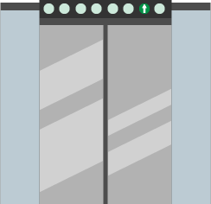
Elevator Speech
If you had 30 seconds to tell a stakeholder about the changes in your strategic plan, what would you say?
Include the following:
Updates made to your strategic plan
How your plan will impact student achievement
How you can get more people involved in the
implementation of the strategic plan
Notes:
EVALUATE
Introduce the participants to the Elevator Speech instructional strategy.
Inform participants they will write down a 30 second speech for explaining their revised strategic plan to stakeholders.
Pass out the Stakeholders Elevator Speech handout.
Give participants time to fill in their thoughts.
Have participants take the time to share their Elevator Speech with other participants at their table.
K20 Center. (n.d.). Elevator Speech. Strategies. https://learn.k20center.ou.edu/strategy/57

Slide 45
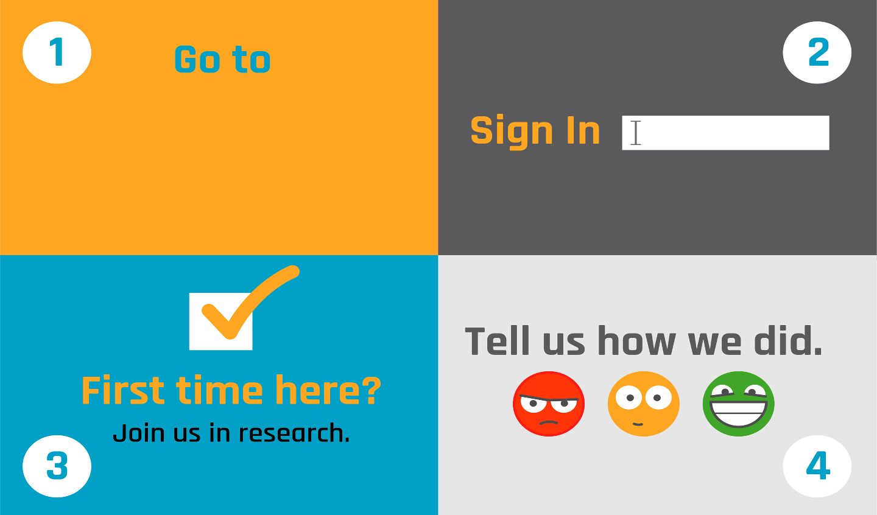
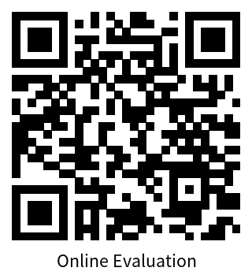
Insert link and change QR code
Google Sign-in (school email)
(No Participant ID is required)
Notes:
Update the link and QR code for each district?

