Slide 1
Embedded Literacy Across All Disciplines
Aimee Myers
Lindsay Williams

Slide 2
Tool Time
Think
Pair
Share
Notes:
*Give actual THINK time* Ask participants to get out their "Instructional Strategy Notes Sheet” and explain that they can fill this out as they go through the session.

Slide 3
Sticky Bars
Which of the five literacy components is most important?
Notes:
Pose the question, “Which of the five literacy components is most important and why?" Have each participant chose one component that they consider most important and explain that choice on a Post-it note Have them bring the Post-it up and stick it to the paper making a bar graph of the reasons from the post it notes.

Slide 4
Objectives
Participants will be able to identify significant components of literacy and evaluate the significance of each literacy component.
Participants will be able to develop an understanding of how instructional strategies can build a toolbox for embedded literacy in the classroom.
Participants will be able to apply instructional strategies to their own subject areas to support disciplined, focused literacy.

Slide 5
3-2-1
3 - elements of literacy seen in the video
2 - elements you might try in your class
1 - obstacle to overcome
Notes:
Before viewing video 1- not perfect, but interesting use of literacy 2- be prepared to share your 3-2-1 w/ an elbow partner

Slide 6
Literacy in Science
Notes:
Note: To save space, video is not embedded. Video is linked in both the image and in the title of the slide. You will need an Internet connection to play this video.
After video, elbow partner and share out

Slide 7
3-2-1
3 - elements of literacy seen in the video
2 - elements you might try in your class
1 - obstacle to overcome
Notes:
Before viewing video 1- not perfect, but interesting use of literacy 2- be prepared to share your 3-2-1 w/ an elbow partner

Slide 8
Reading Strategies
Jig-saw
Thinking Notes
Main Idea - Central to the author’s purpose.
I love this Part! - Great writing or idea.
Raises a Question - Possible discussion point for class.
Something is unclear or confusing to me - I need to ask about this in Class
!
?
??
Notes:
Begin with just the article, before passing out article show reading strategies

Slide 9
What is the impact of digital information on our world today?
Notes:
DO NOT show Tweet Up yet. Allow them to discuss for a few minutes, then move on to the next slide

Slide 10
Tweet Up
w/#
Tweet = Your Opinion Statement / Your Stance
# = Main Idea / Message
Notes:
All groups get the infographic, then do Tweet Up on legal paper or giant post-its
have the hashtag come first (main idea or theme), then give a few opinions/thoughts *remind them that tweets can be thesis statements

Slide 11
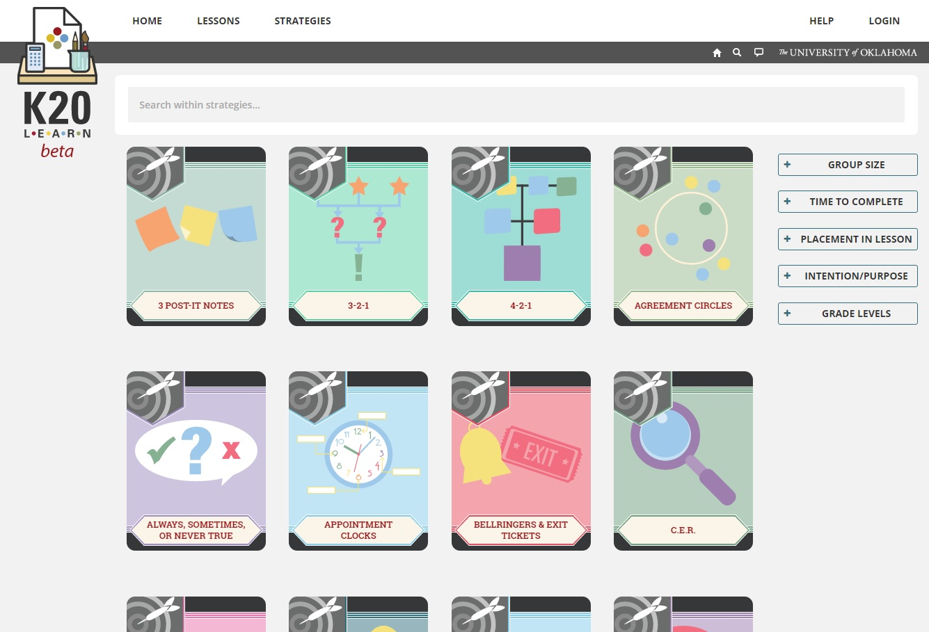
K20 Strategies
https://learn.k20center.ou.edu/strategy/find.html
Notes:
Website with instructional strategies used in session

Slide 12
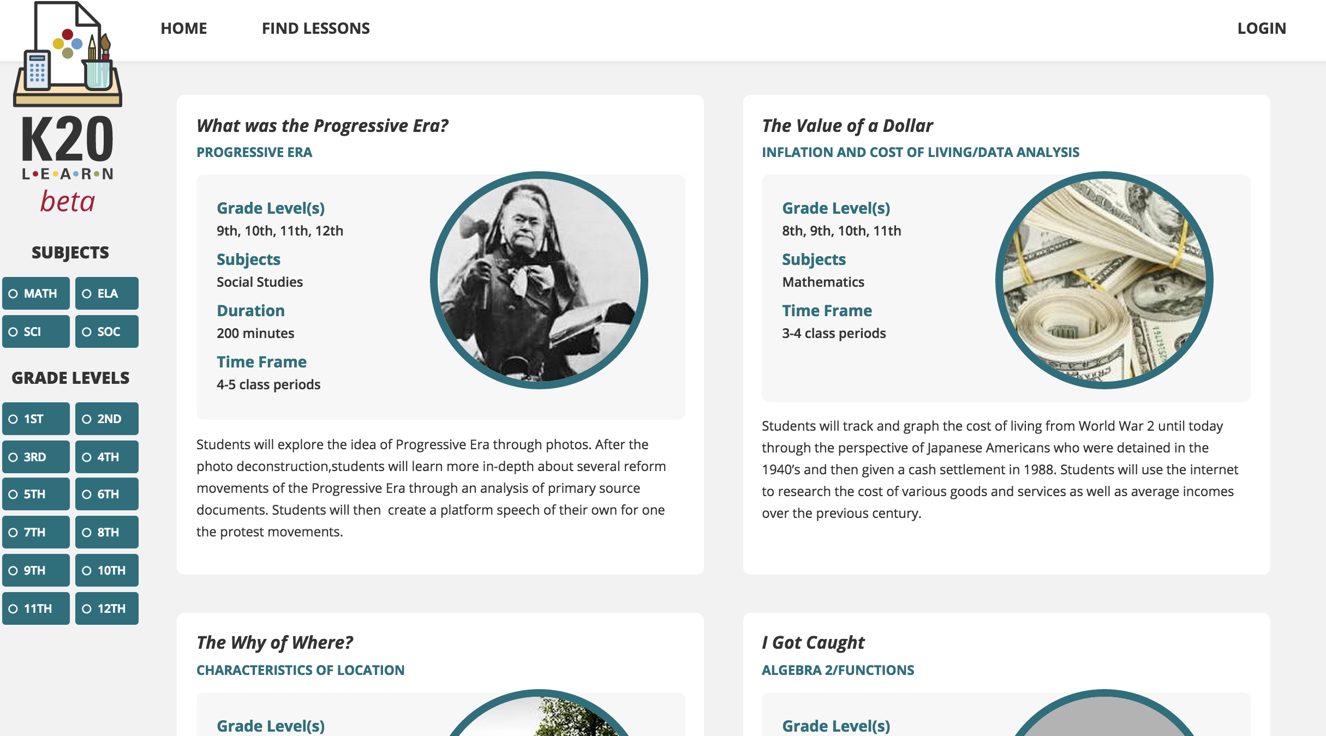
K20 LEARn
learn.k20center.ou.edu
Notes:
Website with lessons using instructional strategies that can be used in the classroom

Slide 13
How did we do?
Develop an understanding of how instructional strategies can build a toolbox for disciplinary literacy in the classroom
Provide participants with opportunities for adaptation and integration within the content areas

