Slide 1
MATH IN ACTION

Slide 2
AGREEMENT CIRCLES
IT IS EASY TO SUPPORT MATH CONTENT IN ANY SUBJECT AREA.

Slide 3
LEARNING OBJECTIVES
Participants will identify parallels between problem solving and logical reasoning in math to other content areas.
Participants will be introduced to math strategies that can reinforce math objectives in their subject areas.

Slide 4
AUTHENTICITY
VALUE BEYOND SCHOOL
Connection is made between the lesson topic and actual situations or experiences and is explored in a way that allows students to create personal meaning and significance.
STUDENT-CENTERED LEARNING
Instruction provides student ownership of the learning environment focused on personal experience and prior knowledge with teacher and student sharing control of the learning.

Slide 5
STATS are FUN!
Find an elbow partner.
During this activity, you will construct a viable argument to address the essential question.
You will utilize the statistics given to support your argument.
Notes:
Read directions to participants. Allow them time to find a elbow partner, then move to next slide and present the question.

Slide 6
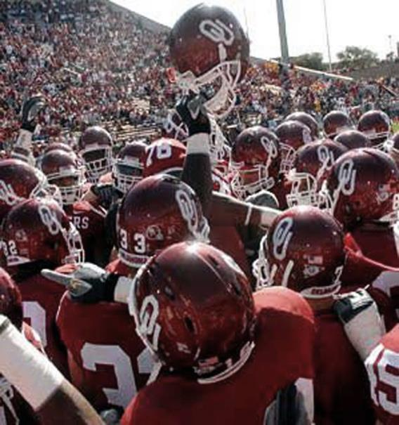
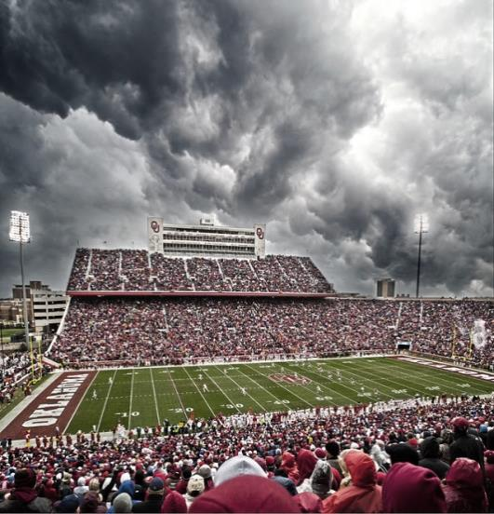
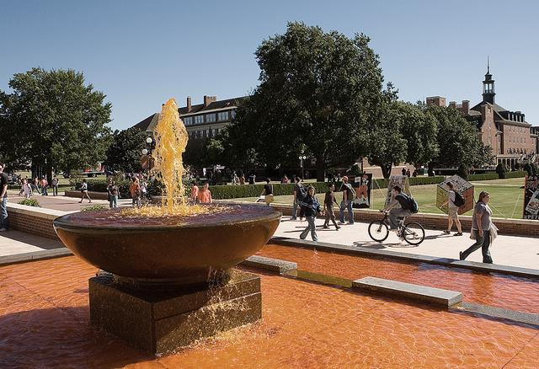
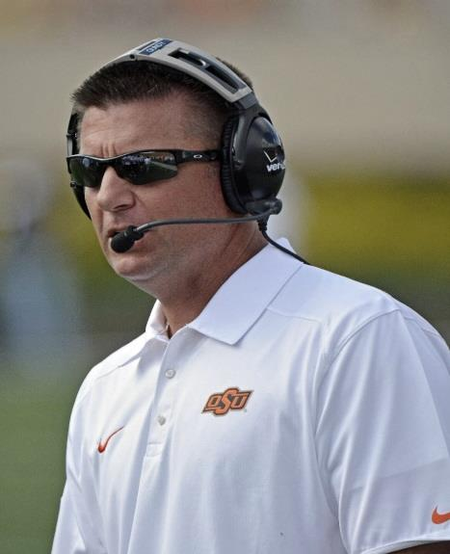
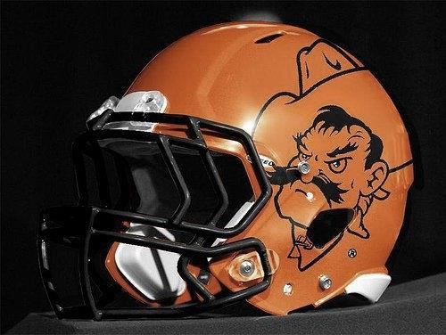
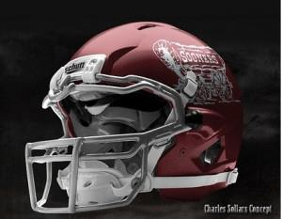
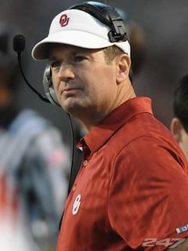
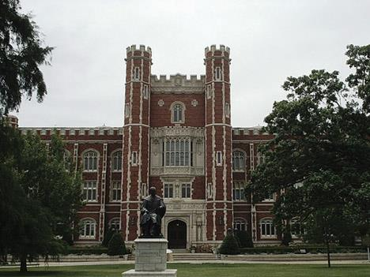
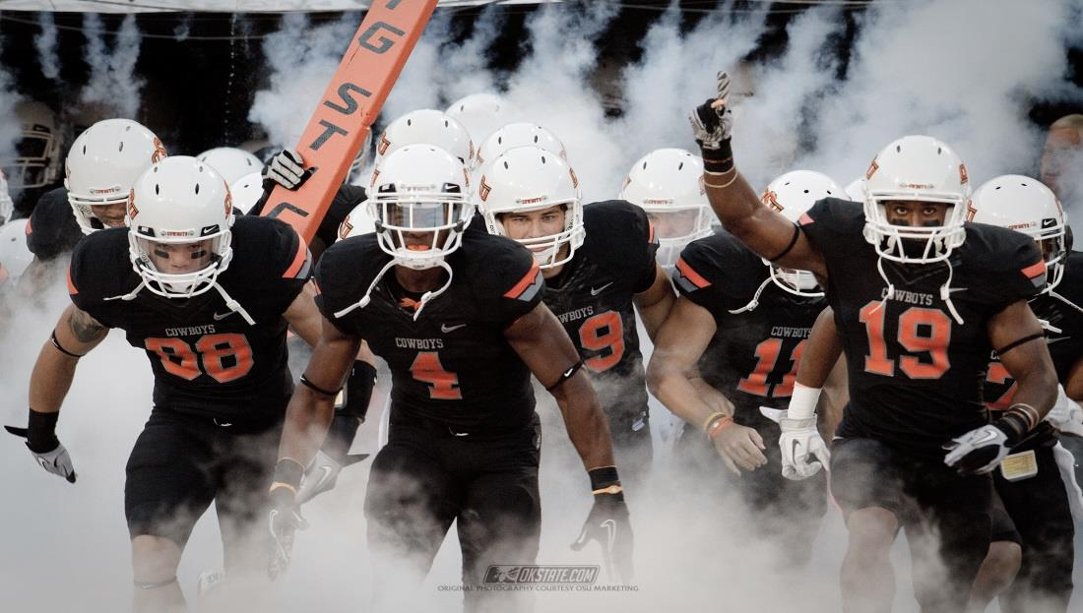
WHO IS THE
BETTER TEAM?

Slide 7
VS. STATISTICS
87, 405, 301, 165 | Rushing yards | 85, 183, 154, 200
150, 118, 171, 193 | Passing Yards | 274, 197, 440, 200
2(0), 0(2), 1(2), 1(2) | Turnovers | 0(1), 1(3), 0(3), 2(1)
12, 48, 41, 33 | Total Points | 42, 38, 49, 24
Notes:
Stats from:
Sports Reference LLC. (2016). 2013 Oklahoma State Cowboys. Retrieved July 05, 2016, from http://www.sports-reference.com/cfb/schools/oklahoma-state/2013-schedule.html
Sports Reference LLC. (2016). 2013 Oklahoma Sooners. Retrieved July 05, 2016, from http://www.sports-reference.com/cfb/schools/oklahoma/2013-schedule.html

Slide 8
OPPONENTS
Baylor |  | Kansas
Iowa State |  | Texas
Kansas State |  | Baylor
Bedlam |  | Bedlam
Notes:
Information from:
Sports Reference LLC. (2016). 2013 Oklahoma State Cowboys. Retrieved July 05, 2016, from http://www.sports-reference.com/cfb/schools/oklahoma-state/2013-schedule.html
Sports Reference LLC. (2016). 2013 Oklahoma Sooners. Retrieved July 05, 2016, from http://www.sports-reference.com/cfb/schools/oklahoma/2013-schedule.html

Slide 9
SHARE OUT
Who did your team decide was the best team, based on the information that you looked at?

Slide 10
CONTENT STANDARDS
Math––Construct viable arguments and critique the reasoning of others.
Science––Develop a logical relationship between evidence and explanation to form and communicate a valid conclusion, and suggest alternative explanation.
Social Studies––Support claims with logical reasoning and relevant, accurate data and evidences that demonstrate an understanding of the topic or text, using critical sources.
English––Write arguments to support claims in an analysis of substantive topics or texts, using valid reasoning and relevant, sufficient evidence.

Slide 11
REFLECTION
How could this practice of constructing a viable argument be used in other content areas? (e.g., English, science, and history)
Why would this math practice be important in all areas?

Slide 12
AUTHENTICITY CONNECTION:
How does this lesson demonstrate the use of the components of authenticity?

Slide 13
EVERYDAY IDEAS
Students compute their own percentages for grades in class
Breaking down math vocabulary in word problems to determine appropriate action steps
Using data wall information to create graphs and track progress.
Students use individual assessment data to track their own progress.
Turn to page “7 x 8” or “66 - 10”, etc., instead of saying the page number.
Math teachers: Any other ideas?
Notes:
7 x 8 is read 7 times 8, and 66 - 10 is read 66 minus 10.

Slide 14
DIY
NUMBER SENSE
Estimating
Percentage and decimals
Rounding
Measurement (e.g., act of measuring, choice of units)
SOCIAL STUDIES––Lewis and Clark, industrial revolution
SCIENCE––weights and measurements, cells
ELA––haiku, iambic pentameter
How do you DIY?

Slide 15
I USED TO THINK, BUT NOW I KNOW . . .
How have your ideas about supporting math in all content areas changed?

Slide 16
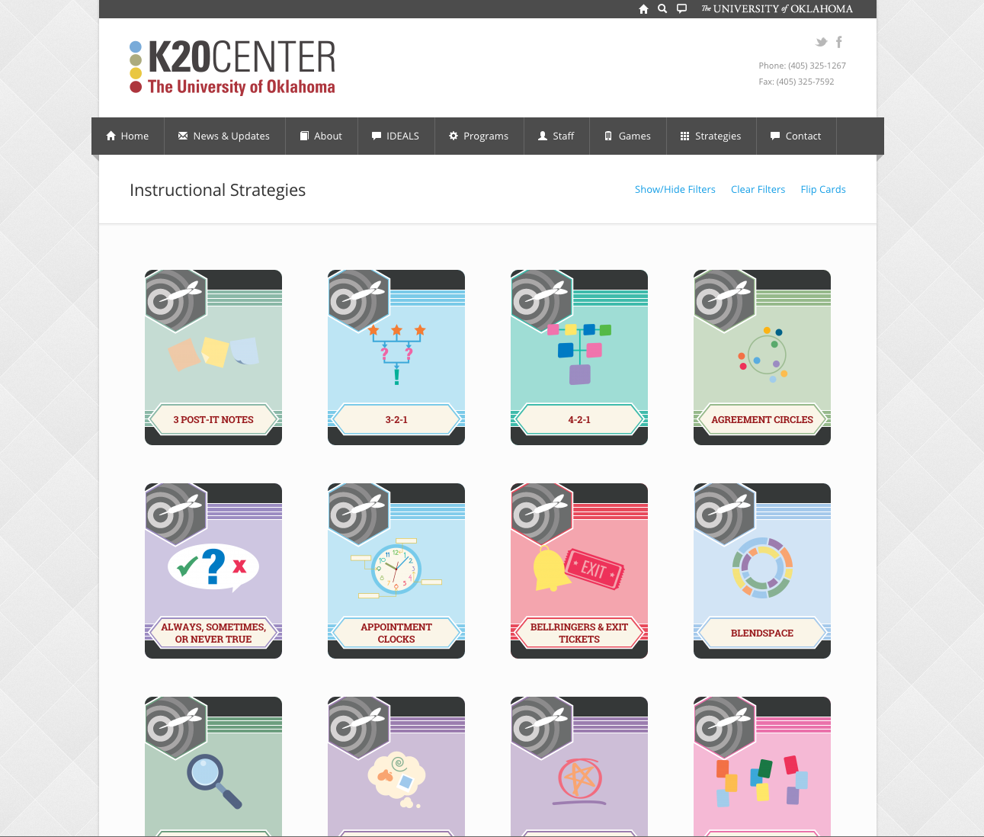
K20 STRATEGIES
https://learn.k20center.ou.edu/strategy/find.html

Slide 17
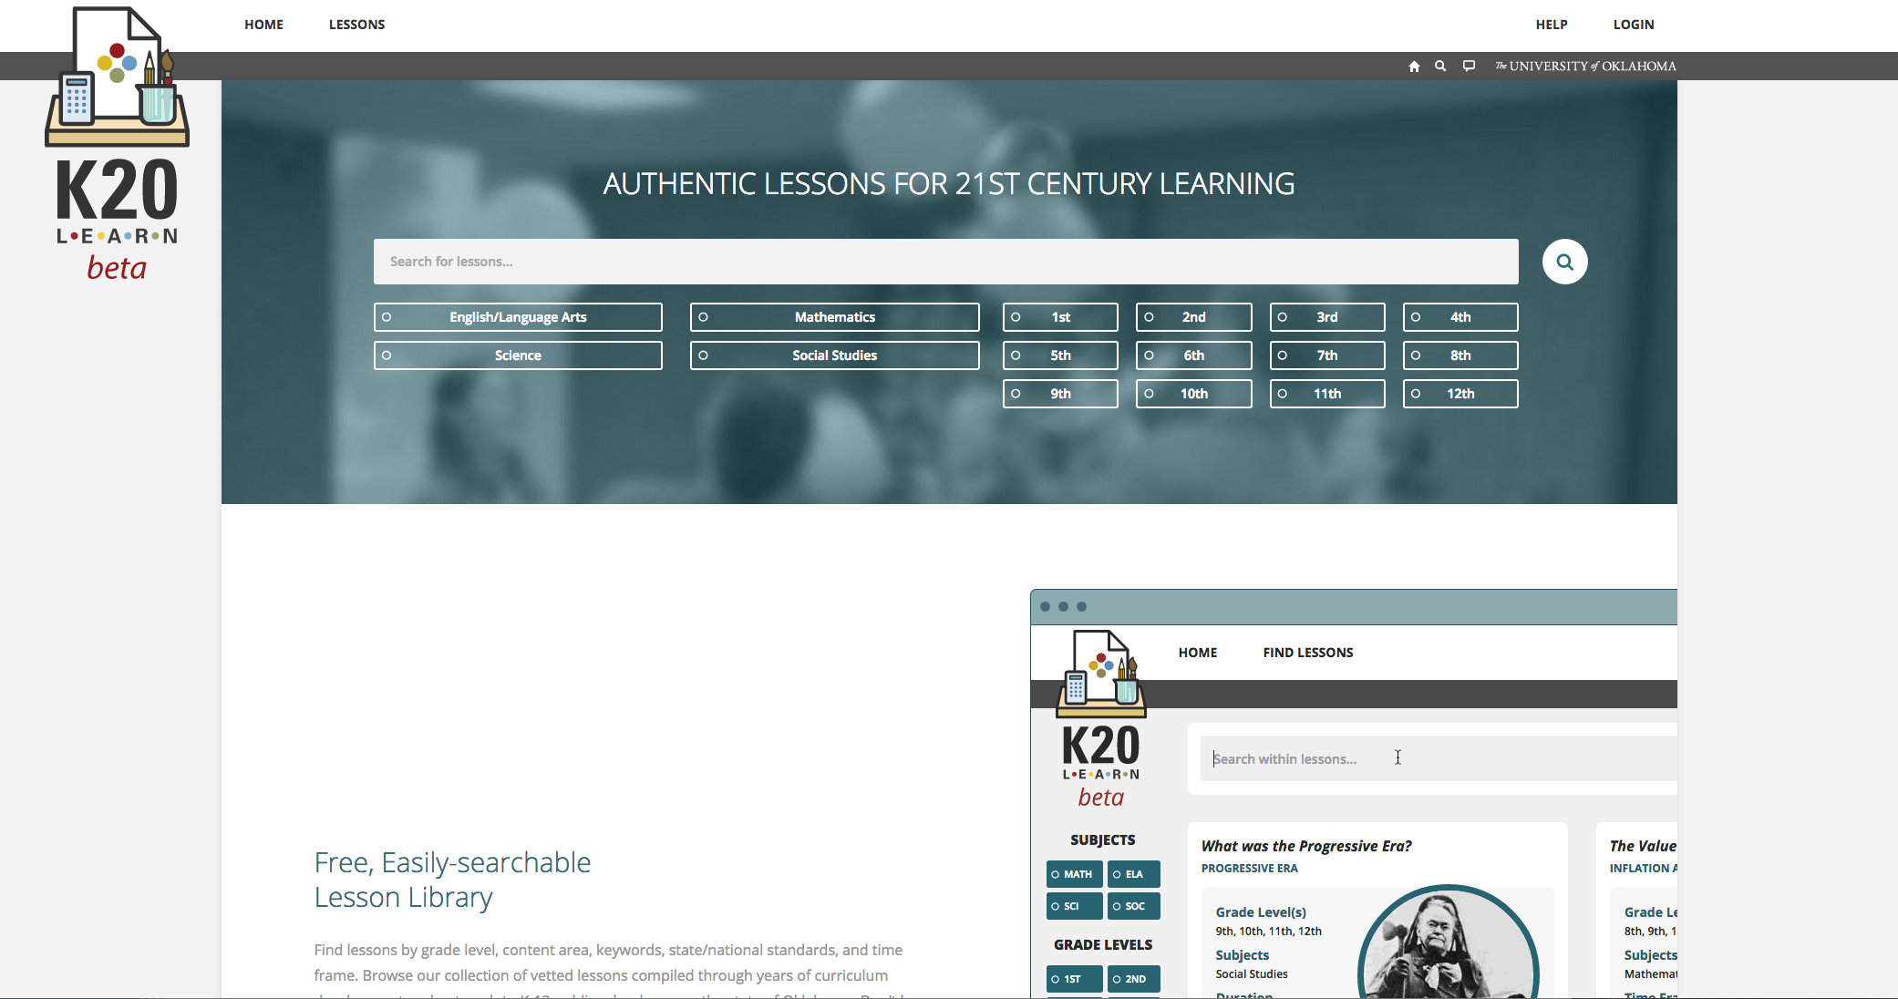
K20 LEARN
learn.k20.ou.edu

Slide 18
EVALUATION
Please complete evaluation before leaving
Your feedback and responses are important!

