Slide 2
Reading Realities
Using E-Readers to Engage and Support Students’ Critical Reading Skills

Slide 3
Think-Pair-Share
How do we engage students in reading?
Notes:
This is the essential question for the PD. May need post-it notes.
Participants will think and discuss this question. They will share best practices and activate prior knowledge.

Slide 4
Objectives
Identify the features of a Kindle e-reader
Experience a mini-lesson utilizing the Kindle and Google Expeditions
Reflect on how Kindles can be used in the classroom for reading activities and to increase student engagement
Notes:
By the end of this session:
Participants will identify the features of a Kindle E-Reader.
Participants will experience a mini-lesson utilizing the E-Reader and Google Expeditions technology.
Participants will reflect on how E-Readers can be used in the classroom for reading activities and increasing student engagement.

Slide 5
GEAR UP for MY SUCCESS Goals
Increase cohort academic performance and preparation for Postsecondary Education (PSE).
Increase high school graduation and PSE participation.
Increase student educational expectations and increase student and family knowledge of PSE options, preparation, and financing.

Slide 6

How familiar are you with a Kindle?
1—I never or rarely use a Kindle e-reader.
2—I have used a Kindle occasionally.
3—I use a Kindle and am familiar with its features.
This Photo by Unknown Author is licensed under CC BY-SA-NC

Slide 7
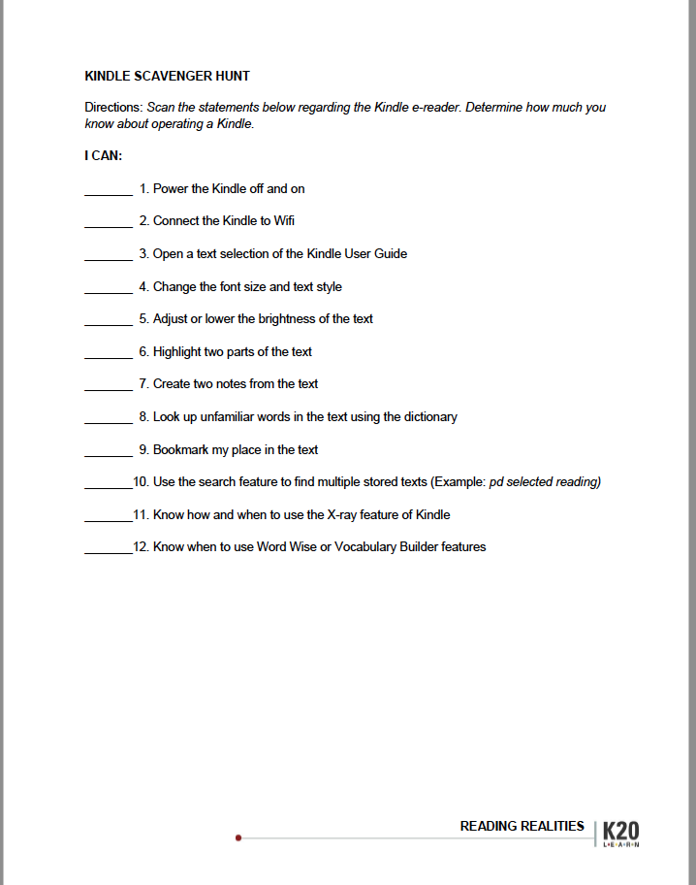
E-Reader Scavenger Hunt
Notes:
Engage: no more than 15 to 20 minutes
Scavenger Hunt on Kindle (fold the line, small group-- fist to five activity, how familiar are you with Kindles or E-Readers), help them find the features (dictionary, vocabulary builder, bookmarks, notes, changing the font/size/spacing, etc.) text to speech
Interest in Reading - what it is?

Slide 8
The New Colossus
ELA 7th or 8th Grade
Model Lesson for E-Readers
Notes:
Explore:
Notes for lesson: https://docs.google.com/document/d/11gvQMt_NZT-hRlP2PcIs7tkIBBoPMy178xTnKcDLEW8/edit
Mini/model 5E Lesson
Engage -
Explore - Gutenberg press book to sample; embedded annotation strategies, highlight main ideas?, make a note? use of the dictionary Vocabulary builder (quick quiz trade), bookmark feature
Explain - Share a main idea from reading, characterization or setting,
Extend - VR connections and extensions (refine and dig in a little deeper - would be centered around the reading in the model lesson - are they exploring settings such as timeframe, culture w/in reading, dress/outfits of a time period, etc.)
Evaluate - Reflection 3-2-1

Slide 9
Essential Questions:
How does the text inform us of an author's perspective?
What is the poem's message about the Statue of Liberty?

Slide 10
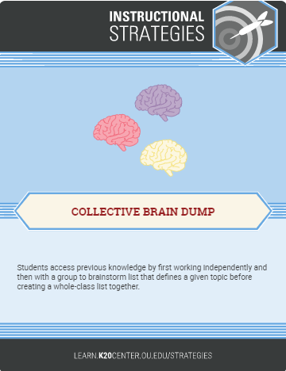
Collective Brain Dump Activity
With your group, brainstorm everything you know about the Statue of Liberty.
You have five minutes.
Online Timer
Notes:
Have groups share out what they know after the five minutes. Create a master list of facts about the Statue of Liberty Clear up any misconceptions.
Tell participants that today they will learn more about an author’s viewpoint of the Statue of Liberty.

Slide 11
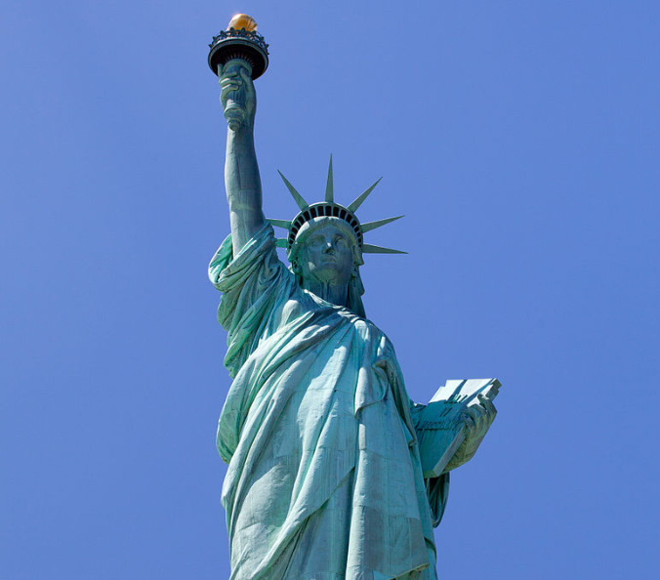
Read-ALong
Find the poem on your e-reader.
Read silently as the poem “The New Colossus” is read aloud.
Notes:
Facilitator reads aloud the poem.

Slide 12

Vocabulary Builder Activity
Highlight at least five unfamiliar words in the poem.
Using the poem’s phrases as clues, try to predict what these words mean.
Compare your prediction with the E-reader dictionary meaning.
Notes:
Pass out the vocabulary builder handout. Ask participants to highlight 5 unfamiliar words and try to predict their meaning on the vocabulary builder.
Ask participants to read aloud the phrase in the poem with an unfamiliar word and what the word means in context.

Slide 13
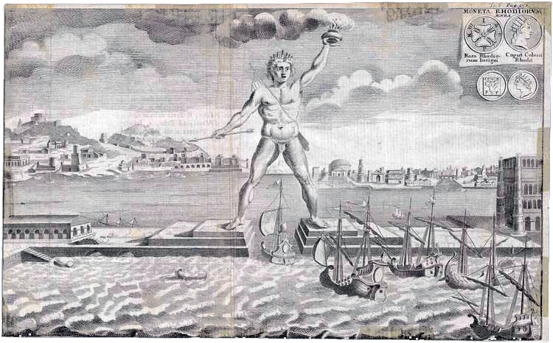
The “First” Colossus
Colossus of Rhodes built in 280 BC
Stood in the harbor of Rhodes so that ships could only enter through its feet
Constructed to celebrate a military victory over Cyprus
The same height and size as the Statue of Liberty
Notes:
Image source: Colossus of Rhodes Wikimedia.
The facilitator reads aloud the first two lines of the poem again. Tell participants that the author Emma Lazarus is comparing the Statue of Liberty with the first statue of that size in the ancient world. Share facts about the Colossus of Rhodes on the slide. How is the author comparing and contrasting the two statues?

Slide 14
Categorical Highlighting
Highlight words or phrases that portray a positive viewpoint about the Statue of Liberty.
Highlight negative words or phrases in the poem.
Create a note on the Kindle about each highlight, recording either a positive or negative comment.

Slide 15
Pairing and Sharing
With your partner, share your positive and negative highlights and why you identified them as such.
Notes:
The facilitator may wish to pair square the participants for this activity.

Slide 16
Summary
With your partner or group, write a response to these questions:
What is the author’s viewpoint of the Statue of Liberty?
What is the author’s viewpoint of new immigrants coming to the United States?
Notes:
Tell participants that the actual lesson has more activities with it but this professional development features how the Kindle can be used to effectively analyze text.

Slide 17
Google Expeditions
Take a virtual field trip to New York Harbor and Ellis Island here.
Notes:
https://www.tes.com/en-us/teaching-resource/poetry-analysis-googleexpeditions-lesson-11385078

Slide 18
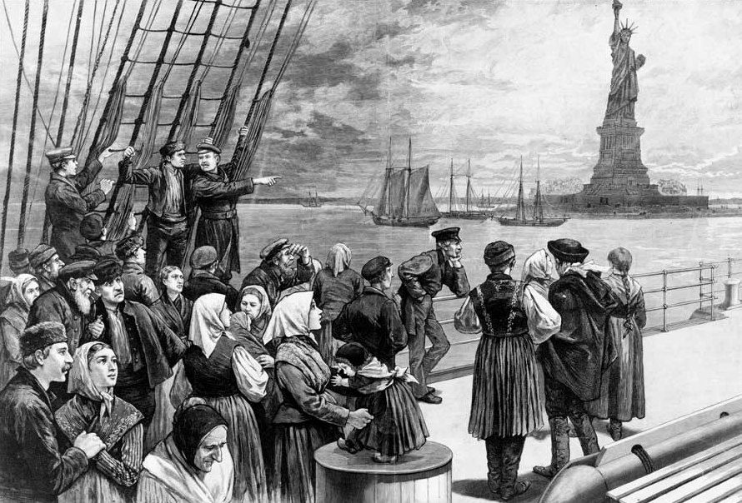
Wordle activity
Imagine you are a new immigrant to the U.S. Consider your thoughts about coming to a new country and entering New York Harbor. Your first sight is the Statue of Liberty.
Jot down one or two words about your thoughts or feelings.
Notes:
This activity can be done after participants have taken a Google Expedition tour of Ellis Island. The summary of the previous slide can also end the lesson.Listen to or read aloud the poem again You may wish participants to listen to the audio only from the YouTube video. Ask them to jot down a few words and paste those into a wordle at wordle.net

Slide 19
Why-Lighting
Highlight and annotate as you read the article on your Kindle, titled:
E-Readers: Powering Up for Engagement
Twyla Miranda, Kary A. Johnson, and Dara Rossi-Williams
How do we engage students with e-readers?
Notes:
Explain:
How does this model lesson/strategies/resources enhance student engagement and critical reading skills
Use this Article and participants will read on the E-Reader itself - Use the instructional strategy Categorical Highlighting to identify how we engage students with using e-readers? http://www.ascd.org/publications/educational_leadership/jun12/vol69/num09/E-Readers@_Powering_Up_for_Engagement.aspx ****Teacher Note: Text to Speech does exist on these specific kindle, but only with the bluetooth headphones/speakers.

Slide 20
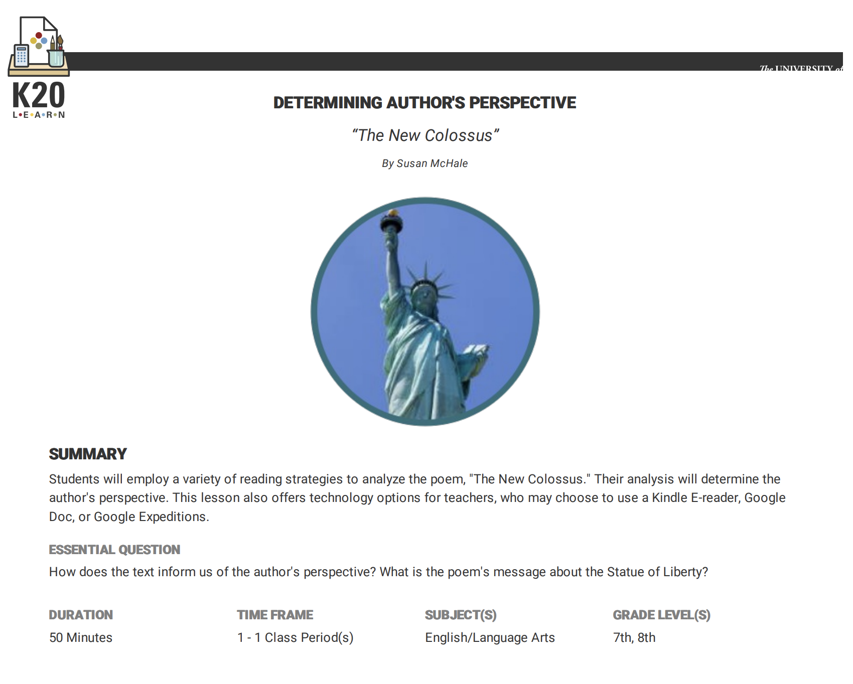
How did the mini-lesson support the use e-readers for engaging students?
or
How were e-readers used to engage students throughout the mini-lesson?
Notes:
Allow participants to discuss and make connections between what they experienced in the lesson and what the Educational Leadership article says e-readers should do to engage students

Slide 21
Extend
How can we use the Kindle e-reader and Google Expeditions to engage students in reading?
How will we be mindful of copyright law and fair use?
Notes:
Extend: Applications- how can we use this in our classroom. How will we plan for use in our school (used with other content areas/advisory)? Include discussion of the Resource page handout. Exclusive to ELA (when used more often and embedded, teachers are more likely to learn and use) Copyright issues discussion
Reading of embedding literacy with E-Readers - looking for other examples of the use of E-Readers with reading programs.
https://company.overdrive.com/education/k-12-schools/ - Overdrive Education for schools

Slide 22
3-2-1 Actvity
List 3 instructional applications you plan for e-readers.
Record 2 questions or concerns you still have.
Brainstorm 1 idea for using Google Expeditions.
Notes:
Evaluate:
I Used to Think, But Now I Know/ 3-2-1: Three uses I see for E-Readers
Two questions or concerns I still Have
One idea for using a Google Expedition
Discuss and address these items as you close the PD session.
Rapid Feedback form

Slide 23

School email
(No Participant ID is required.)
trek.k20center.ou.edu/oe/
Notes:
***This slide MUST be edited with the correct TREK web address.***
Click on the link in the orange box to edit the numbers at the end and the QR code.

Slide 24
Follow-Up Session

Slide 25
S.C.O.R.E. Reflections
What Strategy was used with e-readers or Google Expeditions?
What went well that we can Celebrate?
What Obstacles did you encounter while using this strategy and tech?
What Refinements would you make moving forward when using this lesson again?
Record Extra notes from others.
Notes:
SCORE Sheet - PLC
Ask Teachers what lesson they used and how would they revise it moving forward or work to begin creating a new lesson for future use.

