Slide 1
Up Your Game
Advancing Readiness Through Gaming
Notes:
Table tents with specific games, participants sit according to the game they played.

Slide 2



Welcome
Lindsay Hawkins
Professional Development
Writer & Editor
K20 Center | University of Oklahoma
lhawkins@ou.edu
405.325.5545
Lindsay Williams
Professional Development
Coordinator
K20 Center | University of Oklahoma
lindsay.williams@ou.edu
405.325.9203
Scott Wilson
PI/Project Director
K20 Center | University of Oklahoma
scott.wilson@ou.edu
405.325.2608
Notes:
(Lindsay H)

Slide 3
Learning Goals & Agenda
Explore the implications of engagement and motivation on student learning.
Compare the pedagogical supports facilitated by games with traditional teacher-centered instruction.
Agenda
Engage | Meaningful Learning
Explore | Connecting Motivation & Learning
Explain | The Student & Learning
Explain | The Learning Experience
Extend | Preparing to Advocate

Slide 4
Meaningful Learning
Notes:
(Lindsay W)

Slide 5

Meaningful Learning
Reflect on a meaningful childhood learning experience.
What stood out to you?
What made it meaningful?
Capture and illustrate this experience on the three frame comic strip.
Notes:
(Lindsay W)
Was this your typical learning experience/environment?

Slide 6
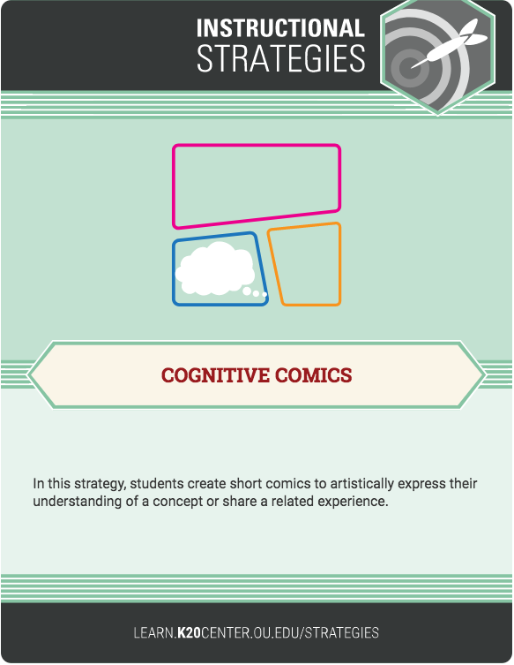
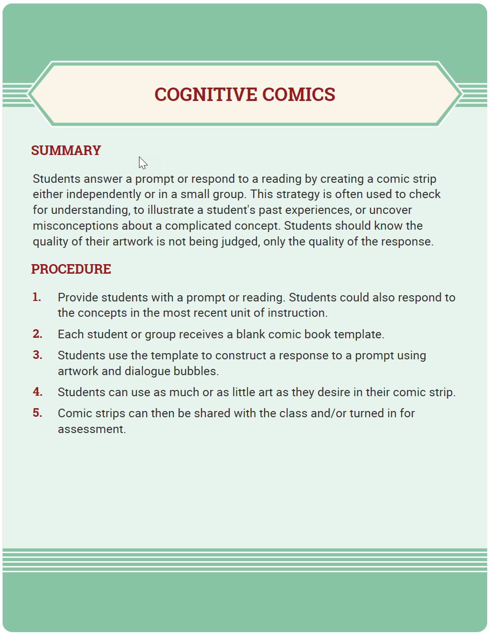
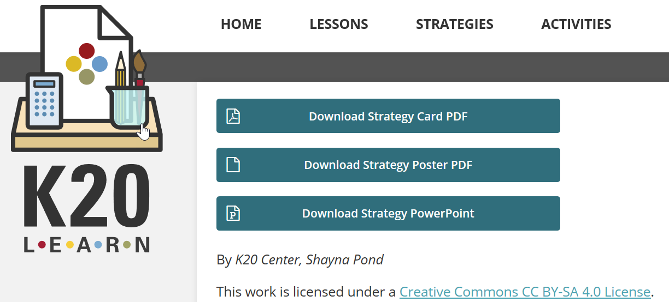
K20 Center’s
LEARN Instructional Strategies
Notes:
(Lindsay W)
Introduce the Strategy cards they have to take home today.

Slide 7
Connecting Motivation & Learning
Notes:
(Scott)

Slide 8
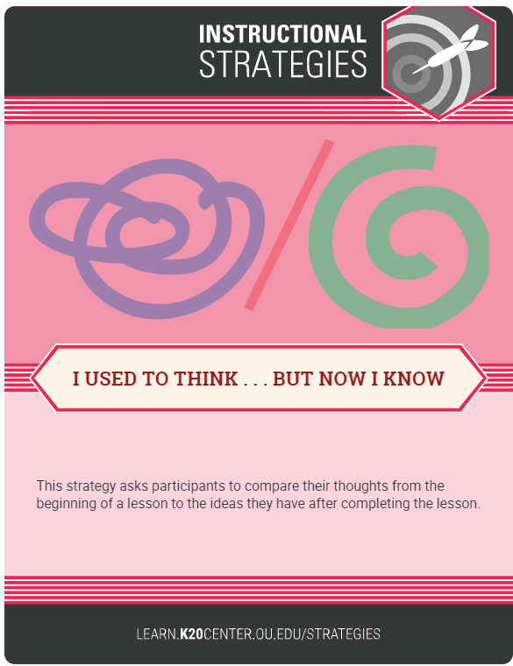

K20 Center’s
LEARN Instructional Strategies
PROCEDURE
Participants will use an online polling system to offer your insights on engaging students in their learning by answering the question “Describe how to best engage students in their learning?”
We will review research on student motivation and engagement;
After this short discussion, you will be asked to reflect on the topic or concept again, completing a second online poll by sharing your insights on “What instructional elements support engaged learning?”

Slide 9



I USED TO THINK . . . BUT NOW I KNOW
Notes:
(Scott)

Slide 10

PROCEDURE
Participants will use an online polling system to offer your insights on engaging students in their learning by answering the question “Describe how to best engage students in their learning?”
We will review research on student motivation and engagement;
After this short discussion, you will be asked to reflect on the topic or concept again, completing a second online poll by sharing your insights on “What instructional elements support engaged learning?”
Notes:
(Scott)
We have PowerPoint slides that you can download and edit for individual lessons and activities

Slide 11
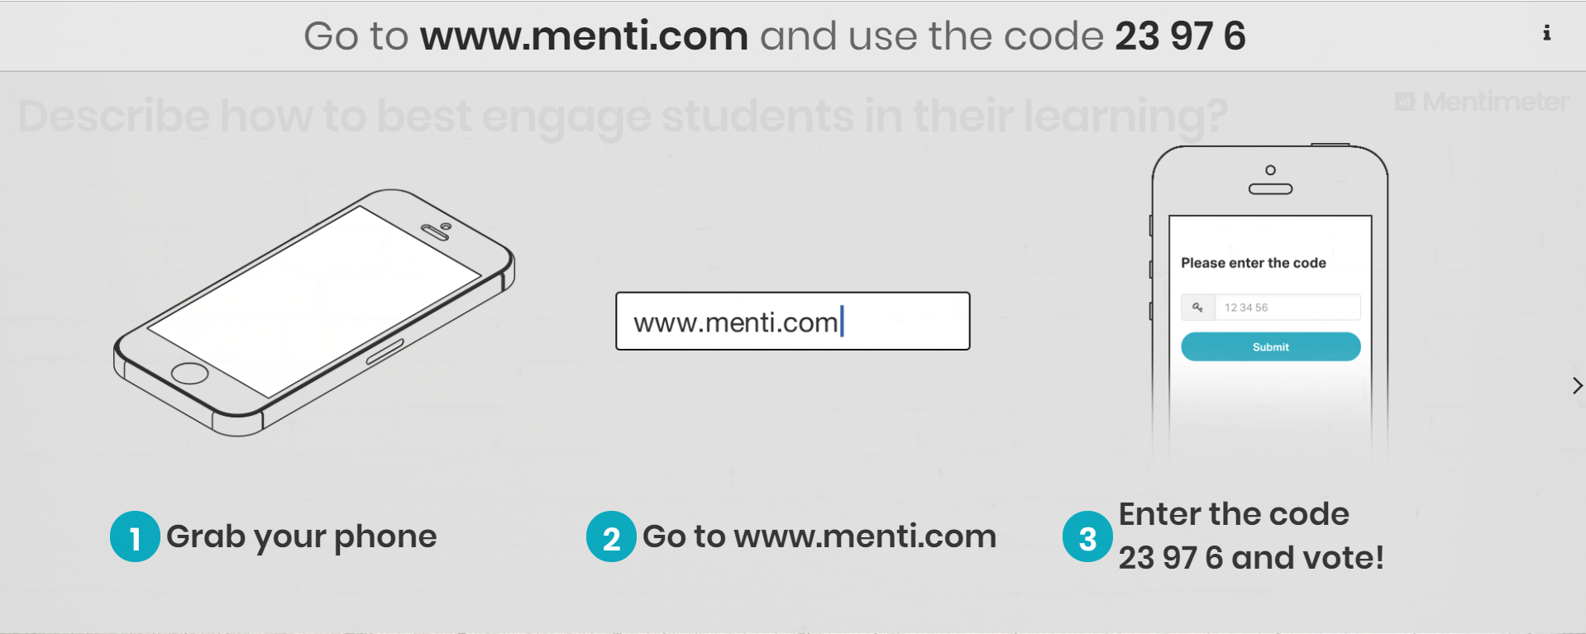
Take 2 minutes and….
Notes:
(Scott)

Slide 12
Motivation
Deci and Ryan’s (1985 & 1991) Self-determination theory (SDT) is one of the best known theories with the factors of:
  intrinsic motivation,
  extrinsic motivation, and
  amotivation.
Academic motivation can be expressed as the elements that affect students to adapt to school and learning environment, show high performance, and succeed in getting a degree.

Slide 13
Motivation | Self Determination Theory
Intrinsic Motivation
Doing an activity for itself, and the pleasure and satisfaction derived from participation.
Extrinsic Motivation
A wide variety of behaviors which are engaged in as means to an end and not for their own sake.
Amotivation
Do not perceive contingencies between outcomes and their own actions and experience feelings of incompetence and expectancies of uncontrollability
Vallerand, R. J., Pelletier, L. G., Blais, M. R., Briere, N. M., Senecal, C., & Vallieres, E. F. (1992). The Academic Motivation Scale: A measure of intrinsic, extrinsic, and amotivation in education. Educational and psychological measurement, 52(4), 1003-1017.
Notes:
Intrinsic Motivation: a student goes to class because he/she finds it interesting and satisfying to learn more about certain subjects.
Extrinsic Motivation: Researchers have proposed a continuum of Extrinsic motivators—external regulation, introjection, and identification. External regulation suggests behavior is regulated from the outside “My parents made me study before a test;” Next on the continuum is Introjection. Here a student begins to internalize the reason for his/her actions. “I study the night before a test because that’s what good students do.” When the behavior becomes valued and judge important for the individual, the motivation moves to Identification, so the student might say “I’ve chosen to study tonight because it is something important for me.”

Slide 14
Motivation | Impact
Fortier et al. (1995) report that the more a student is motivated toward education:
Higher school performance (grades)
(Beck et al., 1991; Boggiano et al., 1992; Gottfried, 1985, 1990; Grolnick et al., 1991; Boggiano et al., 1992; Loyd & Barenblatt, 1984; Meece & Holt, 1993; Mevarech, 1988)
Less likely to dropout
(Vallerand & Bissonnette, 1992; Ballerand et al., 1995; Vallerand & Senecal, 1992)
Report better cognitive engagement
(Ames & Archer, 1988; Meece et al., 1988; Miller et al., 1993; Nolen, 1988; Nolen & Haladyna, 1990; Pintrich & De Groot, 1990; Pokay & Blumefeld, 1990)
Are well adjusted in the school context, and
(Connell & Wellborn, 1990; Ryan & Connell, 1989; Vallerand et al., 1989)
Show higher levels of conceptual learning.
(Benware & Deci, 1984; Graham & Golan, 1991; Grolnick & Ryan, 1987; Ryan, Connell & Deci, 1985)
Fortier, M. S., Vallerand, R. J., & Guay, F. (1995). Academic motivation and school performance: Toward a structural model. Contemporary educational psychology, 20(3), 257-274.

Slide 15
Engagement
Researchers (Ryu & Lombardi, 2015; Fredricks et al., 2016) suggest there are three primary dimensions of student engagement:
  Behavioral
  Cognitive
  Emotional
Student Engagement has been conceptualized, by researchers, as the heightened, simultaneous experience of concentration, interest, and enjoyment (Shernoff, 2013). It is a multidimensional construct that is highly dynamic, fluctuating, context-dependent, and interactive.
Shernoff, D. J. (2013). Optimal learning environments to promote student engagement. New York: Springer

Slide 16
Engagement | The Three Dimensions
Behavioral
The consistency of effort, participation, attendance, homework and other desired academic behaviors.
Cognitive
The investment in learning, depth of processing, and/or the use of self-regulated metacognitive strategies.
Emotional
The students affect and emotions in schools, such as interest, boredom, or anxiety.
Shernoff, D. J., Kelly, S., Tonks, S. M., Anderson, B., Cavanagh, R. F., Sinha, S., & Abdi, B. (2016). Student engagement as a function of environmental complexity in high school classrooms. Learning and Instruction, 43, 52-60.

Slide 17
Engagement
The contextual perspectives of student engagement highlight the malleability of engagement and the role that the learning environment and its social agents, likes teachers, peers, and parents, play in directly affecting engagement or indirectly through student motivation (see e.g., Pianta, Hamre, & Allen, 2012; Raftery, Grolnick, & Flamm, 2012).
Liem, G. A. D., & Chong, W. H. (2017). Fostering student engagement in schools: International best practices.

Slide 18
Engagement | Impact
Quin (2017) reports that students who
demonstrate low engagement are often disruptive, have low attendance, or fail to complete academic work
(Conner & Pope, 2013; Newmann, Wehlage, & Lamborn, 1992).
are moderately engaged behave in class, generally attend school, and tend to complete work but with “little indication of excitement, commitment, or pride” (Conner & Pope, 2013; Newmann, Wehlage, & Lamborn, 1992).
are engaged at school are more likely to experience academic success and positive adolescent development outcomes
(Chase, Warren, & Lerner, 2015; Jimerson, Campos, & Greif, 2003).
Quin, D. (2017). Longitudinal and contextual associations between teacher–student relationships and student engagement: A systematic review. Review of Educational Research, 87(2), 345-387.

Slide 19
Learning Environment | Role in Engagement
According to Shernoff et al. (2017)…
“The immediate learning environment is considered to be among the most salient factors in children’s ability to learn”
(Bronfenbrenner & Ceci, 1994)
“School contexts supporting students’ autonomy, relatedness, and competence have been shown to predict favorable learning and achievement outcomes”
(Allen, Pianta, Gregory, Mikami, & Lun, 2011)
Learning environments should maintain a “simultaneous presence of both environmental challenge and environmental support”
(Shernoff et al., 2016)
Shernoff, D. J., Ruzek, E. A., & Sinha, S. (2017). The influence of the high school classroom environment on learning as mediated by student engagement. School Psychology International, 38(2), 201-218.

Slide 20
Learning Environment | Environmental Challenge
The “challenges, tasks, activities, goals, and expectations intended to guide student action or thinking; these are prescriptions for desired behavior”
(Hektner & Asakawa, 2001)
Aspects of Environmental Challenge, include:
Clear goals (Dickey, 2005),
Clear and high expectations (Wang & Eccles, 2013),
Opportunities to explore and solve meaningful problems (National Research Council, 1999),
Mastery of new skills (Ladd, 1999),
Teachers' high expectations for students' success (Allodi, 2010), and
Relevance of school activities to students' real lives (Meece, 1991).
Shernoff, D. J., Ruzek, E. A., & Sinha, S. (2017). The influence of the high school classroom environment on learning as mediated by student engagement. School Psychology International, 38(2), 201-218.
Notes:
Environmental Support is influenced by both motivational support (students’ intrinsic motivation (Sansone & Harackiewicz, 2000), autonomy (Reeve, 2006), interest development (Hidi & Renninger, 2006), competence (Urdan & Turner, 2005), and self-efficacy (Bandura, 1977)) and supportive relationships (teacher-student relations and rapport (Roorda, Koomen, Spilt, & Oort, 2011) ).

Slide 21
Learning Environment | Environmental Support
The “instrumental, social and emotional resources made available to help students reach environmental challenges”
(Zhang, Scardamalia, Reeve, & Messina, 2009).
Elements of Environmental Support that have been related to student engagement include:
Supportive relations with the teacher (Skinner & Belmont, 1993) and peers (Akey, 2006),
Teachers' support for autonomy (Reeve, 2006),
Peer acceptance (Hughes & Kwok, 2006), and
Immediate feedback (Dickey, 2005)
Shernoff, D. J., Ruzek, E. A., & Sinha, S. (2017). The influence of the high school classroom environment on learning as mediated by student engagement. School Psychology International, 38(2), 201-218.
Notes:
Environmental Support is influenced by both motivational support (students’ intrinsic motivation (Sansone & Harackiewicz, 2000), autonomy (Reeve, 2006), interest development (Hidi & Renninger, 2006), competence (Urdan & Turner, 2005), and self-efficacy (Bandura, 1977)) and supportive relationships (teacher-student relations and rapport (Roorda, Koomen, Spilt, & Oort, 2011) ).

Slide 22
Game-Based Learning
Researchers (Wouters, 2011) have defined a game-based learning experience as a goal-directed competitive activity (against the computer, another player, or oneself) that is conducted within a framework of agreed rules (Lindley, 2004) and constantly provides feedback to players so they may monitor their progress towards the goal (Prensky, 2001).
Wouters, P., Van der Spek, E., & Van Oostendorp, H. (2011). Current practices in serious game research: A review from a learning outcomes perspective. Games‐based learning advancements for multisensory human computer interfaces: techniques and effective practices, 232-55.

Slide 23
Game-Based Learning | Engaging Learners
GBL environments incorporate design elements (goal orientation, task challenge, clear standards, consequences, performance and feedback) that address the three dimensions (behavioral, emotional, and cognitive) of engagement.
(Ge & Ifenthaler, 2017; Dickey, 2005).
Researchers have found that GBL facilitates intrinsic motivation and student interest due to the novelty of the learning experience
(Huang, 2011)
Notes:
Environmental Support is influenced by both motivational support (students’ intrinsic motivation (Sansone & Harackiewicz, 2000), autonomy (Reeve, 2006), interest development (Hidi & Renninger, 2006), competence (Urdan & Turner, 2005), and self-efficacy (Bandura, 1977)) and supportive relationships (teacher-student relations and rapport (Roorda, Koomen, Spilt, & Oort, 2011) ).

Slide 24
Game-Based Learning | Impacts Learning
Researchers report that Game-Based Learning…
narratives can aid in comprehension, reflection, evaluation, and inquiry, allowing learners to explore the cause and effect between elements
(Dickey, 2005)
designs support interactive problem solving, specific goals, adaptive challenges, well-timed feedback, learner agency, and uncertain outcomes to help foster student learning
(Shute & Ke, 2012)
approaches have benefits in engagement, drive, collaboration, and writing
(Groff, Howells, and Cranmer, 2010)

Slide 26
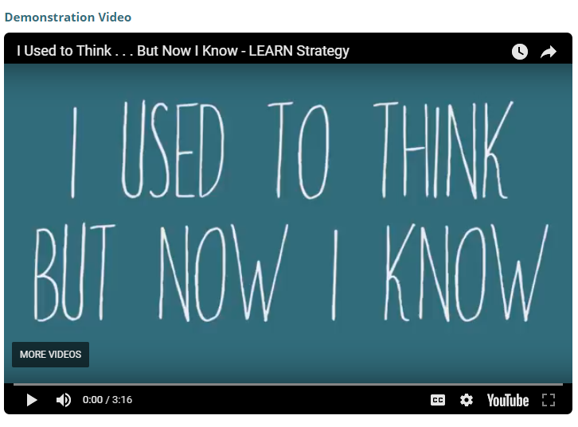
K20 Center’s
LEARN Instructional Strategies
Notes:
(Scott)
The site also has instructional videos for some strategy cards

Slide 27
The Student & Learning

Slide 28
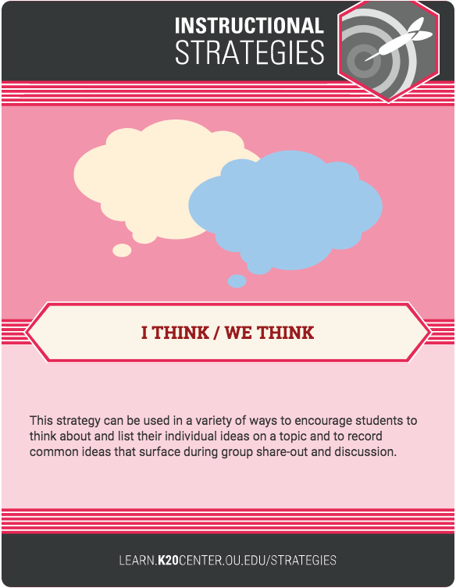
K20 Center’s
LEARN Instructional Strategies
PROCEDURE
Participants will group at new tables based on the selected character.
At new table groups, use the provided scenario and individually write an ‘I Think’ statement answering the following questions
  What qualities within this environment promote motivation and engagement for this student?
  What adjustments could be made to promote this student’s motivation and engagement?
Character groups use their ‘I Think’ statements and write a group ‘We Think’ statement to take back to your original table.
Notes:
(Lindsay H)
Introduce strategy.

Slide 29
PROCEDURE
Participants will group at new tables based on the selected character.
At new table groups, use the provided scenario and individually write an ‘I Think’ statement answering the following questions
  What qualities within this environment promote motivation and engagement for this student?
  What adjustments could be made to promote this student’s motivation and engagement?
Character groups use their ‘I Think’ statements and write ‘We Think’ statement to take back to your original table.
Notes:
(Lindsay H)
Introduce strategy.

Slide 30
The Student & Learning Environment | Motivation & Engagement
What qualities within this environment promote motivation and engagement for this student?
What adjustments could be made to promote this student’s motivation and engagement?
Notes:
(Lindsay H)
Identify the character cards, each person selects one character.
Group tables by character. Ex: Table 1 – Brian, Table 2 – Allison, Table 3 – John, Table 4 – Andrew, Table 5 – Claire (may have to have double table numbers so Tables 1 & 2 – Brian, Tables 3 &4 – Allison, etc)
Individuals look at the scenario and create an ’I Think’ statement for these two questions
Discuss the needs for motivation of their character within the context of the scenario.
Table groups then create a ‘We think’ statement that answers the two questions and take these back to their original table to share out among the mixed character cards.
Return to their original group (red cards, blue, green, etc.)

Slide 31
The Student & Learning Environment | Motivation & Engagement
In your original table group, share your ‘We Think’ statement.
Notes:
(Lindsay H)
Return to their original group (red cards, blue, green, etc.)
Take turns sharing out your We Think statements with your table.

Slide 32
Learning Experience
Notes:
(Lindsay W)

Slide 33
Learning Experience | Game-Based Learning
Link game play with literature
Notes:
Discuss with your group your gaming experience

Slide 34
Learning Experience | Game-Based Learning
How do games meet the motivation needs of the different students?
Pick two personalities to address how this game could challenge or support their learning needs.
Notes:
(Lindsay W. ?)This game meaning either the scenario we address as a whole group or the game they played before the session.

Slide 35
Learning Experience | Game-Based Learning
Data about the game
Not all games are created equal
Failure in games is okay, that is part of the learning process and building growth mindset.
Notes:
It’s not about the game itself, but what the game does for the learner and the learning environment.

Slide 36
Preparing to Advocate

Slide 37
Preparing to Advocate | Resources
K20 LEARN Site
  Lessons, Strategies, and Activities
K20 Center Games
  Mindset, Information Literacy, Financial Literacy, Stats, Biology, and Functions
Notes:
Do we still need this slide?
As you prepare to advocate, we have a few resources you may find helpful.

Slide 38
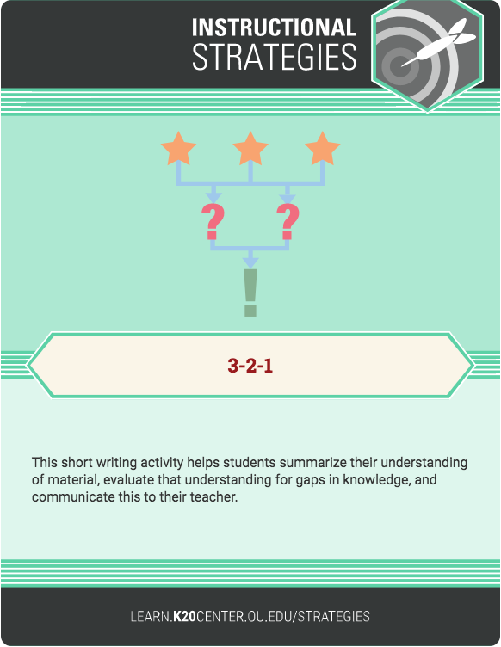

K20 Center’s
LEARN Instructional Strategies
PROCEDURE | 3-2-1
Considering your view of motivation, engagement, and learning environments, you have decided to advocate for game-based learning to be used within your schools. Take a few minutes to answer these three prompts.

Slide 39
PROCEDURE | 3-2-1
Identify three potential stakeholders (teachers, department chairs, administrators, etc.) who you could approach to share the benefits of using Game-Based Learning experiences to support learning.
Generate two statements that succinctly describe the value of GBL.
Think of one potential barrier stakeholders might have in using GBL and begin to consider strategies to overcome possible challenges.

Slide 40
Preparing to Advocate | Implementation
3 – Stakeholders to approach
2 – Benefits to discuss when promoting the use of games
1 – Potential obstacle

Slide 41
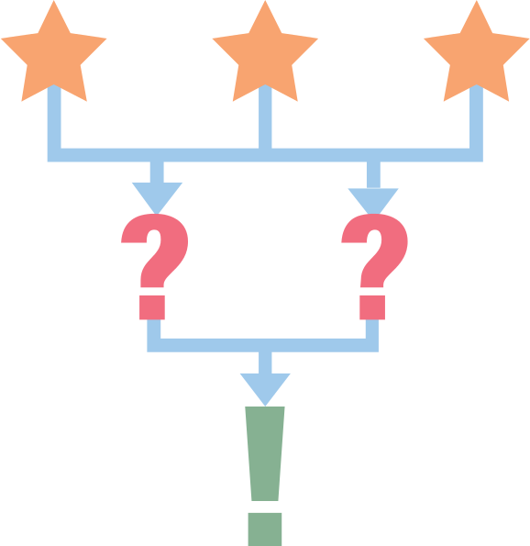
3-2-1

Slide 42
PROCEDURE | 3-2-1
Considering your view of motivation, engagement, and learning environments, you have decided to advocate for game-based learning to be used within your schools. Take a few minutes to answer these three prompts.

Slide 43
PROCEDURE | 3-2-1
Identify three potential stakeholders (teachers, department chairs, administrators, etc.) who you could approach to share the benefits of using Game-Based Learning experiences to support learning.

Slide 44
PROCEDURE | 3-2-1
TWO: Generate two statements that succinctly describe the value of GBL.

Slide 45
PROCEDURE | 3-2-1
Think of one potential barrier in these stakeholders using GBL and begin to consider strategies on how to overcome the challenge to realize the benefits of GBL.

Slide 46
PROCEDURE | 3-2-1
Considering the your view of motivation, engagement, and learning environments, you have decided to advocate for game-based learning to be used within your schools. Take a few minutes to answer these three prompts.
Identify three potential stakeholders (teachers, department chairs, administrators, etc.) who you could approach to share the benefits of using Game-Based Learning experiences to support learning.
Generate two statements that succinctly describe the value of GBL.
Think of one potential barrier in these stakeholders using GBL and begin to consider strategies on how to overcome the challenge to realize the benefits of GBL.

Slide 47
Thank You
Lindsay Hawkins
Professional Development
Writer & Editor
K20 Center | University of Oklahoma
lhawkins@ou.edu
405.325.5545
Lindsay Williams
Professional Development
Coordinator
K20 Center | University of Oklahoma
lindsay.williams@ou.edu
405.325.9203
Scott Wilson
PI/Project Director
K20 Center | University of Oklahoma
scott.wilson@ou.edu
405.325.2608

