Slide 1
How Does Authenticity Grow?
Personal Development

Slide 2
Learning Objectives:
Participants will engage in and analyze an authentic science learning experience, and reflect on it to determine the relevant components of authenticity.
Participants will be able to identify how their authentic learning experience aligns with a 5E lesson model.
Participants will maximize authentic instruction by practicing modification of existing 5E lessons for potential use in their classrooms with their students.
Notes:
Participants will engage in an authentic science learning experience and assess its authenticity.
Participants will identify how their authentic learning experience aligns with a 5E lesson model.
Participants will practice modifying existing 5E lessons to increase their authenticity for potential use with students.

Slide 3
5E Sticky Bars
How comfortable are you on a scale of 1–5 with teaching a lesson in the 5E lesson format?
Take a small yellow sticky note and place it above the number you feel reflects your comfort level.
Notes:
ENGAGE
Participants write a number on a sticky note and place it on a wall/poster to get a quick visual assessment of where the group is at in their understanding overall.

Slide 4
How Does Your Garden Grow?
Middle School Edition
Notes:
EXPLORE
https://learn.k20center.ou.edu/lesson/b5aef944bb8300a7bdb6f1a67f02fc49
Participants will work through the Engage, Explore, and Explain portions of this lesson as learners.

Slide 5
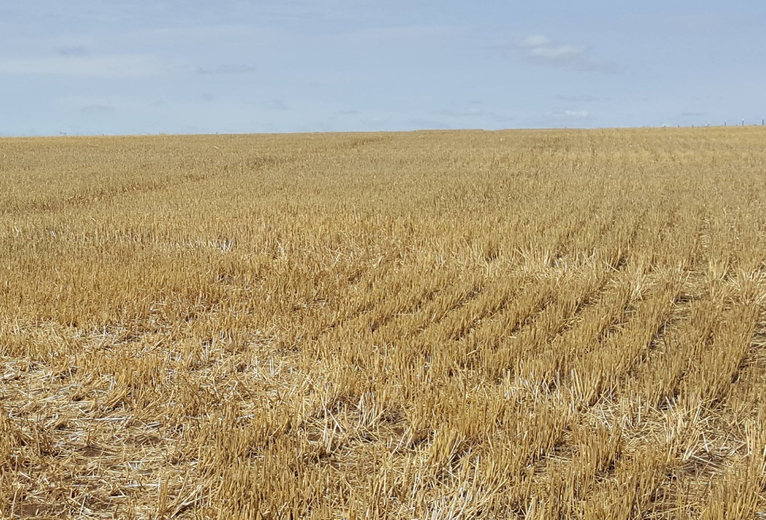
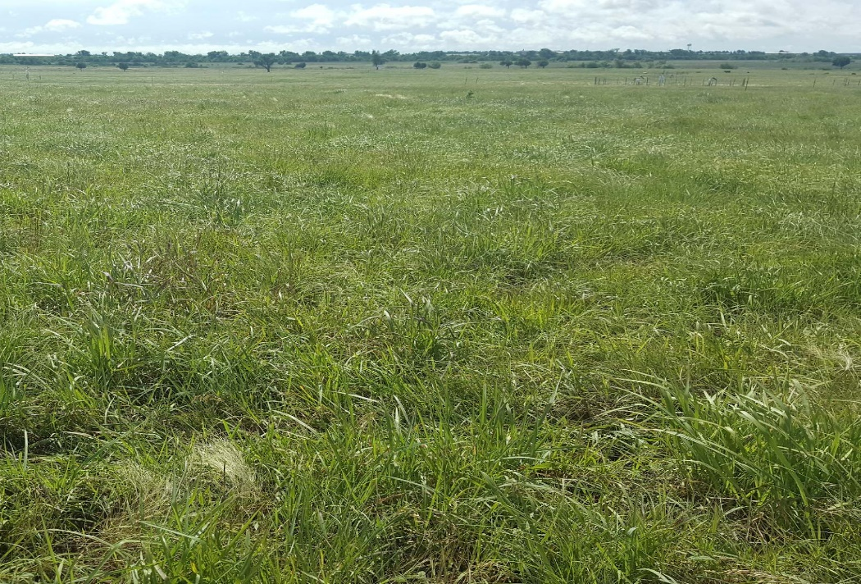
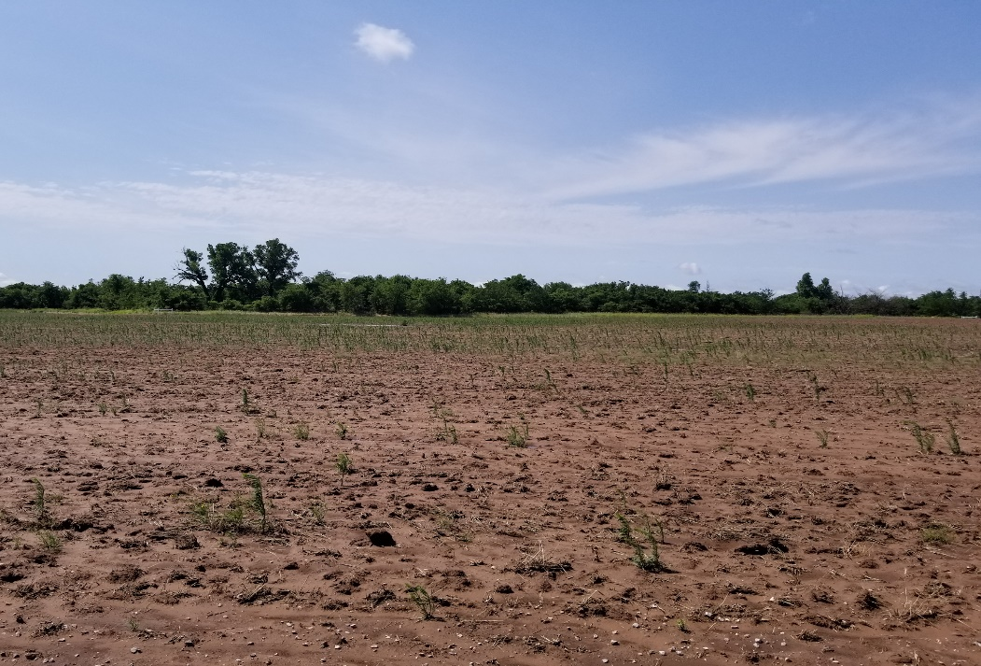
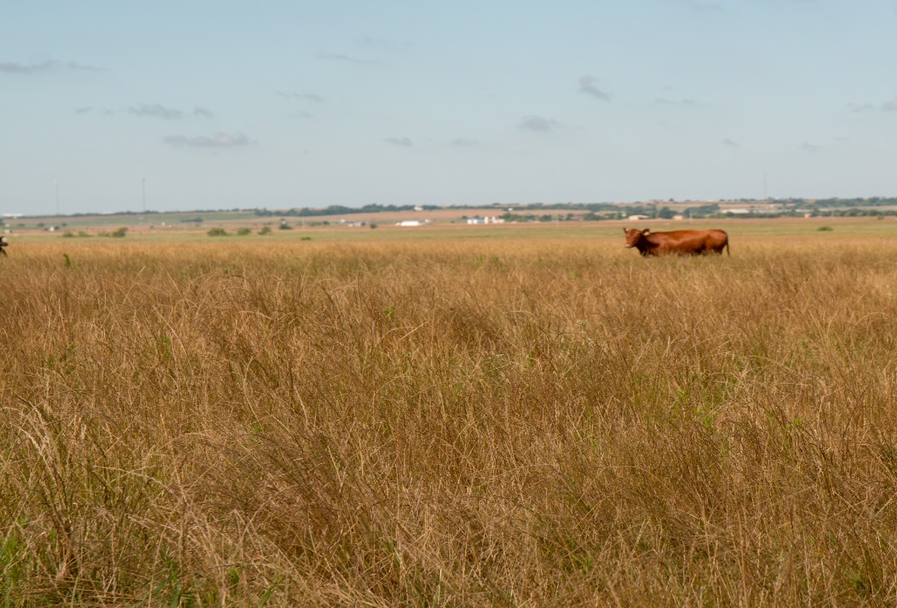
What do you notice?
What is the cause?
Harvested Wheat Fields
Grasslands
Notes:
Engage
Ask participants to reflect on what they observe in each photo, the differences they notice, potential causes for these differences, and what healthy flora might have that the unhealthy flora does not.
Photos: Heather Shaffery

Slide 6
Summarize what you think you know about these images in one sentence.
Harvested Wheat Fields
Grasslands
Notes:
Engage
After the discussion, ask students to summarize what they think they know about the images in one sentence. Effective sentences will essentially summarize the big takeaway each student got out from the conversation.

Slide 7
Soil Chemistry Investigation
Record the soil water sample type in your data table.
Dip each test strip into the sample.
Do not touch the sample with your fingers or put more than ½ the pH strip in the sample.
Wait for 50–60 seconds.
Compare the color of your strip/pads on the strip to the color chart as soon as time is up.
Record the measurement in your table.
Repeat for the next sample.
Notes:
Explore
Now that the students have a sense that soil may be important to plant health, have them test the soil types to determine the level of the nutrients present.
Provide each group with a soil test data sheet. In this PD we only ask the teachers to do the Nitrogen and pH tests in the interest of time and considerations of the mess other tests would generate.
Based on the specific directions for the soil test kit you have purchased, review the procedure for soil testing with your students. (*Note: If your kit requires the use of chemicals, be sure to check the SDS in advance for safety and disposal procedures.)
Have students document their process and results using tablets or their phone’s camera.
Prior Preparation
All of tests require a soil solution which is best to prepare at least a day before to get better results due to the nutrients leaching into the water.
Create a soil solution by adding 100 mg of soil and 200 mL of water to a beaker or other container.
Use the stirring rod or sticks to blend the mixture. (Clean the stirring rod thoroughly or use a different stirring utensil for each soil sample.)
If you are using test strips that require a color comparison, it might be necessary to filter the water sample before collecting data. Depending on how murky the soil makes the water, it is usually clean enough after 2-3 rounds of filtering through a double or triple layer of coffee filters.

Slide 8
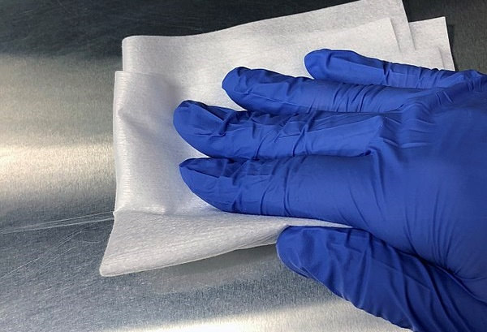
Soil Chemistry Clean-Up
Close the Nitrogen test strip bottles.
Put bottles and pH strips at the end of your table.
Wipe up any messes on your table.
Throw away garbage and gloves.
Blue Thunder Technologies. (5 Dec. 2017.). Polypropylene Clean Room. Commons.wikimedia.org. Retrieved from https://commons.wikimedia.org/wiki/File:Polypropylene_Clean_Room_-_Non-Shedding_Wipe.jpg
Notes:
Explore
Clean-Up
Have students clean up any soil and water messes and wash up surfaces as necessary.
Unless the testing materials have specific disposal instructions, trash and soil water can be disposed off in the regular trash and sink.
If any chemicals were added to the water samples, do not pour them down the drain without consulting their SDS sheets for disposal procedures.
To avoid clogs, do not pour any water with soil in it down drains.
Gloves should be removed by turning them inside out. (See a demonstration here if you are unfamiliar with the technique.) Goggles should be wiped clean/disinfected before being put away.

Slide 9
Soil and Soil Health Investigation
Soil Properties | Soil Health
Soil Chemistry | Nutrient Cycles
bit.ly/ExploreSources
Notes:
Explore
https://docs.google.com/document/d/1T2SkhC-cTzC__-a_VJppSG2Amb7wRLUCWeRcuKHAzgw/copy
Have participants work in groups to gather information about general soil science, soil health, and soil functions. Each participant should record important details in a Window Notes graphic organizer. They will leave the Nutrient Cycle box empty for now. Participants could also use Google Apps (e.g., Docs, Slides) to collaboratively fill out the notes.
Make the document of sources available to participants. Note that several of the sources are YouTube videos which may require headphones or space to not disturb other working groups.
In the interest of time, the source list can be narrowed down to a smaller number of options to explore.
Watch at least 1 video, read 1 article, and 2 infographics. If time left, continue on to more.

Slide 10
Soil and Soil Health Investigation
Soil Properties | Soil Health
Soil Chemistry
Notes:
Explore
As a whole group (PD), summarize the key points to create an anchor chart for each Window Notes box. The soil chemistry information can be incorporated into Soil Properties or Soil Health. Diagrams or drawings of soil horizons and details would also be helpful on an anchor chart.
Some questions to guide the summary discussion include:
What is soil?
How do we describe it?
What criteria factor into soil health?
What are the benefits of having healthy soil?
What soil management practices or strategies would improve soil health?

Slide 11
Breakout!
Soil Properties | Soil Health
Soil Chemistry | Nutrient Cycles
bit.ly/gardengrowbreakout
Notes:
Explain
Participants should work together to complete the How Does Your Garden Grow? Breakout. They should summarize the information in the Nutrient Cycles Window Note box and add to any other sections as necessary. After, create a final anchor chart for nutrient cycles and have students make connections among the Explore and Explain activities.

Slide 12
Soil and Soil Health Investigation
Soil Properties | Soil Health
Soil Chemistry | Nutrient Cycles
Notes:
Explain
Work together to create a final anchor chart for nutrient cycles. Then, have students make connections among the Explore and Explain activities.

Slide 13
Three Post-It Notes
Word
Phrase
Sentence
Summarize what you learned in the breakout using a single word and a short phrase.
Write each on a separate sticky note.
In one sentence, give an example of how nutrient cycles, soil health, and soil management practices relate to each other.
Write this on a new sticky note.
Notes:
Explain
Ask participants to use the Three Post-It Notes strategy in their small groups or individually. At this point only have them complete the Word and Phrase notes. Complete the same process to update the previous anchor charts (as necessary) and create the Nutrient Cycles chart.
Groups should attempt to create a single word and phrase. If they can’t narrow it down to a single example, ask that they limit their responses to one sticky per person (e.g., a group of 3 could have up to 3 words and up to 3 phrases.)
After updating/creating the anchor charts, help participants synthesize the conceptual pieces for themselves. At this point they should complete the Sentence part of the 3-Post It Notes activity. Each participant should create their own sentence, but they can work in groups to come up with their responses. There are other ways to direct participants’ knowledge construction, but they should at least work out the following connections:
the relationship between nutrient cycles and soil health (e.g., how cycles support healthy soil, how unhealthy soil might disrupt cycles)
how soil management practices support or supplement natural nutrient cycles
the impact of soil management practices on soil health

Slide 14
 | Extend | Evaluate
6th MS-LS2-3 | Students will construct a model of matter and energy transfers in their local ecosystem, or the ecosystem from which their soils were sampled. | Students add to their web models to include the environment in the flow of matter and energy within an ecosystem.
7th MS-LS1-5 | Students grow plants in several types of soil to determine: (1) optimal soil conditions for a specific type of plant, and/or (2) the effect of a specific soil health practice on plant growth. | Students present the results of their investigations, and explain the relationship between soil health and the growth of their plants.
8th MS-ESS3-4 | Students identify a threat to soil health and research the threat’s causes, impacts, and potential solutions. | Students produce a PSA about specific practices that support soil health.
Notes:
Rather than going through the Extend and Evaluate, give teachers a chance to look over what the activity would be for their grade level. Be sure to point out that since NGSS (which our OAS-S are based on) treats all MS standards the same, each track could theoretically be taught in any of the three grades.

Slide 15
Phases of Instruction
BEGINNING
MIDDLE
END
Draw a 3–5 panel comic illustrating how a lesson progresses in your science classroom.
INTRO
CONCLUSION
→
→
→
Notes:
EXPLAIN
Ask teachers to illustrate a general overview of how they would divide up their science lessons. Have a few share out to get a broad idea of the group’s classroom structures.

Slide 16
5E Overview:
5 Corners
ENGAGE
Which of the 5Es is the least important?
EVALUATE
EXPLORE
EXTEND
EXPLAIN
Notes:
EXPLAIN
Each E should be posted on the walls around the room. Participants arrange themselves near the E they feel is the least important one. In groups at each poster, participants should discuss their rationale and share out with the whole group. Ask participants to reflect on whether a lesson would be effective if an E was missing. They should come to the conclusion that all 5 Es are necessary in some form or another. (Note: The learning cycle model that preceded 5E didn’t have 5 steps; however, elements/purposes of the 5Es was embedded in the phases that are part of it.)

Slide 17
Inform, Verify, Practice vs. 5E
Traditional: (IVP) Inform-Verify-Practice | Piaget: Learning Theory | 5E Learning Cycle
Inform | Assimilation | Engage
 | Disequilibrium | Explore
Verify (Experiment) | Accommodation | Explain
Practice | Re-equilibration | Elaborate
 | Organization | Evaluate
Notes:
Note: The IVP slides are only for use if the participants rank themselves mostly 4 or 5 on the sticky bar activity.
The traditional model of teaching science is to tell the students the content they need to know, often through lecture and bookwork; maybe have students do an “canned” lab experiment with a predetermined outcome; and then students apply their understanding through additional bookwork, pen-and-paper types of activities, or “just for fun” activities. Not every learner experiences this, but it is by and large the way most teachers learned science as kids.
The result is that many teachers’ classroom instruction, by default, resembles their own.

Slide 18
Inform, Verify, Practice vs. 5E
Traditional: (IVP) Inform-Verify-Practice | Learning Theory (Piaget) | 5E Learning Cycle
Inform | Assimilation | Engage
 | Disequilibrium | Explore
Verify (Experiment) | Accommodation | Explain
Practice | Re-equilibration | Elaborate
 | Organization | Evaluate
Notes:
Research-based science instruction was developed out of Piaget’s Adaptation learning theory. Assimilation is fitting new information into your existing schema (i.e., it aligns with what you already know); disequilibrium occurs when new information doesn’t fit with your current schema (i.e., you don’t have a schema for it or it doesn’t match your understanding of the world); and accommodation occurs as you modify existing schema to fit or construct new schema to make sense of the new information. Assimilation and accommodation are not necessarily mutually exclusive processes. Learners reach re-equilibration when they have fully accommodated, and learning is solidified in the organization phase where the new/modified schema are integrated with other existing schema (i.e., connecting what you’ve learned to what you already knew).
Ask participants what they already know about Piaget’s adaptation model before walking through the steps. It may be useful to draw a visual flowchart-type model as you go. Before moving to the next slide, ask participants to to consider how adaptation is likely to align with the 5E model.

Slide 19
Inform, Verify, Practice vs. 5E
Traditional: (IVP) Inform-Verify-Practice | Learning Theory (Piaget) | 5E Learning Cycle
Investigate | Assimilation | Engage
 | Disequilibrium | Explore
“Inform” (Discuss & Inform if necessary) | Accommodation | Explain
Practice | Re-equilibration | Elaborate
 | Organization | Evaluate
Traditional: (IVP) Inform-Verify-Practice | Learning Theory (Piaget) | 5E Learning Cycle
Inform | Assimilation | Engage
 | Disequilibrium | Explore
Verify (Experiment) | Accommodation | Explain
Practice | Re-equilibration | Elaborate
 | Organization | Evaluate
Notes:
The steps in adaptation roughly align with the 5E in the way shown on the slide. In cases of dotted lines, this indicates that both are likely to be happening at the same time in one or both Es. The 5E instructional sequence model was developed from Piaget’s theories, which should be clear to participants now since they are already familiar or feel comfortable with the 5E model.
Prior to showing teachers this slide ask them to consider how adaptation aligns with 5E. Note that there is not one “right” answer per se and there is room for discussion, assuming participants can justify their choices.
After the white box disappears conclude the original IVP model will be visible. Ask for input on whether IVP aligns with learning theory or Piaget’s work, why or why not. It does not. The final portion of the slide swaps the I and V portions with a note of what “inform” actually means in the context of 5E. This is a good place to note that students are driving the Explain portion and formal instruction shouldn’t occur until they’ve had a chance to work through their own ideas first. The “inform” then would actually only occur in the sense of filling gaps, validating accurate understanding, and helping to guide students through misconceptions.

Slide 20
Phases of Instruction
BEGINNING
MIDDLE
END
How does your original comic compare to the 5E lesson model?
INTRO
CONCLUSION
→
→
→
Notes:
EXPLAIN
Ask a few teachers to share with the group in what ways their comic was aligned/not aligned to the 5E model.

Slide 21
5E Lesson Format Reflection
Engage?
Explore?
Explain?
Extend?
Evaluate?
Notes:
EXPLAIN
Provide 5E Lesson Roles handout and ask teachers to evaluate how well the Engage - Explain of the How Does Your Garden Grow? lesson aligns.

Slide 22
5E Sticky Bars Revisited
After going through the previous activities, has your comfort with teaching lessons in the 5E format changed?
Take a small blue sticky note and place it above the number you feel reflects your comfort level.
Notes:
EXPLAIN
Participants write a number on a sticky note and place it on a wall/poster to get a quick visual assessment of where the group is at in their understanding overall.

Slide 23
Authentic Lesson Reflection Tool & Rubric
Notes:
EXTEND
Teachers reflect on how authentic the Engage - Explain of the How Does Your Garden Grow? lesson was.

Slide 24
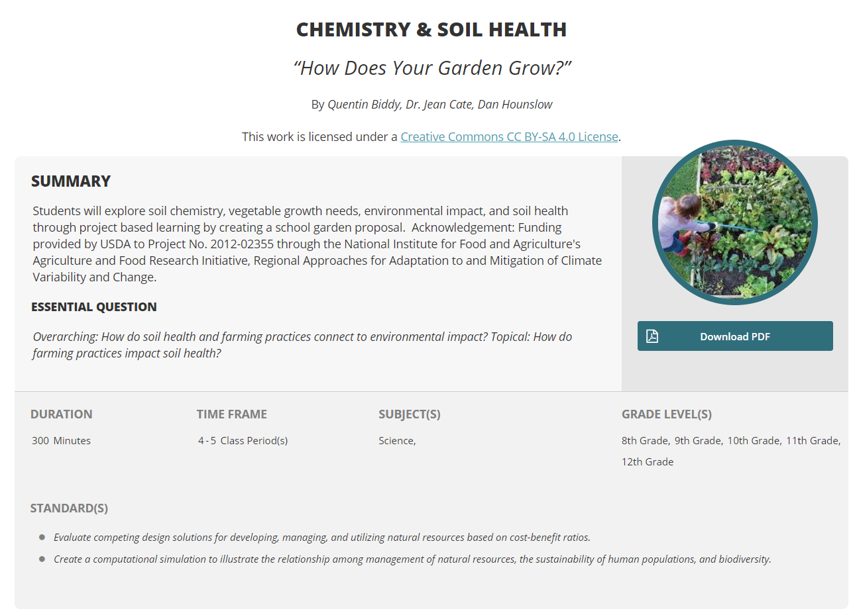
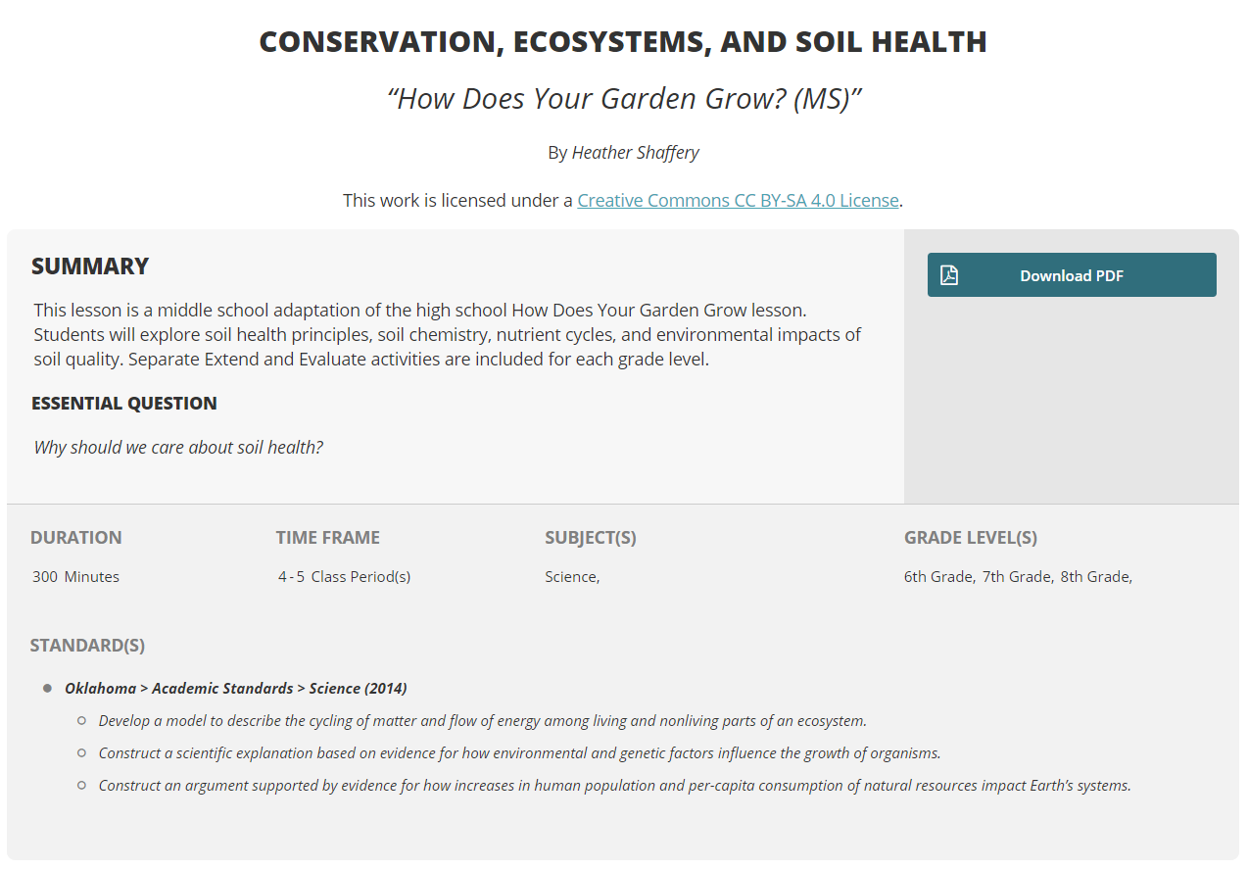
Adapting a Lesson for Increased Authenticity
Notes:
EXTEND
Provide participants with copies of the Explain lesson plan from both the original How Does Your Garden Grow? and the revised middle school version from this PD. (Give both of the full LEARN lessons if time allows/necessitates.)
Discuss Breakout as example of change we made to increase authenticity. We also changed the order of the original lesson to better align with the 5E model.

Slide 25
Adapting a Lesson for Increased Authenticity
How could you further adapt this lesson to be more authentic?
How could you use a digital breakout in your classroom?
Which of your own lessons could you modify to make it more authentic?
bit.ly/34f702s
Notes:
EXTEND/EVALUATE
Have teachers look at the entire middle school version of the lesson. Give them time to brainstorm other ways they could make it more authentic. Provide time near the end to identify one of their own lessons they could modify. Ask them to bring that lesson with them in October when we meet again.
Teachers should participate in the Flipgrid activity to document their plans. Since teachers will be recording their responses as videos, time permitting, several could be shared whole-group on the presenter computer, or teachers could be provided some time to view and respond to a few in the group page.

