Slide 2
Rubrics
Assessing authentic learning tasks

Slide 3
Objectives
Teachers will participate in hands-on activities to evaluate the “whys” of rubrics.
Teachers will brainstorm connections between the use of rubrics and designing authentic instruction in the classroom.
Teachers will create a T-chart to illustrate the connections between the why and how of rubrics in the classroom
Notes:
"Today you will have protected time to engage in hands-on activities evaluating How and Why we use rubrics to promote authentic instruction. I will provide time for you to brainstorm and create rubrics to use for a lesson of your choosing." This will provide a road map of where you will go together during the session and let them know what to expect from the session.

Slide 4
Strike Out!
In your small group, make a list of why teachers use rubrics.
Your group list must contain at least seven items.
Pass your list to the group on your right.
Evaluate the new list you received and STRIKE OUT one of the least important items on the list.
Notes:
Participants get into small groups of four and make a list of why teachers use rubrics. Each list should have at least seven items or statements listed. Pass the list clockwise to the next group. Each group will evaluate the new list they received and strike out the least important piece of information. Continue to pass lists to the right until only the most important information remains. There should be only one or two key ideas or statements remaining on the list.
Groups share out the most important items remaining on the posters/paper. Discuss the similarities and differences found.

Slide 5
Why We Use Rubrics
Note: Reprinted from Lombardi, M. M. (2008, January). Making the grade: The role of assessment in authentic learning (ELI Paper 1: 2008, p. 6). Retrieved from https://library.educause.edu/~/media/files/library/2008/1/eli3019-pdf.pdf. Copyright 2008 by Educause. For educational use.
© (2008)
For educational use.
Notes:
Pass out Traditional vs Authentic Assessment Handout.
Ask, "Do your remaining ideas about rubrics fit in the traditional assessment or the authentic assessment?"
Explain that rubrics are a form of authentic assessment only if they follow the criteria of the authentic side of the chart.

Slide 6
It’s alive!!!!!
Based upon elements of authentic assessment, bring one item back to life.
Notes:
Groups revive one of the original items or statements that had been struck out.
Why did you select to revive that item or statement?
How does it fit within authentic assessment?

Slide 7
Why We Use Rubrics
Note: Reprinted from Lombardi, M. M. (2008, January). Making the grade: The role of assessment in authentic learning (ELI Paper 1: 2008, p. 6). Retrieved from https://library.educause.edu/~/media/files/library/2008/1/eli3019-pdf.pdf. Copyright 2008 by Educause. For educational use.
© (2008)
For educational use.
Notes:
Vote on the three components that are most important to consider when developing a rubric.

Slide 8
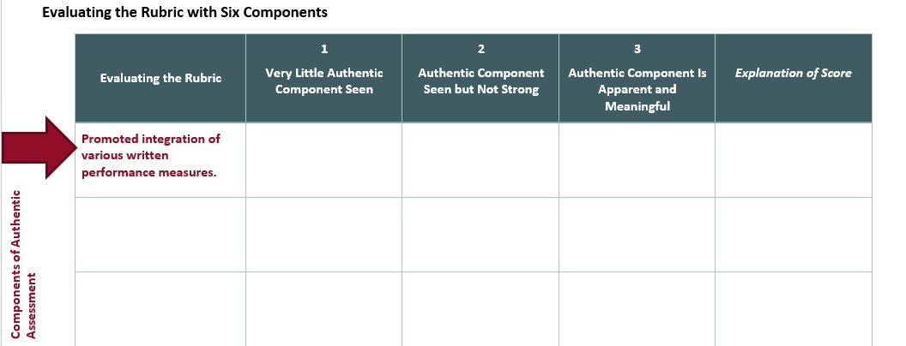
Building It Together
Notes:
After teachers choose the three most important components from the handout, hand out a blank template for them to fill in. They will work with a small group to evaluate the rubric and discuss what might be done to improve evaluation.

Slide 9
Attributes of Authentic Assessment
Task Clarity | Relevance | Potential for Success
Students clearly understand the learning goal and know how teachers will evaluate their learning
Students think the learning goals and assessments are meaningful and worth learning
Students believe they can successfully learn and meet the evaluative expectations
(McTighe & O’Connor, 2005)
Notes:
Distribute Rubistar rubrics at this time and have small groups evaluate the rubric based upon these three attributes. Ask the group to rate it on a scale of 1-3? Have them come up with ways to make the rubric more authentic. * Copies for different content areas????
If enough people, jigsaw 1-look at task clarity, 2-relevance, 3-potential for success
McTighe, T., & O’Conner, K. (2005, November). Seven practices for effective learning. Educational Leadership, 63(3), 10-17.

Slide 10
Four Corners
Statement:
The use of rubrics guarantee more authentic learning.
Notes:
Pose the statement, “The use of rubrics guarantee more authentic learning.”
Instruct participants to move to the corner that best represents how they feel about this statement. The corners are labeled as “Strongly Agree,” “Agree,” “Disagree,” and Strongly Disagree.”
Note: Not all assignments need a rubric for grading, but use them when they can be an asset to increase rigor and critically thinking skills.

Slide 11
Dropout statistics show that numerous so-called normal students are not succeeding because they are not treated as individuals.
Students find new and creative ways to solve problems, achieve success, becoming life-long learners when educators show them that there are different ways to learn.
What does the research say?
There is a correlation between high truancy rates and low academic expectations.
Active learning embraces teaching and learning strategies that engage and involve students in the learning process.
Reimer, M. S., & Smink, J. (2005). Fifteen effective strategies for improving student attendance and truancy prevention. Clemson, SC: National Dropout Prevention Center/Network.
Notes:
Hand out Kohn's rationale in the short excerpt from Kohn's article, "The Trouble with Rubrics."
Participants quickly read the except using Why Lighting, and identify the three problems addressed in the excerpt.
Lead a short discussion about what they found in the last three paragraphs.
Then, click through slide 10 and briefly share the research listed affirming what the participants shared.

Slide 12
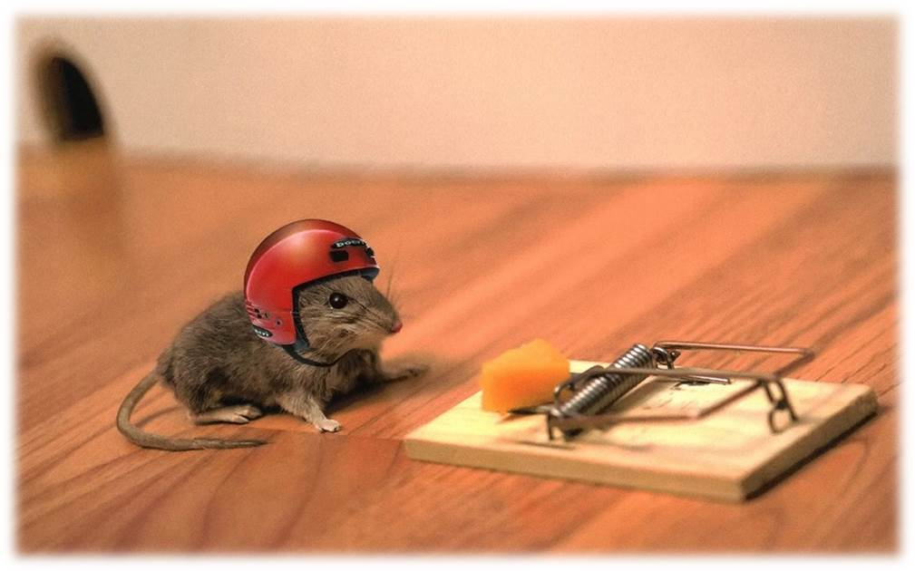
Beware the Rubric Traps
Self-justification
Replacement for number grades
Quick and Efficient
Kohn, A. (2006). The trouble with rubrics. English journal, 95(4), 12-15.
Notes:
“Authentic rubrics promote and encourage divergent thinking, develop meaningful skills, emphasize cooperation, and the assessment guides curriculum and instruction.” Also, not all lesson assessments lend themselves to the need of a rubric, as discussed in the Four Corner activity.

Slide 13
Why and How T-Chart
“When the how’s of assessment preoccupy us, they tend to chase the why’s back into the shadows.” - Alfie Kohn
Notes:
Read the quote and ask participants what that means to them?

Slide 14
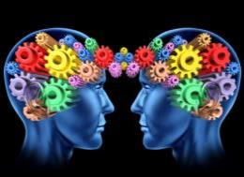
Authentic Teaching
Higher Order Thinking
Disciplined Inquiry
Value Beyond School
Implicit View of Students
Notes:
Distribute the Authentic Learning and Teaching handout, and have participants discuss with an elbow partner, “Which of these four components do you see represented from authenticity in the use of authentic rubrics for assessment?”
A few can share out what they discussed.

Slide 15
Rubistar
http://rubistar.4teachers.org
Notes:
Explore the site with participants.
Use the hyperlink in the PowerPoint to demonstrate how easy and quick it is to create a rubric.
**If time allows, instruct them to pick a lesson they believe might benefit from the use of a rubric. Create and develop a rubric using the website and the tools from the "Rubrics Traditional vs Authentic" handout. As they work to create their own rubrics for a lesson, walk around and help those with questions.

Slide 16
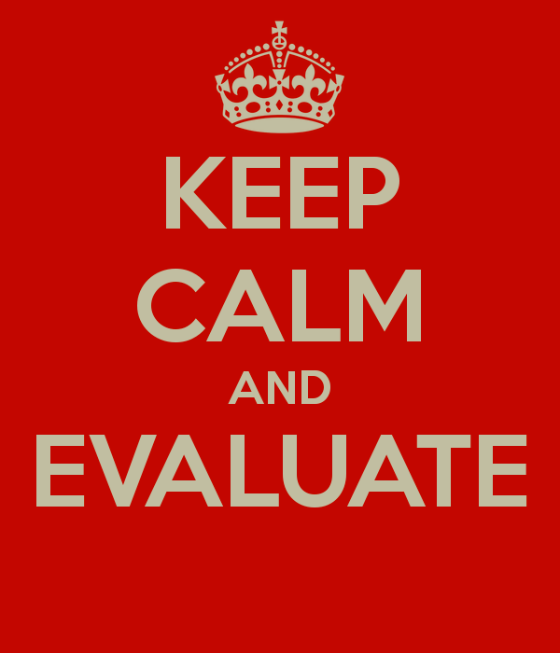
Reflect and Write:
3 important takeaways from today’s session
2 questions they still have about writing or creating rubrics
1 lesson that lends itself to the use of rubric
Notes:
On a piece of paper or sticky note, participants will complete the 3-2-1.
If time allows, participants may share out one of their two questions. This will provide an opportunity for the presenter to clear up any misunderstandings or misconceptions about Rubrics.

Slide 17
Follow Up

Slide 18
SCORE
What is one Strategy you used to support authentic teaching and learning?
What was successful and needs to be Celebrated?
What Obstacle did you face and overcome?
What might you Refine in the future when using this strategy?
Extra notes or ideas?
Notes:
During a follow up session with participants ask them to reflect on the strategies they used. Participants may use the SCORE Reflection Note Sheet for recording thoughts and reflections.

Slide 19
Resources
3-2-1 instructional strategy: K20 Center. (n.d.). 3-2-1. Instructional Strategies. Retrieved from https://learn.k20center.ou.edu/strategy/d9908066f654727934df7bf4f5059a7b
Four Corners instructional strategy: K20 Center. (n.d.). Four corners. Instructional Strategies. Retrieved from https://learn.k20center.ou.edu/strategy/d9908066f654727934df7bf4f5064550
Strike Out instructional strategy: K20 Center. (n.d.). Strike out. Instructional Strategies. Retrieved from https://learn.k20center.ou.edu/strategy/d9908066f654727934df7bf4f5062cdf
Kohn, A. (2006). The trouble with rubrics. English Journal, 95(4), 12-15.
Lombardi, M. M. (2008, January). Making the grade: The role of assessment in authentic learning (ELI Paper 1: 2008). Educause Learning Initiative. Retrieved from https://library.educause.edu/~/media/files/library/2008/1/eli3019-pdf.pdf
McTighe, T. O’Conner, K.,(2005, November). Seven practices for effective learning. Educational Leadership, 63(3), 10-17.
Reimer, M. S., & Smink, J. (2005). Fifteen effective strategies for improving student attendance and truancy prevention. Clemson, SC: National Dropout Prevention Center/Network.

