Slide 2
Welcome to K20 & GEAR UP
Danny Mattox, Project Director
Lindsay Hawkins, Professional Development Coordinator
Misty Reed, Parent Coordinator
Lacy Pennington, Student Coordinator

Slide 3
ENGAGE: Snap, Clap, Pop
If you… Stand up and...
Have attended a previous K20 event or PD
Think quality PD involves modeling strategies
Think learning should be engaging and relevant
Are a first-generation college student
Participated in GEAR UP in some way
KNOW Bigfoot is real
Give a wave
Say, “Here, here!”
Say, “Cheers!”
Clap your hands twice!
Jazz hands!
Do your best holler
Notes:
In order to establish community and model the K20 LEARN Instructional Strategies and authentic teaching and learning that guide our professional development, facilitators will engage participants in the Snap, Clap, Pop strategy.

Slide 4
Objectives
Identify characteristics and generate questions about K20 and its research-based professional development approaches.
Identify characteristics and generate questions about goals, benefits, and expectations of participation in the GEAR UP grant.
Apply your understanding of the benefits of going to college to create an image depicting the effects that going to college could have on an
individual student that you know.

Slide 5
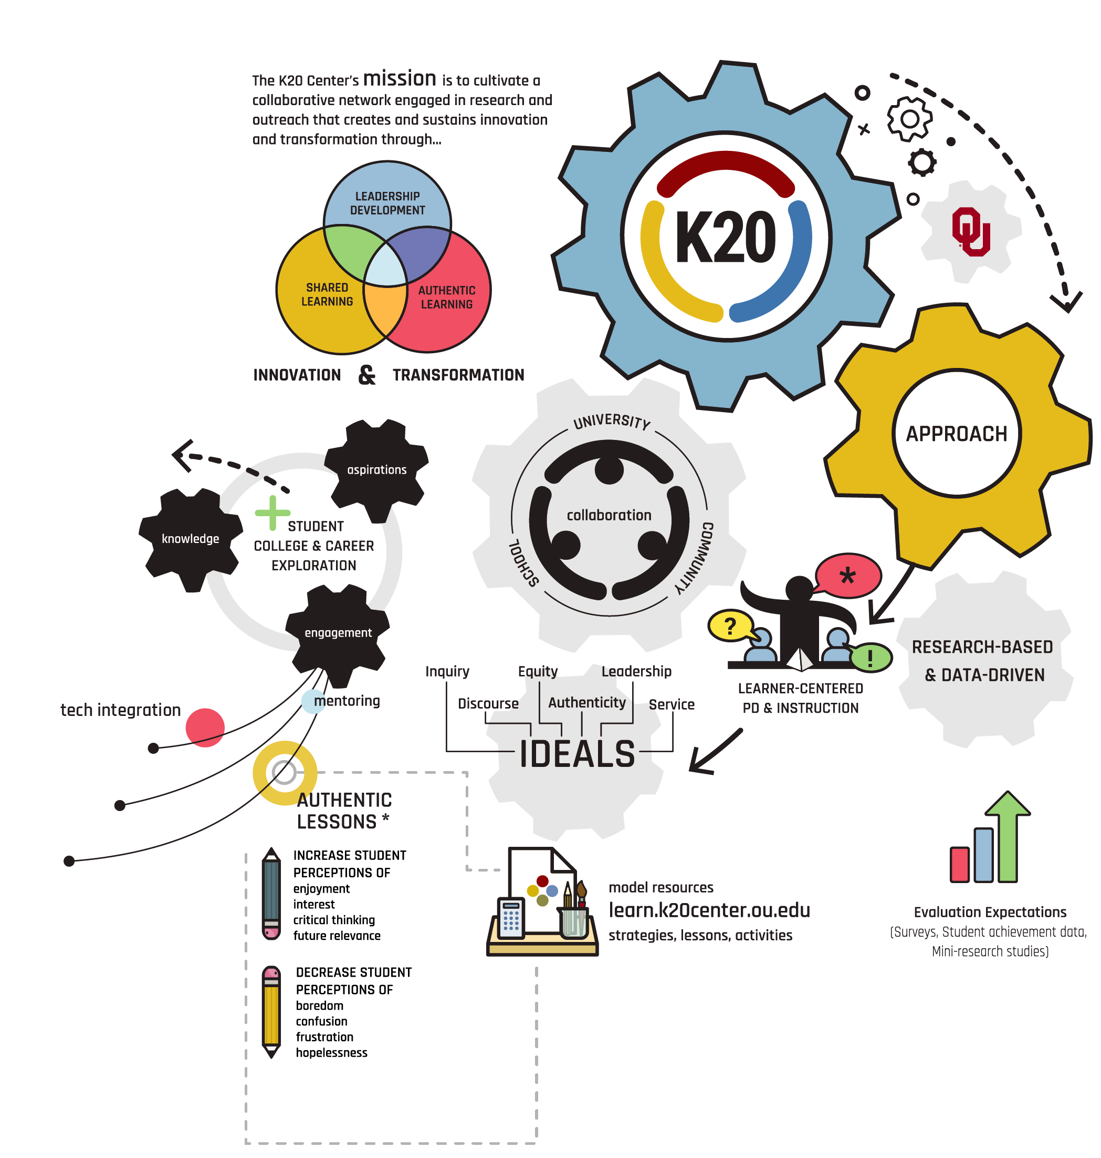
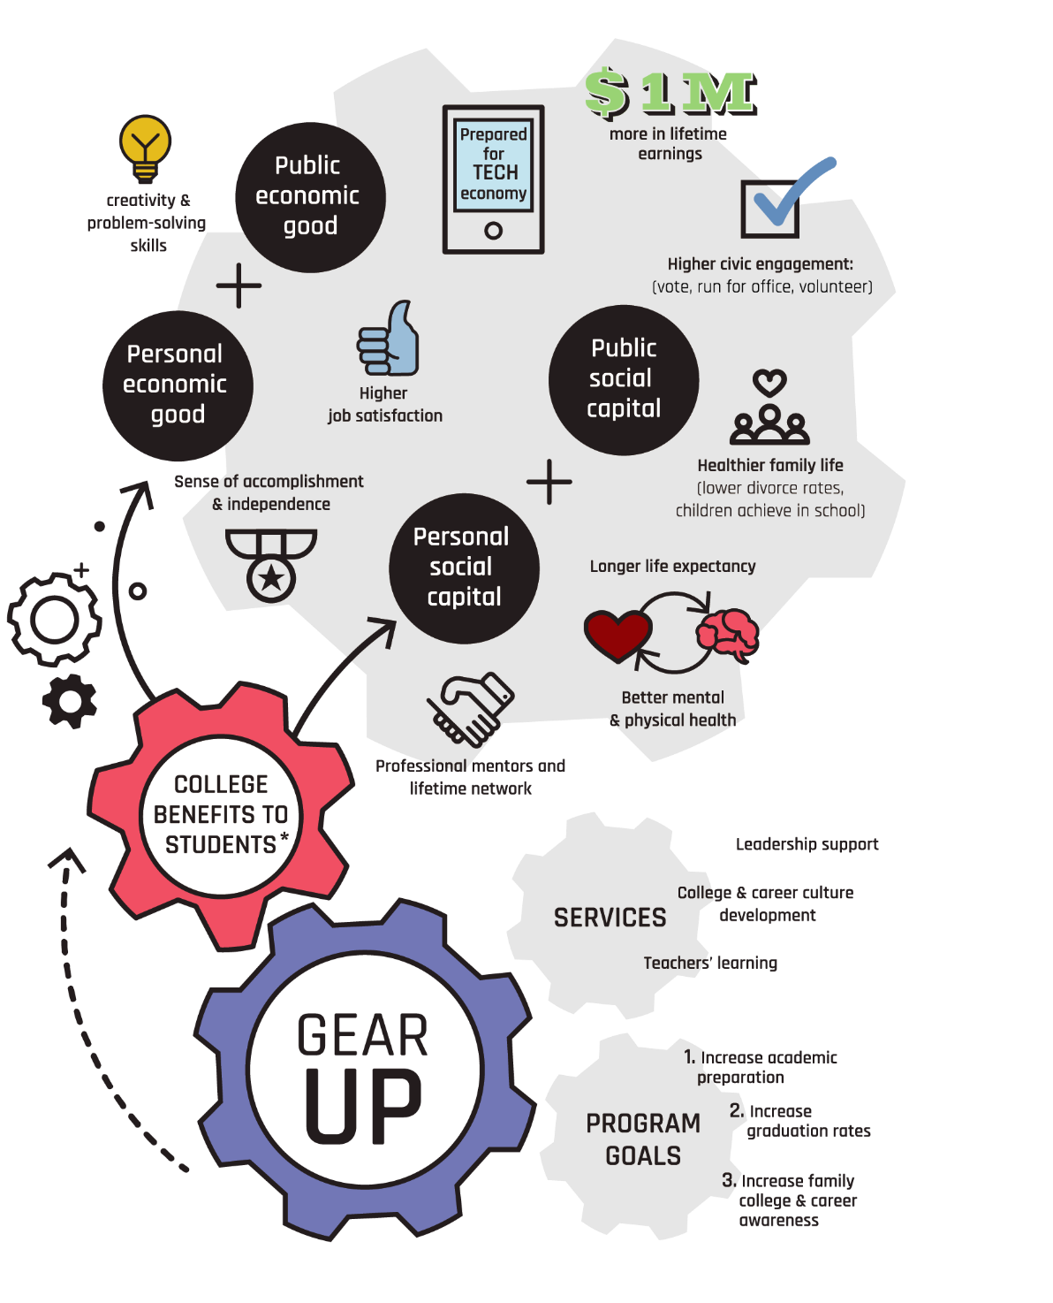
I Notice, I Wonder
3 minutes ​
Left
Right
Notes:
Give an example:
I notice that the K20 Center is centered around collaboration with University, Community, and School
I wonder how the community is involved in the collaborative piece?
Participants review the entire infographic in small groups (2-3) and create an I notice and an I wonder. Participants place stickies on the respective poster being mindful of previous questions and statements.
You can use these guiding questions to help those still struggling to record I Notice/I Wonder Statements.
What connections can you make to your school?
Do you notice any elements that are exciting to learn more about?

Slide 6

EXPLORE: I Notice, I Wonder
Record and label one of each:
Place the stickies on the larger poster in the corresponding area.
I Notice…
I Wonder…
Collaboration is central.
How can we get the community involved?
Notes:
Participants review the entire infographic in small groups (2-3) and create an I notice and an I wonder. Participants place stickies on the respective poster being mindful of previous questions and statements.
You can use these guiding questions to help those still struggling to record I Notice/I Wonder Statements.
What connections can you make to your school?
Do you notice any elements that are exciting to learn more about?

Slide 7
What did you notice and wonder?
K20 Center

Slide 8
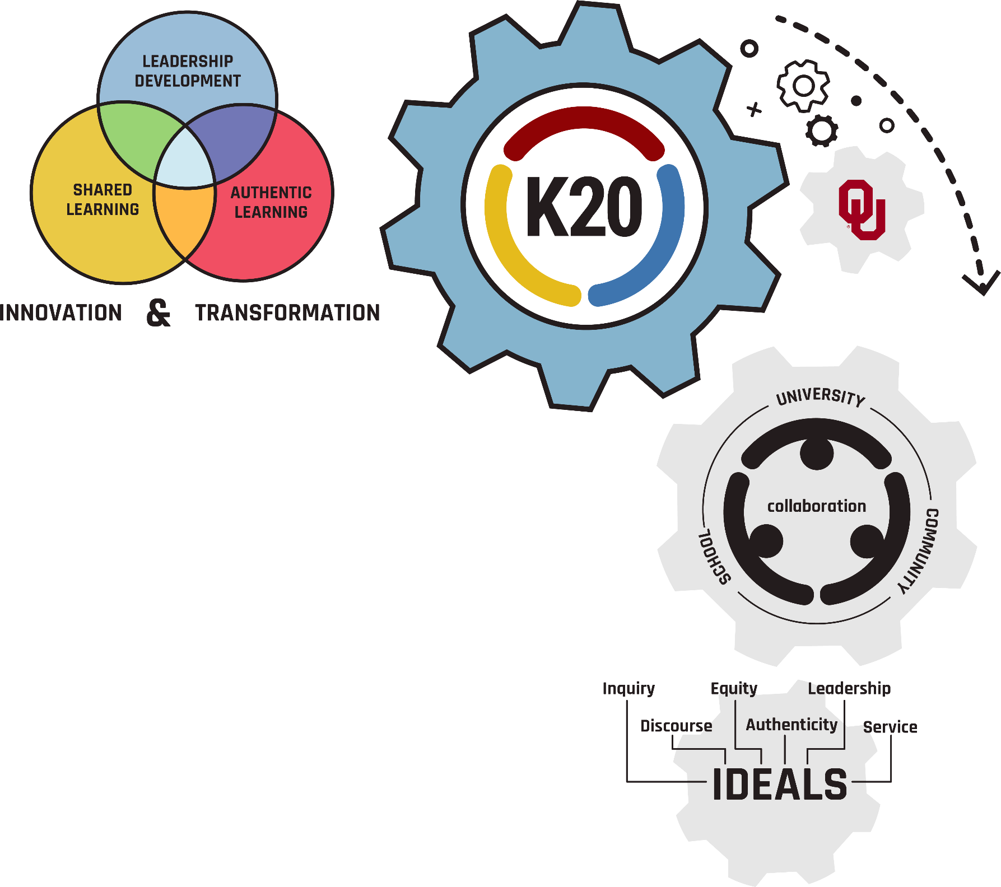
K20 Center
Statewide education research and development center
Provides professional development to educators across the state
Notes:
The K20 Center is an educational research and development center that provides PD to educators across the state.

Slide 9
What did you notice and wonder?
GEAR UP

Slide 10
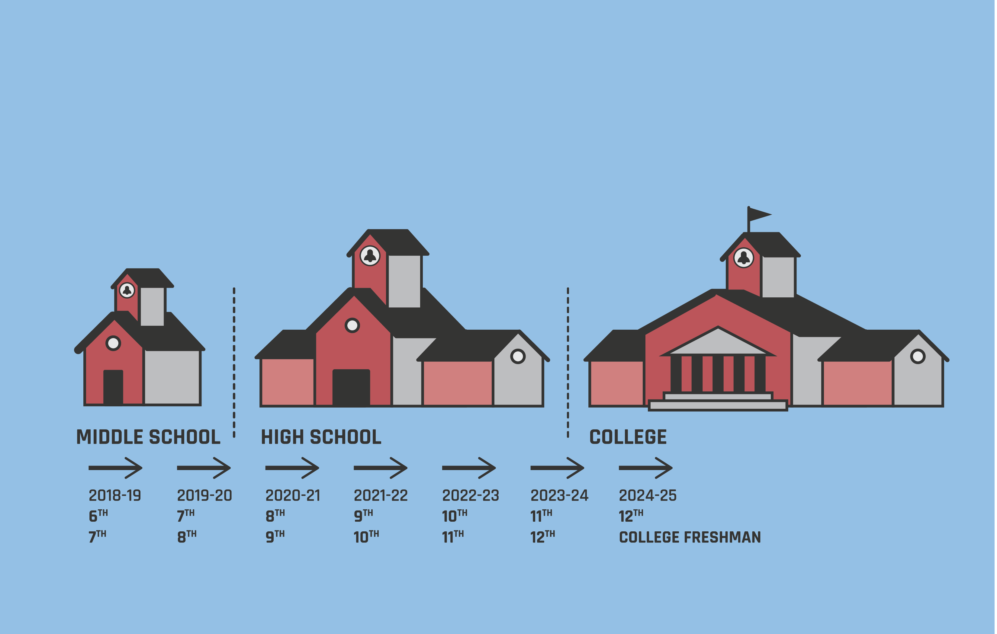
GEAR UP Model:
Gaining Early Awareness and Readiness for Undergraduate Programs
Notes:
Competitive Federal Grant
COHORT MODEL
7 years
Free 50% of free and reduced lunch
GEAR UP is Federal grant, competitive application, cohort model starts in 7th grade and follows students through their freshman year of college, free and reduced rate is 50% or higher summarize the goals Keep any services with students broad because it varies from site to site and grant to grant. “Sites may do campus visits, college and career events, counselor academy,

Slide 11
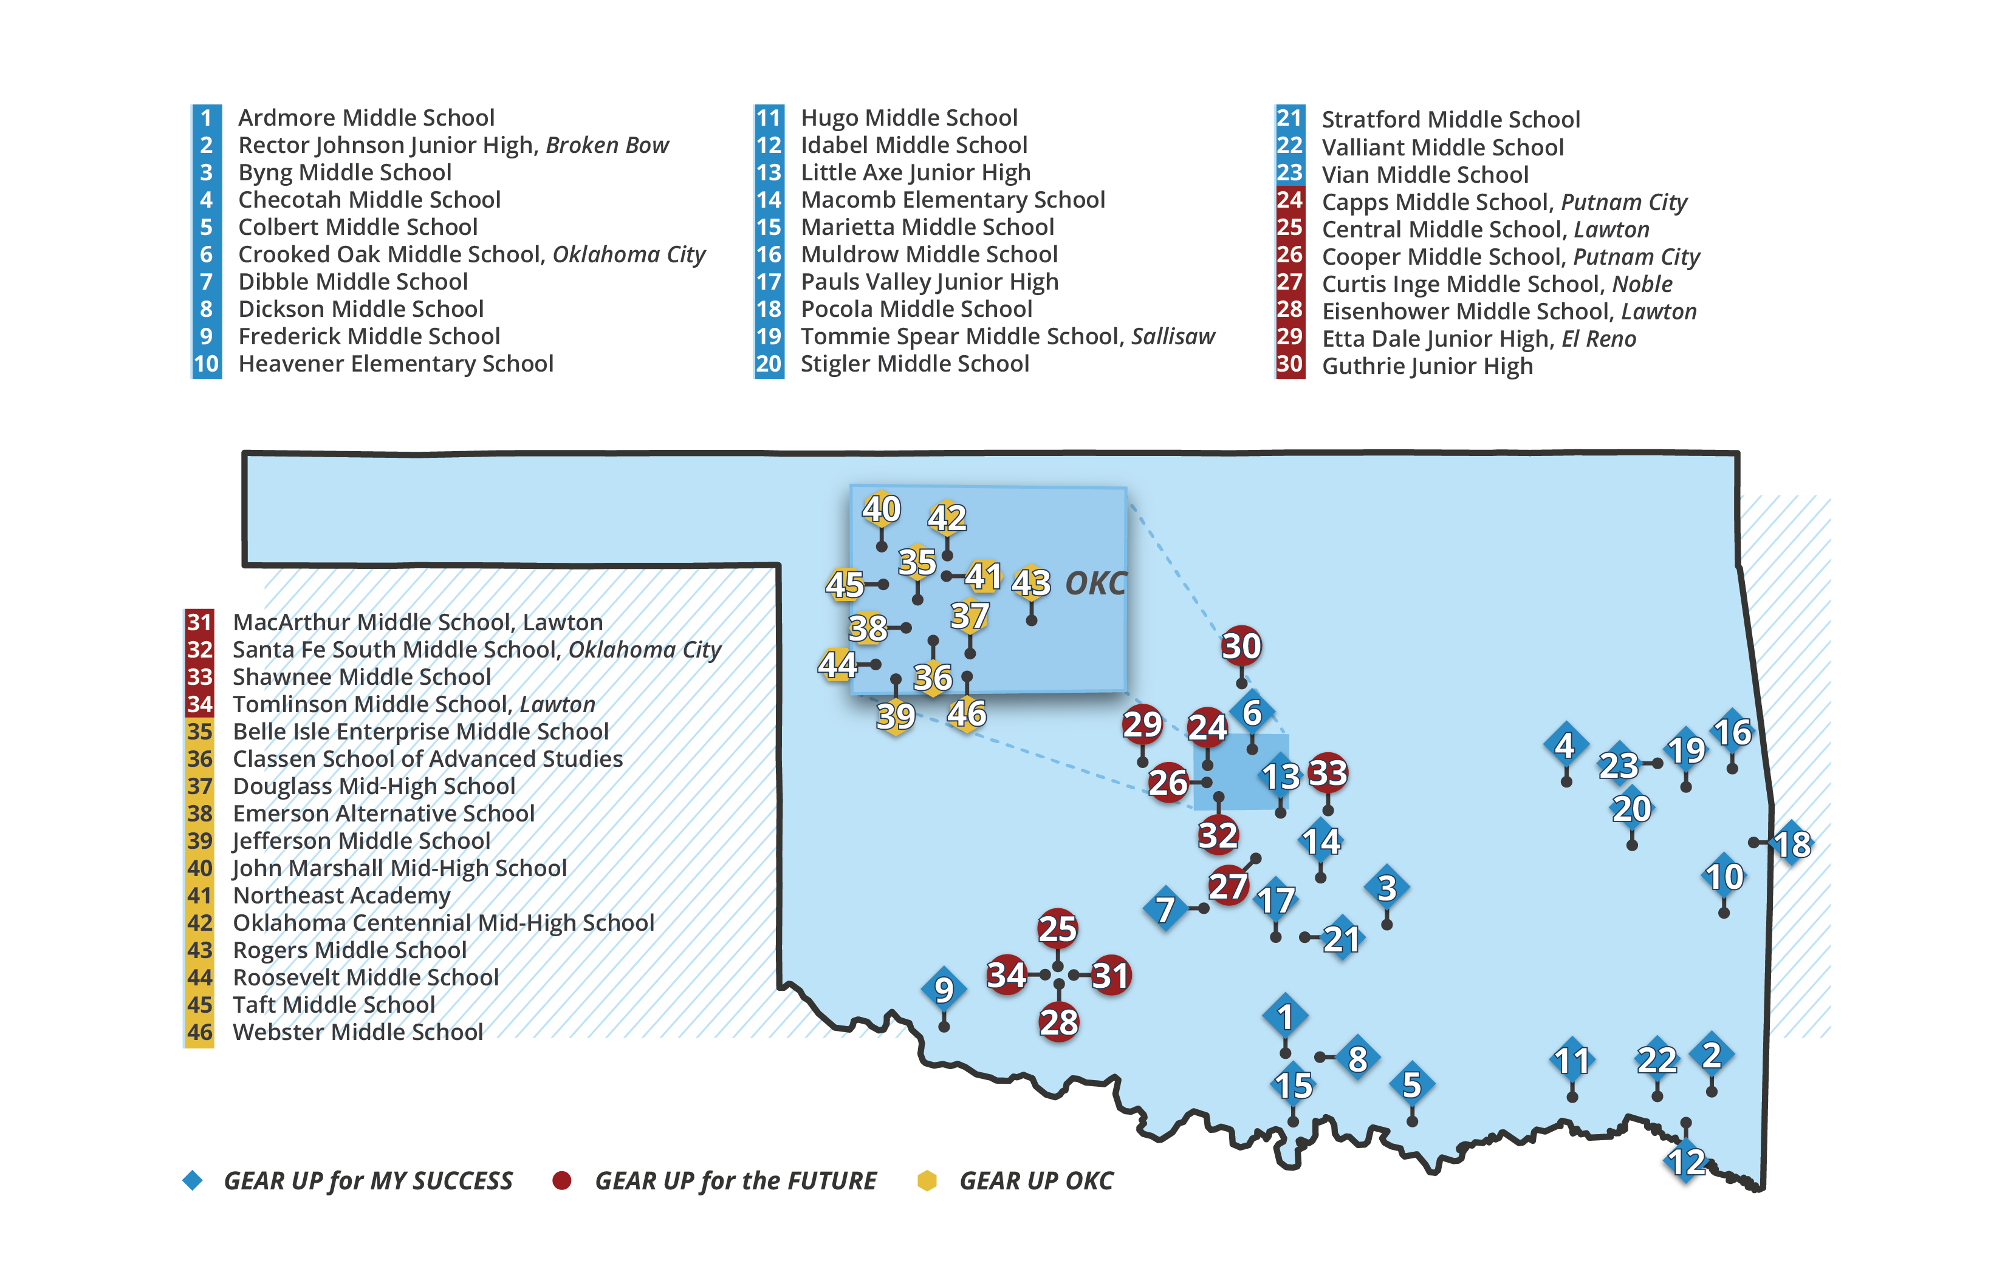
GEAR UP for the FUTURE:
Forging Undergraduates Through University Readiness Experiences
Notes:
Direct participants attention to the back of the info graphic.
This is a partnership between the K20 Center and 11 suburban schools in Oklahoma
Directly impacts over 3,000 students
Provides PD and direct services for
Teachers
Students
Leaders
Parents
Outcomes will increase students’:
Learning
Engagement

Slide 12
GEAR UP for MY SUCCESS:
Motivating You to Seek and Understand College & Career to Enhance Student Scholarship
Notes:
Direct participants attention to the back of the info graphic.
This is a partnership between the K20 Center and 23 rural schools in Oklahoma
Directly impacts 4,154 students
Provides PD and direct services for
Teachers
Students
Leaders
Parents
Outcomes will increase students’:
Learning
Engagement

Slide 13
GEAR UP OKC:
Opportunities + Knowledge = College
Notes:
Direct participants attention to the back of the info graphic.
This is a partnership between the K20 Center and all OKC schools
Directly impacts over 3,000 students
Provides PD and direct services for
Teachers
Students
Leaders
Parents
Outcomes will increase students’:
Learning
Engagement

Slide 14
What did you notice and wonder?
College Benefits to Students

Slide 15
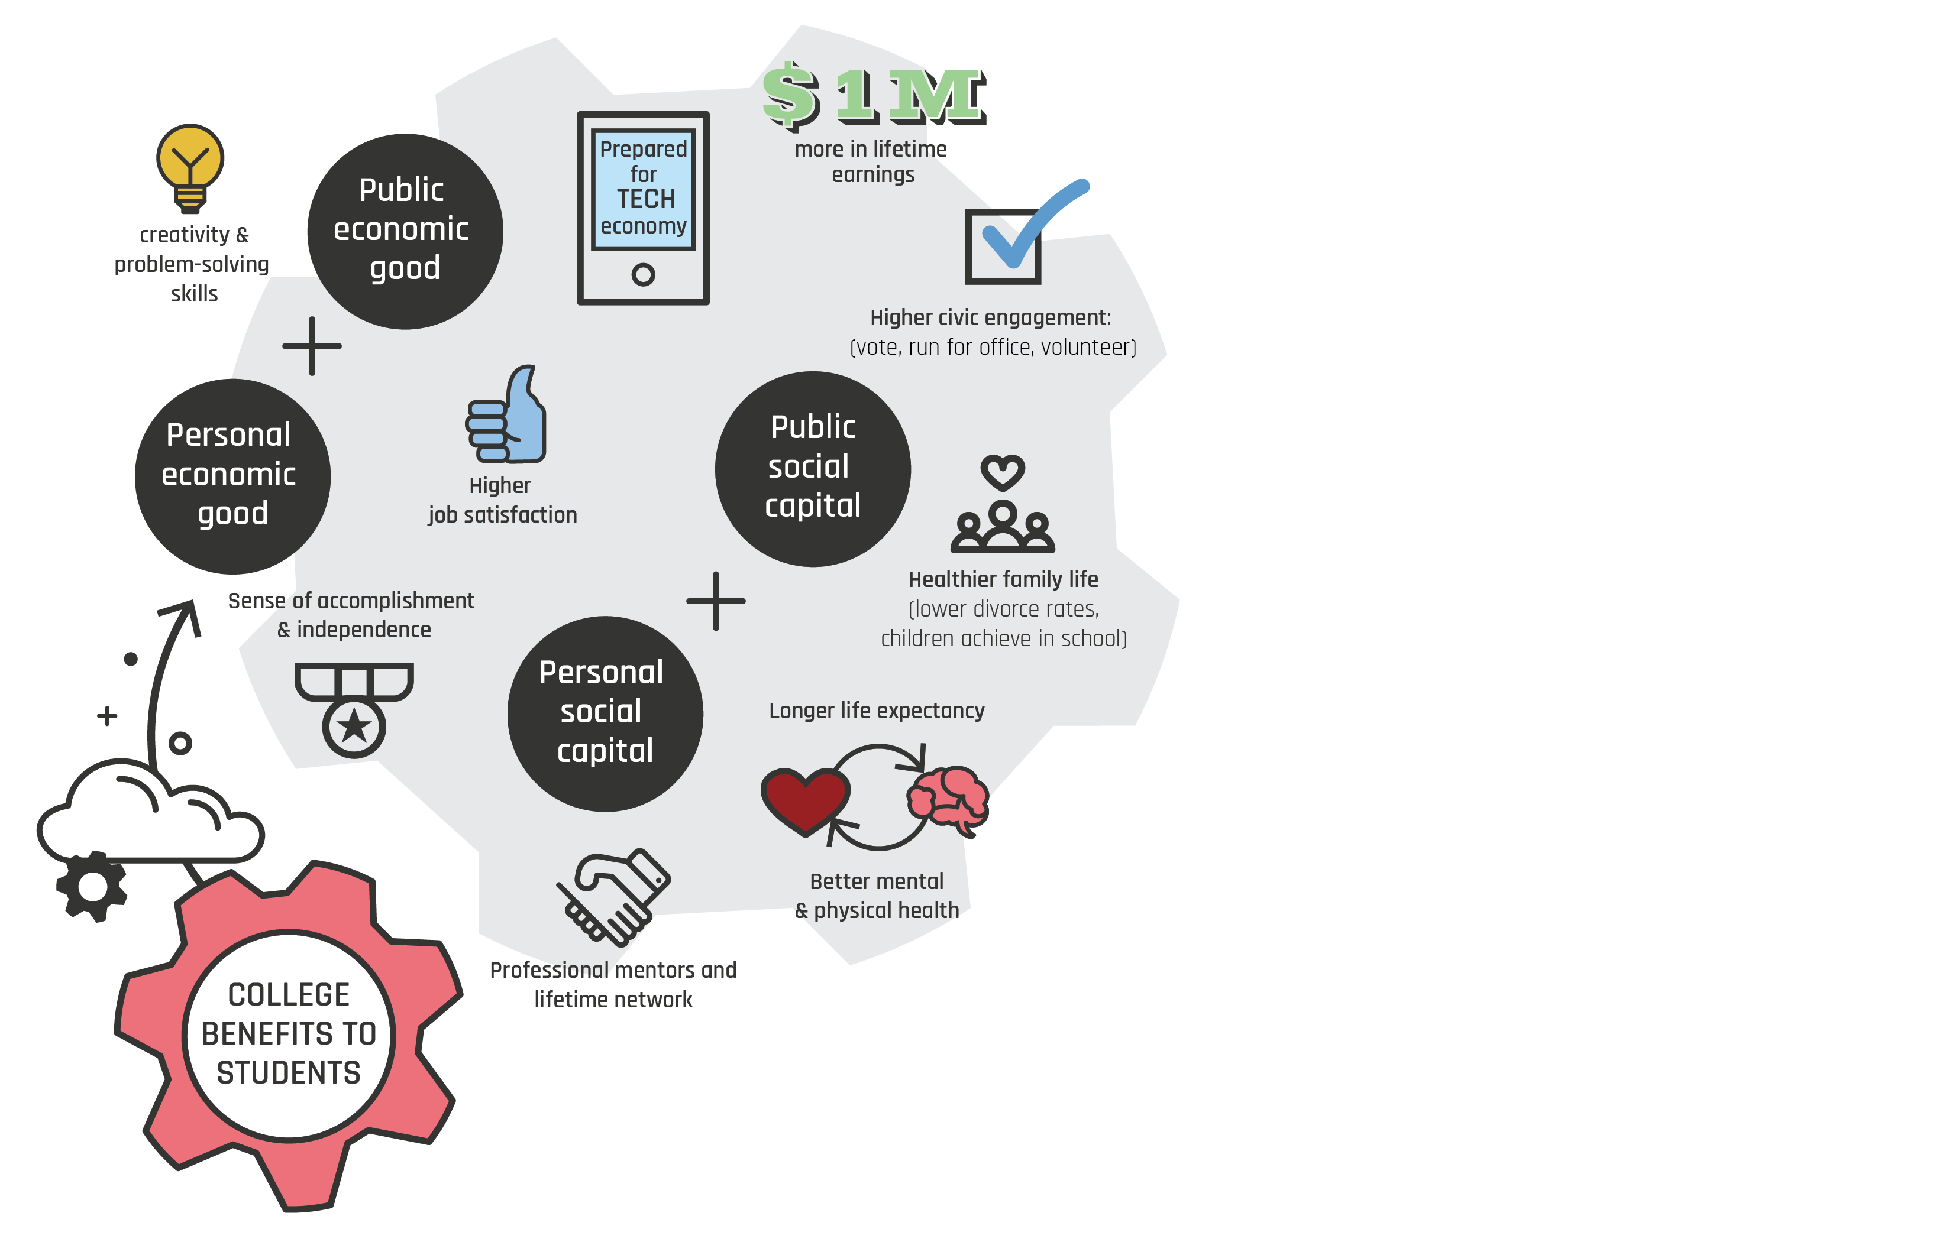
College Benefits to Students
Sutton, H. (2017). Learn to articulate the value of college beyond dollar signs. Recruiting & Retaining Adult Learners, 19(7), 6-7.
Notes:
Personal economic good refers to outcomes that positively affect the students’ financial status (Sutton, 2017). These outcomes might affect finances directly, as in the case of salary differentials, or indirectly, as in the case of employment opportunities.
Public economic good refers to ways in which college graduates bring benefit to the financial status of the communities, regions, states, and nations in which they live. These benefits might include such things as tax revenue generated, charitable contributions, and jobs filled (Sutton, 2017).
Personal social capital relates to a person’s individual development. Benefits can cover a broad range that can include such things as critical thinking skills, understanding international perspectives, and interpersonal skills (Sutton, 2017).
Public social capital refers to social benefits to the community. Components of social capital include civic engagement, social cohesion, and involvement in nonprofit, teaching, and healthcare occupations (Sutton, 2017).

Slide 16
What did you notice and wonder?
Research-Based Approaches

Slide 17
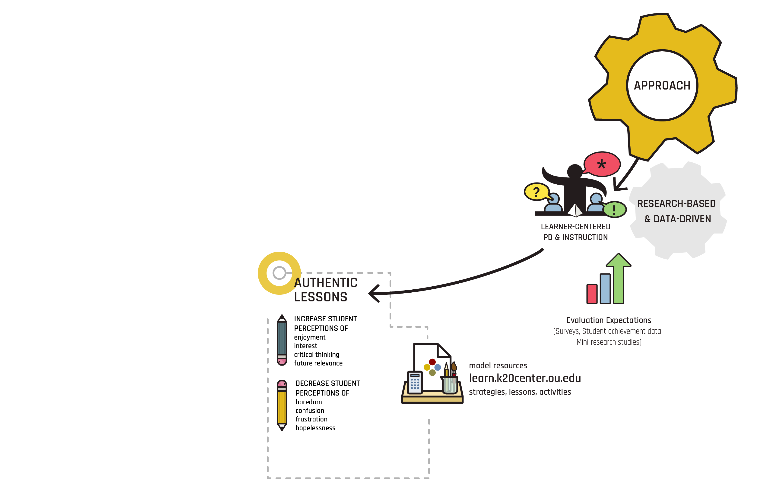
Research-Based
Approaches
Notes:
All approaches are centered around research and lessons, PD, and activities are all learner-centered.
Authentic learning
5E LEARN
PD That moves (literally and Figurative)
Improve and modify practices through feedback, surveys, and mini research studies

Slide 18
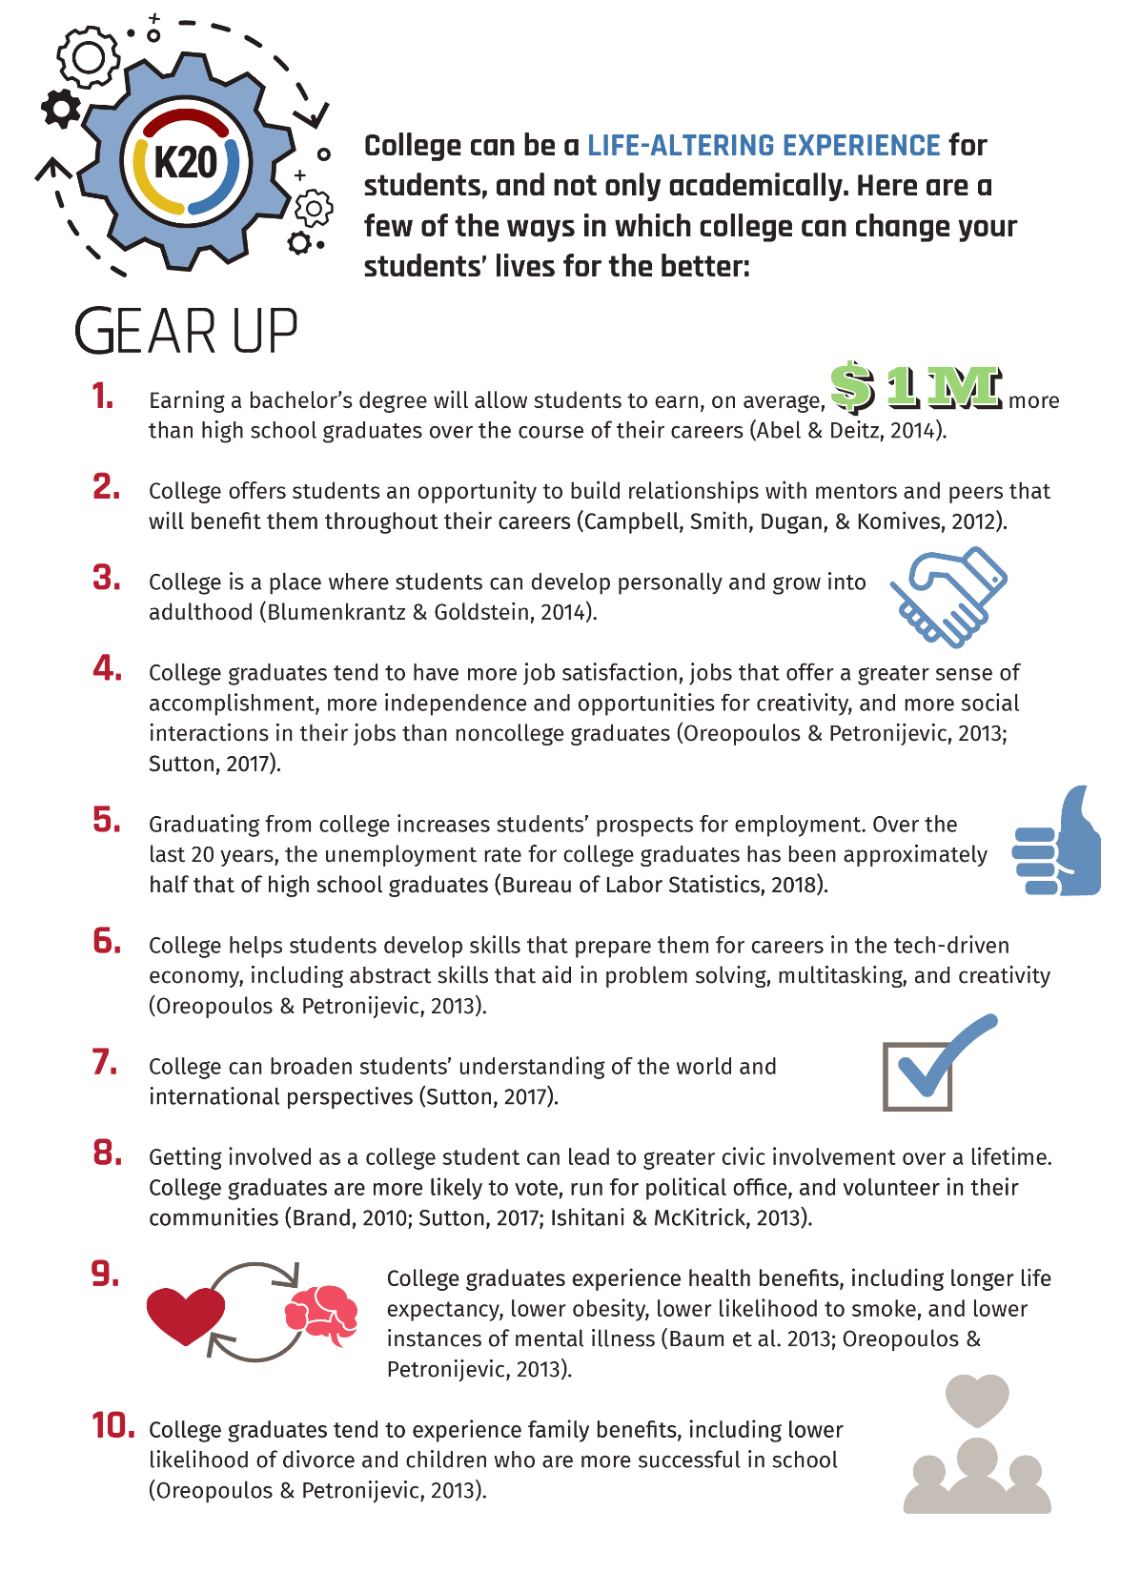
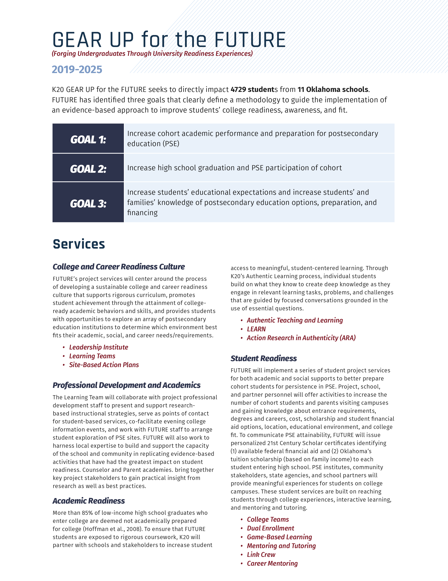
EXPLAIN: 3-2-1
Record 3 student benefits of postsecondary opportunities or college.
Identify 2 benefits FUTURE will have
for my school.
Think of 1 student or group of students you envision this grant affecting
(write a pseudonym or description).
Notes:
Direct participant attention to page 4 of their Overview Booklet.
They will select and record 3 student benefit of postsecondary or college degree.
Then click the slide to show the image of page 5 and they will identify and record 2 benefits of the grant.
Lastly, participants think of 1 student or group of students and record a pseudonym or description.

Slide 19
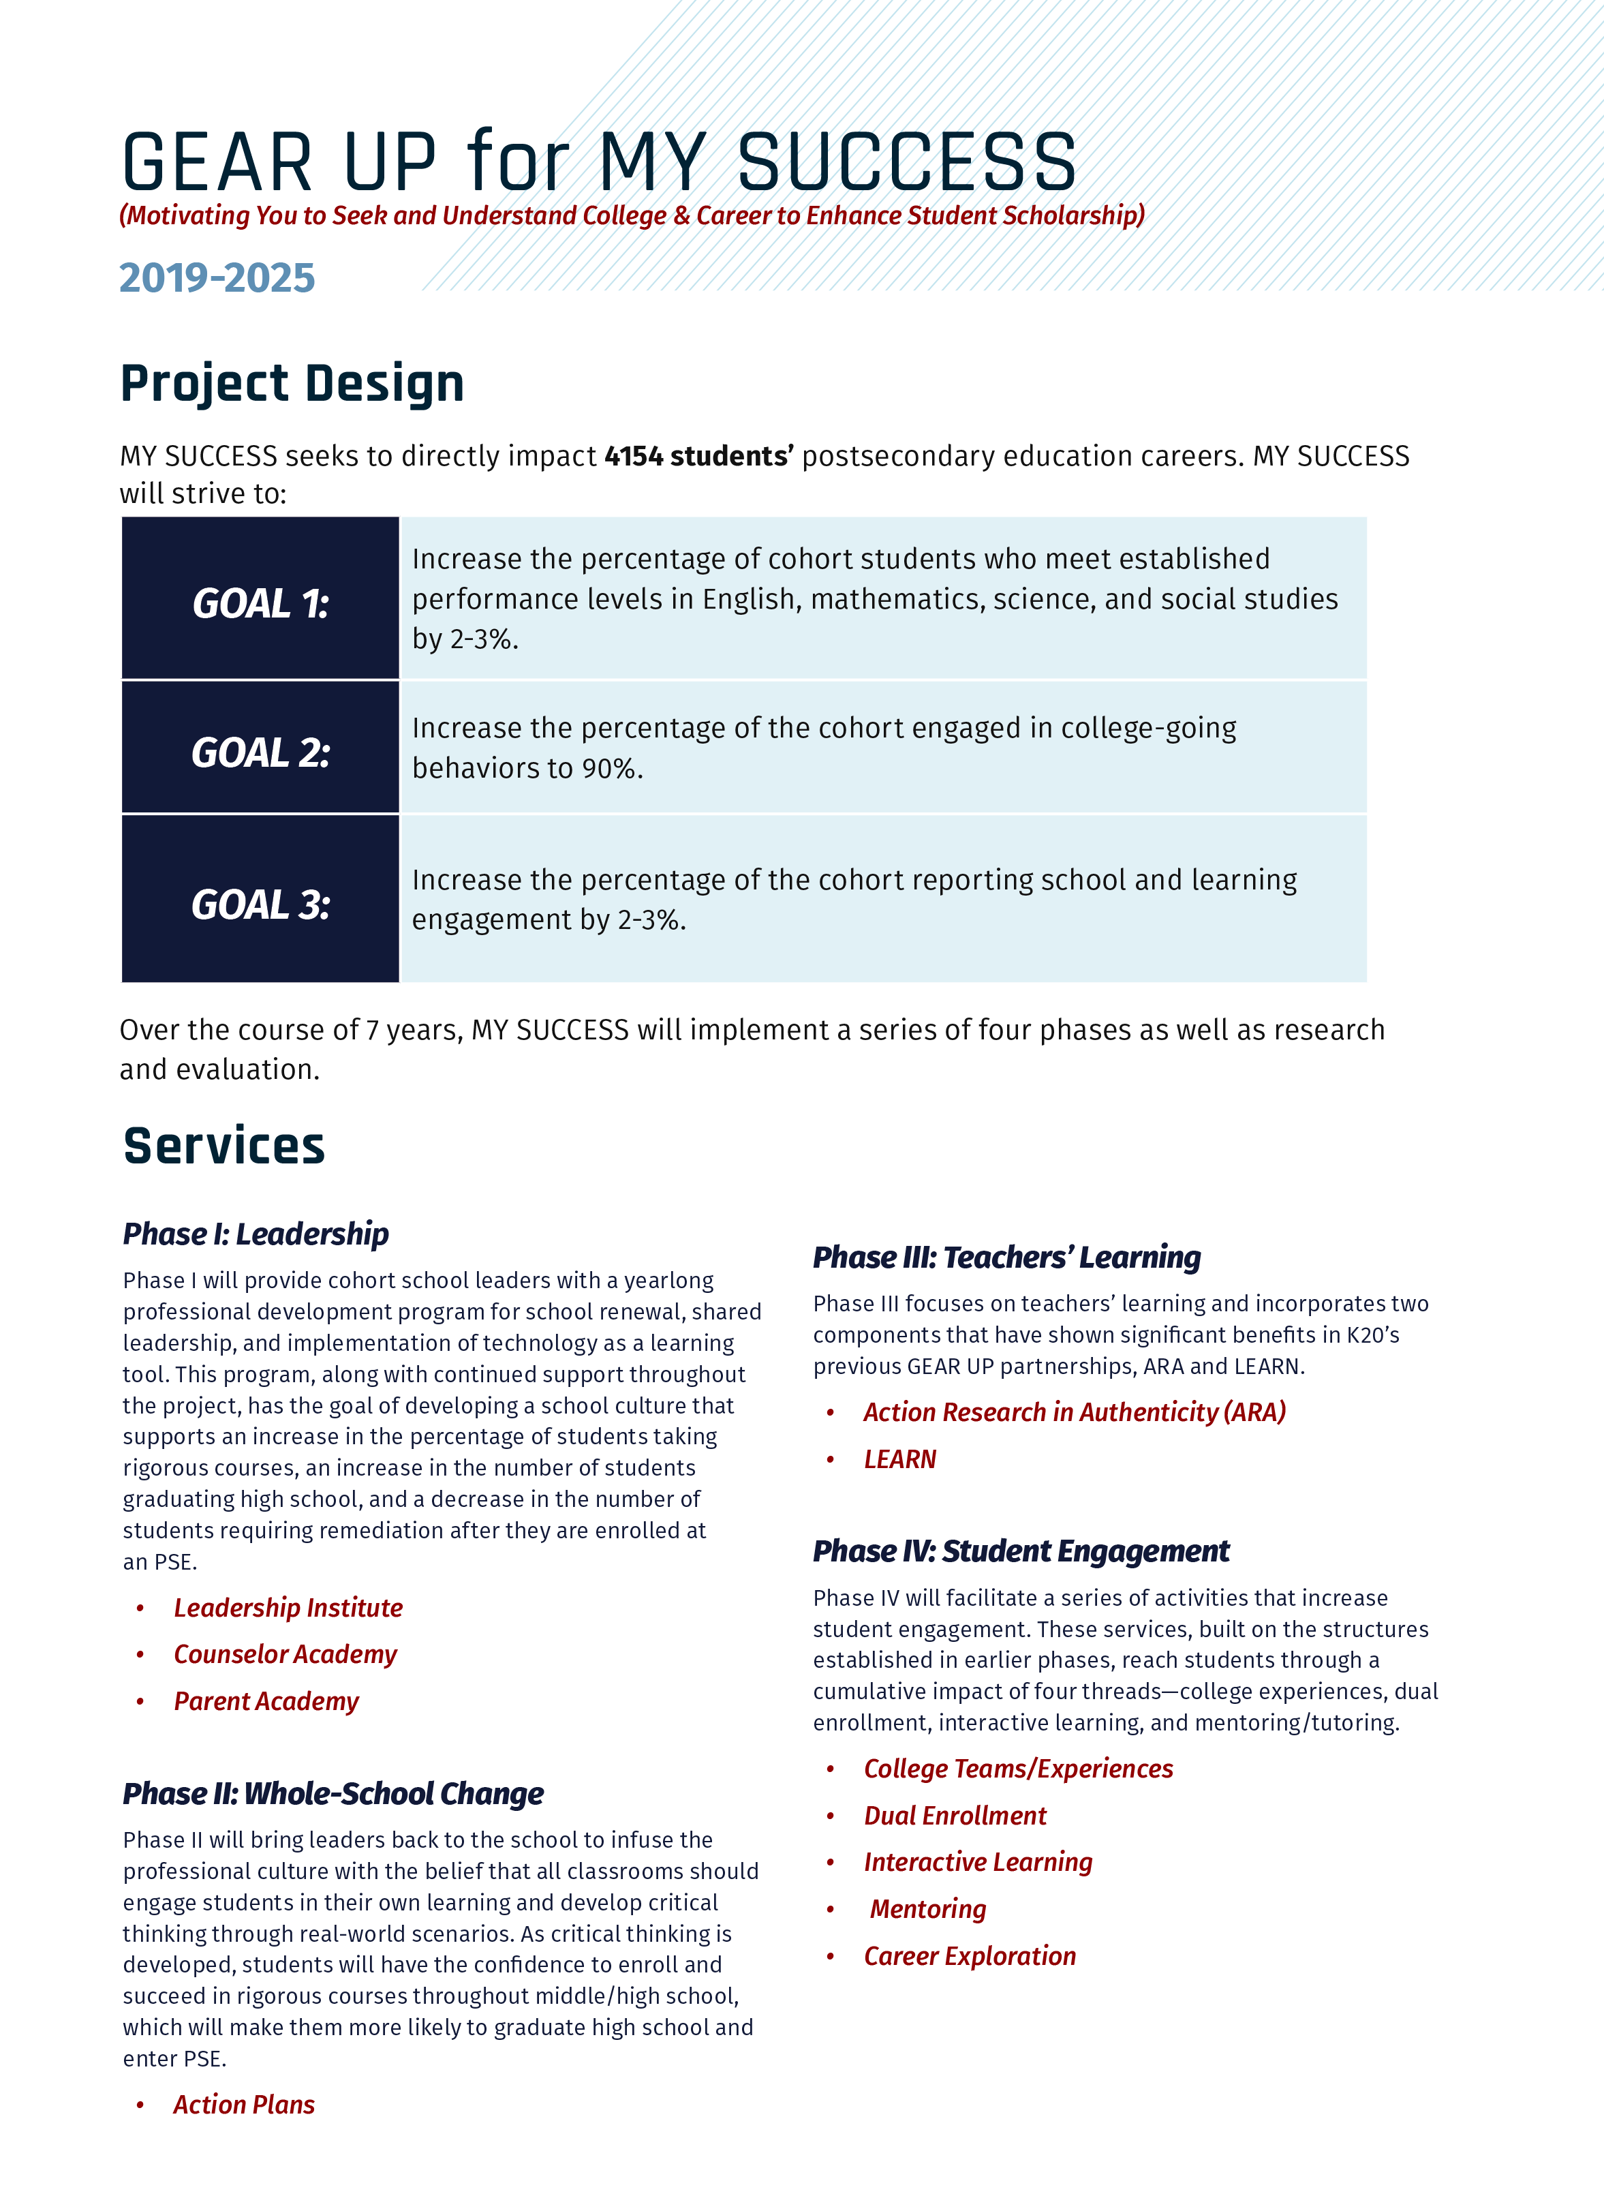
EXPLAIN: 3-2-1
Record 3 student benefits of postsecondary opportunities or college.
Identify 2 benefits MY SUCCESS will have for my school.
Think of 1 student or group of students you envision this grant affecting
(write a pseudonym or description).
Notes:
Direct participant attention to page 4 of their Overview Booklet.
They will select and record 3 student benefit of postsecondary or college degree.
Then click the slide to show the image of page 5 and they will identify and record 2 benefits of the grant.
Lastly, participants think of 1 student or group of students and record a pseudonym or description.

Slide 20
EXPLAIN: 3-2-1
Record 3 student benefits of postsecondary opportunities or college.
Identify 2 benefits OKC will have
for my school.
Think of 1 student or group of students you envision this grant affecting
(write a pseudonym or description).
Notes:
Direct participant attention to page 4 of their Overview Booklet.
They will select and record 3 student benefit of postsecondary or college degree.
Then click the slide to show the image of page 5 and they will identify and record 2 benefits of the grant.
Lastly, participants think of 1 student or group of students and record a pseudonym or description.

Slide 21

Notes:
Here is a short video of some of our past GEAR UP success stories.
The first story is from Belenda, a college freshman at OU. Last year she was the 2017 GEAR UP Youth of the Year.
4 minute video (Belenda, Drew Mark, Earl, Milton, and Tiamber)

Slide 22
EXTEND: Your ONE Student
Again, picture that ONE student (or group of students).
Think deeply about…
How will this partnership make a difference for your student(s)?
What does that difference “look” like?
Notes:
***If they selected a group of students, ask them to picture the face of one student who fits within that group.
Participants share out some thoughts to these two questions.
Rationale: A personal connection from the classroom to the grant using visual literacy strategies.
The polaroid photo to draw what it will look like for a student who is provided the opportunities through GEAR UP and share The Starfish story (optional)

Slide 23


Who do you envision?
Cognitive Comics:
What will the effects of this partnership look like for your student(s)?
Notes:
Think about your own classroom and the specific students within it.
This partnership can have an incredible and positive effect on all students, but there are going to be some that we influence more than others. So, who is your student(s)? For whom can you see this partnership really making a difference?

Slide 24


LEARN Strategies
Snap, Clap, Pop
I Notice, I Wonder
Jigsaw
3-2-1
Cognitive Comics
Notes:
Pass out card set to participants and showcase the LEARN site if time is available.
We encourage you to use the strategy I Notice, I Wonder or 3-2-1 with students. One idea is to let them look at the Top 10 Benefits of College and then use a strategy to reflect on them.

Slide 25
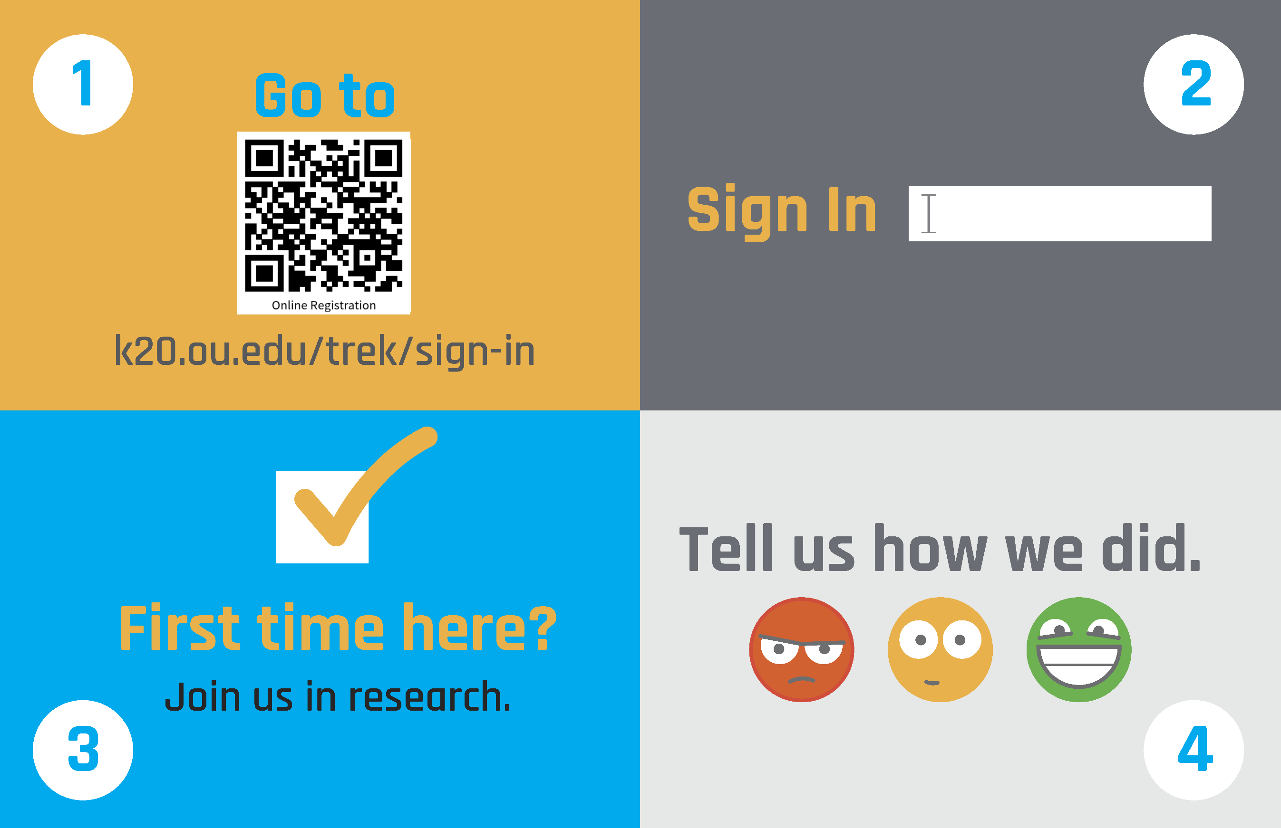
https://trek.k20center.ou.edu/today
Notes:
***This slide has to be edited with the correct TREK web address.***
Click on the link in the orange box to edit the numbers at the end.

Slide 27
https://trek.k20.ou.edu/today
Select GEAR UP Overview
Notes:
Optional link to use instead, but they will need to click on the correct event listed GEAR UP OVERVIEW for ….

Slide 28
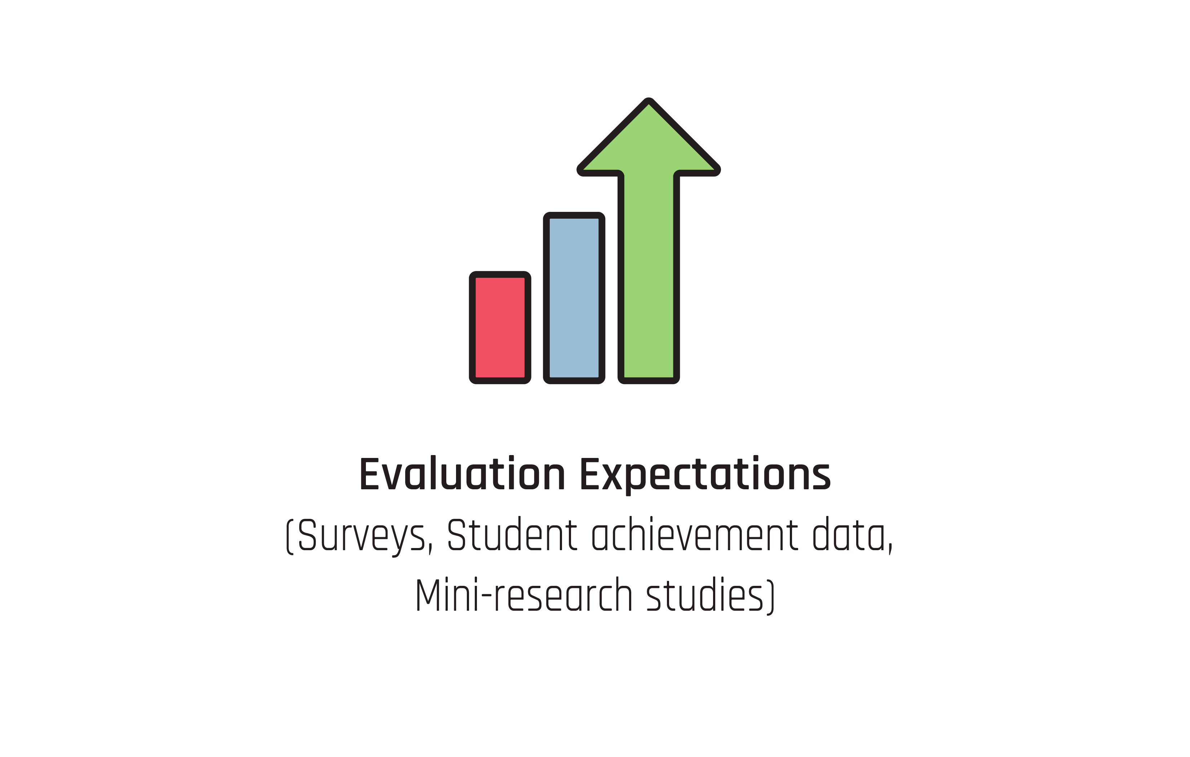
EVALUATE: Research and Rapid Feedback
Name tag with ID code
IRB
Rapid Feedback
Notes:
Address the IRB and the rapid feedback that will be collected as part of our partnership.

