Slide 1
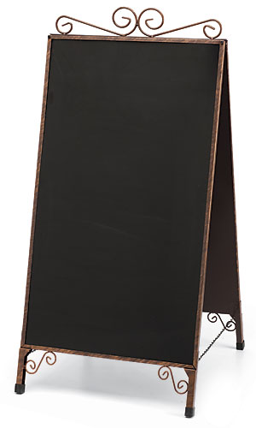

Instructional
Strategy Café

Slide 2

Session Objectives
Evaluate the basics of six instructional strategies used to engage, formatively assess, and give closure.
Through hands-on collaboration, explore three instructional strategies more in-depth.
Reflect on opportunities to use the strategies in your own classrooms.

Slide 3




Strike Out | Create the Problem | Strategy Harvest Tweet Up | 3-2-1 | Synectics
Sticky Bars
Which of these instructional strategies would you like to explore?

Slide 4

Link to vote is . . . https://www.menti.com
Enter code 67 71 12
Explore our menu of items. Then vote to see your top three!
Notes:
Sticky bars as a backup in case tech goes down
Must customize code before PD session. It must be changed for each PD session held.
Be sure to change the code to the one you have established for your group on Mentimeter before using this slide!

Slide 5

Strategy Harvest
A rectangular box holds 36 cubes. When she opened the top, Marcia could see 12 on the top. If she opened it from the side, how many cubes would she see?

Slide 6

Strike Out
What skills do you need for college readiness?
Pass your paper to a different group.
Based on the answers given, strike out one item that does not meet the criteria.

Slide 7

Tweet Up
Similar to a GIST, write an opinion statement about the concept presented in the infographic. Your “tweet” must be fewer than 140 characters and include a hashtag.
Example:
Students today must learn how to move beyond basic comprehension. #CriticalThinking

Slide 8

Write an opinion statement about the concept presented in the infographic. It must be fewer than 140 characters and include a hashtag.

Slide 9

Create the Problem
Using the given information, create a problem in context that would result in the given solution.

Slide 10
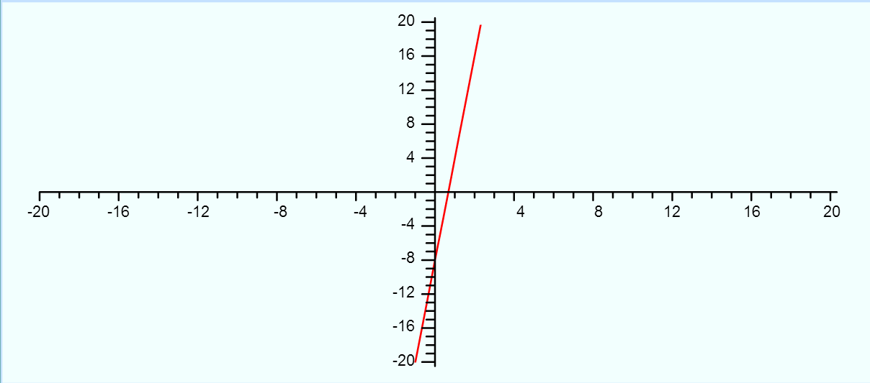
Using the given information, create a problem in context that would result in the given solution.

Slide 11
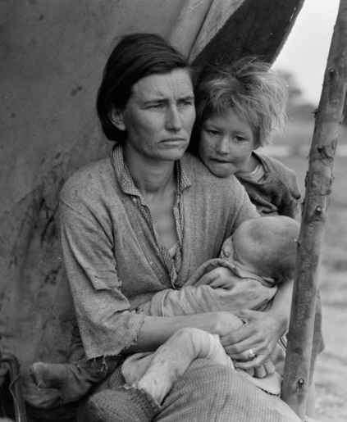
3-2-1
3- things you notice
2- things you can infer based on your knowledge of the Dust Bowl
1- question you have

Slide 12

Synectics
A cell is like a _____ because _________.
  Shopping mall
  A Bowl of Jell-o
  Brick Wall
  iPod

Slide 13

How would I…
Notes:
How could you switch it up and use one as formative assessment instead of engage
How could you apply this to your content area

Slide 14



Strategy Cards
Notes:
Pass out the strategy cards to everyone

Slide 15




Higher-Order Thinking
Disciplined Inquiry
Authentic Teaching
Value Beyond School
Implicit View of Students
Notes:
Distribute rubric and have them discuss with an elbow partner what they are already doing in classroom that meets authenticity * if you have time only

Slide 16

Notes:
Pass out evals

