Slide 1
The “Design A Project” project
The Project-Based Learning Approach
Susan McHale & Kristen Sublett

Slide 2
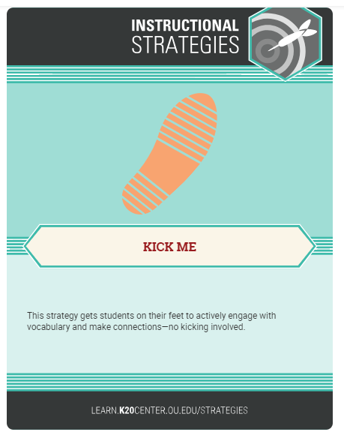
Where am I…...
Secondary
You will have a label on your back of one of the top 25 vacation destinations.
Your task is to guess which destination you have by asking questions of other participants.
You can only ask a question that can be answered with a yes or no.
Notes:
After this icebreaker, pass out instructional strategy sheet here. Talk about whenever they see this card cue, the presenters will give them time to fill out the instructional strategy sheet and how they might use it in their classroom.

Slide 3
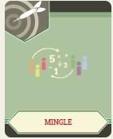
Mingle, mingle…..
Are you more a:
Couch potato or activity enthusiast?
Book lover or TV binge watcher?
Meat eater or vegan?
Big picture person or detail devotee?
Roller Coaster rider or Lazy River floater?
Notes:
This icebreaker can be used in place of the vacation labels icebreaker if your group is less than 20. After the icebreaker, pass out instructional strategy sheet here. Talk about whenever they see this card cue, the presenters will give them time to fill out the instructional strategy sheet and how they might use it in their classroom.

Slide 4
Welcome
About The K20 Center
About Today’s Presenters
Notes:
5 minute introduction: The K20 Center is an outreach department of the OU College of Education. We work with schools in delivering a variety of professional development. All of our staff are former educators. Have presenter(s) introduce themselves and explain a little about their educational experiences, as needed.

Slide 5
Today’s Objectives
To engage and immerse participants in a mini-PBL experience.
To identify and investigate the essential elements of PBL.
To support participants in exploring further PBL experiences.
Notes:
Explain today’s learning objectives.

Slide 6

Our Motto for Today:
Notes:
The elements of project-based learning may overwhelm a teacher beginning to plan lessons this way. . Research suggests it is better for students to immerse themselves in projects even if the project design is not perfect or does not have all the elements-- in other words JUST DO IT.

Slide 7
Real World Scenario
Some dedicated and master teachers have decided they want to take a new approach to learning with one or a few of their current classroom lessons. They have heard that project-based learning is very engaging for students and helps with academic rigor. They’ve decided to learn as much as they can about project-based learning and determine if project-based learning is doable for their classes.
Driving Questions:
Why is it important to have students participate in PBLs?
How do I create a PBL for my students?
Notes:
Introduce the scenario and driving questions

Slide 8
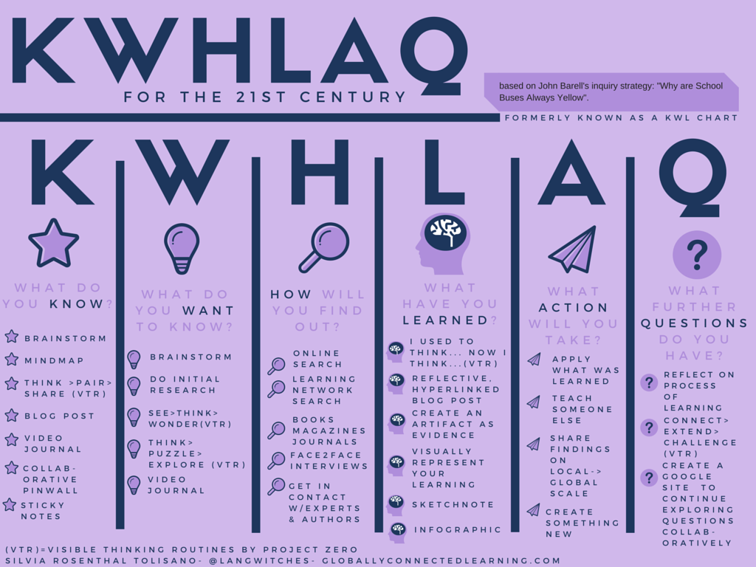
Source: Tolisano, S. (2015). An update to the upgraded KWL for the 21st century. Blog. Retrieved from: http://langwitches.org/blog/2015/06/12/an-update-to-the-upgraded-kwl-for-the-21st-century/
Notes:
Pass out the KWHLAQ and also the blank KWHLAQ sheets. Explain that the one on color paper is just for explanation.

Slide 9
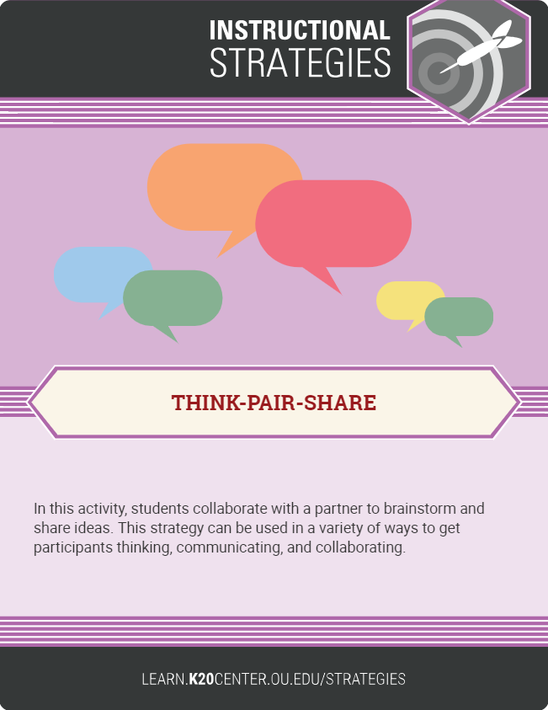
K-W-H-L-A-Q
What do we already KNOW about project based learning?
What do we NEED or WANT to KNOW about project-based learning?
Notes:
Have participants FIRST write down what they know about project-based learning and what they NEED to know about project-based learning. Then have them pair with a partner and share their information with each other. If the group is larger than 20, you may wish to put participants in groups of three for time management purposes.

Slide 10
K-W-H-L-A-Q
How will we find out more about project-based learning?
This presentation
Internet research
Learning from someone who has created some projects
Notes:
For the purposes of this presentation, we will learn about PBL from this presentation, videos, and internet research.and some dialog with the presenters who have created PBLs.

Slide 11

Let’s Watch a Video
Elementary
Notes:
Kristen--As you watch the video, jot down in KWHLAQ what information you discover

Slide 12

Addressing HOW I will learn more about PBL
Secondary

Slide 13

I Notice/I Wonder video discussion
What did you NOTICE about Project-based learning?
What did you WONDER about after viewing the video?

Slide 14
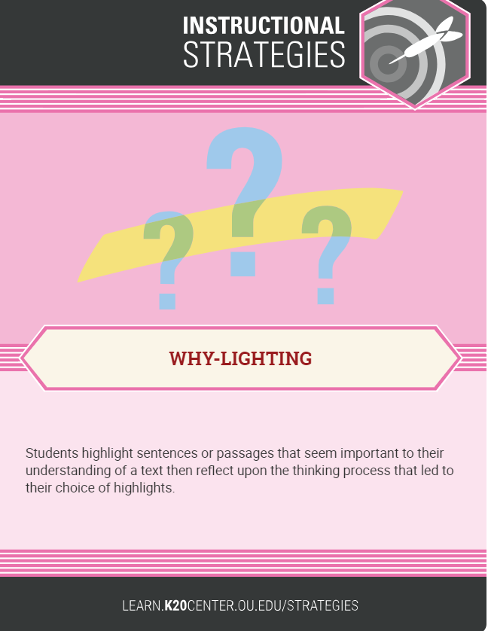
Addressing How I will learn more about PBL
Let’s read about project-based learning.
As you read, highlight information that would be useful.
Jot in the margin why you think it is useful or important.
Notes:
Discuss with participants what they highlighted and why on about project-based learning. Allow time for participants to write down information about Why-lighting on their instructional strategy sheet.

Slide 15
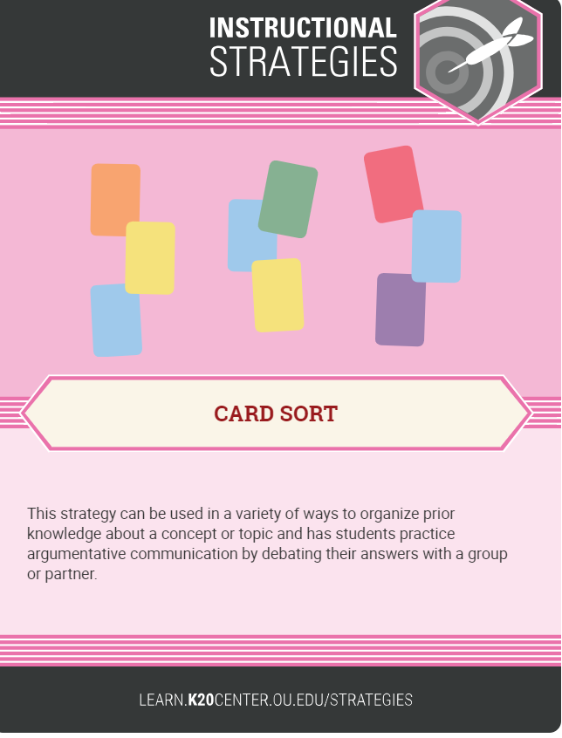
What steps are involved in a project, start to finish?
2 -Step Card sort:
Step 1: Use the planning cards, and sequence the steps of planning a project from start to finish.
Notes:
How would you begin with designing a project? When groups present their sequence in the card sort, encourage them to explain their reasoning for the sequence they chose. Allow time for participants to write down information about Card Sort on the instructional strategy sheet

Slide 16
Determine the standards to be addressed
Create an Entry Event with a problem or challenge
Design a driving question
Teach lessons that scaffold the problem and address the standards
Offer project ideas and allow student input
Tell students project parameters and deadlines
Peer feedback on draft
Product Presentation
Notes:
This is a suggested sequence but slight variations are fine. Pass out the Design a Project Checklist at this time.

Slide 17
What activities might be involved in a project, start to finish?
2 -Step Card sort:
Keep your first set of cards in the sequence you determined.
Step 2: Use second set of activity cards, and match the activity to the correct steps.

Slide 18
K-W-H-L-A-Q
What have we now LEARNED about project-based learning?
What further questions do we have?

Slide 19
Identifying PBL Resources
Using the handout of websites provided and the “Design a Project” checklist, find a project-based learning experience that could be adapted for your subject matter or grade level.
Be prepared to share your “find” and how it matches the elements of a quality project-based learning experience.
Notes:
Allow time for participants to explore websites, find a PBL lesson, and report progress. Time will vary depending on size of group. You may wish to partner your participants with similar grade level or subject matter participants and have them share one.

Slide 20
Project Share-out
What ideas have you found for Projects?
How does this project address one or more of the essential elements of a high quality PBL?

Slide 21
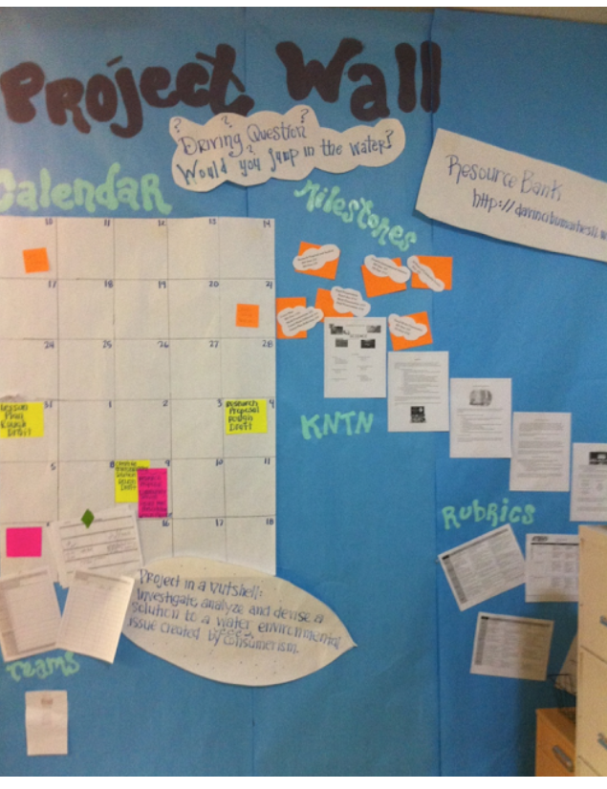
How do we monitor progress?
Student checklists or rubrics
Groups reporting on progress
Interim deadlines
Rehearsal presentations

Slide 22
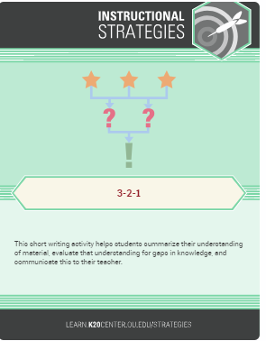
Your own progress….
3 ideas from this presentation that will help you create your own PBL.
2 concerns that you may still have about PBLs.
1 instructional strategy that you will definitely use with your class.

Slide 23
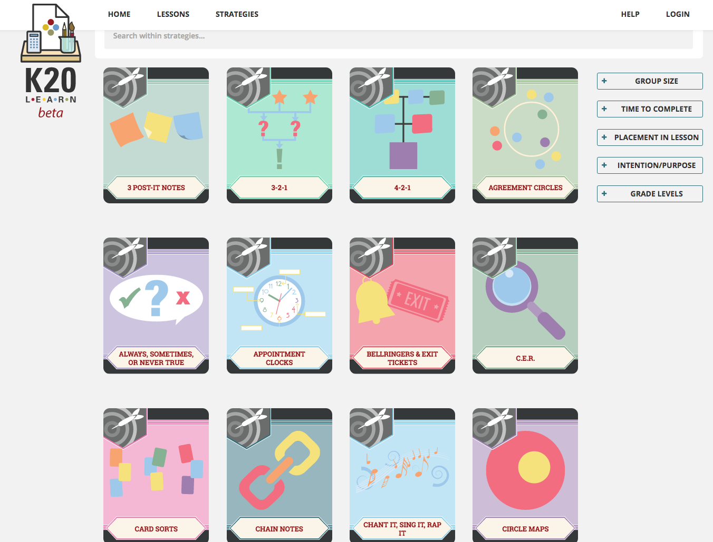
K20 LEARN Website
https://learn.k20center.ou.edu/strategies
Notes:
Resource with more instructional strategies

Slide 24

Thank you!
Feedback on this presentation
Susan McHale
susanmc@ou.edu
Kristen Sublett
kristen.sublett@ou.edu
Notes:
Session Feedback forms; names of presenters if needed to email

