Slide 2
Creating 5E Lessons
Welcome!

Slide 3
Learning Objectives:
Participants will be able to…
identify and describe the components of a 5E lesson.
distinguish how the 5E instructional model supports authentic learning.
demonstrate ability to use the 5E model by modifying or creating a content lesson.

Slide 4
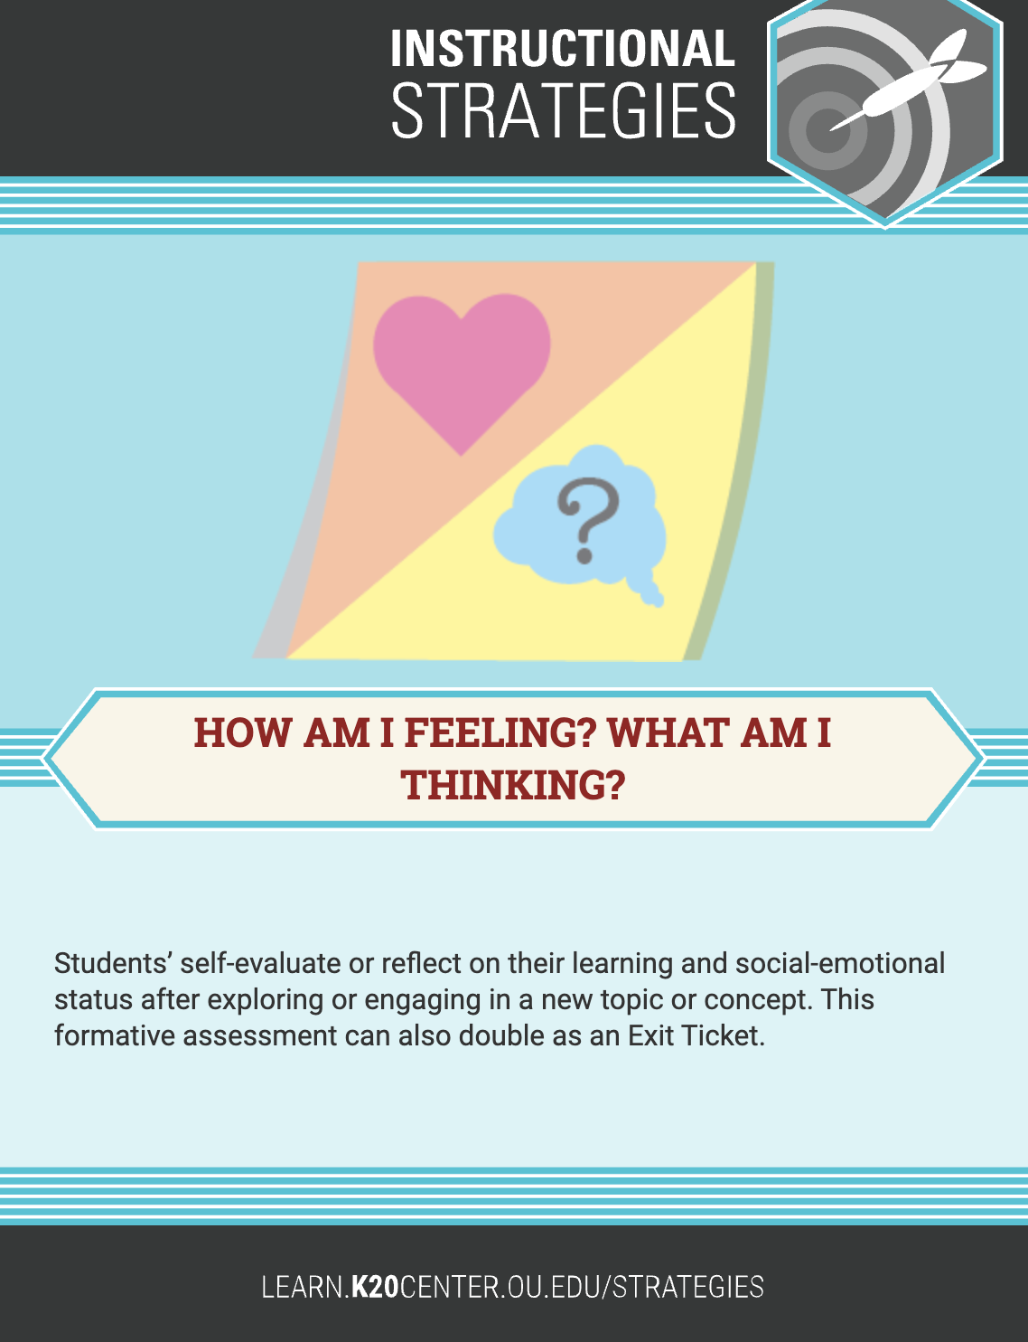
How Am I Feeling? What Am I Thinking?
Either:
Write a statement that represents how you feel about lesson planning, or…
Write a thought, reaction, or comment that you have had about authenticity since our last session.

Slide 5
CONSTRUCTION OF KNOWLEDGE
DISCIPLINED INQUIRY
Authentic Teaching
Prior Knowledge
REAL-WORLD CONNECTIONS
STUDENT-CENTERED

Slide 6
Authentic Lesson Reflection Tool

Slide 7
Frayer Model
Use the Frayer Model handout and the Authentic Lesson Reflection Tool to develop a definition, characteristics, examples, and non-examples for the component of Authenticity assigned to your group.
ELA: Construction of Knowledge
Math: Disciplined Inquiry - Meaningful Questioning
Science: Disciplined Inquiry - Substantive Conversation
Social Studies: Real-World Connections
Unicorns: Student-Centered Learning

Slide 8
Chant It, Sing It, Rap It
Using the information from your Frayer Model, come up with a chant, song, or rap about the content. You may also choose to snap, clap, stomp, or tap to accompany your creation. If necessary, you can model your song after tunes like "Mary Had a Little Lamb," "Row, Row, Row Your Boat," etc.
After 5 minutes, each group will perform!

Slide 9
Essential Question
How can I structure an authentic lesson from beginning to end?

Slide 11
Fist-To-Five
How familiar are you (on a scale of 1 to 5) with the 5E instructional model?
Hold up your hand with the number you feel reflects your familiarity with teaching lessons in the 5E format:
1 = “The 5 what?”
5 = “I eat, sleep, and breathe 5E!”

Slide 13
5E Card Sort
With your group, sequence the purpose of the Es (italicized) and the lesson activities (normal) in the 5E (bold) lesson format:
Engage, Explore, Explain, Extend, Evaluate
Discuss why you sequenced the lesson the way you did.

Slide 14
Why-Lighting
Highlight parts of the text you deem important to your understanding.
Write why you highlighted that section in the margins.
As you read, keep in mind: What is this E? What could it look like in the classroom?

Slide 15
T-Chart & Carousel
Groups: 1 = Engage, 2 = Explore, 3 = Explain, 4 = Extend, 5 = Evaluate
Create a T-Chart
Left side: “What it is this E?”
Right side: “What could this E look like in the classroom?”
Carousel
As you carousel, add to both sides of the T-Charts.

Slide 16
“I Notice, I Wonder”
Let’s wrap up our discussion on the connections between each E and what happens in the classroom for each E. You may write:
an “I Notice” statement;
an “I Wonder” statement;
or, both an “I Notice” and an “I Wonder” statement.

Slide 18
Revisit 5E Card Sort
With your group, revisit the sequence of your lesson snapshot.
If applicable, discuss why you made any changes you did to your Card Sort.

Slide 19
K20 LEARN
https://learn.k20center.ou.edu/

Slide 20
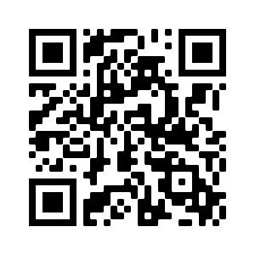
5E Card Sort Lessons
Using the LEARN website (https://learn.k20center.ou.edu/) find the lesson your group completed the Card Sort for.
ELA: Sweet and Savory Writing
Math: Are We Golden?
Science: Water We Going To Do?
Social Studies: Resistance and Rebellion
Unicorns: Are the Odds in Your Favor?
Is the Lesson Snapshot formatted the same way you formatted it in the Card Sort?

Slide 21
5E & Authenticity
Use the 5E & Authenticity Rubric to evaluate your LEARN lesson.
Does it score well according to the 5E indicators?
Can you identify the components of Authenticity in the lesson? What are they?
Refer back to the Authentic Teaching Reflection Tool as an additional resource.

Slide 23
Modifying a Content Lesson
Identify a lesson of your own that you’d like to modify into a 5E format. Use this work time to…
identify areas of the lesson you can structure into a 5E.
identify where your lesson supports Authenticity.

Slide 25
Triangle-Square-Circle
Write 3 important points from the session.
Write anything from the session that “squares” with your thinking or something you agree with.
Write anything that is still “circling” in your mind or that you have questions about.

Slide 26
Fist-To-Five Revisited
After going through the previous activities, has your familiarity with the 5E instructional model changed?
Hold up your hand with the number you feel reflects your familiarity with teaching lessons in the 5E format now: 1 = “The 5 what?”
5 = “I eat, sleep, and breathe 5E!”

Slide 27
LEARN Strategy Reflection
How Am I Feeling? What Am I Thinking?
Frayer Model
Chant It, Sing It, Rap It
Fist-To-Five
Card Sort
Why-Lighting
T-Chart
Gallery Walk/Carousel
I Notice, I Wonder
Triangle-Square-Circle

Slide 28
Resources
5E Videos (https://tinyurl.com/5EVideos)
5E Lesson Organizer
5E Lesson Framework Reading
5E & Authenticity Rubric
Authentic Lesson Reflection Tool
Authenticity Framework Reading
LEARN Lesson Repository

